Slide 1
Reference Ontologies, Application Ontologies, Terminology Ontologies
Barry Smith
http://ontologist.com

Slide 2
GO: the Gene Ontology
3 large telephone directories of standardized designations for gene functions and products
Designed to cover the whole of biology
Model for
fungal ontology,
plant ontology,
drosophila ontology,
etc.

Slide 3
GO: cell fate commitment
Definition: The commitment of cells to specific cell fates and their capacity to differentiate into particular kinds of cells.

Slide 4
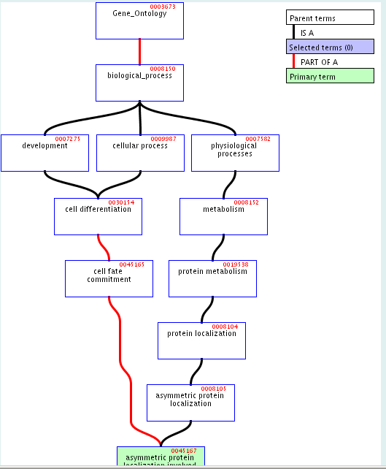
GO: asymmetric protein localization involved in cell fate commitment

Slide 5
GO: the Gene Ontology
GO organized into 3 hierarchies via is_a and part_of
(No links between hierarchies)

Slide 6
GO divided into three disjoint term hierarchies
cellular component ontology | molecular function ontology | biological process ontology
flagellum, chromosome, cell | ice nucleation, binding, protein stabilization | glycolysis, death

Slide 7
The intended meaning of part-of
as explained in the GO Usage Guide is:
“part of means can be a part of, not is always a part of: the parent need not always encompass the child. For example, in the component ontology, replication fork is a part of the nucleoplasm; however, it is only a part of the nucleoplasm at particular times during the cell cycle”

Slide 8
GO Usage Guide:
But examples like
Cellular Component Ontology is part-of Gene Ontology
and
a flagellum is part-of some cells
make it clear that there are in fact two further uses of part-of in GO

Slide 9
Three meanings of part-of
1. inclusion relations between vocabularies (lists of terms)
A time-dependent mereological inclusion relation
A sometimes_part_of B =_{def} ∃t ∃x ∃y
(inst(x, A, t) & inst(y, B, t) & part(x, y, t)).
Some (types of) Bs have As as parts:
A part_of_{GO} B =_{def} ∃C (C is_a B & A part_of C)

Slide 10
GO’s Usage Guide
lists four ‘logical relationships’ between its ‘is a’ and ‘part of’:
(1) (A part_of_{GO} B & C is_a B) → A part_of_{GO} C
(2) is_a is transitive
(3) part_of_{GO} is transitive
(4) (A is_a B & C part_of_{GO} A) → C part_of_{GO} B.





Slide 11
(A part_of_{GO} B & C is_a B) → A part_of_{GO} C
hydrogenosome part_of_{GO} cytoplasm
sarcoplasm is_a cytoplasm
But not: hydrogenosome part_of_{GO} sarcoplasm.

Slide 12
(2) is_a is transitive
GO states the law of transitivity for subsumption as:
If A is an instance of B
and B is an instance of C
Then A is an instance of C

Slide 13
(3) part_of_{GO} is transitive
As concerns (3), consider:
plastid part_of_{GO} cytoplasm
cytoplasm part_of_{GO} cell (sensu Animalia)
But not: plastid part_of_{GO} cell (sensu Animalia).

Slide 14
(4) (A is_a B & C part_of_{GO} A) → C part_of_{GO} B
GO justifies its rejection of (4) with the following:
meiotic chromosome is_a chromosome
synaptonemal complex part_of_{GO} meiotic chromosome
But not necessarily:
synaptonemal complex part_of_{GO} chromosome

Slide 16
GO’s Four Logical Relationships
(1) (A part_of_{GO} B & C is_a B) → A part_of_{GO} C
(2) is_a is transitive
(3) part_of_{GO} is transitive
(4) (A is_a B & C part_of_{GO} A) → C part_of_{GO} B.

Slide 17
GO’s Four Logical Relationships
(1) (A part_of_{GO} B & C is_a B) → A part_of_{GO} C
(2) is_a is transitive
(3) part_of_{GO} is transitive
(4) (A is_a B & C part_of_{GO} A) → C part_of_{GO} B.

Slide 18
On the definition
A part_of_{GO} B =_{def} ∃C (C is_a B & A part_of C)
(4) can be proved as a matter of logic.

Slide 19
The problem of ontology alignment
GO
SCOP
SWISS-PROT
SNOMED
MeSH
FMA
…
all remain at the level of TERMINOLOGY (two reasons: legacy of dictionaries + DL)
What we need is a REFERENCE ONTOLOGY = a formal theory of the foundational relations which hold TERMINOLOGY ONTOLOGIES and APPLICATION ONTOLOGIES together

Slide 20
Formal Theory of Is_a and Part_of for Bioinformatics Ontology Alignment
entity
two kinds of elite entities: instances and classes
Classes are natural kinds
Instances are natural exemplars of natural kinds
(problem of non-standard instances)
variables x, y for instances, A, B for classes

Slide 21
Two primitive relations: inst and part
inst(Jane, human being)
part(Jane’s heart, Jane’s body)
A class is anything that is instantiated
An instance as anything (any individual) that instantiates some class

Slide 22
Two primitive relations: inst and part
Axioms governing inst :
  it holds in every case between an instance and a class, in that order;
  that nothing can be both an instance and a class.
Axioms governing part (= ‘proper part’)
(1) it is irreflexive
(2) it is asymmetric
(3) it is transitive
(+ usual mereological axioms)

Slide 23
Further axioms (for ‘naturalness’)
In addition we need axioms specifying the properties of classes as natural kinds rather than arbitrary collections
+ axioms dealing with the different sorts of classes (of objects, functions, processes, etc.)
+ axiom of extensionality: classes which share identical instances are identical

Slide 24
Definitions
D1 A is_a B =def ∀x (inst(x, A) → inst(x, B))
D2 A part_for B =def
∀x ( inst(x, A) → ∃y ( inst(y, B) & part(x, y) ) )
D3 B has_part A =def
∀y ( inst(y, B) → ∃x ( inst(x, A) & part(x, y) ) )
human testis part_for human being,
But not: human being has_part human testis.
human being has_part heart,
But not: heart part_for human being.

Slide 25
part_of
D4 A part_of B =def A part_for B & B has_part A
This defines an Egli-Milner order
It guarantees that As exist only as parts of Bs and that Bs are structurally organized in such a way that As must appear in them as parts.
part_of NOT a relation between classes!

Slide 26
Analogous distinctions required for nearly all foundational relations of ontologies and semantic networks:
A causes B
A is associated with B
A is located in B
etc.
Reference to instances is necessary in defining mereotopological relations such as spatial occupation and spatial adjacency

Slide 27
We can prove: is_a is reflexive and antisymmetric
Axiom: part_of is irreflexive
We can prove that part_of is asymmetric
We can prove that both is_a and part_of are transitive

Slide 28
Classes vs. Sums
Classes are distinguished by granularity: they divide up the corresponding domain into whole units or members, whose interior parts and structure are traced over. The class of human beings is instantiated only by human beings as single, whole units.
A mereological sum is not granular in this sense.

Slide 29
Instances are elite individuals
Which classes (and thus which instances) exist in a given domain is a matter for empirical research.
Cf. Lewis/Armstrong “sparse theory of universals”

Slide 30
Prototypicality
Biological classes are marked always by an opposition between standard or prototypical instances and a surrounding penumbra of non-standard instances
How solve this problem: restrict range of instance variables x, y, to standard instances?
Recognize degrees of instancehood? (Impose topology/theory of vagueness on classes?)

Slide 31
Classes vs. Sets
Both classes and sets are marked by granularity – but sets are timeless
Each class or set is laid across reality like a grid consisting (1) of a number of slots or pigeonholes each (2) occupied by some member.
But a set is determined by its members. This means that it is (1) associated with a specific number of slots, each of which (2) must be occupied by some specific member. A set is thus specified in a double sense.
A class survives the turnover in its instances, and so it is specified in neither of these senses, since both (1) the number of associated slots and (2) the individuals occupying these slots may vary with time.
A class is not determined by its instances as a state is not determined by its citizens.

Slide 32
Classes vs. Sets
A set with n members has in every case exactly 2n subsets
The subclasses of a class are limited in number
(which classes are subsumed by a larger class is a matter for empirical science to determine)

Slide 33
Classes vs. sets
A set is an abstract structure, existing outside time and space. The set of human beings existing at t is (timelessly) a different entity from the set of human beings existing at t′ because of births and deaths.
A class can survive changes in the stock of its instances because classes exist in time. (An organism can similarly survive changes in the stock of cells or molecules by which it is constituted.)
D1* A is_a B =def ∀t ∀x ( inst(x, A, t) → inst(x, B, t) ),
D1* will take care of false positives such as adult is_a child

Slide 34
Conclusion
Work on biomedical ontologies and terminologies grew out of work on medical dictionaries and nomenclatures, and has focused almost exclusively on classes (or ‘concepts’) atemporally conceived (IN FACT IT HAS FOCUSED ON TERMS).
This class-orientation is common in knowledge representation, and its predominance has led to the entrenchment of an assumption according to which all that need be said about classes can be said without appeal to formal features of instantiation of the sorts described above.
This, however, has fostered an impoverished regime of definitions in which the use of identical terms (like ‘part’) in different systems has been allowed to mask underlying incompatibilities.

Slide 35
Conclusion
Matters have not been helped by the fact that description logic, the prevalent framework for terminology-based reasoning sys­tems, has with some recent exceptions been oriented primarily around reasoning with classes.
Certainly if we are to produce information systems with the requisite computational properties, then this entails recourse to a logical framework like that of description logic.
At the same time we must ensure that the data that serves as input to such systems is organized formally in a way that sustains rather than hinders successful alignment with other systems.
There are two complementary tasks: REFERENCE ONTOLOGY and APPLICATION ONTOLOGY

