Slide 1
Introduction to the Logic of Definitions
Barry Smith
DO 2013

Slide 2
A definition is a statement of necessary and sufficient conditions
being an A is a necessary condition for being a B:
every B is an A
being an A is a sufficient condition for being a B:
every A is a B
If both of these hold, we can define an A is a thing which satisfies B
We would want to do that because A is a term that is more difficult to understand than B.

Slide 3
The following are necessary conditions for x to be a triangle which are also jointly sufficient
x has exactly three sides
each of x's sides is straight
x is a closed figure
x lies in a plane
the sides of x are joined at their ends
Everything which satisfies all of these conditions is also a triangle.
Everything which is a triangle satisfies all of these conditions

Slide 4
Not every statement of necessary and sufficient conditions is a definition
a switchquipf is a prime number that is divisible by 4
Alan Ruttenberg is a human being (necessary condition) who will have this dollar bill in his wallet at noon today (sufficient condition)

Slide 5
Principle of non-circularity
A definition of a given term should use terms which more intelligible, more easily understood
hemolysis =def. the causes of hemolysis

Slide 6
Aristotelian definitions (rule of thumb)
Definitions should be of the form
S = Def. a G which Ds
where ‘G’ (for: genus) is the parent term of S (for: species) in the corresponding reference ontology – S and G range over types
human being =def. an animal which is rational
human being =def. intersection of (animal) and (rational)

Slide 7
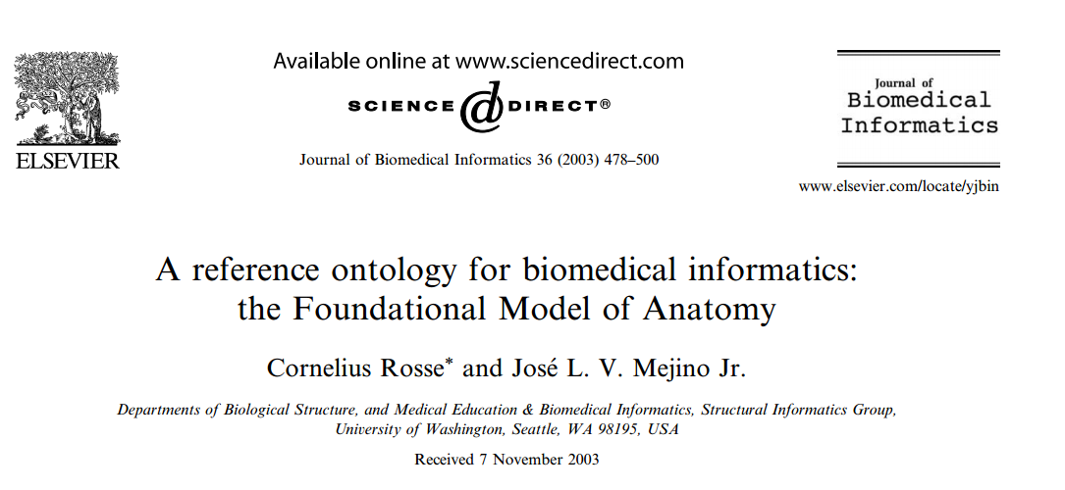
Each definition reflects the position in the ontology hierarchy to which the defined term belongs
The Aristotelian rule of thumb prevents circularity
Definitions serve quality assurance

Slide 8
FMA Examples
Cell =def. an anatomical structure which consists of cytoplasm surrounded by a plasma membrane
Plasma membrane =def. a cell part that surrounds the cytoplasm

Slide 9
Multiple Inheritance
thing
blue thing
car
is_a
is_a
blue car

Slide 10
Aristotelian definitions
work well for common nouns (especially for names of types)
they do not work for common nouns which are in root position in an ontology (no genus)
Do they work for relations?
a has-membrane-part b = a has-part b and b instance-of membrane
See “Relations in Biomedical Ontologies”, http://genomebiology.com/2005/6/5/R46

Slide 11
Root node of an ontology cannot be defined
The root node of an ontology is (relative to that ontology) a primitive term
Every definition, when unpacked, takes us back to the root node of the ontology to which it belongs
We cannot define the root node (in our ontology)
We may be able to define it by calling in aid an upper-level ontology such as BFO
Primitive terms cannot be defined, but they can be elucidated (by means of illustrative examples, statements of recommended usage, and axioms)

Slide 12
Multiple Inheritance
thing
blue thing
car
is_a
is_a
blue car

Slide 13
Multiple Inheritance
is a source of errors
encourages laziness
serves as obstacle to integration with neighboring ontologies
hampers use of Aristotelian methodology for defining terms

Slide 14
promotes forking
In fact I now think IAO should even include (published) concrete poetry -- though not under the ICE heading
blue car =def. a car that has-quality: blue
blue car =def. a blue thing that has-function: car

Slide 15
Multiple Inheritance
thing
blue thing
car
is_a
is_a
blue car

Slide 16
reference ontologies (asserted)
color quality ontology | vehicle ontology
color | vehicle
red | car
green | truck
blue | tractor

Slide 17
Principle of asserted single inheritance
Each reference ontology module should be built as an asserted monohierarchy (a hierarchy in which each term has at most one parent)
Asserted hierarchy vs. inferred hierarchy
blue car =def. intersection of:
(car) & (has-quality: blue)
Inferred hierarchy can use multiple inheritance

Slide 18
OBO Foundry Principle
In fact I now think IAO should even include (published) concrete poetry -- though not under the ICE heading
Each term (below the root) should have exactly one natural language definition and an equivalent logical definition (formulated as a cross-product of terms taken from other OBO Foundry ontologies)
Modulo this caveat:
“No object can have more than one definition.”
This, too, is an Aristotelian principle
(from MATERNA, http://x.co/1I1D3)

Slide 19
“Every definition, when unpacked, takes us back to the root node”
What does ‘unpacking’ mean?
Substitution of the definition for the defined term

Slide 20
FMA Examples
cell =def. an anatomical structure which consists of cytoplasm surrounded by a plasma membrane
plasma membrane =def. a cell part that surrounds the cytoplasm

Slide 21
FMA Examples
cell =def. an anatomical structure which consists of cytoplasm surrounded by a
plasma membrane
plasma membrane =def.
a cell part that surrounds the cytoplasm

Slide 22
FMA Examples
cell =def. an anatomical structure which consists of cytoplasm surrounded by
a plasma membrane
plasma membrane =def.
a cell part that surrounds the cytoplasm

Slide 23
FMA Examples
cell =def. an anatomical structure which consists of cytoplasm surrounded by
a cell part that surrounds the cytoplasm

Slide 24
Substitution is the key idea to understanding definitions
if a definition is correct, then we can substitute the definition for the term defined in all contexts and preserve truth
= substitution salva veritate
Better: in all transparent contexts = in all contexts not having to do with knowledge and belief

Slide 25
Knows, believes … create opaque contexts
John knows that a leukocute is an animal cell
leukocyte =def. an achromatic cell of the myeloid or lymphoid lineages capable of ameboid movement
John does not know that an achromatic cell of the myeloid or lymphoid lineages capable of ameboid movement is an animal cell

Slide 26
Providing we confine ourselves to transparent contexts
definitions are in principle ineliminable; we can unpack the texts which contain them completely, without changing the truth value at all
(definitions are in this sense dispensable abbreviations)

Slide 27
For Aristotle
only one definition can be correct:
Man is featherless biped
Man is a rational animal
Aristotle: The essence must be found (by doing science)
trilateral =def. x is a closed plane figure having three sides.
triangle =def. x is a closed plane figure having three angles.

Slide 28
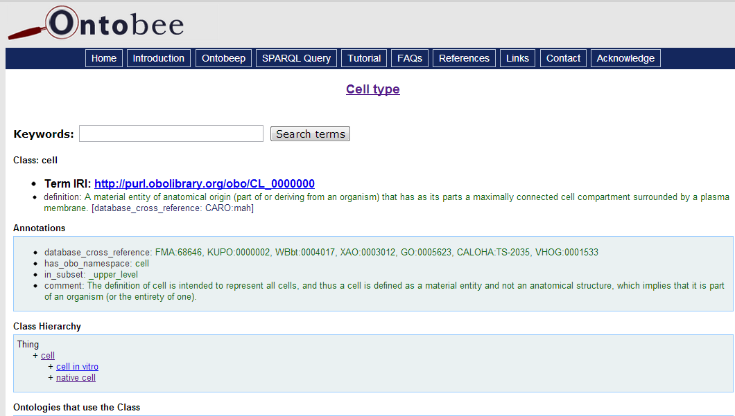

Slide 29
Case Study: Examples of Definitions from CL (Cell Ontology)
Taken from http://www.ontobee.org/browser/

Slide 30
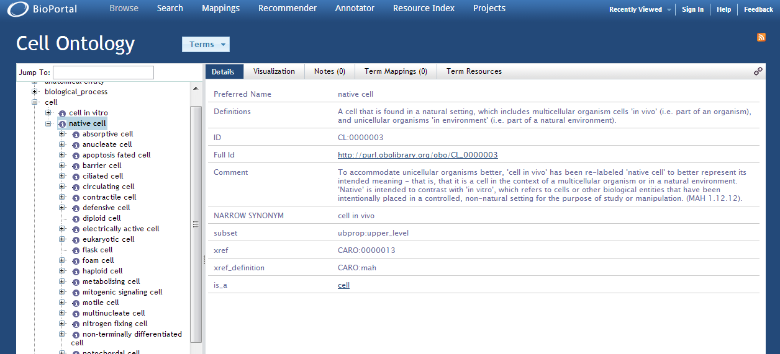

Slide 31
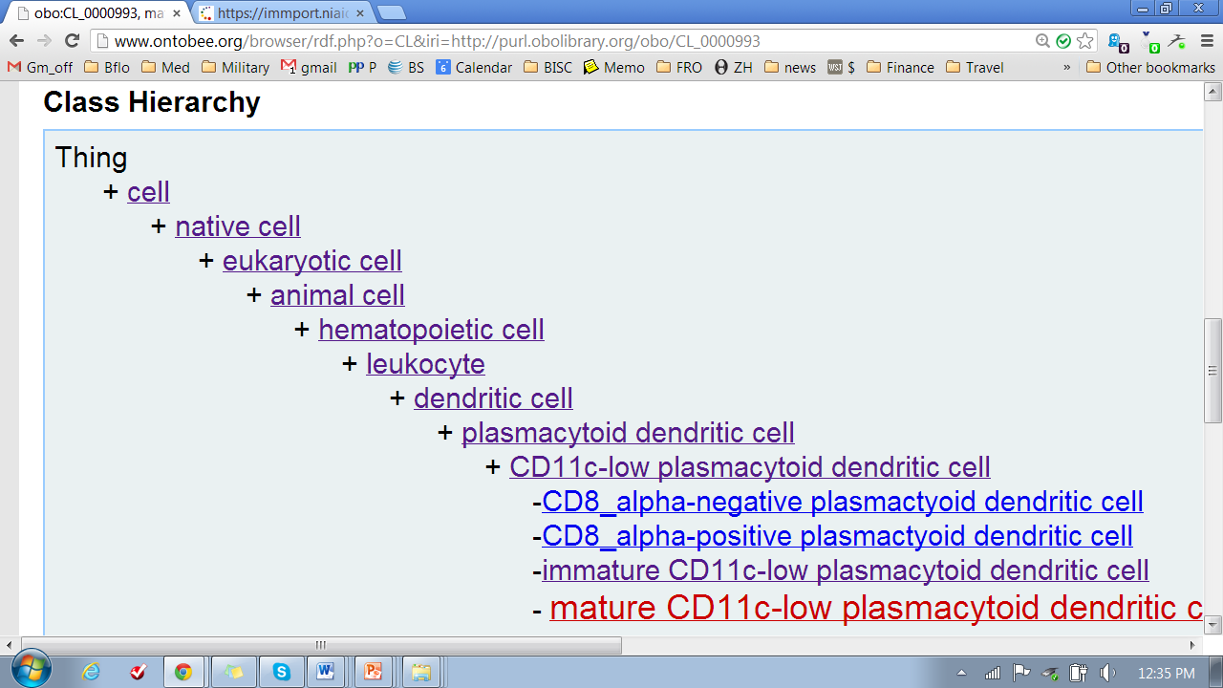
Class Hierarchy

Slide 32
Class: cell
IRI: http://purl.obolibrary.org/obo/CL_0000000
definition: A material entity of anatomical origin (part of or deriving from an organism) that has as its parts a maximally connected cell compartment surrounded by a plasma membrane. (From FMA via CARO)
Comment: The definition of cell is intended to represent all cells, and thus a cell is defined as a material entity and not an anatomical structure, which implies that it is part of an organism (or the entirety of one).

Slide 33
Note role of comments
To include usage notes.
To explain departures e.g. from FMA
To add supplementary information that is not part of the statement of necessary and sufficient conditions, but may be of interest to users of an ontology
ANYTHING NOT IS NOT PART OF THE STATEMENT OF NECESSARY AND SUFFICIENT CONDITIONS SHOULD BE TURNED INTO A COMMENT

Slide 34
Class: native cell
In fact I now think IAO should even include (published) concrete poetry -- though not under the ICE heading
IRI: http://purl.obolibrary.org/obo/CL_0000003
definition: A cell that is found in a natural setting, which includes multicellular organism cells 'in vivo' (i.e. part of an organism), and unicellular organisms 'in environment' (i.e. part of a natural environment).

Slide 35
Better
native cell =def. a cell that is found in a natural setting*
Comment: includes multicellular organism cells 'in vivo' (i.e. part of an organism), and unicellular organisms 'in environment' (i.e. part of a natural environment).
*[Every native cell is a cell; every cell found in a natural setting is a native cell]

Slide 36
Class: eukaryotic cell
IRI: http://purl.obolibrary.org/obo/CL_0000255
[No definition provided]
This would do:
a native cell in (or from) a eukaryotic organism
(Note that this is an Aristotelian definition)

Slide 37
Class Hierarchy

Slide 38
Class: animal cell
Term IRI: http://purl.obolibrary.org/obo/CL_0000548
[No definition provided]
This would do:
a eukaryotic cell in (or from) an animal
(Note that this is an Aristotelian definition)

Slide 39
Class: hematopoietic cell
IRI: http://purl.obolibrary.org/obo/CL_0000988
definition: A cell of a hematopoietic lineage.

Slide 40
Class: leukocyte
IRI: http://purl.obolibrary.org/obo/CL_0000738
definition: An achromatic cell of the myeloid or lymphoid lineages capable of ameboid movement, found in blood or other tissue.
has_exact_synonym: immune cell, white blood cell, leucocyte
Equivalents: hematopoietic cell and (capable_of some ameboidal cell migration)

Slide 41
Class: leukocyte
Here the cross-product equivalent:
leukocyte =def. hematopoietic cell and (capable_of some ameboidal cell migration)
is good as it stands

Slide 42
Class: leukocyte
However the
definition: An achromatic cell of the myeloid or lymphoid lineages capable of ameboid movement, found in blood or other tissue.
contains superfluous chatter

Slide 43
Class: leukocyte
and should be just
definition: An achromatic cell of the myeloid or lymphoid lineages capable of ameboid movement, found in blood or other tissue.

Slide 44
Still much better than the National Cancer Institute Thesaurus (NCIT), which has
Tuberculosis =def.
A chronic, recurrent infection caused by the bacterium Mycobacterium tuberculosis. Tuberculosis (TB) may affect almost any tissue or organ of the body with the lungs being the most common site of infection. The clinical stages of TB are primary or initial infection, latent or dormant infection, and recrudescent or adult-type TB. Ninety to 95% of primary TB infections may go unrecognized. Histopathologically, tissue lesions consist of granulomas which usually undergo central caseation necrosis. Local symptoms of TB vary according to the part affected; acute symptoms include hectic fever, sweats, and emaciation; serious complications include granulomatous erosion of pulmonary bronchi associated with hemoptysis. If untreated, progressive TB may be associated with a high degree of mortality. This infection is frequently observed in immunocompromised individuals with AIDS or a history of illicit IV drug use.

Slide 45
when what they meant was
Tuberculosis
=def. A chronic, recurrent infection caused by the bacterium Mycobacterium tuberculosis.

Slide 46
Class Hierarchy

Slide 47
Class: dendritic cell
IRI: http://purl.obolibrary.org/obo/CL_0000451
definition: A cell of hematopoietic origin, typically resident in particular tissues, specialized in the uptake, processing, and transport of antigens to lymph nodes for the purpose of stimulating an immune response via T cell activation. These cells are lineage negative (CD3-negative, CD19-negative, CD34-negative, and CD56-negative).

Slide 48
Class: plasmacytoid dendritic cell
IRI: http://purl.obolibrary.org/obo/CL_0000784
definition: A dendritic cell type of distinct morphology, localization, and surface marker expression (CD123-positive) from other dendritic cell types and associated with early stage immune responses, particularly the release of physiologically abundant amounts of type I interferons in response to infection.
Annotations: has_exact_synonym: pDC, DC2, lymphoid dendritic cell, type 2 DC, T-associated plasma cell, interferon-producing cell, IPC, plasmacytoid T cell, plasmacytoid monocyte

Slide 49
Class: CD11c-low plasmacytoid dendritic cell
IRI: http://purl.obolibrary.org/obo/CL_0000989
definition: CD11c-low plasmacytoid dendritic cell is a leukocyte that is CD11c-low, CD45R-positive, GR1-positive and CD11b-negative.
Annotations
comment: Originally described in the dendritic cell ontology (DC_CL:0000001)(PMID:19243617). These cells are CD281-positive (TLR1), CD282-positive (TLR2), CD285-positive (TLR5), CD286-positive (TLR6), and CD288-positive (TLR8).

Slide 50
Class: immature CD11c-low plasmacytoid dendritic cell
Term IRI: http://purl.obolibrary.org/obo/CL_0000992
definition: Immature CD11c-low plasmacytoid dendritic cell is a CD11c-low plasmacytoid dendritic cell that is CD80-low and CD86-low.
Annotations
comment: Originally described in the dendritic cell ontology (DC_CL:0000006)(PMID:19243617).

Slide 51
Class: mature CD11c-low plasmacytoid dendritic cell
IRI: http://purl.obolibrary.org/obo/CL_0000993
definition: Mature CD11c-low plasmacytoid dendritic cell is a CD11c-low plasmacytoid dendritic cell that is CD83-high and is CD80-positive, CD86-positive, and MHCII-positive.
Annotations
comment: Originally described in the dendritic cell ontology (DC_CL:0000007)(PMID:19243617).

Slide 52
Class Hierarchy

Slide 53
Further topics
nominal vs. real definitions
syntactic classes
intension/extension
intention
definitions and comments

