Slide 1
VT

Slide 2
Ontology, the Semantic Web and the Unification of Medical Knowledge
Barry Smith

Slide 3
IFOMIS
Institute for Formal Ontology
and Medical Information Science
http://ifomis.de

Slide 4
The problem
Different communities of medical researchers use different and often incompatible category systems in expressing the results of their work

Slide 5
Example: Medical Nomenclature
UMLS:
blood is a tissue
MeSH:
blood is a body fluid

Slide 6
The solution
“ONTOLOGY!”
But what does “ontology” mean?

Slide 7
Two alternative readings
Ontologies are special sorts of terminology systems = currently popular IT conception, with roots in KR
Ontologies are special sorts of theories about entities in reality = traditional philosophical conception, embraced by IFOMIS

Slide 8
Example: The Gene Ontology (GO)
hormone ; GO:0005179
%digestive hormone ; GO:0046659
%peptide hormone ; GO:0005180 %adrenocorticotropin ; GO:0017043 %glycopeptide hormone ; GO:0005181 %follicle-stimulating hormone ; GO:0016913
% = subsumption (lower term is_a higher term)

Slide 9
as tree
hormone
digestive hormone peptide hormone
adrenocorticotropin glycopeptide hormone
follicle-stimulating hormone

Slide 10
GO
is very useful for purposes of standardization in the reporting of genetic information
but it is not much more than a telephone directory of standardized designations organized into hierarchies

Slide 11
GO
can in practice be used only by trained biologists
whether a GO-term stands in the subsumption relationship depends on the context in which the term is used
(for example on the type of organism)

Slide 12
A still more important problem:
GDB
Genome Database of Human Genome Project
GenBank
National Center for Biotechnology Information, Washington DC
etc.

Slide 13
What is a gene?
GDB: a gene is a DNA fragment that can be transcribed and translated into a protein
GenBank: a gene is a DNA region of biological interest with a name and that carries a genetic trait or phenotype
GO uses ‘gene’ in its term hierarchy,
but it does not tell us which of these definitions is correct

Slide 14
GO
has no robust formal organization
no capability to be aligned with systems which would have the power to use it to reason with genetic information

Slide 15
GO deals with basic ontological notions very haphazardly
GO’s three main term-hierarchies are:
component, function and process
But GO confuses functions with structures, and also with executions of functions
and has no clear account of the relation between functions and processes

Slide 16
IFOMIS:
Get basic ontological organization right
and problems of formalization (consistency, portability) will become easier to solve later

Slide 17
Current orthodoxy
focuses instead on issues of
representation (XML)
and reasoning (Description logics)

Slide 18
Description logics
decidable logics, thus expressively weaker than first-order predicate logic
used for ensuring consistency of definitions of terms and for computing relations of subsumption
ontologically neutral
(i.e. neutral as between good ontology and ontological nonsense)

Slide 19
SNOMED RT (2000)
already has description logic definitions
but it also has some bad coding, which derives from failure to pay attention to ontological principles:
e.g.
both testes is_a testis

Slide 20
See Workshop:
CEUSTERS Werner, SMITH Barry
Ontology for the Medical Domain Room E Today: 16.00-17.30

Slide 21
DL is supposed to allow future SNOMED
to reason from data formulated in a structured way
to handle multiple relationship types, in addition to is_a
to take account of context-sensitivity in use of terms

Slide 22
The long march of Description Logic
Today SNOMED
Tomorrow THE WORLD

Slide 23
The Semantic Web Initiative
The Web is a vast edifice of heterogeneous data sources
Needs the ability to query and integrate across different conceptual systems

Slide 24
How resolve such incompatibilities?
enforce terminological compatibility via standardized term hierarchies, with standardized definitions of terms, which
1. satisfy the constraints of a description logic (DL)
2. are applied as meta-tags to websites

Slide 25
Metadata: the new Silver Bullet
agree on a metadata standard for washing machines as concerns size, price, etc.
create machine-readable databases and put them on the net
→ consumers can query multiple sites simultaneously
and search for highly specific, reliable, context-sensitive results

Slide 26
A world of exhaustive, reliable metadata would be a utopia.

Slide 27
PLAN
General problems with the Semantic Web initiative
(Partial) solutions to these general problems in the medical domain
Problems specific to the medical domain

Slide 28
The Semantic Web
General problems with the Semantic Web initiative
(Partial) solutions to these general problems in the medical domain
Problems specific to the medical domain

Slide 29
Problem 1: People lie
Meta-utopia is a world of reliable metadata.
But poisoning the well can confer benefits to the poisoners
Metadata exists in a competitive world.
Some people are crooks.
Some people are cranks.

Slide 30
Problem 2: People are lazy
Half the pages on Geocities are called “Please title this page”

Slide 31
Problem 3: People are stupid
The vast majority of the Internet's users
(even those who are native speakers of English)
cannot spell or punctuate
Will internet users learn to accurately tag their information with whatever DL-hierarchy they're supposed to be using?

Slide 32
Problem 4: Multiple descriptions
“Requiring everyone to use the same vocabulary denudes the cognitive landscape, enforces homogeneity in ideas.”
(Cary Doctorow)

Slide 33
Problem 5: Ontology Impedance
= semantic mismatch between ontologies being merged
This problem recognized in Semantic Web literature:
http://ontoweb.aifb.uni-karlsruhe.de
/About/Deliverables/ontoweb-del-7.6-swws1.pdf
Notes:
http://ontoweb.aifb.uni-karlsruhe.de/About/Deliverables/ontoweb-del-7.6-swws1.pdf

Slide 34
Solution 1: treat it as (inevitable) ‘impedance’
and learn to find ways to cope with the disturbance which it brings
Suggested here:
http://ontoweb.aifb.uni-karls-ruhe.de/Ab-out/Deliverables/ontoweb-del-7.6-swws1.pdf

Slide 35
Solution 2: resolve the impedance problem on a case-by-case basis
Suppose two databases are put on the web.
Someone notices that "where" in the friends table and "zip" in the places table mean the same thing.
http://www.w3.org/DesignIssues/Semantic.html
Notes:
http://www.w3.org/DesignIssues/Semantic.html

Slide 36
Both solutions fail
treating mismatches as ‘impedance’ ignores the problem of error propagation
(and is inappropriate in an area like medicine)
2. resolving impedance on a case-by-case basis defeats the very purpose of the Semantic Web

Slide 37
The Semantic Web
General problems with the Semantic Web initiative
(Partial) solutions to these general problems in the medical domain
Problems specific to the medical domain

Slide 38
Solutions in the medical domain
Problem 1: People lie
Problem 2: People are lazy
Problem 3: People are stupid
None of these is true in the world of medical informatics

Slide 39
Solutions in the medical domain
Problem 1: People lie
Problem 2: People are lazy
Problem 3: People are stupid
Achieve quality control via division of labour

Slide 40
Division of Labour
1. Clinical activities
2. Structured data representation
3. Software coding (e.g. for NLP)

Slide 41
Division of Labour
1. Clinical activities
2. Structured data representation
3. Software coding
4. Ontology building
Use 4. to constrain 2. and 3.
to achieve better data processing via quality control

Slide 42
DL-Division of Labour
1. Clinical activities
2. Structured data representation
3. Software coding
4. Ontology building
For DL 4. is a special case of 3.

Slide 43
For DL
Ontologies are software tools
thus limited
in their expressive power
and in their effectiveness as quality controls

Slide 44
IFOMIS idea:
distinguish two separate tasks:
- the task of developing computer applications capable of running in real time
the task of developing an expressively rich ontology of a sort which will allow sophisticated quality control

Slide 45
The Semantic Web
General problems with the Semantic Web initiative
(Partial) solutions to these general problems in the medical domain
Problems specific to, or made more acute within, the medical domain

Slide 46
Problem 4: Multiple descriptions
Requiring everyone to use the same vocabulary to describe their material is not always medically practicable

Slide 47
Clinicians
often do not use category systems at all – they use unstructured text
from which usable data has to be extracted in a further step
Why?
Because every case is different, much patient data is context-dependent

Slide 48
Problem 5: Ontology Impedance
= semantic mismatch between ontologies
‘gene’ used in websites issued by
biotech companies involved in gene patenting
medical researchers interested in role of genes in predisposition to smoking
insurance companies

Slide 49
Other problems with DL-based ontologies
DL poor when dealing with context-dependent information/usages of terms
DL poor when it comes to dealing with information about instances (rather than concepts or classes)
∴ also DL poor when it comes to dealing with time

Slide 50
SARS
is NOT
Severe Acute Respiratory Syndrome
it is THIS collection of instances of
Severe Acute Respiratory Syndrome
associated with THIS coronavirus and ITS mutations

Slide 51


different terminology systems

Slide 52
need not interconnect at all
for example they may relate to entities of different granularity

Slide 53
we cannot make incompatible terminology-systems interconnect
just by looking at concepts,
or knowledge or language

Slide 54
to decide which of a plurality of competing definitions to accept
we need some tertium quid

Slide 55
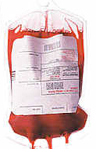
we need, in other words,
to take the world itself into account

Slide 56
BFO
= basic formal ontology

Slide 57
BFO
ontology not the ‘standardization’ or ‘specification’ of concepts
(not a branch of knowledge or concept engineering)
but an inventory of the types of entities existing in reality

Slide 58
BFO goal:
to remove ontological impedance by constraining terminology systems with good ontology

Slide 59
BFO not a computer application
but a reference ontology
(not a reference terminology
in the sense of SNOMED)

Slide 60
Recall:
GDB: a gene is a DNA fragment that can be transcribed and translated into a protein
Genbank: a gene is a DNA region of biological interest with a name and that carries a genetic trait or phenotype

Slide 61
Ontology
‘fragment’, ‘region’, ‘name’, ‘carry’, ‘trait’, ‘type’
... ‘part’, ‘whole’, ‘function’, ‘inhere’, ‘substance’ …
are ontological terms in the sense of traditional (philosophical) ontology

Slide 62
UMLS has ontological problems, too
Idea or Concept
Functional Concept
Qualitative Concept
Quantitative Concept
Spatial Concept
Body Location or Region
Body Space or Junction
Geographic Area
Molecular Sequence
Amino Acid Sequence
Carbohydrate Sequence
Nucleotide Sequence

Slide 63
UMLS has ontological problems, too
Idea or Concept
Functional Concept
Qualitative Concept
Quantitative Concept
Spatial Concept
Body Location or Region
Body Space or Junction
Geographic Area
Molecular Sequence
Amino Acid Sequence
Carbohydrate Sequence
Nucleotide Sequence

Slide 64
St. Malo
is an Idea or Concept

Slide 65
UMLS has ontological problems, too
Idea or Concept
Functional Concept
Qualitative Concept
Quantitative Concept
Spatial Concept
Body Location or Region
Body Space or Junction
Geographic Area
Molecular Sequence
Amino Acid Sequence
Carbohydrate Sequence
Nucleotide Sequence

Slide 66
The Reference Ontology Community
IFOMIS (Leipzig)
Laboratories for Applied Ontology (Trento/Rome, Turin)
Foundational Ontology Project (Leeds)
Ontology Works (Baltimore)
Ontek Corporation (Buffalo/Leeds)
Language and Computing (L&C) (Belgium/Philadelphia)

Slide 67
Domains of Current Work
IFOMIS Leipzig: Medicine, Bioinformatics
Laboratories for Applied Ontology
Trento/Rome: Ontology of Cognition/Language
Turin: Law
Foundational Ontology Project: Space, Physics
Ontology Works: Genetics, Molecular Biology
Ontek Corporation: Biological Systematics
Language and Computing: Natural Language Understanding

Slide 68
Two basic BFO oppositions
Granularity
(of molecules, genes, cells, organs, organisms ...)
SNAP vs. SPAN
getting time right of crucial importance for medical informatics

Slide 69
SNAP vs. SPAN
Two different ways of existing in time:
continuing to exist (of organisms, their qualities, roles, functions, conditions)
occurring (of processes)
SNAP vs. SPAN = Anatomy vs. Physiology

Slide 70
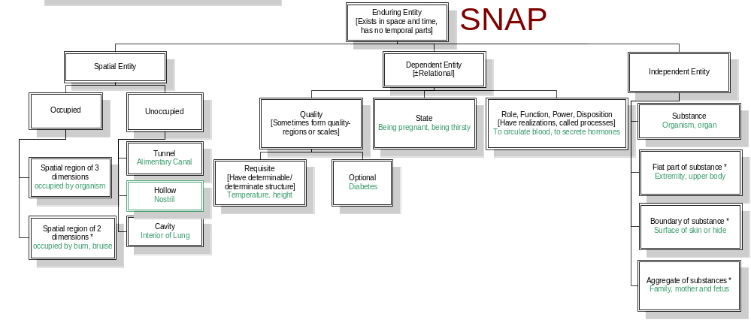
SNAP: Entities existing in toto at a time

Slide 71
Three kinds of SNAP entities
SNAP Independent: Substances, Objects, Things
SNAP Dependent: Qualities, Functions, Conditions, Roles
SNAP Spatial regions

Slide 72
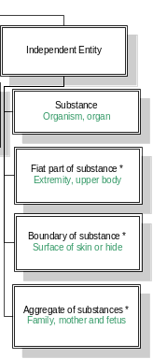
SNAP-Independent

Slide 73
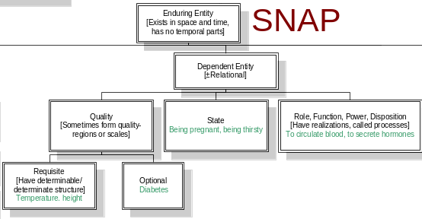
SNAP Dependent

Slide 74
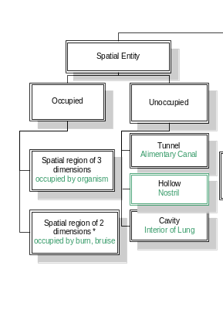
SNAP-Spatial Region

Slide 75
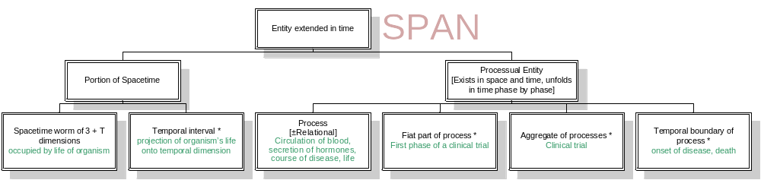
SPAN: Entities occurring in time

Slide 76
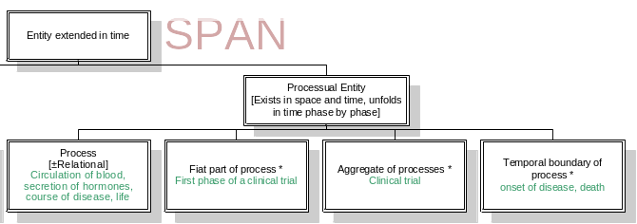
SPAN Dependent (Processes)

Slide 77
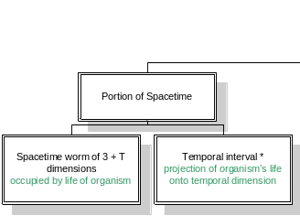
SPAN Spatiotemporal Regions

Slide 78
Realization (SNAP → SPAN)
the execution of a plan
the expression of a function
the exercise of a role
the realization of a disposition
the course of a disease
the application of a therapy

Slide 79
SNAP dependent entities and their SPAN realizations
plan
function
role
disposition
disease
therapy
SNAP

Slide 80
SNAP dependent entities and their SPAN realizations
execution
expression
exercise
realization
course
application
SPAN

Slide 81
More examples:
performance of a symphony
projection of a film
expression of an emotion
utterance of a sentence
increase of body temperature
spreading of an epidemic
extinguishing of a forest fire
movement of a tornado

Slide 82
BFO = SNAP/SPAN + Theory of Granular Partitions +
  theory of universals and instances
  theory of part and whole
  theory of boundaries
  theory of functions, powers, qualities, roles
  theory of environments
  theory of spatial and spatiotemporal regions

Slide 83
MedO: medical domain ontology
  universals and instances and normativity
  theory of part and whole and absence
  theory of boundaries/membranes
  theory of functions, powers, qualities, roles, (mal)functions, bodily systems
  theory of environments: inside and outside the organism
  theory of spatial and spatiotemporal regions: anatomical mereotopology

Slide 84
MedO: medical domain ontology
  theory of granularity relations
  between
  molecule ontology
  gene ontology
  cell ontology
  anatomical ontology
  etc.

Slide 85
Theory of Granular Partitions
See Workshop:
Ontology for the Medical Domain Room E: 16.00-17.30

Slide 86
Testing the BFO/MedO approach
collaboration with
Language and Computing nv (www.landcglobal.be)

Slide 87
The Project
collaborate with L&C to show how an ontology constructed on the basis of philosophical principles can help in overhauling and validating the large terminology-based medical ontology LinkBase® used by L&C for NLP

Slide 88
L&C
LinKBase®: world’s largest terminology-based ontology
with mappings to UMLS, SNOMED, etc.
+ LinKFactory®: suite for developing and managing large terminology-based ontologies

Slide 89
LinKBase
BFO and MedO designed to add better reasoning capacity
by tagging LinKBase domain-entities with corresponding BFO/MedO categories
by constraining links within LinKBase according to the theory of granular partitions

Slide 90
L&C’s long-term goal
Transform the mass of unstructured patient records into a gigantic medical experiment

Slide 91
IFOMIS’s long-term goal
Build a robust high-level BFO-MedO framework
THE WORLD’S FIRST INDUSTRIAL-STRENGTH PHILOSOPHY
which can serve as the basis for an ontologically coherent unification of medical knowledge and terminology

Slide 92

END
http://ontologist.com
http://ifomis.de

Slide 93
Description Logics allow specifying a terminological hierarchy using a restricted set of first order formulas.
They usually have nice computational properties (often decidable and tractable) but the inference services are restricted to classification and subsumption. That means, given formulae describing classes, the classifier associated with a certain description logic will place them inside a hierarchy, and given an instance description, the classifier will determine the most specific classes to which the particular instance belongs.
Notes:
http://www.semanticweb.org/inference.html

Slide 94
Good metadata
Google exploits metadata in the form of: number of links pointing at a page – a measure of reliability
Observational metadata vs. good human-created metadata vs. marketing hype

Slide 95
Two super-categories in DL
Concepts (e.g. blood)
Definitions (term strings associated with concepts)
Relationships (e.g. is_a)
E.g. fetal blood stands in the relation is_a to blood

Slide 96
DL thus goes hand in hand with the assumption that ontology deals with ‘simplified models’
Tom Gruber (1993):
An ontology should make as few claims as possible about the world being modeled … specifying the weakest theory (allowing the most models) and defining only those terms that are essential to the communication of knowledge consistent with that theory.
Notes:
Toward Principles for the Design of Ontologies Used for Knowledge Sharing, 1993

Slide 97
Semantic Web effort
thus far devoted primarily to developing systems for standardized representation of web pages and web processes
(= ontology of web typography)
not to the harder task of developing of ontologies (term hierarchies) for the content of such web pages

Slide 98
BFO vs. KR
In the knowledge engineering world in which information systems ontology has its home
terms and definitions come first,
– the job is to validate them and reason with them
In the BFO world robust ontology (with all its reasoning power) comes first
and terms and term-hierarchies must be subjected to the constraints of ontological coherence

Slide 99
Problem 4: Metrics influence results
Example: software which scores well on convenience scores badly on security
Every player in a metadata standards body will want to emphasize their high-scoring axes

