Slide 1
Using Cross-Lingual Information to Cope with Underspecification in Formal Ontologies.
W. Ceustersª, I. Desimpelª, B. Smith^{b}, S. Schulz^{c}
ª Language and Computing nv., Zonnegem, Belgium
^{b} IFOMIS, Leipzig, Germany
^{c} Dept. of Medical Informatics, Freiburg University Hospital, Germany

Slide 2
Presentation overview
Ontologies and underspecification
Implementation of a novel algorithm to detect underspecification
Evaluation of results
Applications
Conclusion

Slide 3
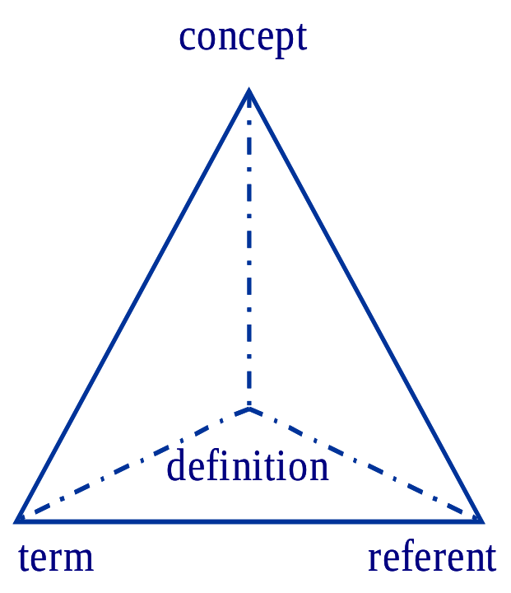
From concept-based representations to ontology
“Ontology” in Information Science:
  “An ontology is a description (like a formal specification of a program) of the concepts and relationships that can exist for an agent or a community of agents.” (Tom Gruber)
“Ontology” in Philosophy:
  “Ontology is the science of what is, of the kinds and structures of objects, properties, events, processes and relations in every area of reality.” (Barry Smith)

Slide 4
What is ontologic underspecification ?
SARS: “Severe Acute Respiratory Syndrome”
A tentative description (in CEN/TC251 MOSE style):
  ISA respiratory syndrome
  HAS-ONSET acute
  HAS-SEVERITY severe
A DL-classifier using this description would classify ANY respiratory syndrome that is acute and severe as SARS, and not just that particular disease now recognised as being caused by a rapidly mutating coronavirus

Slide 5
“Minimal ontological commitment”
An ontology should make as few claims as possible about the world being modeled, allowing the parties committed to the ontology freedom to specialize and instantiate the ontology as needed. Since ontological commitment is based on consistent use of vocabulary, ontological commitment can be minimized by specifying the weakest theory (allowing the most models) and defining only those terms that are essential to the communication of knowledge consistent with that theory.
  Toward Principles for the Design of Ontologies Used for Knowledge Sharing, 1993, Thomas R. Gruber

Slide 6
Pro’s and con’s of minimal ontological commitment
Some arguments in favour:
  it is better to have partial information than no information at all
  reasoning with fewer information is faster than with lots of information
  less risk for descriptive errors
Some arguments against:
  it reduces applicability of the ontology
  knowing that a specific entity in the real world fits a class in the ontology, allows you to infer some characteristics for that entity, but knowing that an entity has some characteristics, does not allow you to infer that it fits a specific class
  simple subsumption-based reasoning goes wrong quickly
Key issue: it is a doctrine, hence it may be rejected, and we believe the arguments against are strong enough to do so !

Slide 7
Underspecification can be very subtle
(Fistula which
<
isPartitivelyTo AbdominalSkin
isPartitivelyFrom Colon
isSpecificImmediateConsequenceOf SurgicalConstructingProcess
>)
name ColostomyStructure
Grail-6; Dec 2002
Just any surgical construction ?

Slide 8

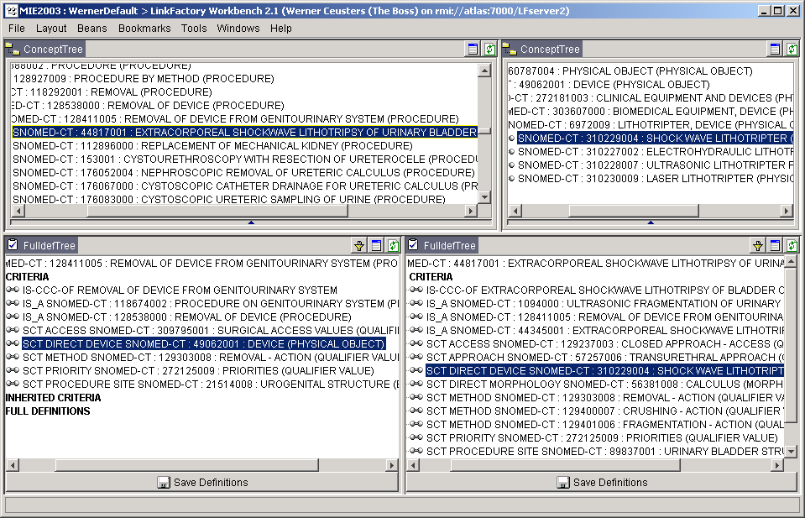
From underspecification to wrong classification

Slide 9
Objectives
As developers and users of LinkBase, we want to avoid such mistakes

Slide 10
LinkBase architecture
Language A
Proprietary Terminologies
Language B
Lexicon
Lexicon
Others ...
Grammar
Grammar
ICPC
Formal Domain Ontology
SNOMED
ICD
Cassandra Linguistic Ontology
MEDDRA
L
&
C
LinkBase

Slide 11
Objectives
As developers and users of LinkBase, we want to avoid such mistakes
Approach
expand an existing LinkFactory algorithm (FRVP) such that it takes into account linguistic information

Slide 12
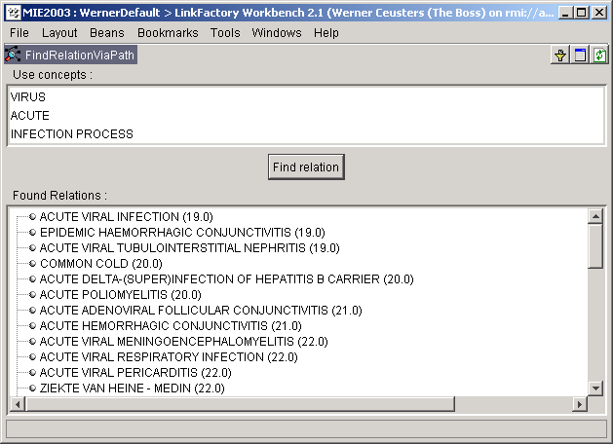

Slide 13
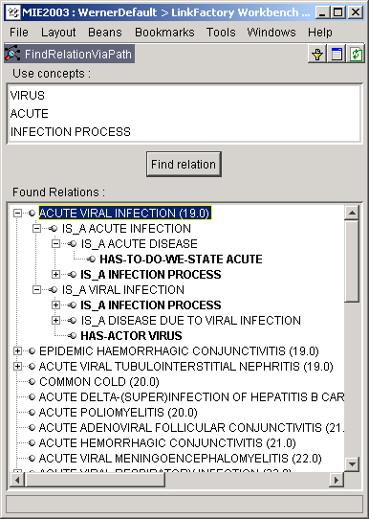
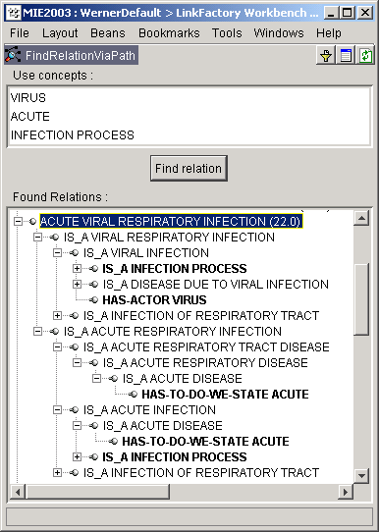
Mechanism: finding cross-roads

Slide 14
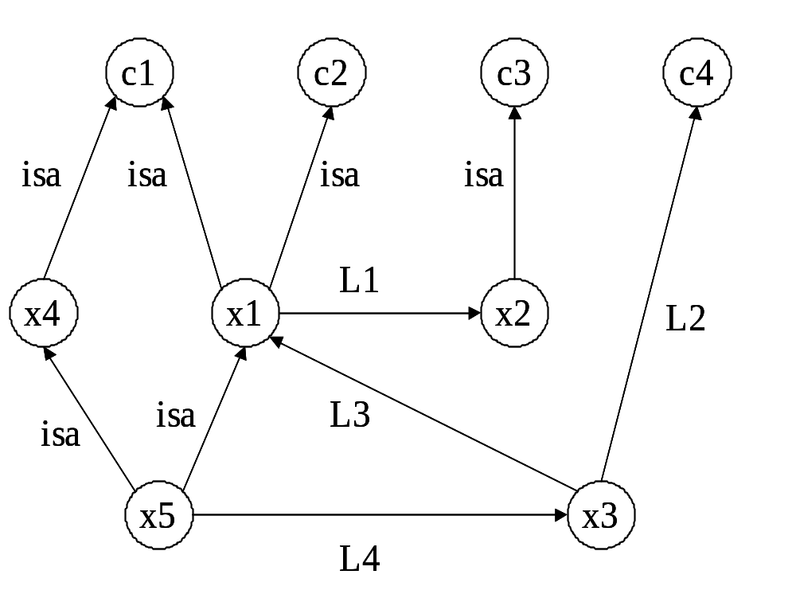
Ranking of best results in case of multiple cross-roads: x5 or x3 ?
Applying a cost function based on a mixture of:
shortest path
type of links traversed

Slide 15
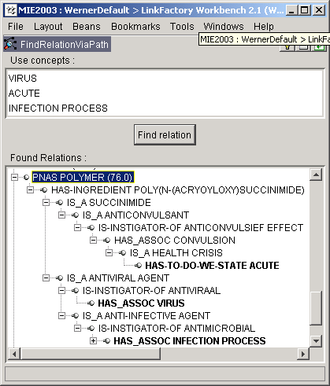
Long distance intersections
PNAS polymer:
  no direct ISA link to any of the concepts queried for;
  many non-ISA links traversed;
  ⇒ high cost

Slide 16
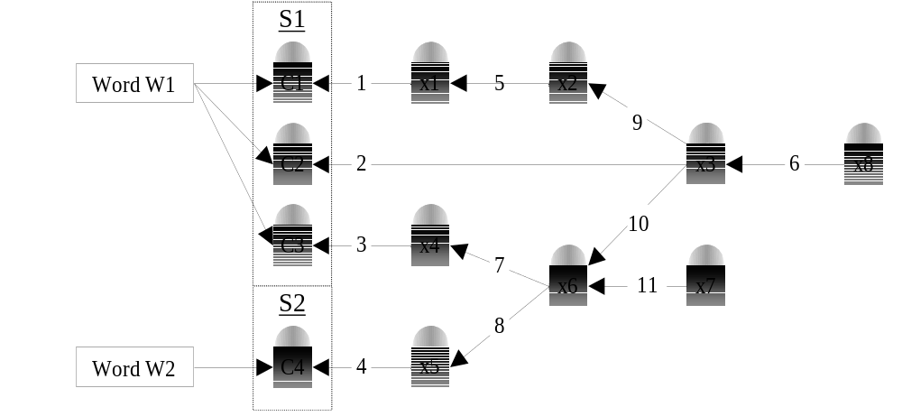
Basic improvement: starting search with words instead of concepts
homonym
disambiguation
required !

Slide 17
Additional improvements
pick up also concepts associated with terms containing only a subset of the words from the query term, to be able to deal with:
  terms containing words not associated with LinKBase® concepts
  semi-tautologies: dorsal back pain, knee joint arthropathy
language-specific term generator based on inflection-, derivation-, and clause-generation rules, with prevention of overgeneration by checking whether such constructed combinations of words qualify as terms for an existing concept in LinKBase®.
generate larger sections for a given word by checking the ontology also for translations and/or possible synonyms of the word and its generated words in other languages

Slide 18
An example
lung embolism
lung
??
pulmonary
embolism
C3
pulmonary
embolism
embolie pulmonaire
pulmonary infarction
pulmonaire
embolie
C1
infarction pulmonaire
C2
infarctus du poumon
poumon
when more ontological information available

Slide 19
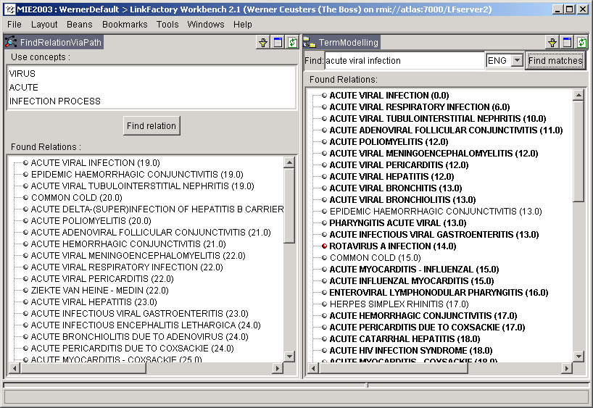
FRVP versus TermModeling

Slide 20
Evaluation with double purpose
Quantification of effect
Applicability for Quality Control

Slide 21
Experiment design
Random selection of 100 terms from LinKBase®, all of them associated with concepts for which explicit conceptual information is lacking.
Application of 6 languages plus Morphosaurus® MIDs
We ran 7 tests, for each of which a separate base language was chosen and then the other languages added in order of next least available terms. As an exception, the MID-language was always added last.
For quantification purposes we used the cost function as described earlier: the gain in cost after applying additional linguistic information is a good measure for how much implicit information could be used.

Slide 22
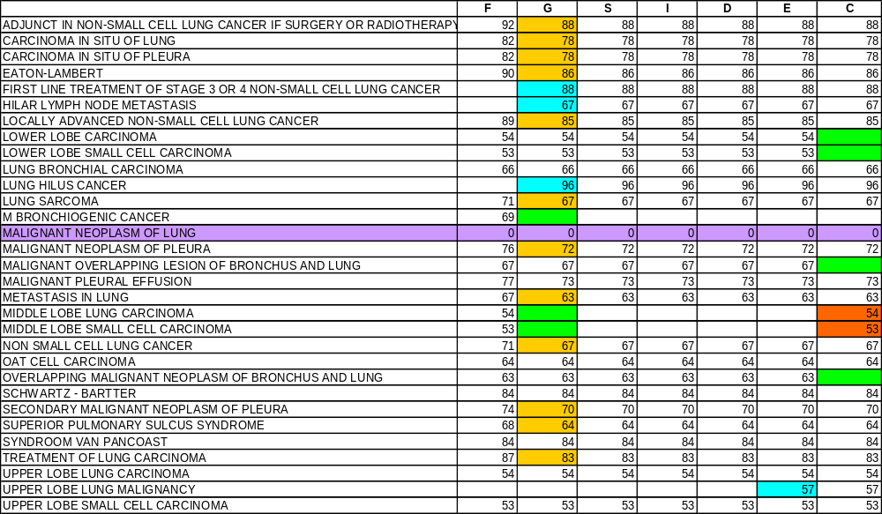
Some results for 72th term in French

Slide 23
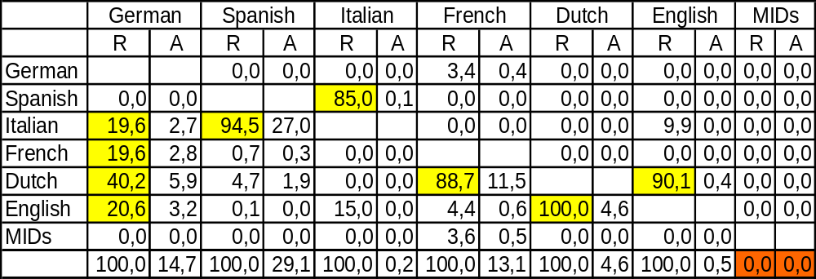
Results
Language processed
“winner takes nearly all”

Slide 24
Some applications

Slide 25
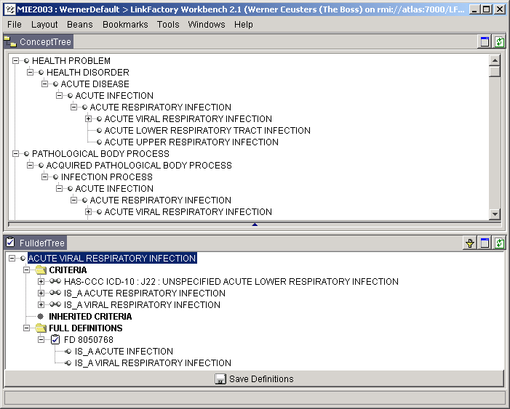
Improving classification
the concept acute viral infection does not yet subsume acute viral respiratory infection

Slide 26
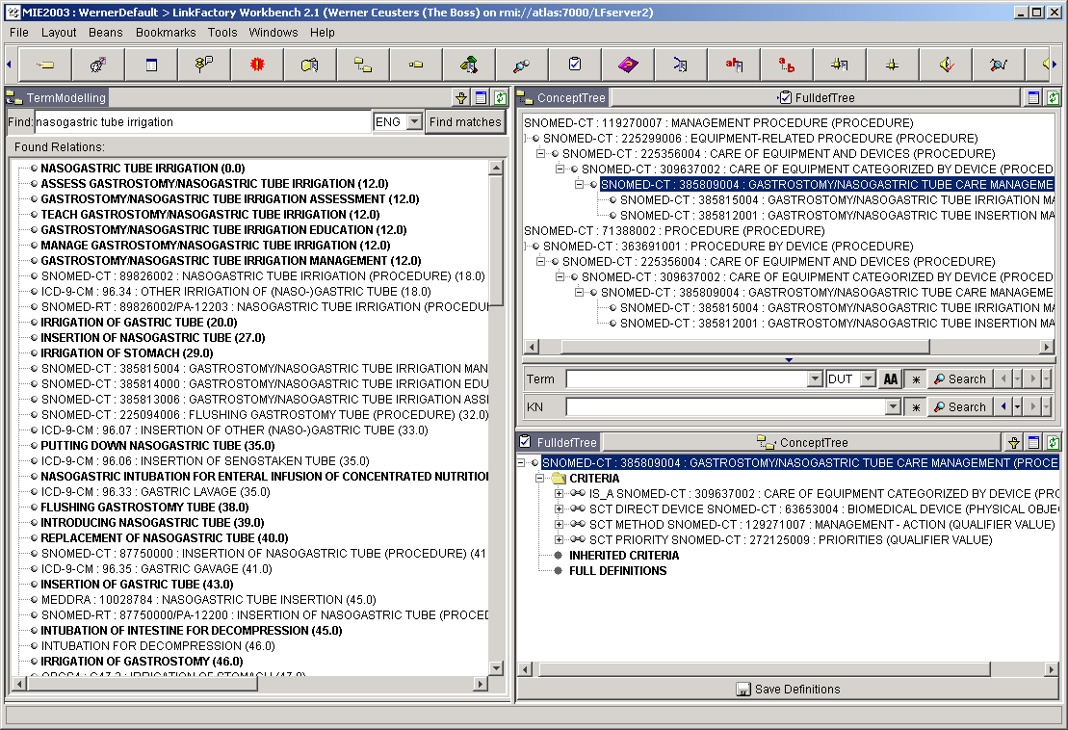
Finding missing links

Slide 27
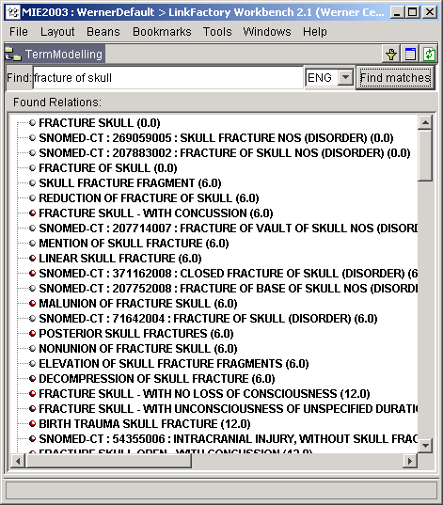
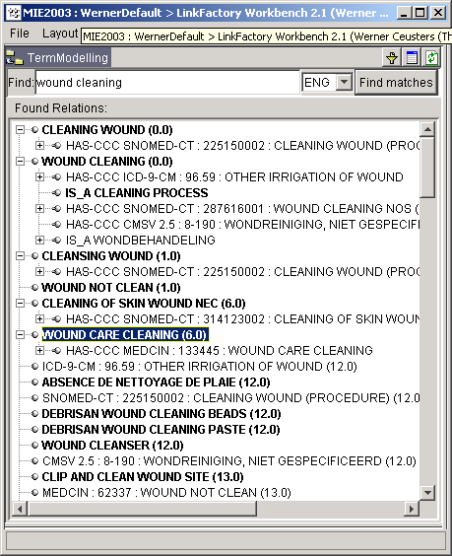
Finding different concepts with same meaning

Slide 28
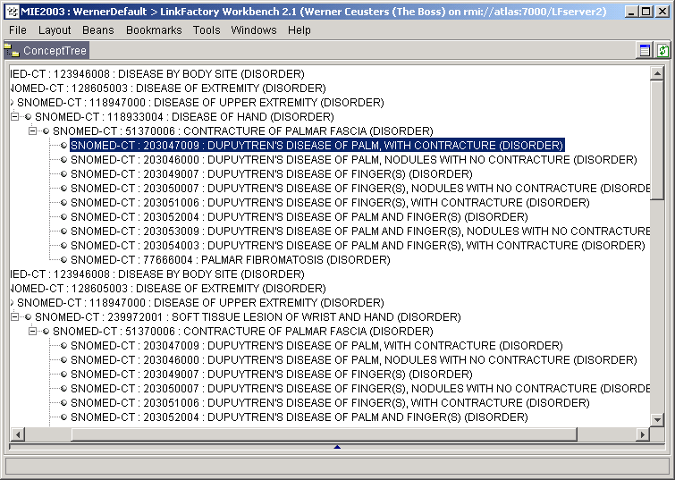
Finding mistakes (say no more)

Slide 29
Conclusion
We have shown that there is an objectively measurable value to exploiting implicit linguistic-semantic information present in multi-lingual annotations of concepts in resolving the problem of formal underspecification in ontologies.
Hence, multilingual annotations are an additional means for quality assurance in ontologies, adding a dimension that cannot be covered by description logics only.

