Slide 1
Ontologies for the medical domain: current deficiencies in light of the needs of medical natural language understanding
Werner Ceusters
Language & Computing nv

Slide 2
Requirements for multilingual NLU
knowledge about terms and how they are used in valid constructions within natural language;
knowledge about the world, i.e. how the referents denoted by the terms interrelate in reality and in given types of contexts;
an algorithm:
  that is able to pick out the portion of the world that the language user is describing in his utterances;
  that is able to track the ways in which people make mistakes in representing reality.
all of the above grounded in an ontological theory.

Slide 3
Are existing medical terminologies, ontologies, etc., useful for natural language understanding ?
Do they represent a correct representation of reality ?
Can they be used as lexica for NLU ?

Slide 4
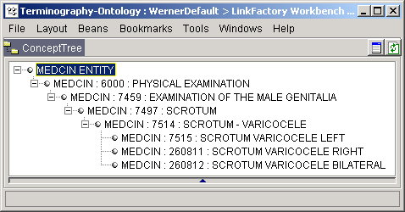
Problems in terminologies
Inappropriate label for out of context reading
Agrammatical constructions for labels

Slide 5
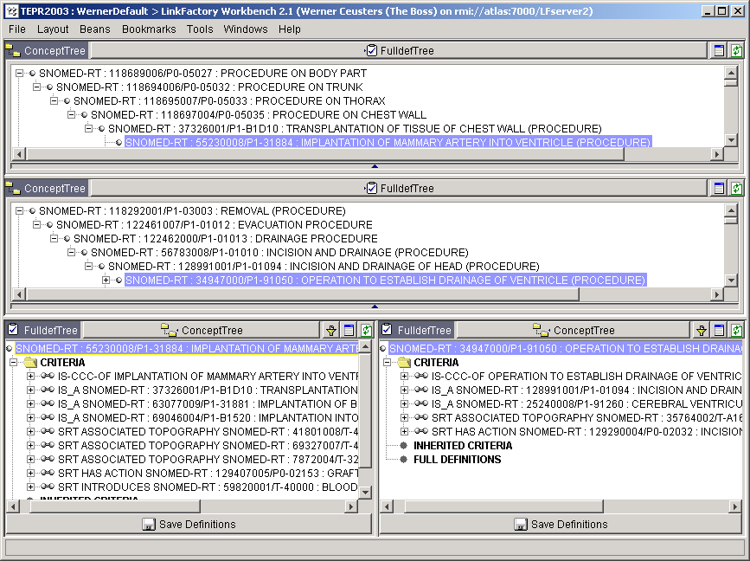
Label inappropriate for out of context reading

Slide 6
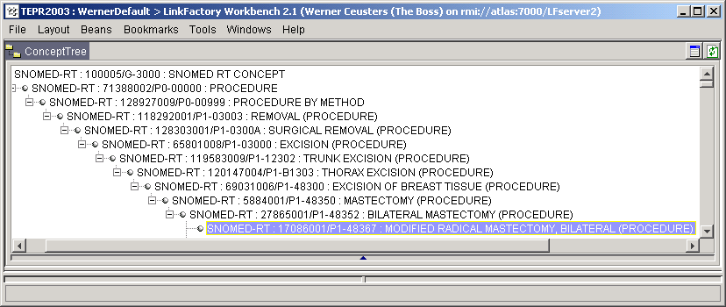
Ungrammatical constructions in terms

Slide 7
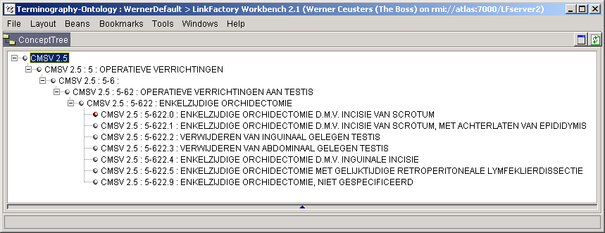
Problems in terminologies
inconsistent sibling assignment
possible conflict in precedence

Slide 8
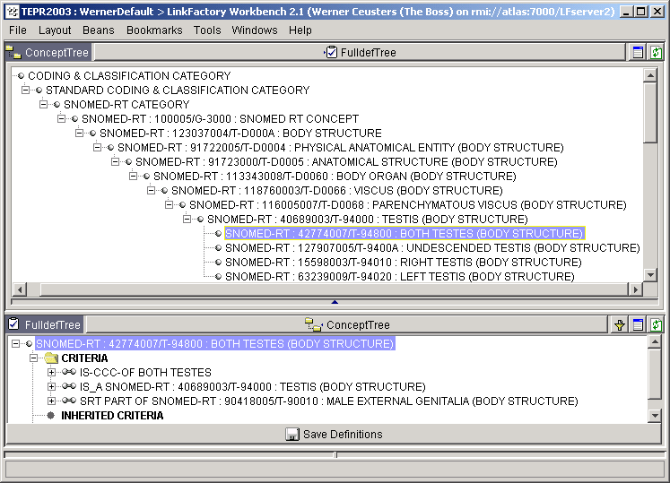
Mereological sum mismodelling

Slide 9
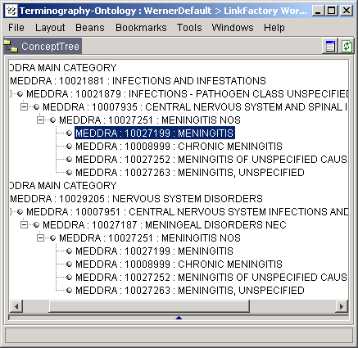
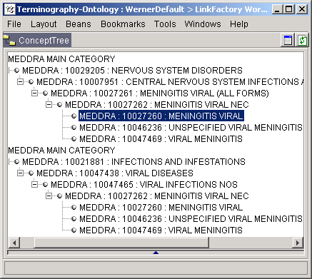
Problems in terminologies
For MedDRA: a viral meningitis is not a meningitis

Slide 10
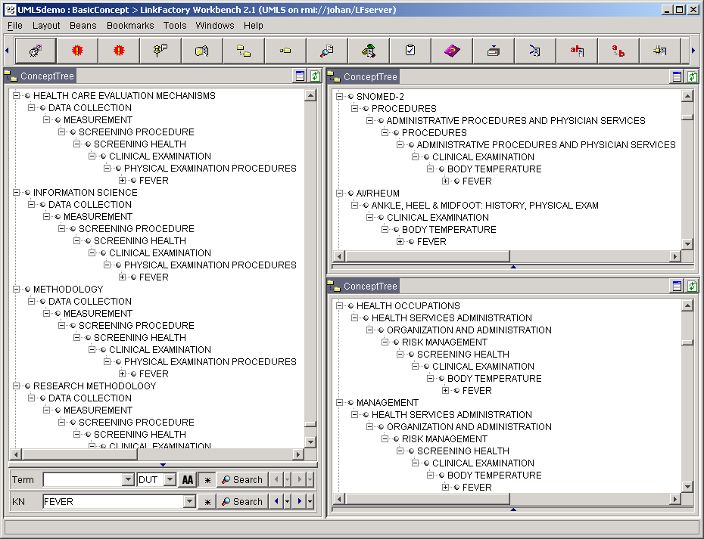
Problems in merging terminologies
cycles in
hierarchical
relationships

Slide 11
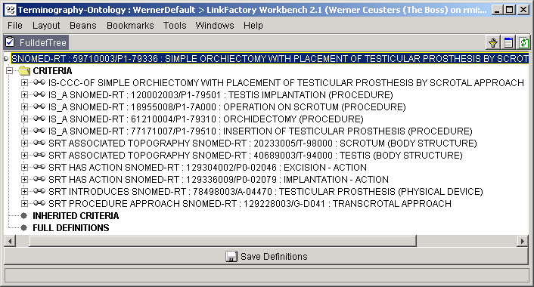
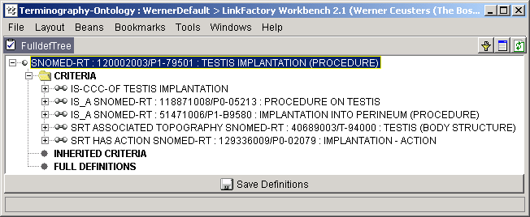
Are formal DL-based systems any better ?
Can there be something that is an excision and an implantation ?
No ! Although suggested, that is not what is expressed.
Does “testis implantation” mean that a testis is implanted ?

Slide 12
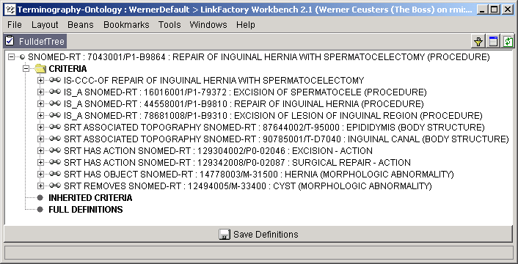
Are formal DL-based systems any better ?
?
Use of description logics does not guarantee correct representations !

Slide 13
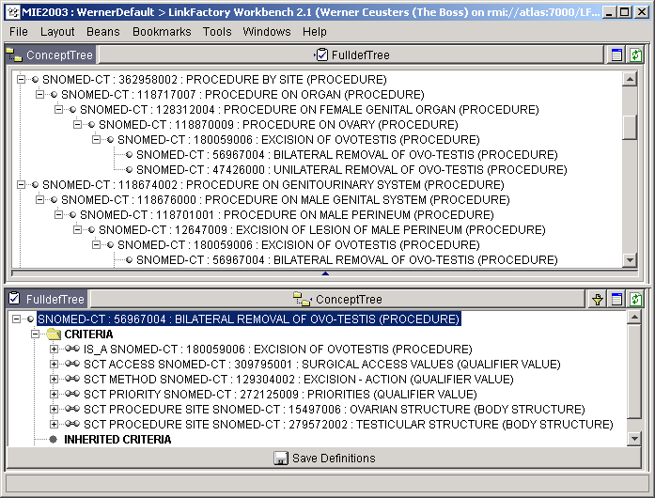

Slide 14

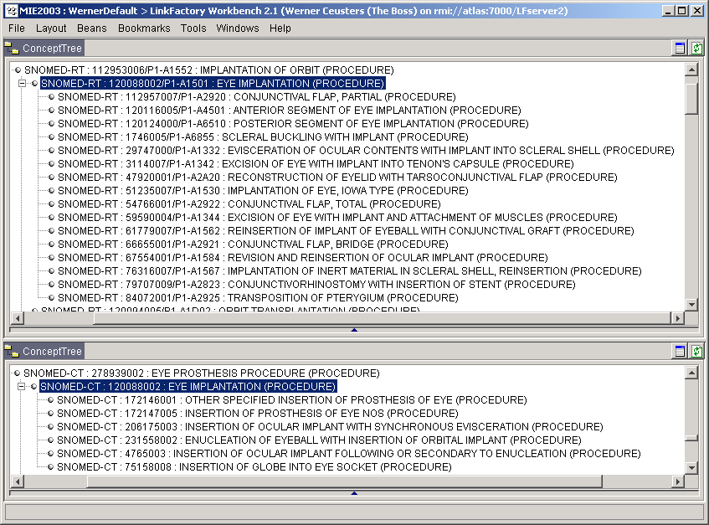
Change of meaning over versions

Slide 15
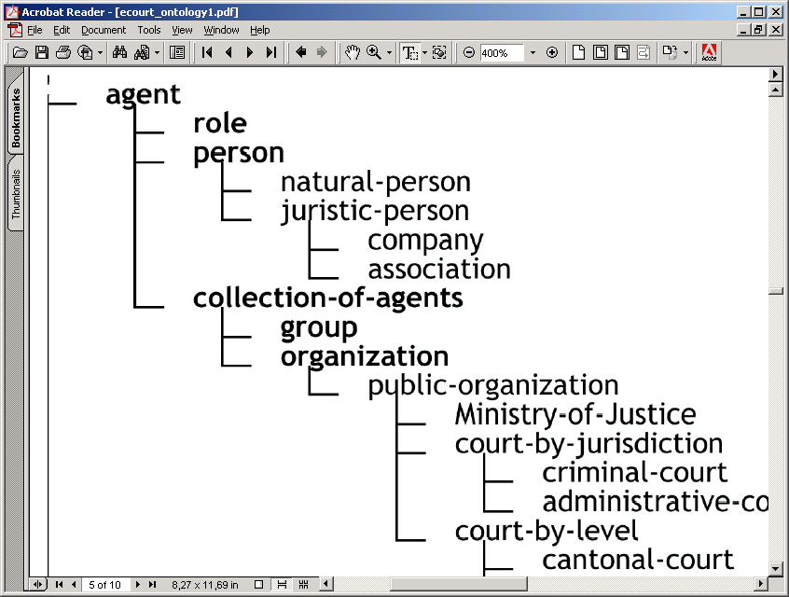
It is not just a problem in healthcare
Ontologies for Legal Information Serving and Knowledge Management
Joost Breuker, Abdullatif Elhag, Emil Petkov and Radboud Winkels

Slide 16
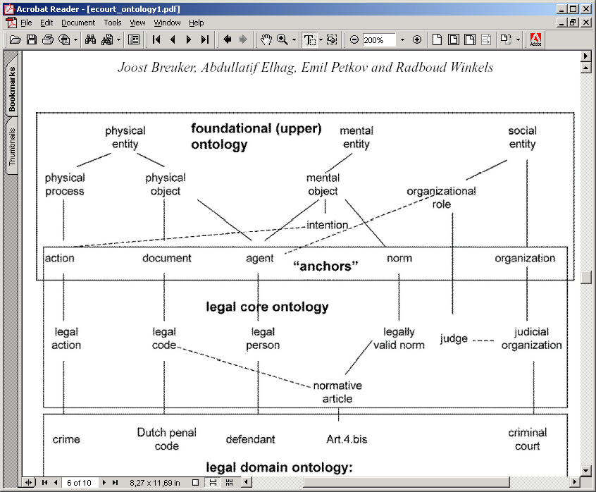

Slide 17
Summary of current deficiencies in traditional and formal terminologies (1)
Terms often require “reading in context”
Agrammatical constructions (paper-based indexing)
Semantic drift as one moves between hierarchies
Not (yet) useful for natural language understanding by software (but were not designed for that purpose)

Slide 18
Summary of current deficiencies in traditional and formal terminologies (2)
labels for terms do not correspond with formal meaning
underspecification (leading to erroneous classification in DL-based systems)
overspecification (leading to wrong assumptions with respect to instances)

Slide 19
Our claim:
Many of these deficiencies can be corrected or prevented by doing
the right sort of “ontology”
using a proper tool.

Slide 20
Next presentations:
about the right sort of ontology:
  Barry Smith
  From BFO to MedO
about the right tool:
  W. Ceusters, M. Cassella dos Santos, M. Fielding:
  Applying a realist ontology for medical natural language understanding.

