Slide 1
Applying a realist ontology for medical natural language understanding.
W. Ceusters, M. Cassella dos Santos, M. Fielding
Language & Computing nv

Slide 2
An integrated approach
NLU enabling tools for
knowledge supported
data-entry and -retrieval
L
&
C
Linguistic
application components
Medical and linguistic
knowledge required for
language understanding
L
&
C
LinKBase
Data structure and
function library for
language understanding
L
&
C
LinKFactory

Slide 3
Medico-linguistic ontology
Language A
Proprietary Terminologies
Language B
Lexicon
Lexicon
Others ...
Grammar
Grammar
ICPC
Formal Domain Ontology
SNOMED
ICD
Cassandra Linguistic Ontology
MEDDRA
L
&
C
LinKBase

Slide 4
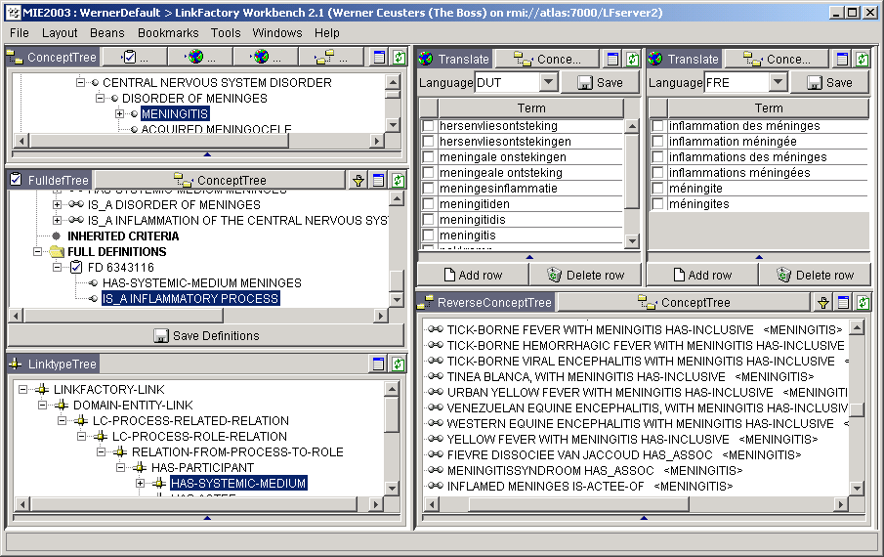
Some LinkFactory/LinkBase views

Slide 5
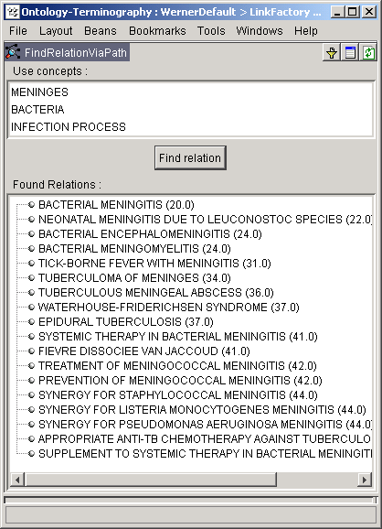
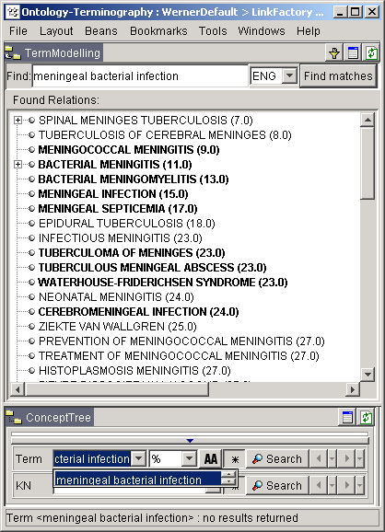
Some benefits: improved search
conceptual linguistic+conceptual

Slide 6
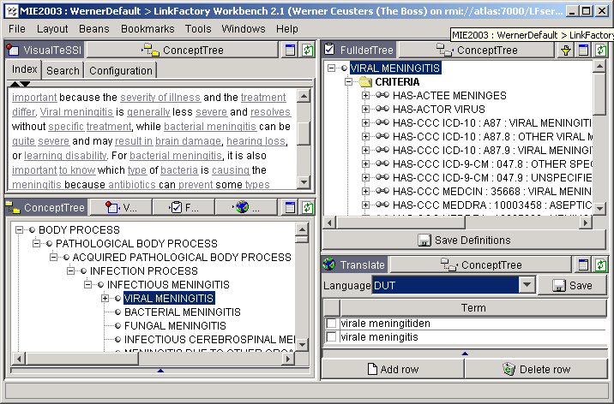
Document indexing and coding

Slide 7
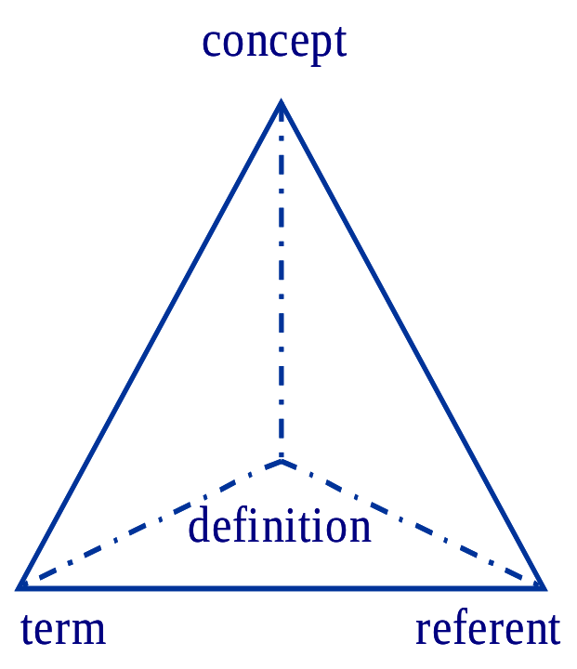
From concept-based representations to ontology
“Ontology” in Information Science:
  “An ontology is a description (like a formal specification of a program) of the concepts and relationships that can exist for an agent or a community of agents.” (Tom Gruber)
“Ontology” in Philosophy:
  “Ontology is the science of what is, of the kinds and structures of objects, properties, events, processes and relations in every area of reality.” (Barry Smith)

Slide 8
Our approach
medical+linguistic ontology
(data + algorithms)
concept system
the real world
definitions
concept system
language
referents
language
referents
the standard view
our view

Slide 9
Exploit the relationships along the vertices
Halliday’s systemic
functional
grammar
Aristotelian
realism
The structures of language are
partially determined by our
conceptualisation of the
world. Halliday
No mental representation without language Fodor
Meaning is located in
the interaction between living
beings and the environment
James J. Gibson, Ecological
Realism in Psychology
concept
language
referents
Baboons and humans have different cut-off points for discerning "same" objects because our verbal expression for "same" makes the idea of "same" more restrictive.”
Fagot and Wasserman (Centre for Research in Cognitive Neuroscience in Marseille)

Slide 10
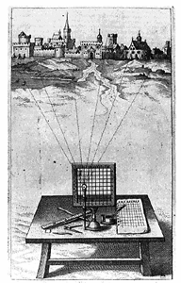
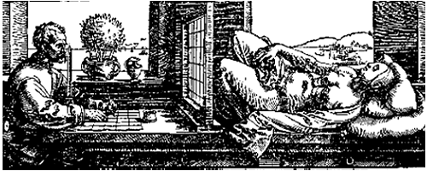
Theory of granular partitions (B. Smith)
Think of it as Alberti’s grid

Slide 11
A partition view on meningitis
meninges
systemic-medium
partition
disorder of
meninges
disorder
partition
inflammation
of CNS
inflammation
partition
meningitis

Slide 12
Partitions and LinkBase®
domain-entity: what is captured by cells of different partitions of reality
  MENINGITIS (captured e.g. by the inflammation partition)
  MENINGES (captured by an anatomical map)
meta-entity: entity as foregrounded by cells of a partition prepared by third parties
  ICD-10 : G03.9 : MENINGITIS, UNSPECIFIED
domain-entity-link: aspect of domain-entities determining a partition/perspective
  HAS-SYSTEMIC-MEDIUM
  HAS-CONSEQUENCE
criterion: perspective on a domain-entity yielded by a given partition
  HAS-SYSTEMIC-MEDIUM MENINGES
  HAS-CONSEQUENCE HEADACHE

Slide 13
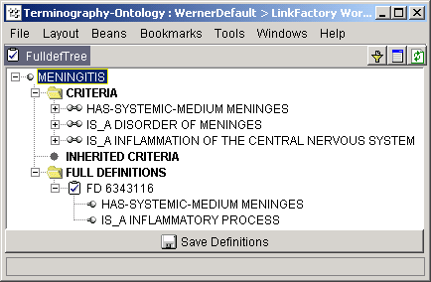
What does linkBase say about the world ?
if a real-world entity is an instance of a domain-entity, all that is said about the domain-entity applies to the instance;
the statement “A-Link-B” says something about all instances of A, but nothing about instances of B unless the Link is declared to have an inverse;
if you know that a real-world entity satisfies the Full Definition of a domain-entity-type, then you may infer that that object is an instance of that type.

Slide 14
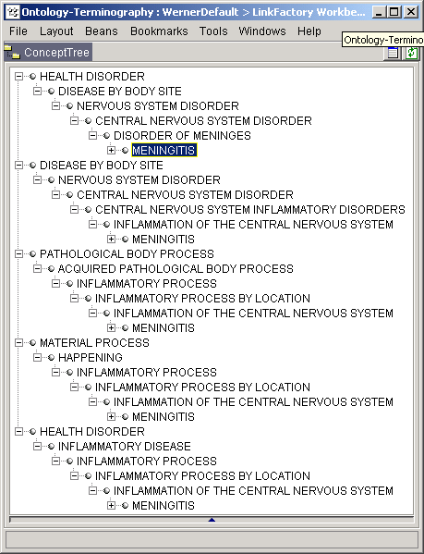
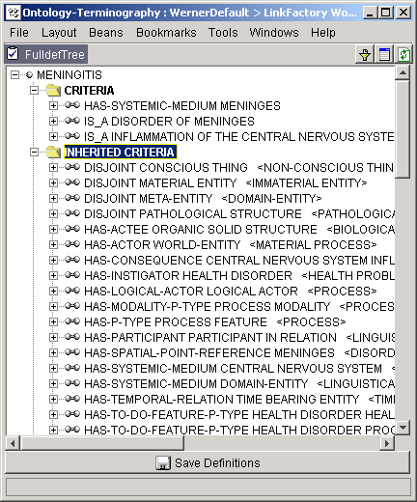
What does linkBase say about the world ?
everything that is true for a domain-entity is true for all its subsumers

Slide 15
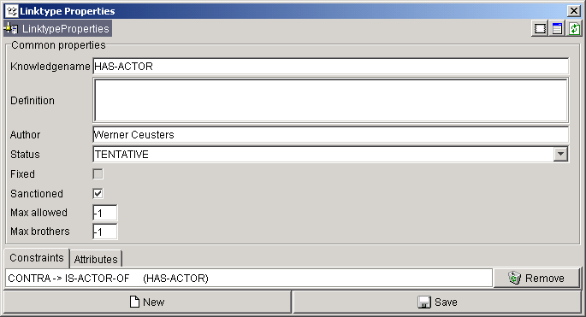
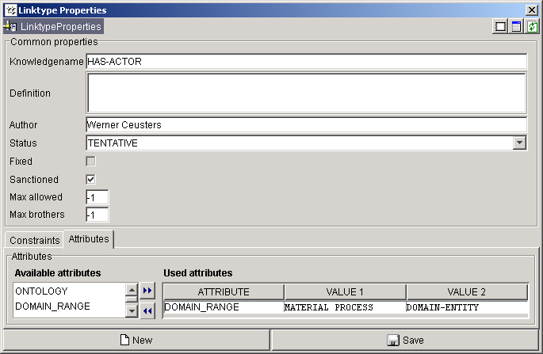
What does LinkBase say about the world ?
Restrictions apply
Linktypes (may) have an (auto-)contra linktype
  if: L1 autocontra L2,
  then
  if C1 L1 C2
  then C2 L2 C1
  if: L1 contra L2,
  then
  if c1 L1 c2 (instances)
  then c2 L2 c1

Slide 16
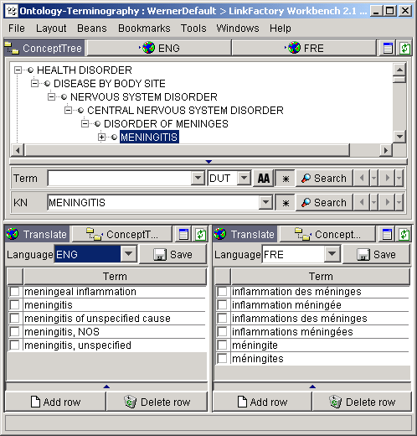
Domain-entities and terms
we call “terms” evidence-based expressions relating to domain-entities in a particular language
no idea of enforcement (no language cops)

Slide 17
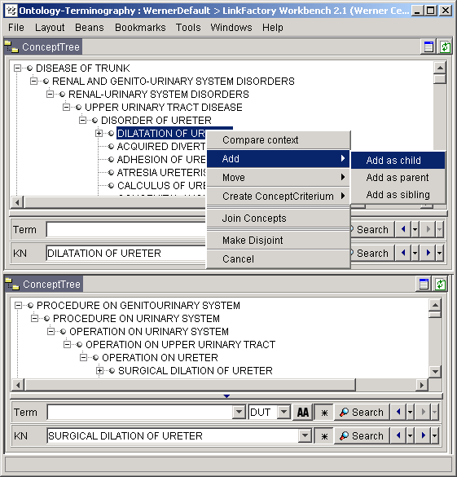
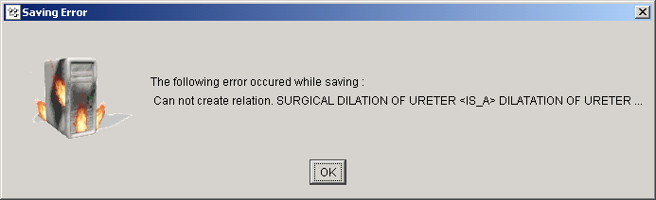
Some benefits:
QA for terminology authoring

Slide 18
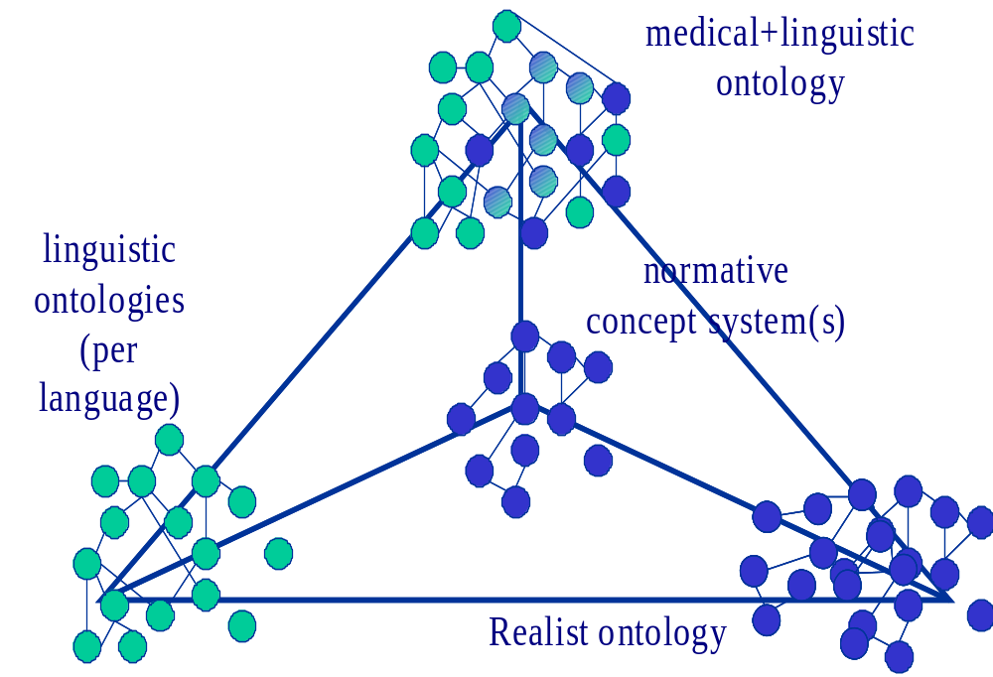
BFO/MedO and LinkBase
BFO/MedO
“validates”

Slide 19
Granular partition theory and BFO provide a
LinkBase Standardization
For every LinkBase concept C the definition is a mapping to a pair:
  < the Universal named by C, the extension of the universal named by C>
For every LinkBase relation R(x,y), the definition is a mapping to a п₂ formula
  (where X and Y are variables ranging over LinkBase concepts):
For all x: x is the universal named by X or x is the extension of that universal, there is a y: y is the universal named by Y or y is an element in the extension of that universal, such that R*(x,y) (where R*(x,y) is a relation in the formal language of BFO)
Notes:
The benefits of the standardization are:
allow distinction between concepts (cells in the granular partition theory, which locate the objects: universal + instances of the universal) and instances
Support formaly our current statement: “a criteria assigned to a concept is valid for all instances of that concept”
Facilitates the mapping/correlation of Link types to the BFO formal relations (necessary to apply BFO axioms), by helping identify Link types which are not formal on its essence (where standard doesn’t apply).

Slide 20
Implementation of BFO axioms
(Descriptive axioms of BFO elements)
BFO entities axioms: apply when LinkBase concepts are subsumed by a BFO entity.
BFO SUBSTANCE
Defined by axiom: SBx <=> ∃y(yIHx)
SUBSUMED BY
Axiom is then applied, what allows
properties and states (temperature, shape,
colour...) to inhere in the HUMAN BODY.
BODY OF ORGANISM
IS-A
HUMAN BODY
Notes:
Reading BFO substance axiom: “X is a substance if and only if there is a Y such that Y inheres on X”
Applying this axiom when a concept is declared a substance, the information that there’s a property or state inhering on it can be deduced.
(Or also vice-versa, if a concept has an incoming link that maps to inherence(BFO formal relation), an “IS-A/subsumed by” link to substance can be deduced.)

Slide 21
Implementation of BFO axioms
(Descriptive axioms of BFO elements)
BFO formal relations axioms: apply on instances of particular Linktype mapped to BFO formal relations.
Linktype
IS-ACTEE-OF
MAPS TO
BFO formal relation INCESSION
Defined by axiom: xICy => End(x) & Perd(y)
INFECTED CYST
INFECTION
IS-ACTEE-OF
Axiom is then applied, what allows the deduction that INFECTION is a
Perdurant and consequentely has temporal parts.
Notes:
Reading of BFO INCESSION axiom: “If X “incesses” on Y then X is an Endurant and Y is a Perdurant”

Slide 22
Implementation of BFO axioms
Instance level (NLP applications) X Domain ontology level (LinkBase)
Applied at instance level axioms help to transform natural language text into formal
semantic representation by:
- Inferring semantic relations between instances of concepts in the ontology.
- Identifying new instances of concepts not explicitily mentioned or mapped.
ABDOMINAL
PAIN
PERDURANT
ENDURANT
INCESSION
SUBSUMED BY
SUBSUMED BY
HAS-CONSEQUENCE
CRAMP
ABDOMEN
HAS-SYSTEMIC
MEDIUM
::
::
ABDOMINAL
CRAMP
“The patient complained of cramps in his abdomen.”
::
Identified relation: HAS-SYSTEMIC-MEDIUM
(mapped to INCESSION)
Notes:
Inferring semantic relations between instances of concepts in the ontology: From the axiom xICy=>End(x) and Perd(y) (already mentioned on previous slide) the system deduces that the relationship between an endurant and a perdurant is INCESSION. When instances in text are recognized as instances of endurant and perdurant , and a relation between them is recognized (from syntax), the axiom helps to infer that the nature of this relation is of INCESSION, so the adequate Linktype for the semantic representation is a Linktype mapped to INCESSION, in the case HAS-SYSTEMIC-MEDIUM.
Identifying new instances of concepts not explicitily mentioned or mapped: The term “cramps in his abdomen” is transformed (above) into a semantic representation: IS-A CRAMP and HAS-SYSTEMIC-MEDIUM ABDOMEN, which corresponds to the semantic representation (modelling) of the concept ABDOMINAL CRAMP. The term “cramps in his abdomen” is then recognized as an instance of the concept ABDOMINAL CRAMP, allowing the aditional information this concept has (HAS-CONSEQUENCE ABDOMINAL PAIN) also to be explored.

Slide 23
Implementation of BFO axioms
Domain ontology level (LinkBase)
BFO is an “upper level” ontology formalized according to a first order language of logical entailments that work on the instance level. LinkBase, however, is a system of generalizations, or categorical relations.
In LinkBase most direct links, for example “x is a part of y”, have a reverse link, “y has part x”. We determined that the reverse links require reverse axioms in order to maintain the generalizability governed by the Π₂ formula.
BFO INHERENCE
Defined by axiom: xIHy => xODPy
MAPS TO
Linktype
IS-STATE-OF-WE-OF
CONTRA-LINK
Linktype
HAS-WE-STATE
CAPILLARY HYPERPERMEABILITY
IS-STATE-OF-WE-OF
CAPILLARY
ONE-SIDED DEPENDENCY?
NECESSITY FOR REVERSE
AXIOM.
IS-O-S-DEPENDENT-ON
CAPILLARY
HAS-WE-STATE
PERMEABILITY
Notes:
Here we call “direct links”, the Link types that map dierectly to a BFO axiom (the ones given by BFO, not the reverse ones writen by us).
Reading of axiom: “If X inheres on Y, then X is one-side-dependent on Y”
Higher red box is an example of applying the axiom directly (the original axiom from BFO) over the IS-STATE-OF-WE-OF link.
Lower red box is an example of the necessity of a reverse axiom to be applied over the HAS-WE-STATE link, in order to derive a one-sided-dependence relation. (note: one-sided-dependence relation doesn’t map directly to any of the Link types but their axioms lead to Weak foundation relation, which maps to IS/HAS-CONSEQUENCE.)
By “generalizability” Matthew meant our current statement: “a criteria assigned to a concept is valid for all instances of that concept”

Slide 24
Implementation of BFO axioms
Domain ontology level (LinkBase)
The requirement of generalizability in LinkBase entails that we cannot simply reverse the terms from x <IS-STATE-OF-WE-OF> y (xIHy) to y <HAS-WE-STATE>x (yRIHx), an operation perfectly valid at the instance level. Consequently axioms cannot be reverted by reverting the variables!
CAPILLARY HYPERPERMEABILITY
IS-STATE-OF-WE-OF
CAPILLARY
HAS-WE-STATE
Link violates the Π₂ formula:
Not all instances of CAPILARRY
have a hyperpermeability.
Reverse axiom xRIHy => yODPx is then incorrect!
Our solution then, has been to introduce a set of reverse axioms through the entire chain of formal relations, till the most primitive BFO formal relation (Weak Foundation). For the example above the correct reverse axiom is: xRIHy => xRODPy
Notes:
RIH = reverse inherence (read “has-inherent”)
Reading incorrect reverse axiom: “If X has-inherent Y, then Y is one-sided dependent on X”
Axiom is incorrect because it would generate FALSE links: (using the example from previous slide) CAPILLARY HAS-WE-STATE PERMEABILITY, then PERMEABILITY is-o-s-dependent-on CAPILLARY
Reading of correct reverse axiom: “If X has-inherent Y, then X has-one-sided-dependent Y”
The solution refers to reverting all axioms that follow (are implied by) a axiom towards which a Linktype is mapped: inherence implies one-sided-dependence, which implies dependence, which implies strong foundation, which implies weak foundation. Weak foundation is the last axiom from all chains.

Slide 25
Axioms at the Domain Ontology level
Applied at domain ontology level axioms help us improve and expand the ontology by:
- Inferring new relations between concepts in the ontology.
- Supporting automated check for ontological errors.
- Constraining the modelling space.
HAS-ACTEE
INFECTION OF SKIN ULCER
SKIN
HAS-ACTEE
ULCER
IS-PROPER-
MATERIAL-
PART-OF
The link HAS-ACTEE is mapped to the BFO relation INCESSION,which leads to Weak Foundation and its axiom:
xWFy & z≤y => xWFz
IS-A
HAS-ACTEE
SKIN ULCER
Notes:
Reading of axiom: “If X is weakly fpounded on Y and Z is part of Y, then X is weakly founded on Z”
The HAS-ACTEE link (red) can be deduced from the combination of the links:
INFECTION OF SKIN ULCER HAS-ACTEE SKIN (what implies that the INFECTION OF SKIN ULCER is weakly founded on the SKIN)
And
SKIN ULCER IS-PROPER-MATERIAL-PART-OF SKIN (which maps to part ≤ in “z ≤y”)

Slide 26
Axioms at the Domain Ontology level
Supporting automated check for ontological errors & Constraining the modelling space
ENDURANT
PERDURANT
IS-A
IS-A
The link HAS-THEME is mapped to the reverse BFO relation INCESSION,
defined by the axiom:
xRICy => Perd(x) & End(y)
SURGICALLY ALTERED
STRUCTURE
BYPASS SURGERY
IS-A
IS-A
OESOPHAGUS BYPASS
BYPASS OF OESOPHAGUS
Link is not allowed because
according to the axiom the target
concept must be an Endurant!
HAS-THEME
HAS-THEME
REMOVAL OF BYPASS OF OESOPHAGUS
Notes:
Reading of axiom: “If X has-incessed Y, then X is a perdurant and Y is an Endurant”
The arguments here are:
A careless or unexperienced modelled would not identify the difference between the concepts and add the wrong link.
If the link has been added (previous to the check) it is detected by the system as an error (mechanisms that can be used to “clean” ontologies like the UMLS)
A tool like ontomatcher could have an extra feature, which besides sugesting the concept already poist out the correct one for the specific relations.

Slide 27
Conclusions (1)
“Ontology” is too often not taken seriously, and only few people understand that. But there is hope:
  The promise of Web Services, augmented with the Semantic Web, is to provide THE major solution for integration, the largest IT cost / sector, at $ 500 BN/year. The Web Services and Semantic Web trends are heading for a major failure (i.e., the most recent Silver Bullet). In reality, Web Services, as a technology, is in its infancy. ... There is no technical solution (i.e., no basis) other than fantasy for the rest of the Web Services story. Analyst claims of maturity and adoption (...) are already false. ... Verizon must understand it so as not to invest too heavily in technologies that will fail or that will not produce a reasonable ROI.
      Dr. Michael L. Brodie, Chief Scientist, Verizon IT
      OntoWeb Meeting, Innsbruck, Austria, December 16-18, 2002

Slide 28
Conclusions (2)
Better no ontology, than an ontology without a theory.
  description logics are not enough
Ontology for terminology is only useful if the terminology is to be used by software.
  ( is terminology without an intended use by software still useful ? )
Ontology is not THE solution, but just part of the solution.

