Slide 1
Semantic Interoperability and the Patient Summary
Barry Smith
http://ontology.buffalo.edu/smith

Slide 2
Who am I?
Founder, Institute for Formal Ontology and Medical Information Science (IFOMIS), Saarland University
Director, (US) National Center for Ontological Research
Founding Coordinating Editor of the OBO (Open Biomedical Ontologies) Foundry project

Slide 3
National Center for Biomedical Ontology (NCBO)
NIH Roadmap Center for Biomedical Computing
collaboration of:
Stanford Medical Informatics
University of San Francisco Medical Center
The Mayo Clinic
University at Buffalo Ontology Research Group
PI for Dissemination and Ontology Best Practices

Slide 4
Who am I?
Advisory Boards of
Gene Ontology
Ontology for Biomedical Investigations (OBI)
Cleveland Clinic Semantic Database in Cardiothoracic Surgery
Advancing Clinico-Genomic Trials on Cancer (ACGT)

Slide 5
Who am I?
Evaluator for NeOn (Networked Ontologies) EU FP7 Integrated Project
PI Protein Ontology (PRO) (NIH/NIGMS)
PI Infectious Disease Ontology (IDO) (NIH/NIAID)

Slide 6
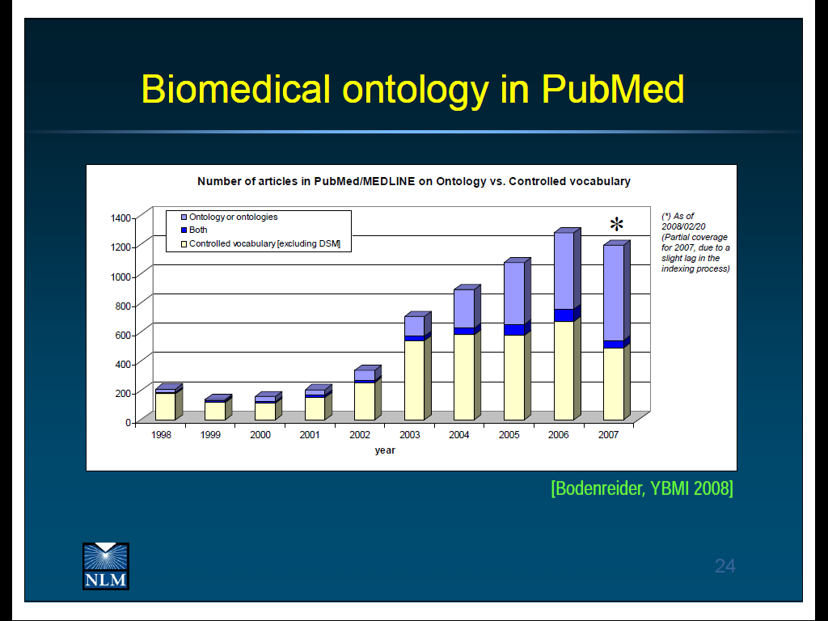
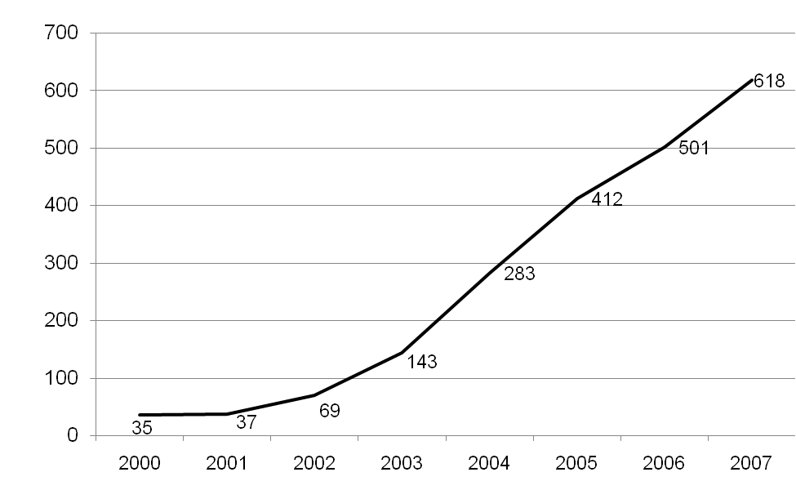
Uses of ‘ontology’ in PubMed abstracts

Slide 7
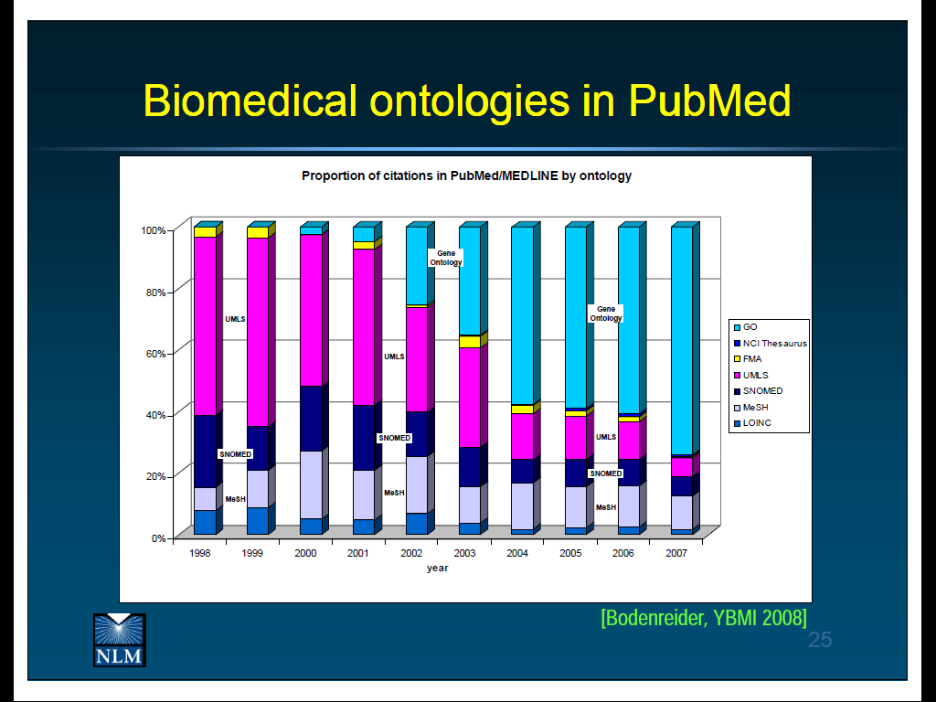
By far the most successful: GO (Gene Ontology)

Slide 8
RELATION TO TIME GRANULARITY | CONTINUANT |  |  |  | OCCURRENT
 | INDEPENDENT |  | DEPENDENT
ORGAN AND ORGANISM | Organism (NCBI Taxonomy) | Anatomical Entity (FMA, CARO) | Organ Function (FMP, CPRO) | Phenotypic Quality (PaTO) | Biological Process (GO)
CELL AND CELLULAR COMPONENT | Cell (CL) | Cellular Component (FMA, GO) | Cellular Function (GO)
MOLECULE | Molecule (ChEBI, SO, RnaO, PrO) |  | Molecular Function (GO) |  | Molecular Process (GO)
The Open Biomedical Ontologies (OBO) Foundry

Slide 9
Infectious Disease Ontology
Create an infectious disease ontology (IDO) focusing on Staphylococcus aureus bacteremia.
Empirically test the ability of the ontology to improve the analysis and interpretation of clinical data.
Empirically test the impact of the ontology on understanding Staphylococcus aureus pathogenesis, on identifying novel therapeutic targets, and on improving patient management.

Slide 10
Patient Summary
T3.5.2: Examine the existing terminology used
each country will have its own reference terminology
alignment to be achieved through an incremental process
each country continues to use its own terms, but they will be understood by neighbour countries in automatic fashion, leaving no room for ambiguity, and therefore preventing medical error.

Slide 11
T3.5.3: Determine a mechanism for managing terminology
how to map from one terminology to another?
how to keep mappings up-to-date?
how to deal with progressive improvements (elimination of errors, extensions to include new terms)
Ontology can help

Slide 12
Items needed
1. Term lists from each project country
2. Shared reference ontology to support automatic translation and evolution over time
3. Summary shapshots, one for each country (a template, to be filled in using terms taken from the term lists)

Slide 13
1. Creating a term list
The terms will consist initially of the statistically most frequently used terms in all project languages
They will be organized into classes and subclasses under major headings such as:
  allergies
      medications
      clinical problems

Slide 14
Sources
Term lists to be compiled and evaluated on the basis of inputs provided by organizations such as DIVI and DGAI (intensive medicine, anaesthesiology) and terminology experts, also by national and regional bodies with large constituencies of travelers, for example:
hospitals and medical schools located close to cross-linguistic borders
national automobile clubs
pensioners‘ organisations which sponsor holidays for their members
cross-border coach tour companies
package tour agencies

Slide 15
Tools to be used
Use of simple wiki technology for initial term collection
Subsequently, use of Protégé and semantic wiki technology to create a structured representation and as basis of mappings to and from reference ontology

Slide 16
Coverage
The goal is to find terms which, in total, cover some 90% of all relevant cases in each of the dimensions distinguished – focusing on those terms relating to features likely to be of relevance to cross-border healthcare.

Slide 17
Examples
Antibiotika-Allergie allergy to antibiotic agents Muskelrelaxanzien-Allergie allergy to muscle relaxants Kontrastmittel-Allergie allergy to cantrast media Neuroleptika-Allergie allergy to neuroleptics Antihistaminika-Allergie allergy to antihistamines Allergie gegen Antidepressiva allergy to antidepressants | Eiprotein-Allergie allergy to protein Jodallergie allergy to iodine Penizillin-Allergie allergy to penicillin Latex-Allergie allergy to latex Allergie gegen Sulfonamide allergy to sulfonamides Allergie gegen Anästhetika allergy to anaesthetic agent

Slide 18
2. Creating a reference ontology
= a list of language-neutral codes to which the terms in the term lists will be mapped and thereby become intertranslateable
its use will create a basis for powerful statistical associations resting the fact that information about single patients is gathered in multiple countries
these statistical associations can be used to validate translations

Slide 19
The ontology can provide IT support for cross-border healthcare
  cross-border public health statistics
  epidemiological research
  biodefense and biosurveillance
  interface to decision support tools (drug contraindications, ...)
  basis for more comprehensive mappings between healthcare information systems in different countries

Slide 20
Creating semantic interoperability
= interoperability between different national information systems that is rooted in the meanings of the terms involved , resting on ; this will be ensured because the word lists will be callibrated in a way which involves verification by humans (in princople including patiens themselves), who can check on the preservation of meaning.
The reference ontology is a language-neutral table (in later phases with an appropriate hierarchical organization), comparable to a general switchboard interface, to which all the single terms in the separate language-specific list sets are mapped. In this way the corresponding language-specific terms become intertranslatable, and the corresponding bodies of data residing in national repositories become semantically interoperable.

Slide 21
The reference ontology
Nodes in the ontology will be identified via alphanumeric codes,
They will be associated with SNOMED codes, or with codes from similar standardized vocabularies e.g. for drugs and procedures
The reference ontology will be constructed using Protege and validated using RACER or similar reasoners

Slide 22
Logical organization
The reference ontology should have a logical organization, including a backbone subtype (is_a) hierarchy, enabling coding to the next higher level in the hierarchy if there is no more appropriate term available

Slide 23
3. Creating a patient summary
(a small pilot experiment)
Tasks:
to create a snapshot of the health situation of the patient to be used while traveling, based on term list for language of the host country (A)
to translate this snapshot into a snapshot in the language of the target country (B)
to evaluate the result in language B: can the healthcare provider or pharmacist read and make use of the snapshot in speeding up provision of urgent care, or, avoiding prescribing errors?

Slide 24
3. Creating a patient summary
(A small pilot experiment)
Participants:
healthcare practitioners and pharmacists, including students, together with informaticians (and ontologists), from a subset of project countries
Tools:
modeled on the ACGT ontology-based Form-builder tool created by IFOMIS researchers

Slide 25
A strategy of self-learning
Each task will be iterated as translations are corrected and the summary enhanced in format and scope and take account of specific conditions on project countries
In later stages, tasks will be included testing the software used to support input, translation, and output
At every stage there will be a need for constant evaluation and update

Slide 26
Need to start with a small reference ontology
This is designed to guarantee semantic interoperability among all the lists maintained in each of the project languages and associated software systems
In order to initiate the workings of the system in a timely and economically feasible and medically reliable way it will be necessary to begin with very simple lists – focusing exclusively on those terms in common use in each of the countries involved.

Slide 27
Facility to ensure constant growth
Software will allow creation of patient snapshots via drop-down lists followed by an additional request:
  Name other allergies [etc.] from which this patient suffers and which you believe may be of relevance in case of need for urgent care.
Entries under this heading will be collected and used as basis for extensions of the system in all other languages and in the reference ontology.

Slide 28
Again, the goal is a self-learning system
Software should provide a facility for tracking and correction of errors identified in course of use.
Errors and inadequacies in the initial set of created lists should be progressively eliminated in the course of real-world evaluation and implementation.

Slide 29
Why a small core ontology, with a system based on snapshots?
  The SNOMED Clinical Terms vocabulary currently consists, in its English version, of some 357,000 ‘concepts‘ with unique meanings and partial formal logic-based definitions organized into hierarchies. When measured by these standards, any approach to our problem will be ‘small‘ = there will at any given stage be patients with salient conditions, or rarely prescribed drugs, which cannot be described using the terms available.

Slide 30
Why not use Natural Language Processing (NLP)?
Term lists, translations and core ontology must be created manually
Patient summary snapshots must be created manually (though with software support from drop-down lists, later through interface with Electronic Health Records)
Why? Because NLP does not provide outputs with sufficient reliability for the intended uses

Slide 31
Role of ontology in healthcare
T The need is to create a simple snapshot-style representation, which will be maximally useful for the practitioner in country B in achieving a quick overview of relevant features of the patients condition.

Slide 32
Antibiotika-Allergie allergy to antibiotic agents Muskelrelaxanzien-Allergie allergy to muscle relaxants Kontrastmittel-Allergie allergy to cantrast media Neuroleptika-Allergie allergy to neuroleptics Antihistaminika-Allergie allergy to antihistamines Allergie gegen Antidepressiva allergy to antidepressants | Eiprotein-Allergie allergy to protein Jodallergie allergy to iodine Penizillin-Allergie allergy to penicillin Latex-Allergie allergy to latex Allergie gegen Sulfonamide allergy to sulfonamides Allergie gegen Anästhetika allergy to anaesthetic agent

Slide 33
Question
Is it not a problem that there are, for example, drugs with the same name and produced by the same company in different countries but with different mixture of ingredients?
Note that the names in the simple lists will have a prefix corresponding to the language used. Thus what the practitioner in Germany sees in the drop down list is 'Aspirin'; what the system sees is 'DE: Aspirin'.

Slide 34
Question
Question: Who will pay for the coding on the initial experimental phase)?
The experiment will apply only to that small fraction of patients who (a) volunteer (b) because they have a high likelihood of engaging in cross-border travel.
Thus we anticipate that sufficiently many practitioners and pharmacists in the home country will find it within their commercial interests to volunteer to participate in this experiment.

Slide 35
A good solution to the silo problem must be:
modular
incremental
bottom-up
evidence-based
revisable
incorporate a strategy for motivating potential developers and users

