Slide 1







national center for ontological research

Slide 2
Ontologies (tech.)
Standardized classification systems which enable data from different sources to be combined, accessed and manipulated
Ontology (phil.)
A theory of the types of entities existing in a given domain of reality, and of the relations between these types

Slide 3
Types have instances
Ontologies are about types
Diaries, databases, clinical records are about instances

Slide 4
The need
strong general purpose classification hierarchies created by domain specialists
clear, rigorous definitions
thoroughly tested in real use cases
ontologies which, like scientific theories, can teach us about the instances in reality by supporting cross-disciplinary reasoning about types

Slide 5
The actuality (too often)
myriad special purpose ‘light’ ontologies, prepared by ontology engineers and deposited in internet ‘repositories’ or ‘registries’

Slide 6
often do not generalize …
repeat work already done by others
are not interoperable
reproduce the very problems of communication which ontology was designed to solve
contain incoherent definitions
and incoherent documentation

Slide 7
Signs of hope
founding of National Center for Biomedical Ontology (an NIH Roadmap Center)
http://ncbo.us
new logic-based criteria for inclusion in the OBO (Open Biomedical Ontologies) ontology library

Slide 8
Philosophy as the mother of the disciplines
Aristotelian natural philosophy → Physics, Biology
Kantian philosophy of mind → Psychology
Frege’s philosophical logic → Mathematical Logic → Computer Science
Ontology (Science) born October 27, 2005

Slide 9
Ontologies (tech.)
Standardized classification systems which enable data from different sources to be combined, accessed and manipulated
Ontology (science)
A theory of the types of entities existing in a given domain of reality, and of the relations between these types, subject to empirical testing via ontology (tech.)

Slide 10
NCOR will
advance ontology as science
advance ontology education inter alia through internships and partnerships
develop empirical measures to establish best practices for ontologies

Slide 11
NCOR will
provide coordination and support for investigators working on theoretical ontology and its applications
engage in outreach endeavors designed to foster the goals of high quality ontology in both theory and practice
NCOR Wiki: http://ontologist.org

Slide 12
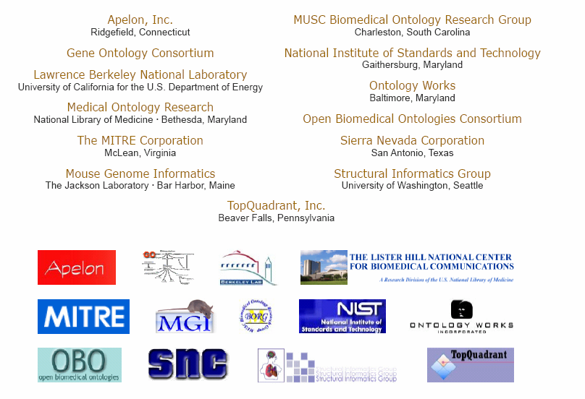

Slide 13
national center for ontological research
partnership inquiries:
ncor@buffalo.edu

Slide 14
HL7 RIM
Lessons for Semantic Interoperability

Slide 15
National Cancer Institute National Biospecimen Network (NBN)
“The NBN bioinformatics system should be standards-based (e.g., SNOMED, HL7, ... for data; Internet for communications) to enable data and information exchange among system components and the researchers who use them.”

Slide 16
Standards for Semantic Interoperability in Medicine
SNOMED
HL7
DEMONS

Slide 17
Standards for Semantic Interoperability in Medicine
SNOMED
really exists as a viable working standard

Slide 18
HL7 V2 as messaging standard
HL7 V3 claims to be:
“The foundation of healthcare interoperability”
“The data standard for biomedical informatics”
from blood banks to Electronic Health Records to clinical genomics

Slide 19
HL7 Incredibly Successful
adopted by Oracle as basis for its Electronic Health Record technology; supported by IBM, GE, Sun ...
embraced as US federal standard
central part of $35 billion program to integrate all UK hospital information systems

Slide 20
Semantic interoperability
The rationale of the HL7 messaging standard:
to ensure that health information systems can communicate their information in a form which will be understood in exactly the same way by both sender and recipient – no local dialects
HL7 is an ambitious effort to realize a laudable goal, involving dedicated user communities in many countries.

Slide 21
with thanks to Thomas Beale, Ocean Informatics
patient
Allied
health
other
provider
PAYER
Secondary
users
portal
Imaging lab
billing
ECG etc
Security / access control
UPDATE
QUERY
Path lab
notifications
Msg gateway
Multimedia
genetics
Patient
Record
LAB
workflow
demographics
Clinical
reference data
Clinical
models
telemedicine
guidelines
protocols
Online
Demographic
registries
Interactions DS
Online drug,
Interactions DB

Slide 22
Problem
in HL7 V2 the realization of the messaging task allows ad hoc interpretations of the standard by each sending or receiving institution.
Result: vendor products never properly interoperable, and always require mapping software.

Slide 23
The solution to this problem (V3) is the HL7 RIM
or Reference Information Model
= a world standard for exchange of information between clinical information systems

Slide 24
The V3 solution
Remove optionality by having the RIM serve as a master model of all health information, from blood banks to Electronic Health Records to clinical genomics

Slide 25
Should a messaging standard be used as the Foundation for Healthcare Interoperability?
Is using a messaging system as a basis for an information model, e.g. for core genomic data, not rather like using air-traffic control messaging as a starting point for a science of airplane thermodynamics?

Slide 26
The hype
“HL7 V3 is the standard of choice for countries and their initiatives to create national EHR and EHR data exchange standards as it provides a level of semantic interoperability unavailable with previous versions and other standards. Significant V3 national implementations exist in many countries, e.g. in the UK (e.g. the English NHS), the Netherlands, Canada, Mexico, Germany and Croatia.”

Slide 27
The reality (I asked them)
“None of the implementations have a national scope” (e.g. Stockholm City Council)
The paradigm Dutch national HL7 V3 EHR implementation uses HL7 technology exclusively for exchanging data (i.e. messaging). The EHR architectures themselves are HL7-free.

Slide 28
... and one can understand why
HL7 does not have an EHR architecture
The "HL7 EHR System Functional Model and Standard” is not a functional model for an EHR system at all; it is a specification of requirements – a profile of what would be needed to create such a functional model.

Slide 29
The hype
The RIM is “credible, clear, comprehensive, concise, and consistent”
It is “universally applicable” and “extremely stable”

Slide 30
The reality
HL7 V3 documentation is 542,458 KB, divided into 7,573 files
It remains subject to frequent revisions
It is very difficult to understand
The decision to adopt the RIM was made already in 1996, yet the promised benefits of interoperability still, after 10 years, remain elusive.
HL7 has bet the farm on the RIM – technology has advanced in these 10 years

Slide 31
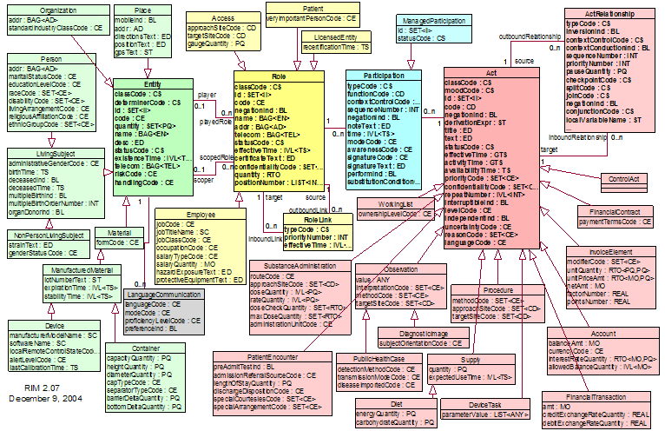
RIM NORMATIVE CONTENT

Slide 32
to design a message, choose from here

Slide 33
Too many combinations
as the traffic on HL7’s own vocabulary mailing list reveals, there is no adequate mechanism for ensuring that the vast number of combinations of coded terms within actual messages can be controlled in such a way that messages will be understood in the same way by designers, senders and receivers.

Slide 35
These pre-defined attributes
code, class_code, mood_code,
status_code, etc.
yield a combinatorial explosion:
class_code (61 values) x mood_code (13 values) x code (estimate 200) x status_code (10 codes) = 1.58 million combinations.
Adding in the other codes this becomes 810 billion.
Notes:
with thanks to Thomas Beale of Ocean Informatics

Slide 36
Why does the RIM embody so many combinations?
To ensure in advance that everything can be said in conformity to the standard

Slide 37
The RIM methodology
defines a set of ‘normative’ classes (Act, Role, and so on), with which are associated a rich stock of attributes from which one must make a selection when applying the RIM to each new domain (pharmacy, clinical genomics ...),
Compare: attempting to create manufacturing software by drawing from a store containing pre-established parts (so that the store would need to have the bits needed for making every conceivable manufacturable thing, be it a lawnmower, a refrigerator, a hunting bow, and so on).

Slide 38
The RIM methodology
Is there even one example where a methodology of this sort has been made to work? Does the RIM yield a coherent basis for constructing well-designed software artifacts for functions like the EHR or computerized decision support?

Slide 39
This methodology does not impede the formation of local dialects
Different teams produce different message designs for the very same topic.
In the UK, the $ 35 bn. NHS National Program “Connecting for Health” has applied the RIM rigorously, using all the normative elements, and it discovered that it needed to create dialects of its own to make the V3-based system work for its purposes (it still does not work)

Slide 40
The RIM is difficult to implement
When Eire assessed both V2 and V3, it chose V2 as the basis for its health messaging designs.

Slide 41
The RIM documentation
is subject to multiple and systematic internal inconsistencies and unclarities:
is marked by sloppy and unexplained use of terms such as ‘act’, ‘Act’, ‘Acts’, ‘action’, ‘ActClass’ ‘Act-instance’, ‘Act-object’
and uncertain cross-referencing to other HL7 documents
no publicly available teaching materials (no HL7 for Dummies)

Slide 42
from HL7 email forum (do not circulate)
“I am ... frightened when I contemplate the number of potential V3ers who ... simply are turned away by the difficulty of accessing the product.
“Some of them attend V3 tutorials which explain V3 as the hugely complex process of creating a message and are turned off. [They] simply do not have the stamina, patience, endurance, time, or brain-cells to understand enough for them to feel comfortable contributing to debates / listserves, etc., so they remain silent.”

Slide 43
Problems with secrecy
the fact that the HL7 documentation is so difficult to access means that there is almost no critical secondary literature – errors become entrenched because of intellectual inbreeding
HL7 benefits from the widespread assumption that it is a viable standard – yet many of those who maintain that it is a viable standard have never read the documentation

Slide 44
Problems of scope
Only two main classes in the RIM
Act = roughly: intentional action
Entity = persons, places, organizations, material
How can the RIM deal transparently with information about, say, disease processes, drug interactions, wounds, accidents, bodily organs, documents?

Slide 45
Diseases in the RIM
... are not Acts
... are not Entities
... are not Roles, Participations ...
So what are they?
At best: a case of pneumonia is identified as the Act of Observation of a case of pneumonia

Slide 46
HL7 Clinical Document Architecture
defines a document as an Act
HL7’s Clinical Genomics Standard Specifications
defines an individual allele as an Act of Observation

Slide 47
Why the centrality of ‘Act’
because of HL7’s roots in US hospital messaging – and thus in US hospital billing:
intentional actions are what can be billed

Slide 48
Mayo RIM discussion of the meaning of ‘Act’ as “intentional action”
Is a snake bite or bee sting an "intentional action"?
Is a knife stabbing an intentional action?
Is a car accident an intentional action?
When a child swallows the contents of a bottle of poison is that an intentional action?
Notes:
http://informatics.mayo.edu/wiki/index.php/Intentionality_of_Act_and_the_Future_of_Observations

Slide 49
The RIM has no coherent criteria for deciding
For this reason, too, dialects are formed – and the RIM does not do its job. One health information system might conceive snakebites and gunshots as Procedures. Another might classify them with diseases, and so treat them as Observations.
If basic categories cannot be agreed upon for common phenomena like snakebites, then the RIM is in serious trouble.

Slide 50
Are definitions like this a good basis for achieving semantic interoperability in the biomedical domain?:
LivingSubject
Definition: A subtype of Entity representing an organism or complex animal, alive or not.

Slide 51
Person (from HL7 Glossary)
Definition: A Living Subject representing single human being [sic] who is uniquely identifiable through one or more legal documents

Slide 52
The Problem of Circularity
A Person =def. A person with documents
‘An A is an A which is B’
– useless in practical terms, since neither we nor the machine can use it to find out what ‘A’ means
– incorporates a vicious infinite regress
– has the effect of making it impossible to refer to A’s which are not Bs, for example to undocumented persons

Slide 53
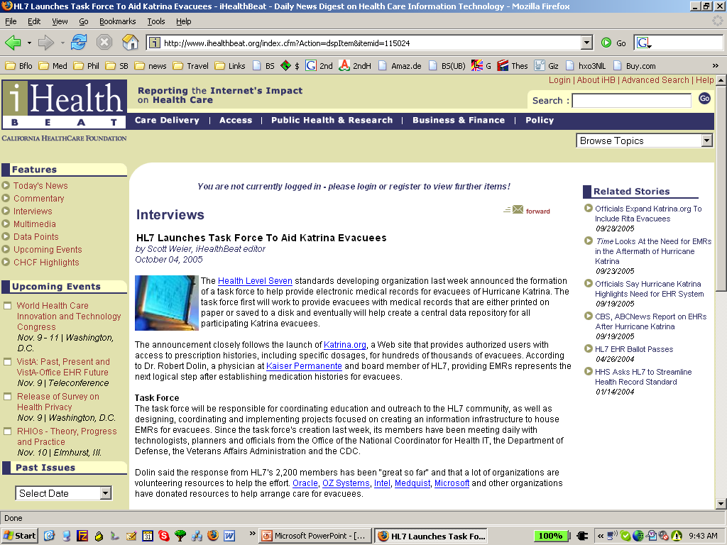
Katrina

Slide 54
Katrina

Slide 55
What is the RIM about?
blood pressure measurement = an information item
blood pressure = something in reality which exists independently of any recording of information, and which the measurement measures
Q: Is the RIM about information, or about the reality to which such information relates?
A: There is no difference between the two

Slide 56
RIM Philosophy
“The truth about the real world is constructed through a combination and arbitration of attributed statements ...
“As such, there is no distinction between an activity and its documentation.”

Slide 57
The RIM as an Information Model
‘a static (UML) model of health and health care information’
The scope of the RIM’s class hierarchy consists in packets of information:
the information content of invoices, statements of observations, lab reports, …

Slide 58
A good, general constraint on a theory of meaning
For each linguistic expression ‘E’
‘E’ means E
‘snow’ means snow
‘pneumonia’ means pneumonia

Slide 59
From the perspective of the RIM on the Information Model conception
  ‘medication’ does not mean: medication
  rather it means:
  the record of medication in an information system
  ‘stopping a medication’ does not mean: stopping a medication
  rather it means:
  change of state in the record of a Substance Administration Act from Active to Aborted

Slide 60
The RIM’s Entity class
persons, places, organizations, material

Slide 61
States of Entity
• active: The state representing the fact that the Entity is currently active.
• nullified: The state representing the termination of an Entity instance that was created in error.
• inactive: The state representing the fact that an entity can no longer be an active participant in events.
• normal: The “typical” state. Excludes “nullified”, which represents the termination state of an Entity instance that was created in error

Slide 62
Persons are Entities
What do ‘active’ and ‘nullifed’ mean as applied to Person?
Is there a special kind of death-through-nullification in the case of those instances of Person who were created in error?

Slide 63
HL7 Glossary
Definition of Animal: A subtype of Living Subject representing any animal-of-interest to the Personnel Management domain.
An Animal is not an animal. Rather (an) Animal represents an animal: it is an information item which represents a certain highly specific kind of animal-of-interest, namely an animal that is of interest to the Personnel Management domain.

Slide 64
Double Standards
The RIM is a confusion of two separate artifacts:
1. an “information model”, relating to names of persons, records of observations, social security numbers, etc.
2. a reference ontology, relating to persons, observations, documents, acts, etc.

Slide 65
The examples provided to illustrate the RIM’s classes
are almost always in conformity with the Reference Ontology Conception of the RIM
They involve the familiar kinds of things and processes in reality (medication, patients, devices, paper documents, surgery, diet, supply of bedding) with which healthcare messages are concerned.

Slide 66
HL7 Glossary:
Instances of Person include: John Smith, RN, Mary Jones, MD, etc.
not: information about John Smith ...

Slide 67
Some of the RIM’s definitions are in conformity with the Information Model Conception

Slide 68
HL7’s backbone ‘Act’ class
Definition of Act:
A record of something that is being done, has been done, can be done, or is intended or requested to be done
An Act is the record of an Act
“There is no difference between an activity and its documentation”

Slide 69
Acts are records: but the examples of Act given by the RIM are as follows:
“The kinds of acts that are common in health care are (1) a clinical observation, (2) an assessment of health condition (such as problems and diagnoses), (3) healthcare goals, (4) treatment services (such as medication, surgery, physical and psychological therapy), ...

Slide 70
The class Procedure
(a subclass of Act)
Definition of Procedure: An Act whose immediate and primary outcome (post-condition) is the alteration of the physical condition of the subject
Examples:
chiropractic treatment, acupuncture, straightening rivers, draining swamps.

Slide 71
What’s gone wrong?
People of good will are making mistakes because of insufficient concern for clarity and consistency
Even large ontologies are built in the spirit of the amateur hobbyist
Money is wasted on megasystems that cannot be used

Slide 72
What is an information model ?
Is it a model of entities in reality (an ontology)?
Or of information about entities in reality (an ontology)?
The RIM is an incoherent mixture of the two
Does this matter?

Slide 73
Lessons for Semantic Interoperability
Clear and easily accessible documentation – based on an intuitive ontology (understandable to all classes of users)
Business model should be such that those responsible for creating documentation do not have an incentive for it to be unclear
Centralized control of documentation, to ensure consistency (too much democracy is a bad thing)

Slide 74
Lessons for Standards for Semantic Interoperability
Create standards on the basis of thorough pilot testing
(Avoid systems like the RIM, which is imposed from the top down, on a wing and a prayer)

Slide 75
What should take the place of the RIM?
A Reference Ontology of the types of biomedical entity such as thing, process, person, disease, infection, molecule, procedure, etc.,
A Reference Ontology of the types of biomedical information entity such as message, document, record, image, diagnosis, interpretation, etc.
1. provides a high-level framework in terms of which the lower-level types captured in vocabularies like SNOMED CT could be coherently organized
2. helps to specify how information can be combined into meaningful units and used for further processing.

Slide 76
Partnerships for science-based ontology improvement
Foundational Model of Anatomy
National Cancer Institute
Open Biomedical Ontologies Consortium
Gene Ontologies Consortium
CEN Catanat Anatomy Standard
FuGO Functional Genomics Ontology
PATO Phenotype Ontology
DOLCE

Slide 77
NCBO/OBO
OBO-UBO (Ontology of Biomedical Reality) ontology of types of biomedical entity such as person, disease, infection, molecule, etc.
NCBO workshop on image ontology in Stanford, March 23-24 – part of a series
http://ontology.buffalo.edu/smith

