Slide 1
Current Ontology-related Standards Efforts
IFOMIS
26 July 2002

Slide 2
RDF – Resource Description Framework
Homepage: http://www.w3.org/RDF
Useful documentation
  RDF Primer
    http://www.w3.org/TR/2002/WD-rdf-primer-20020319/
  Miller, "An Introduction to the Resource Description Framework”
    http://www.dlib.org/dlib/may98/miller/05miller.html
  "Resource Description Framework (RDF) Model and Syntax Specification”
    http://www.w3.org/TR/1999/REC-rdf-syntax-19990222/
  Hayes, " RDF Model Theory”
    http://www.w3.org/TR/rdf-mt

Slide 3
RDF in a Nutshell
From http://www.dlib.org/dlib/may98/miller/05miller.html
“RDF provides a model for describing resources. Resources have properties (attributes or characteristics). RDF defines a resource as any object that is uniquely identifiable by an Uniform Resource Identifier. The properties associated with resources are identified by property-types, and property-types have corresponding values. Property-types express the relationships of values associated with resources. In RDF, values may be atomic in nature (text strings, numbers, etc.) or other resources, which in turn may have their own properties. A collection of these properties that refers to the same resource is called a description.”

Slide 4
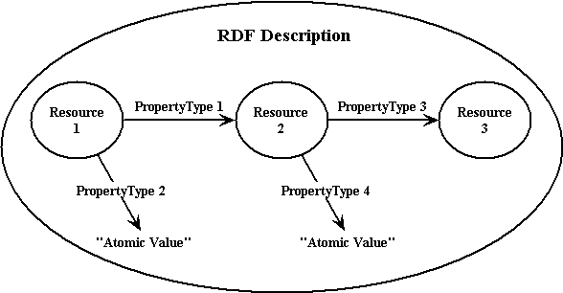
The RDF Data Model

Slide 5

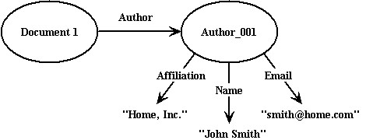
RDF Data Model Examples
“The author of Document 1 is John Smith”
Added Detail

Slide 6

Data Models → RDF Syntax
RDF representation
<?xml:namespace ns = "http://www.w3.org/RDF/RDF/" prefix ="RDF" ?>
<?xml:namespace ns = "http://purl.oclc.org/DC/" prefix = "DC" ?>
<RDF:RDF>
<RDF:Description RDF:HREF = "http://uri-of-Document-1">
<DC:Creator>John Smith</DC:Creator>
</RDF:Description>
</RDF:RDF>

Slide 7
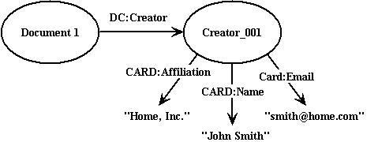
<?xml:namespace ns = "http://www.w3.org/RDF/RDF/" prefix = "RDF” ?>
<?xml:namespace ns = "http://purl.oclc.org/DC/" prefix = "DC" ?>
<?xml:namespace ns = "http://person.org/BusinessCard/" prefix = "CARD" ?>
<RDF:RDF>
<RDF:Description RDF:HREF = "http://uri-of-Document-1">
<DC:Creator RDF:HREF = "#Creator_001"/>
</RDF:Description>
<RDF:Description ID="Creator_001">
<CARD:Name>John Smith</CARD:Name>
<CARD:Email>smith@home.net</CARD:Email>
<CARD:Affiliation>Home, Inc.</CARD:Affiliation>
</RDF:Description>
</RDF:RDF>

Slide 8
DAML+OIL
(DARPA Agent Markup Language + Ontology Interchange Language)
Homepage: http://www.daml.org/
Useful documentation
  Example
    http://www.daml.org/2001/03/daml+oil-ex
  Syntax spec
    http://www.daml.org/2001/03/daml+oil
  Semantics spec
    http://www.daml.org/2001/03/model-theoretic-semantics
  Axiomatization (Fikes and McGuinness)
    http://www.ksl.stanford.edu/people/dlm/daml-semantics/abstract-axiomatic-semantics.html
  Reference Description
    http://www.daml.org/2001/03/reference.html
  RDF Spec
    http://www.daml.org/2001/03/daml+oil.daml

Slide 9
SUO (Standard Upper Ontology)
Homepage: http://suo.ieee.org
Suggested Upper Merged Ontology (SUMO)
  KIF-based
  Useful documentation
    http://ontology.teknowledge.com
    Overview doc
      http://ontology.teknowledge.com:8080/rsigma/FormalSUOdraft.rtf
IFF Foundation Ontology
  Category theoretic
  Useful (sic?) documentation
    http://suo.ieee.org/IFF

Slide 10
Common Logic
Homepage: http://cl.tamu.edu
Useful documentation
  Syntax and Semantics (technical)
    HTML: http://cl.tamu.edu/discuss/cl-syntax-semantics.html
    PDF: http://cl.tamu.edu/discuss/cl-syntax-semantics.pdf
  KIF implementation of CL
    Hayes/Menzel: “A Semantics for the Knowledge Interchange Format”
      http://reliant.teknowledge.com/IJCAI01/HayesMenzel-SKIF-IJCAI2001.pdf

Slide 11
CYC
Homepage: http://www.cyc.com
CYC-Hype
  “The Cyc product family is powered by an immense multi-contextual knowledge base and an efficient inference engine. The knowledge base is built upon a core of over 1,000,000 hand-entered assertions (or "rules") designed to capture a large portion of what we normally consider consensus knowledge about the world. For example, Cyc knows that trees are usually outdoors, that once people die they stop buying things, and that glasses of liquid should be carried rightside-up.”
Useful Documentation
  Intro to Cyc
    http://www.cyc.com/cyc-2-1/intro-public.html
  CYC Ontology Guide: Table of Contents
    http://www.cyc.com/cyc-2-1/toc.html
  CYC Top-level VocabularyGeneral Medicine Vocabulary
    http://www.cyc.com/cyc-2-1/vocab/top-vocab.html
  General Medicine Vocabulary
    http://www.cyc.com/cyc-2-1/vocab/general-medicine-vocab.html

