Slide 1







national center for ontological research

Slide 2
Part One: The History of NCOR and ECOR
Part Two: How to Establish JCOR: The Japanese Consortium for Ontological Research

Slide 3
national center for ontological research

Slide 4
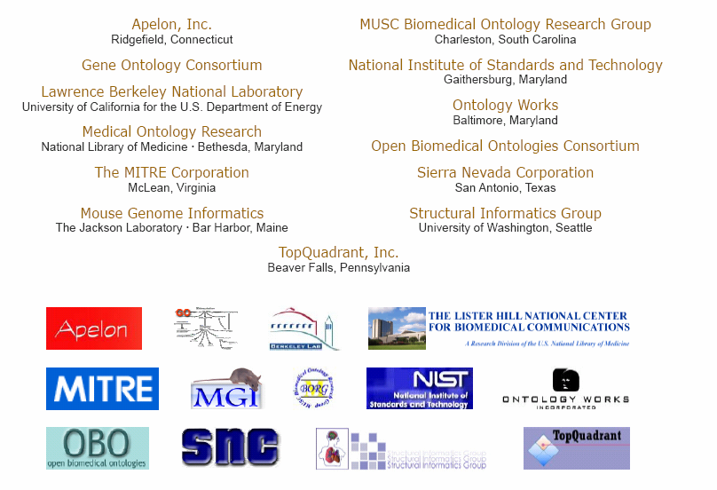

Slide 5
Ontologies (tech.)
Standardized classification systems which enable data from different sources to be combined
Ontology (phil.)
A theory of the types of entities existing in a given domain of reality, and of the relations between these types

Slide 6
Types have instances
Ontologies are about types
Diaries, databases, clinical records are about instances

Slide 7
The need
strong general purpose classification hierarchies created by domain specialists
clear, rigorous definitions
thoroughly tested in real use cases
can teach us about instances by supporting cross-disciplinary reasoning about types

Slide 8
The actuality (too often)
myriad special purpose ‘light’ ontologies, prepared by ontology engineers and deposited in internet ‘repositories’ or ‘registries’

Slide 9
often do not generalize …
repeat work already done by others
are not interoperable
reproduce the very problems of communication which ontology was designed to solve
contain incoherent definitions
and incoherent documentation

Slide 10
Signs of hope
founding of National Center for Biomedical Ontology (an NIH Roadmap Center)
http://ncbo.us

Slide 11
National Center for Biomedical Ontology
$18.8 mill. NIH Roadmap Center
Stanford Medical Informatics
University of San Francisco Medical Center
Berkeley Drosophila Genome Project
Cambridge University Department of Genetics
The Mayo Clinic
University at Buffalo Department of Philosophy

Slide 12
Signs of hope
OBO (Open Biomedical Ontologies) ontology library – obo.sourceforge.net
OBO Foundry Project
new logic-based criteria for inclusion
ontology developers agree in advance to accept a growing set of best practices in ontology development

Slide 13
ECOR
European Center for Ontological Research
Founders: Barry Smith and Werner Ceusters
Current President: Nicola Guarino

Slide 14
ECOR Partner Institutions
Laboratory for Applied Ontology, Trento/Rome
Center for Theoretical and Applied Ontology, Turin
Foundational Ontology Group, University of Leeds
other partners

Slide 15
Other developments
Ontolog Forum (US)
Australasian Ontology Consortium
Canadian Center for Ontological Research

Slide 16
Members of OBO Foundry Project
Gene Ontology
National Cancer Institute Thesaurus
Cell Ontology
ChEBI (Chemical Entities of Biological Interest)

Slide 17
Members of OBO Foundry Project
FuGO (Functional Genomics Investigation Ontology)
  The MGED Ontology Working Group (microarray)
  The MGED RSBI Working Group (toxicogenomics, environmental genomics, nutrigenomics)
  PSI General Proteomics Standards
  Metabolomics Society Ontology Working Group
  Flow cytometry

Slide 18
OBO Foundry Principles

Slide 19
The groups involved will document disagreements which arise and engage in good faith efforts to resolve them.
The ontology is open and available to be used by all
The ontology is in, or can be instantiated in, a common shared syntax. See: http://obo.sf.net/
The ontology possesses a unique identifier space.
The ontology provider has procedures for identifying distinct successive versions.
The ontology is well-documented.
The ontology has a plurality of independent users.
The ontology has clearly specified and clearly delineated content.
The ontology includes textual definitions for all terms.
The ontology uses relations which are unambiguously defined following the pattern of definitions laid down in the OBO Relation Ontology.

Slide 20
Why NCOR?
NCOR will
advance ontology as science
advance ontology education inter alia through internships and partnerships
develop measures of quality for ontologies to establish best practices

Slide 21
Why NCOR?
NCOR will
provide coordination and support for investigators working on theoretical ontology and its applications
engage in outreach endeavors designed to foster the goals of high quality ontology in both theory and practice
NCOR Wiki: http://ontologist.org

Slide 22
Philosophy as the mother of the disciplines
Aristotelian natural philosophy → Physics, Biology
Kantian philosophy of mind → Psychology
Frege’s philosophical logic → Mathematical Logic → Computer Science

Slide 23
Ontology (science)
A theory of the types of entities existing in a given domain of reality, and of the relations between these types

Slide 24
Philosophy as the mother of the disciplines
Aristotelian natural philosophy → Physics, Biology
Kantian philosophy of mind → Psychology
Frege’s philosophical logic → Mathematical Logic → Computer Science
Ontology (Science) born October 27, 2005

Slide 25
Part Two
How to Found the Japanese Consortium for Ontological Research

Slide 26
1. Create a small steering committee
Barry Smith (Buffalo)
Mark Musen (Stanford)

Slide 27
2. Choose a Name

Slide 28
3. Choose a Mission Statement
Create ontology as a science
Coordinate ontology development efforts
Federal Government Ontology Architectures

Slide 29
4. Organize and Advertize an Inaugural Meeting

Slide 30
October 27, 2005
2:00 pm - 5:00 pm
Barry Smith (Director, NCOR-Buffalo)
Introduction and Welcome
John Walker (U.S. National Security Agency)
Ontology and National Security
Brand Niemann (U.S. Environmental Protection Agency)
Towards e-Government:
The Federal Enterprise Architecture Reference Ontology
Mark Musen (Director, NCOR-Stanford)
The National Center for Biomedical Ontology
Werner Ceusters (ECOR)
Ontology: The Need for International Coordination

Slide 31
5. Approach Potential Partners

Slide 33
6. Create a website
http://ncor.us

Slide 34
7. Raise funding for
training of ontologists
support for ontology coordination
focused ontology research efforts

Slide 35
8. Journal, Newsletter, Meetings
Applied Ontology
International Ontology Coordination

Slide 36
1. Create a small steering committee
2. Choose a name
3. Choose a mission statement
4. Organize and advertize an inaugural meeting
5. Approach potential partners
6. Create a website
7. Raise funding
8. Journal, newsletter, meetings

