Slide 2
approaches
1. sweb.umls – what we have at the moment
2. industrial monolith
3. go
all need a benchmark – what should it be?
2. HL7
3. biological reality

Slide 3
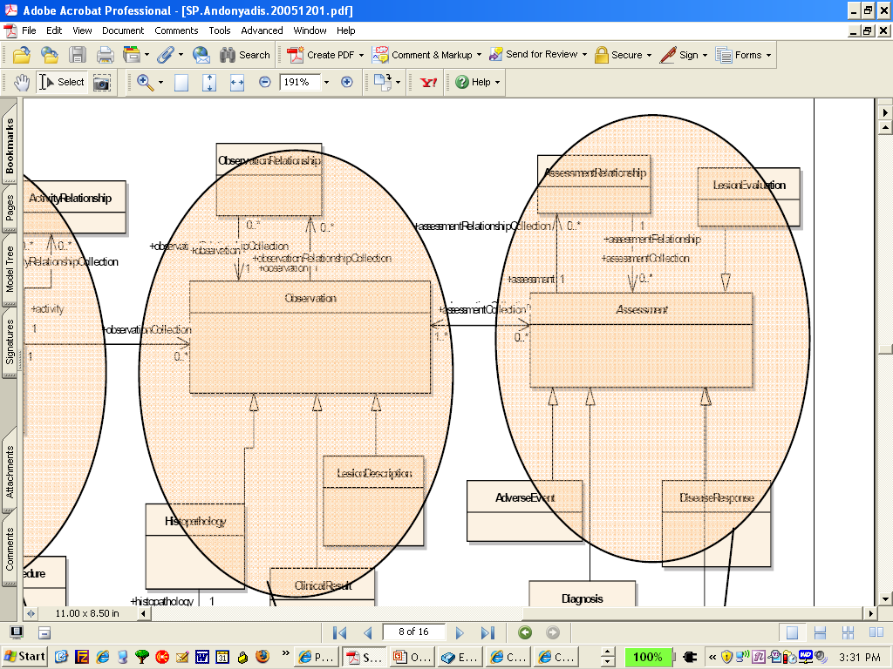
what does is_a mean?
Notes:
http://rd100.cceb.med.upenn.edu/crcu_html/roadmap/mtgs/dec_steering_2005/SP.Andonyadis.20051201.pdf

Slide 4
Information on CDISC's website that describes the relationship of CDISC and others (i.e. FDA, HL7). I've copied it here for you.
Will the CDISC SDTM be mandated by the US Food and Drug Administration?
What is the relationship between CDISC and Health Level Seven (HL7)?
What is the relationship between CDISC and FDA?
What should I do if I want to make a regulatory submission to FDA using CDISC standards?
Clinical Data Acquisition Standards Harmonization Initiative
From the FDA website, opportunity #45: Private efforts to streamline clinical trial data collection through voluntary standardization of case report forms (CRFs) have recently been formalized under the auspices of the Clinical Data Acquisition Standards Harmonization (CDASH) Initiative. Catalyzed by CDISC and the Association of Contract Research Organizations (ACRO), dozens of product sponsors, investigators, data managers and other stakeholders are working together to agree on a core set of data collection fields to support clinical research studies (i.e., creation of consensus CRFs and implementation guides for four "safety data/domains": adverse events, prior medications, concomitant medications, demographics and subject characteristics). FDA is providing input on issues as requested (e.g., FDA requirements). The CDASH process is open to any participant and will include a public comment process.
Electronic Case Report Form Submission: Notice of Pilot Project
FDA Information / Documentation Relevant to CDISC
Good information on various CDISC initiatives, such as proposed FDA rules, ongoing / past pilot programs.
In the CDER Data Standards Manual, there are references to CDISC adoption. Here's an example of one data element (country code) that states the FDA's data standards should be compatible with CDISC and HL7.

Slide 5
HL7 adopts anything which expands momentum
so CDISC was incorporated with RCRIM = regulated research stuff,
HL7 got its start with FDA and pharma
BRIDG = way for both HL7 and CDISC to say they are working together but while keeping separate
HL7 Clinical Genomics SIG -- ELKIN on caBIG -- no tissue in caBIG -- SAIC wrote this\\
Elkin on interoperability

Slide 6
registering scientific information
http://users.sdsc.edu/~ludaesch/Paper/scisw03-seek.pdf
IUIs

Slide 7
gov.nih.nci.cadsr.domain
Class Person
java.lang.Object gov.nih.nci.cadsr.domain.Person
All Implemented Interfaces:
  java.io.Serializable
Direct Known Subclasses:
  PersonImpl
public class Person
extends java.lang.Object
implements java.io.Serializable
Information about a contact person
See Also:
  Serialized Form

Slide 8
Ontology spectrum
Controlled vocabularies
Database schema (relational, XML, …)
Conceptual schema (ER, UML, … )
Thesauri (synonyms, broader term/narrower term)
Taxonomies
Informal/semi-formal representations
“Concept spaces”, “concept maps”
Labeled graphs / semantic networks (RDF)
Formal ontologies, e.g., in [Description] Logic (OWL)
“formalization of a specification”
constrains possible interpretation of terms
What is an ontology? An ontology usually …
specifies a theory (a set of models) by …
defining and relating …

Slide 9
http://www.etrials.com/resource_library/white_papers/use_cdisc_format.php
http://www.cdisc.org/about/index.html
http://www.cdisc.org/models/odm/v1.3/final/ODM1-3-0-foundation.xsd

Slide 10
CDASH
http://www.cdisc.org/standards/cdash/index.html

Slide 11
BRIDG
cabig software standardization process
LOINC
LOINC
Logical Observation Identifiers Names and Codes – applies universal code names and identifiers to medical terminology related to the Electronic Health Record and assists in the electronic exchange and gathering of clinical results (such as laboratory tests, clinical observations, outcomes management and research).
CDISC
c-tom
MedDRA

Slide 12
Gunther:
‘A complete and integrated ontology of everything would certainly be nice to have; however, we think it is impractical and dangerous to force such a model into being independently of the RIM. The moment such a model gained traction people would then expect that the RIM reflect that other model. Why should there be two models, if in the end one is to reflect the other? Instead, a single model of real world objects should suffice, but must contain well-defined features for information-management functions.’

Slide 13
Gunther (paraphrased):
HL7 has created a clunky ontology which is full of gaps which force strange and arbitrary seeming choices; however, it would be impractical and dangerous to complete it to create a more coherent framework. The single HL7 model must suffice, even with its strange rules for information-management functions which make the documentation so difficult to understand.

Slide 14
"Optionality is a Four-Letter Word"
The limitation, if not elimination, of ‘optionality; is a primary goal of HL7 version 3. (MDM document, section 1.4.3)
pervasive preference for specialization by restriction, supported by the erection of complex superstructures of conditionals, in the "message" development process.
underutilization of composition in creation of domain classes.

Slide 15
Lessons for the Future
Establish standards only after thorough pilot testing
Encourage criticism and open discussion
Create clear documentation under expert supervision
Avoid attempting to impose untested systems like the RIM across entire nations from the top down

Slide 16
This philosophy is in direct opposition to the philosophy of modern object-oriented development, which is based on the principle that the inheritance mechanism should be invoked to support extensions of, not constraints upon, progenitor classes.

Slide 17
for an object-oriented developer
inheritance hierarchies with complex ("Rube Goldberg") constraint mechanisms, is an indication that the top-level classes were poorly suited to the use case to begin with

Slide 18
Lessons for the Future
Establish standards only after thorough pilot testing
Encourage criticism and open discussion
Create clear documentation under expert supervision
Avoid attempting to impose untested systems like the RIM across entire nations from the top down

Slide 19
This philosophy is in direct opposition to the philosophy of modern object-oriented development, which is based on the principle that the inheritance mechanism should be invoked to support extensions of, not constraints upon, progenitor classes.

Slide 20
for an object-oriented developer
inheritance hierarchies with complex ("Rube Goldberg") constraint mechanisms, is an indication that the top-level classes were poorly suited to the use case to begin with

Slide 21
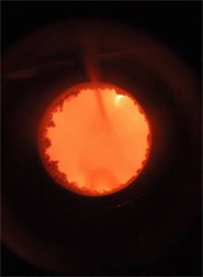
An ontology is a representation of universals
We learn about universals in reality from looking at the results of scientific experiments in the form of scientific theories
experiments relate to what is particular
science describes what is general

