Slide 1
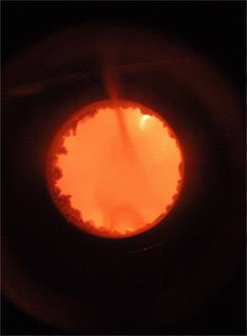
Why a Credit Card Number is Not a Number
Barry Smith
http://ontology.buffalo.edu/smith

Slide 2
Why Lite Ontologies will Not Even Work for Cataloging Your Collection of Favorite Rock Bands
Barry Smith
http://ontology.buffalo.edu/smith

Slide 3
Ontology for the Intelligence Community: A Strategy for the Future
Barry Smith
http://ontology.buffalo.edu/smith

Slide 4
Semantic Web, wikis, statistical textmining, etc.
  let a million flowers bloom
How create broad-coverage semantic annotation systems which will enable sharing of gigantic bodies of heterogeneous data?

Slide 5
  let a million flowers (weeds) bloom
how create broad-coverage semantic annotation systems which will enable sharing of gigantic bodies of heterogeneous data?

Slide 6
Unified Medical Language System
(National Library of Medicine)
built by trained experts
massively useful for information retrieval and information integration
creates out of PubMed literature a huge semantically searchable space (much better than Semantic Wiki …)

Slide 7
for UMLS
local usage respected, regimentation frowned upon
mappings between ‘synonyms’ full of noise
is_synonymous_with is not transitive
no cross-framework consistency
no concern to establish consistency with basic science
different grades of formal rigor, different degrees of completeness, different update policies

Slide 8
with UMLS-based annotations
we can know what data we have (via term searches)
we can map between data at single granularities (via ‘synonyms’)
can’t combine data
can’t resolve (or even identify) logical conflicts
can’t reason with data

Slide 9
with UMLS, Web 2.0, ...
no evolutionary path towards improvement

Slide 10
We will be able to use ontologies to help us share data
only if the ontologies represent the world correctly
are humanly intelligible
and computationally tractable
and work well (and thus evolve) together, under adult supervision

Slide 11
A new approach
prospective standardization based on objective measures of what works
bring together selected groups to agree on and commit to good terminology / annotation habits preemptively

Slide 12
for science
ensure legacy annotation efforts not wasted
create an evolutionary path towards improvement, of the sort we find in science
a collaborative, community effort to ensure buy-in
with rewards for participation
Requirements

Slide 13
for science
Create a consensus core of interoperable domain ontologies
starting with low hanging fruit and working outwards from there
built and validated by trained experts
backed by persons of influence in different communities

Slide 14
This solution is already being implemented in the domain of biomedicine

Slide 15
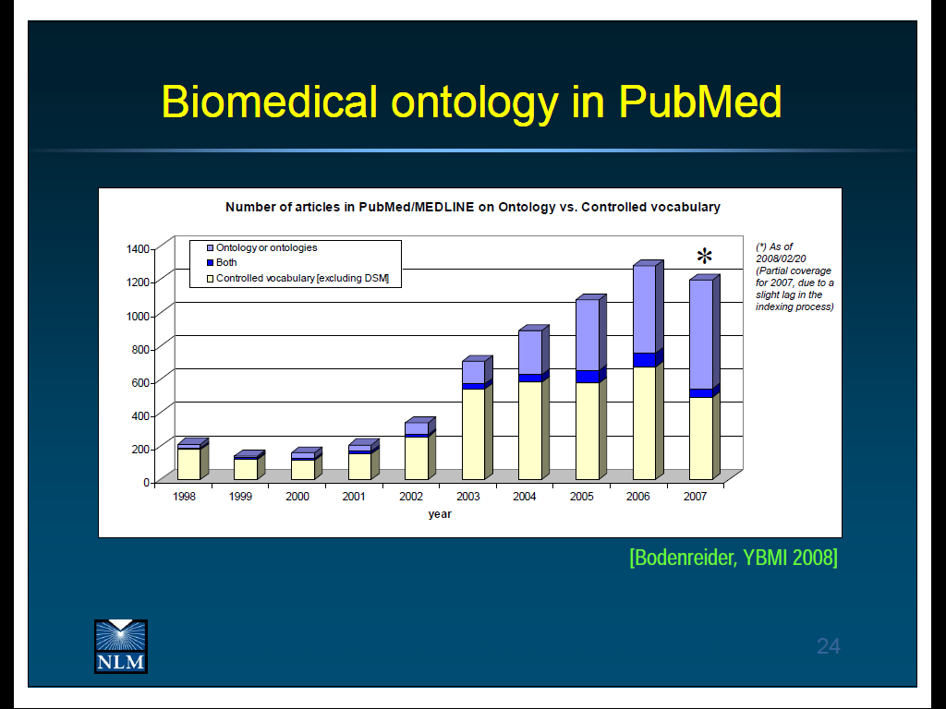
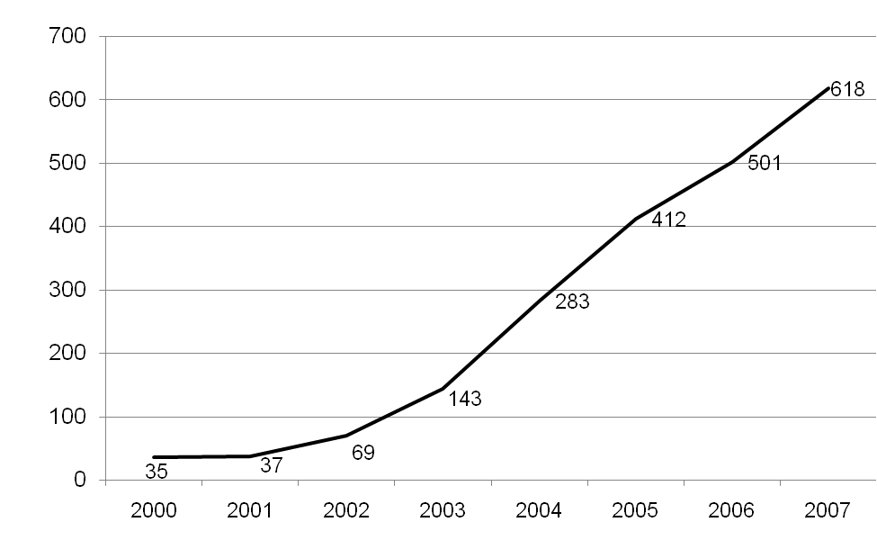
Uses of ‘ontology’ in PubMed abstracts

Slide 16
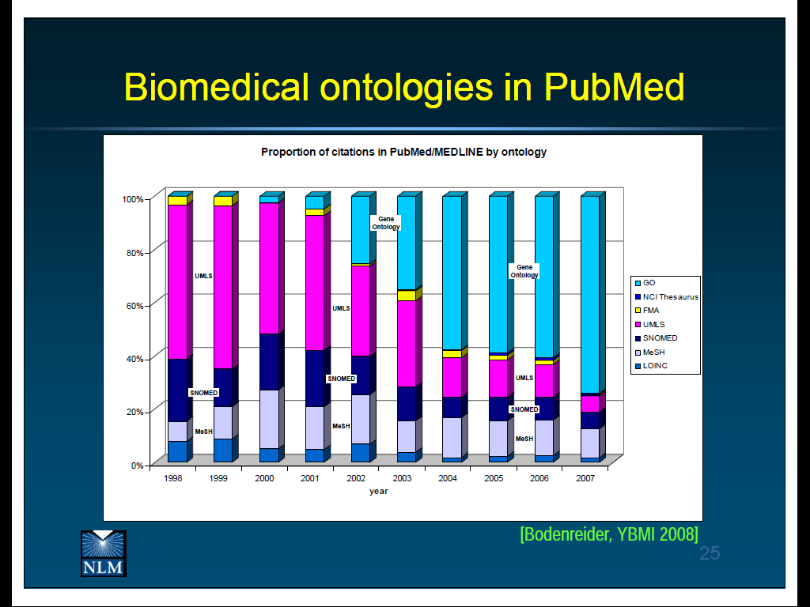
By far the most successful: GO (Gene Ontology)

Slide 17
a family of interoperable gold standard biomedical reference ontologies, based on the GO, designed to serve the annotation of
  scientific literature
  biological research data
  clinical data
  public health data
The OBO Foundry

Slide 18
RELATION TO TIME GRANULARITY | CONTINUANT |  |  |  | OCCURRENT
 | INDEPENDENT |  | DEPENDENT
ORGAN AND ORGANISM | Organism (NCBI Taxonomy) | Anatomical Entity (FMA, CARO) | Organ Function (FMP, CPRO) | Phenotypic Quality (PaTO) | Biological Process (GO)
CELL AND CELLULAR COMPONENT | Cell (CL) | Cellular Component (FMA, GO) | Cellular Function (GO)
MOLECULE | Molecule (ChEBI, SO, RnaO, PrO) |  | Molecular Function (GO) |  | Molecular Process (GO)
The Open Biomedical Ontologies (OBO) Foundry

Slide 19
 | CONTINUANT |  |  |  | OCCURRENT
 | INDEPENDENT |  | DEPENDENT
ORGAN AND ORGANISM | Organism (NCBI Taxonomy) | Anatomical Entity (FMA, CARO) | Organ Function (FMP, CPRO) | Phenotypic Quality (PaTO) | Organism-Level Process (GO)
CELL AND CELLULAR COMPONENT | Cell (CL) | Cellular Component (FMA, GO) | Cellular Function (GO) |  | Cellular Process (GO)
MOLECULE | Molecule (ChEBI, SO, RnaO, PrO) |  | Molecular Function (GO) |  | Molecular Process (GO)
RELATION TO TIME
GRANULARITY
OBO Foundry ontology modules

Slide 20
in the intelligence domain, too:
geospatial transport religion biometrics | demographics ethnics politics law
use common rules drawing on best practices for creating these ontologies ... and for linking them together

Slide 21
for science
geospatial transport religion weather | bacteria chemicals politics law
... exploiting the division of labor
... relying on champions in dispersed communities to spread the words

Slide 22
Obstacles to the realization of Ontology Modularity in the Intelligence Domain

Slide 23
Too few knowledgeable folks, and fewer cleared.
Computer scientists are teaching people ontology tools and ...
Paris has_temperature 62º
Mohammed is_a string
Amount of money is_a integer
Currency has_unit $
Nuclear weapon is_a concept
with thanks to Jen Williams, Ontology Works Inc.

Slide 24
What we need 1
thoroughly tested, mandated, common top-level ontology to promote interoperability
institutions for ontology standardization

Slide 25
What we need 2
Professional training for ontologists
to teach people to CREATE ONTOLOGY CONTENT
to teach people to USE ONTOLOGY CONTENT

Slide 26
What we need 3
Greater organization:
Division of labor for ontology modules plus
Authorities governing
rules for ontology development, versioning, modularity
ensuring interoperability
filling in gaps
sustainability

Slide 27
What we need 4
ontology evaluation with teeth
if ontology (science) is to be born, ontologies must die

Slide 28
Ontology needs to become more like a science
basis in evidence
established results – authoritative ontologies*
credit for good ontology work

Slide 29
Ucore Conceptual Data Model
In process of adoption by DoD, DoJ, DHS
http://www.gcn.com/print/27_20/46900-1.html?page=1
Army-Funded NCOR project to create UCore Semantic Layer

Slide 30
Treat ontologies like publications
Nature Signaling, Nature Pathway Interactions
Nature Ontologies ?
Ontologies subjected to a process of expert peer review
Peer review methodology being tested within the OBO Foundry

Slide 31
Peer review evaluation process
Required where the quality of inputs cannot be evaluated mechanically

Slide 32
Peer review assessment tasks
Is the ontology consistent with the policies on modularity?
Does the ontology provide adequate coverage of the defined domain?
To what level is inferencing supported in the ontology relations structure?
Does the ontology interoperate with other ontologies in the system

Slide 33
Is the ontology being developed collaboratively through the engagement and participation of relevant domain stakeholders and developers of neighboring ontologies?
Does the ontology have a tracker for submissions of new terms and notification of errors?
Does the ontology have a help desk which has prompt response times?

Slide 34
Verify syntactical correctness, either OBO-Format or OWL-DL, or FOL or some combination.
Is a URI assigned to each term of the ontology? Does the URI point to required metadata for this term (including definition).
Verify uniqueness of all identifiers and preferred terms
Verify correctness of all asserted subclass relations

Slide 35
Information Artifact Ontology
http://code.google.com/p/information-artifact-ontology/

Slide 36
What is a credit card number?
– not a mathematical object
– not a contingent object with physical properties, taking part in causal relations
– but a historical object, with a very special provenance, relations analogous to those of ownership, existing only within a nexus of working financial institutions of specific kinds

Slide 37
Basic Formal Ontology (BFO)
Continuant
Occurrent
process
Independent
Continuant
thing
Dependent
Continuant
quality, role,
function …
.... ..... .......

Slide 38
Blinding Flash of the Obvious
Continuant
Occurrent
process
Independent
Continuant
thing
Dependent
Continuant
quality
quality depends
on bearer
.... ..... .......

Slide 39
What is a datum?
Continuant
Occurrent
process
Independent
Continuant
laptop, book
Dependent
Continuant
quality
datum: a pattern in some medium with a certain kind of provenance
.... ..... .......

Slide 40
Continuant
Occurrent
Independent
Continuant
Dependent
Continuant
Action
creating a datum
Information
Entity
.... ..... .......

Slide 41
Generically Dependent Continuants
Generically
Dependent
Continuant
if one bearer ceases to exist, then the entity can survive, because there are other bearers (copyability)
the pdf file on this laptop
the DNA (sequence) in that chromosome
Information
Entity
Sequence

Slide 42
Generically Dependent Continuants
Generically
Dependent
Continuant
Information
Artifact
Gene
Sequence
.pdf file
.doc file
instances

Slide 43
Transcriptomics (MIAME Working Group)
Proteomics (Proteomics Standards Initiative)
Metabolomics (Metabolomics Standards Initiative)
Genomics and Metagenomics (Genomic Standards Consortium)
In Situ Hybridization and Immunohistochemistry (MISFISHIE Working Group)
Phylogenetics (Phylogenetics Community)
RNA Interference (RNAi Community)
Toxicogenomics (Toxicogenomics WG)
Environmental Genomics (Environmental Genomics WG)
Nutrigenomics (Nutrigenomics WG)
Flow Cytometry (Flow Cytometry Community)
IAO adopted, and being violently tested, inter alia, by:

