Slide 1
BFO/MedO:
Basic Formal Ontology and Medical Ontology
Draft 0.0004 (17.6.02)

Slide 2
Basic Formal Ontology
consists in a series of sub-ontologies (most properly conceived as a series of perspectives on reality), the most important of which are:
SnapBFO, a series of snapshot ontologies (O_{ti} ), indexed by times
SpanBFO a single videoscopic ontology (O_{v}).

Slide 3
SNAP and SPAN
Each O_{ti} is an inventory of all entities existing at a time.
O_{v} is an inventory (processory) of all processes unfolding through time.
(Each O_{ti} is thus analogous to anatomy; O_{v} is analogous to physiology.)

Slide 4
SNAP and SPAN
Each snapshot ontology represents a presentistic assay of the entities existing at some given present instant.
O_{v} is a (God’s eye) partition of the totality of processes.

Slide 5
Granularity
Both SnapBFO and SpanBFO will serve as basis for a series of sub-ontologies at different levels of granularity.
The same portion of reality may appear at a plurality of levels of granularity. Thus masses at one level may be aggregates at another level.
What counts as a unitary process at one level may be part of a process-continuum at another level.

Slide 6
BFO applied to Medicine
What follows is a preliminary taxonomic tree (inspired in part by LADSEB work)
examples of medical entities are indicated in green as a first step towards expanding BFO to MedO

Slide 7
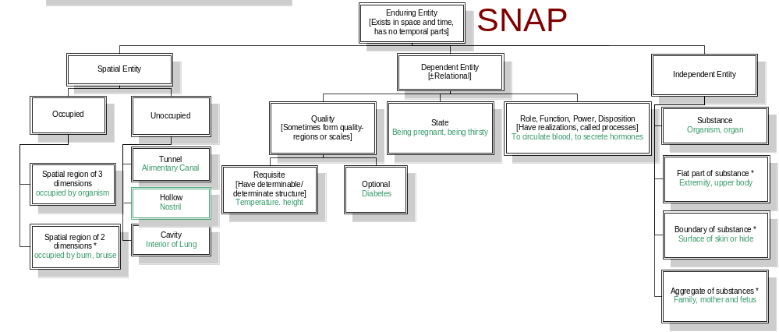
SNAP: Entities existing in toto at a time

Slide 8
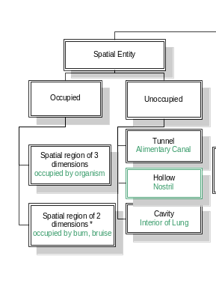

Slide 9
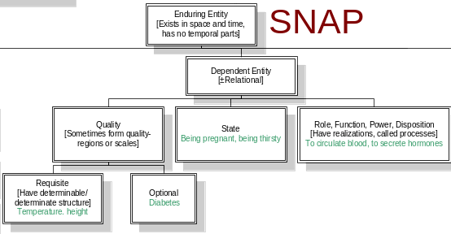

Slide 10
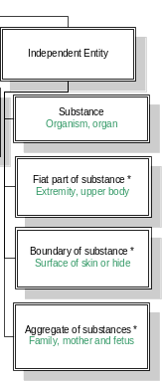
SNAP

Slide 11
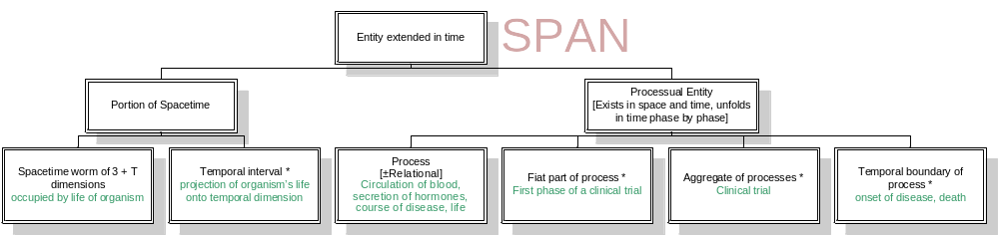
SPAN: Entities extended in time

Slide 12
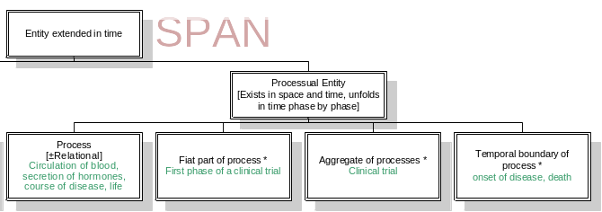
SPAN: Entities extended in time

Slide 13
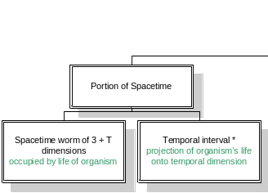
SPAN: Entities extended in time

Slide 14
Each ontology above represents some partition of reality into categories or universals. Individual instances (tokens) are to be conceived as being located in cells of the diagrams.

Slide 15
  The ontologies here indicated are partial only (they are windows on just that portion of reality which is visible through the given ontology).

Slide 16
Double-Counting
A cell labeled * within a given ontology represents a category division which involves some double-counting in relation to the categories within the same ontology represented by cells not so labeled.

Slide 17
For example here

Slide 18
Spatial Regions
The spatial regions acknowledged by SnapBFO are, on the mesoscopic level of granularity, the sorts of domesticated spatial regions referred to by expressions such as:
‘in the room’, ‘in the lung’, ‘on the table’, ‘in Poland’ etc.
(Thus they are not the abstract spatial regions investigated by physics.)

Slide 20
Free and bound portions of space
Free portions of space are spatial regions of the same (domesticated) kind but with no physical boundaries or retainers (such as walls, floor, ceiling).
Bound portions of space can be bound either completely, as in the case of a closed room or an air-bubble inside your body, or partially, as in the case of a birdcage or nostril.

Slide 21
Free and bound portions of space
Both free and bound portions of space retain their identity from one instant to the next even though they are projected in succession onto distinct abstract spatial regions in the physicist’s sense (just as substances retain their identity from one instant to the next even though they are projected in succession on distinct aggregates of molecules).

Slide 22
Behavior Settings
The spatiotemporal regions acknowledged by SpanBFO are similarly regions determined by domesticated portions of space over (for example) clock or calendar time. They are the spatiotemporal regions occupied by behavior settings in Roger Barker’s sense (the 5pm train to Long Island, the early morning swim, your meeting with the Dean).

Slide 23
SPAN: Entities extended in time

Slide 24
Relational Dependent Entities
Dependent entities, both within the SNAP and within the SPAN ontologies, are divided into:
relational (for entities dependent on a plurality of entities)
and non-relational (for entities dependent on a single entity).

Slide 25
Problems
How are entities visible in the SPAN ontology related to entities visible in the SNAP ontologies (e.g. via dependence, participation, initiation, sustaining in being,etc.)
How are entities visible in ontologies at different levels of granularity related to each other (most importantly: as part to whole)

