Slide 1
VT

Slide 2
IFOMIS
Institute for Formal Ontology and Medical Information Science
Faculty of Medicine
University of Leipzig
http://ifomis.de

Slide 3
Reference Ontology
An ontology is a theory of a domain of entities in the world
Ontology is outside the computer
seeks maximal expressiveness and adequacy to reality
and sacrifices computational tractability for the sake of representational adequacy

Slide 4
Reference Ontology
rejects Gruber’s doctrine of minimal ontological commitment
-- this doctrine has been a disaster e.g. in medical informatics ontology
(it will cause further disasters in Semantic Web ontologies)

Slide 5
Reference Ontology
a theory of reality
designed as quality control for
database/terminology systems

Slide 6
Methodology
Get ontology right first
(realism; descriptive adequacy; rather powerful logic);
solve tractability problems later

Slide 7
The Reference Ontology Community
IFOMIS (Leipzig)
Laboratories for Applied Ontology (Trento/Rome, Turin)
Foundational Ontology Project (Leeds)
Ontology Works (Baltimore)
Ontek Corporation (Buffalo/Leeds)
Language and Computing (L&C) (Belgium/Philadelphia)

Slide 8
Two basic BFO oppositions
Granularity
(of molecules, genes, cells, organs, organisms ...)
SNAP vs. SPAN
getting time right of crucial importance for medical informatics

Slide 9
Research projects
UMLS – Universal Medical Language System
“Leipzig is an idea or concept”
“An Amino Acid Sequence is an idea or concept”
“A human being is a physical entity”
“A finger is an idea or concept”
“A physician is a group”

Slide 10
Research projects
ISO Standardization

Slide 11
User Ontologies for Adaptive Interactive Software Systems
The problem: to extract information about users in a form that can be exploited by adaptive software.

Slide 12
1. types of users
2. characteristics of users
a. permanent (independent of experience with the software system)
b. variable
i. change independently of use of system
(for example: age, disease state)
ii. change with experience of use of system
3. types of user behavior
a. behavior independent of the system
b. behavior involving the system
i. types of system use (keyboard actions, etc.)
ii. other behavior involving the system (rejection, etc.)
4. contexts/environments of users
a. contexts independent of the system
b. contexts of system use

Slide 13
The Theory of Granular Partitions
Grids
Theory of Grain-Size
-- relevance to issue of disambiguation
Mappings
Knowledge-increase
vs. Closed World Assumption
Complete and incomplete partitions

Slide 14
Mereotopological Theories for Medical Ontology
Parts of anatomy of the human body
Parts of physiology of the human body
→ Formal Theories for Layered Structures

Slide 15
The Ontology of the Gene Ontology
Medical Ontology and Medical Anthropology
Foundations of Spatiotemporal Ontology

Slide 16
Testing the BFO/MedO approach
collaboration with
Language and Computing nv (www.landcglobal.be)

Slide 17
L&C Technology
‘Semantic Indexing for Smart Information Retrieval and Extraction’

Slide 18
L&C Technology
FreePharma®, L&C’s natural language analyzer for converting free text (spoken or typed) prescription and pharmacology information into XML.
FastCode®, L&C’s automated clinical coding product for translation of free text strings into ICD, SNOMED, MedDRA, etc.
LinKBase®, the largest formal medical knowledge base in the world, representing medicine in such a way that it is understandable for a computer.
LinKFactory®, L&C’s product suite for developing and managing large formal multilingual ontologies.

Slide 19
L&C’s long-term goal
Transform the mass of unstructured free text patient records into a gigantic medical experiment

Slide 20
The Project
collaborate with L&C to show how a realist ontology constructed on the basis of philosophical principles can help in overhauling and validating the large terminology-based medical ontology LinkBase® used by L&C for NLP

Slide 21
IFOMIS’s long-term goal
Build a robust high-level BFO-MedO framework
THE WORLD’S FIRST INDUSTRIAL-STRENGTH PHILOSOPHY
which can serve as the basis for an ontologically coherent unification of medical knowledge and terminology
and for quality control in medical informatics software

Slide 22
A language-independent ontology
an ontology of reality as it is independently of thought and language
realism about instances (objects, qualities, functions, & processes)
realism about universals/properties
mismatch between our concepts (expressed in any given language) and the universals existing in reality

Slide 23
IFOMIS
will provide the open source upper level framework for L&C’s large terminology based ontology
QUESTION: what language to use for this purpose?

Slide 24
Ontology:
A Generalization of Davidsonian Semantics
Notes:
Ontologie Eins Null

Slide 25
NOT ALL FORMALISMS ARE CREATED EQUAL
bad (over-weak, over-strong) formalisms lead to bad ontology

Slide 26
Armstrong’s
spreadsheet ontology

Slide 27
 | F | G | H | I | J | K | L | M | N | O | P | Q | R | S | T | U | V
a
b
c
d
e
f
g
h
i
j
k

Slide 28
 | F | G | H | I | J | K | L | M | N | O | P | Q | R | S | T | U | V
a |  |  | x |  | x |  |  |  | x | x | x
b
c
d
e
f
g
h
i
j
k

Slide 29
 | F | G | H | I | J | K | L | M | N | O | P | Q | R | S | T | U | V
a |  |  | x |  | x |  |  |  | x | x | x
b |  | x | x |  |  |  |  |  |  |  | x | x |  |  |  | x
c
d
e
f
g
h
i
j
k

Slide 30
 | F | G | H | I | J | K | L | M | N | O | P | Q | R | S | T | U | V
a |  |  | x |  | x |  |  |  | x | x | x
b |  | x | x |  |  |  |  |  |  |  | x | x |  |  |  | x
c |  | x | x |  |  |  |  |  |  |  |  |  | x | x | x
d
e
f
g
h
i
j
k

Slide 31
 | F | G | H | I | J | K | L | M | N | O | P | Q | R | S | T | U | V
a |  |  | x |  | x |  |  |  | x | x | x
b |  | x | x |  |  |  |  |  |  |  | x | x |  |  |  | x
c |  | x | x |  |  |  |  |  |  |  |  |  | x | x | x
d |  |  |  |  |  | x |  |  |  |  |  |  |  |  |  | x
e
f
g
h
i
j
k
and so on …

Slide 32
Fantology
The doctrine, usually tacit, according to which ‘Fa’ (or ‘Rab’) is the key to ontological structure
The syntax of first-order predicate logic is a mirror of reality
(Fantology a special case of linguistic Kantianism: the structure of language is they key to the structure of [knowable] reality)

Slide 33
Formal Ontology and Symbolic Logic
Great advances of Frege, Russell, Wittgenstein, Peano
(in logic, and in philosophy of mathematics)
Leibnizian idea of a universal characteristic
…symbols are a good thing

Slide 34
First-order logic
F(a), G(a)
R(a,b)
F(a) v G(a)
F(a) & G(a)
F(a) v ∃xR(a,x)

Slide 35
Booleanism
if F stands for a property and G stands for a property
then
F&G stands for a property
FvG stands for a property
not-F stands for a property
F→G stands for a property
and so on

Slide 36
Strong Booleanism
There is a complete lattice of properties:
self-identity
FvG
F G
F&G
non-self-identity

Slide 37
Strong Booleanism
There is a complete lattice of properties:
self-identity
FvG
not-F F G not-G
F&G
non-self-identity

Slide 38
Booleanism
responsible, among other things, for Russell’s paradox
Armstrong, D. Lewis free from Booleanism
With their sparse theory of properties

Slide 39
20th-Century Analytic Metaphysics
embraced Booleanism as the default position

Slide 40
that Lewis and Armstrong
arrived at their sparse view of properties against the solid wall of fantological Booleanist orthodoxy
is a miracle of modern intellectual history
analogous to a 5 stone weakling climbing up to breathe the free air at the top of Mount Everest with 1000 ton weights attached to his feet

Slide 41
leading them back, on this point,
to where Aristotelians were from the very beginning

Slide 42
Standard semantics
F stands for a property
a stands for an individual
properties belong to Platonic realm of forms
or
properties are sets of individuals for which F(a) is true (circularity)

Slide 43
Fantology infects computer science, too
here I will concentrate on the role of fantology within analytical metaphysics

Slide 44
Fantology
Works very well in mathematics
Platonist theories of properties here are very attractive

Slide 45
Fantology
Fa
All generality belongs to the predicate
‘a’ is a mere name
Contrast this with the way scientists use names:
The electron has a negative charge
DNA-Binding Requirements of the Yeast Protein Rap1p as selected In Silico from Ribosomal Protein Gene Promoter Sequences

Slide 46
For extreme fantologists ‘a’ leaves no room for ontological complexity
Hence: reality is made of atoms
Hence: all probability is combinatoric
Fantology reduces all complexity to Boolean combination
All true ontology is the ontology of ultimate universal furniture – the ontology of some future, perfected physics
Thus fantology is conducive to reductionism in philosophy

Slide 47
Fantology
Tends to make you believe in some future state of ‚total science‘
when the values of ‚F‘ and ‚a‘,
all of them,
will be revealed to the elect
(A science is a totality of propositions closed under logical consequence)

Slide 48
Fantological Mysterianism
Fa
noumenal view of particulars
Cf. Wittgenstein’s Tractatus (doctrine of simples)

Slide 49
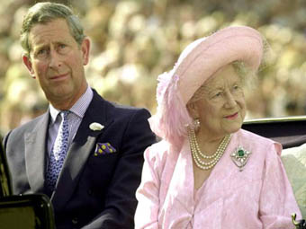
Fantology leads you to talk nonsense about family resemblances

Slide 50
Fantology
emphasizes the linguistic over the perceptual/physiognomic
(the digitalized over the analogue)

Slide 51
Fantology implies a poor treatment of relations
R(a,b)
in terms of adicity
What is the adicity of your headache (A relation between your consciousness and various processes taking place in an around your brain) ?

Slide 52
For the fantologist
“(F(a)”, “R(a,b)” … is the language for ontology
This language reflects the structure of reality
The fantologist sees reality as being made up of atoms plus abstract (1- and n-place) ‘properties’ or ‘attributes’

Slide 53
Fantology
Fa
To understand properties is to understand predication
(effectively in terms of functional application à la Frege)

Slide 54
The limitations of fantology
lead one into the temptations of possible world metaphysics,
and other similar fantasies

Slide 55
Fantology leads one to talk nonsense about possible worlds
Definition: A possible world W is a pair (L,D) consisting of a set of first-order propositions L and a set of ground-level assertions D. …
Informally, the set L is called the laws of W, and the set D is called the database of W. Other informal terms might be used: L may be called the set of axioms or database constraints for W.
(John Sowa)

Slide 56
Fantology and time
Fa
No clear way to deal with time and tense
(Set theory neglects the dimension of time)

Slide 57
Fantology
(given its roots in mathematics)
has no satisfactory way of dealing with time
hence leads to banishment of time from the ontology
(as in Quine’s and Armstrong’s four-dimensionalism)

Slide 58
The alternative to fantology
‘a’ in ‘F(a)’ refers to something that is complex
Thus we must take the spatiality and materiality and modular complexity and temporality of substances seriously
Mereology plus granularity plus theory of spatial extension plus dimension of TIME

Slide 59
Strange goings on!
Jones did it slowly, deliberately, in the bathroom, with a knife, at midnight. What he did was butter a piece of toast.
There is an action x such that Jones did x slowly and Jones did x deliberately and Jones did x in the bathroom:
∃x Did(Jones, x)

Slide 60
Solution
not FOPL
but FOLWUT
first-order logic with universal terms

Slide 61
A better syntax
variables x, y, z … range over
universals and particulars
predicates stand only for FORMAL relations such as instantiates, part-of, connected-to, is-a-boundary-of, is-a-niche-for, etc.
FORMAL relations are not extra ingredients of being
(compare jigsaw puzzle pieces and the relations between them)

Slide 62
FOLWUT
All predicates are formal predicates (analogous to ’=’)
(cf. Filmore-style case grammars)
Material content is captured entirely by terms, both constant and variable

Slide 63
A new syntax:
=(x,y)
Part(x,y)
Inst(x,y)
Dep(x,y)
Isa(x,y)
John is wise: Inst(John, wisdom)
John is a man: Isa(John, man)

Slide 64
Jones buttered the toast
∃x Did(Jones, x) & Inst(x, buttering)
A man buttered the toast
∃xy Did(y, x) & Inst(x, buttering)
& Inst(y, man)

Slide 65
Sparse repertoire of predicates
→ insurance against Booleanism, and against paradoxes
Combined with quantification over universals, gives us some of the power of 2nd-order logic
(2nd-order logic is problematic only when Boolean combination is allowed in the space of predicates)

Slide 66
Compare the syntax of set theory
∈(x,y)
one (formal) predicate
+
constant and variable terms for material entities called sets

Slide 67
First-order logic with identity
= interpretation of identity is fixed
(does not vary with semantics)

Slide 68
Syntax of FOLWUT
A few dozen formal predicates
+
constant and variable terms for particulars and universals

Slide 69
Which formal relations we need is not an a priori matter
Logic gives us no clue as to what the few dozen formal relations are
(they must include: location in space, location at a time …)

Slide 70
Which universals exist is not an a priori matter
Logic gives us no clue as to what universals exist in reality
(they must include: universals corresponding to each of the elements in the periodic table)

Slide 71
New syntax:
=(x,y)
Part(x,y)
Inst(x,y)
Dep(x,y)
Does(x,y)’
What else?

Slide 72
what ARE the formal relations?
how separate form and content?

Slide 73
Linguistic Ontologies
SIMPLE
<fabbricare>
make
Ala (wing)
Agentive
SemU: 3232
Type: [Part]
Part of an airplane
Agentive
<volare>
fly
Used_for
Is_a_part_of
<aeroplano>
airplane
Isa
SemU: 3268
Type: [Part]
Part of a building
Isa
<parte>
part
Used_for
SemU: D358
Type: [Body_part]
Organ of birds for flying
Isa
<edificio>
building
Is_a_part_of
Is_a_part_of
SemU: 3467
Type: [Role]
Role in football
<giocatore>
player
<uccello>
bird
Isa

Slide 74
Different ontological perspectives
Universals vs. Particulars
Different levels of granularity:
molecular, cellular, organism ...

Slide 75
Nouns and verbs
Substances and processes
Continuants and occurrents
Endurants and perdurants
In preparing an inventory of reality
we keep track of these two different categories of entities in two different ways

Slide 76
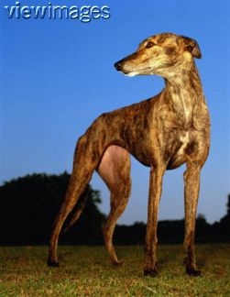
Substances and processes
t i m e
process
demand different sorts of inventories

Slide 77
Endurants/continuants
Objects, things, substances +
states, powers, qualities, roles,
functions, dispositions, plans, shapes …
Perdurants/Occurrents
Processes = the expressions, realizations of functions, roles, powers in time

Slide 78
Endurants/continuants
SNAP ontology
Perdurants/Occurrents
SPAN ontology

Slide 79
Substances and processes form two distinct orders of being
Substances exist as a whole at every point in time at which they exist at all
Processes unfold through time, and are never present in full at any given instant during which they exist.
When do both exist
to be inventoried together?

Slide 80
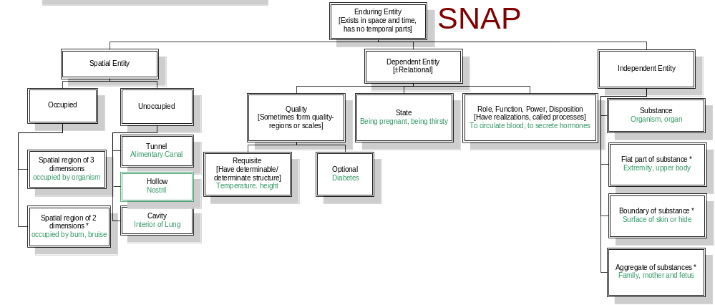
SNAP: Entities existing in toto at a time

Slide 81
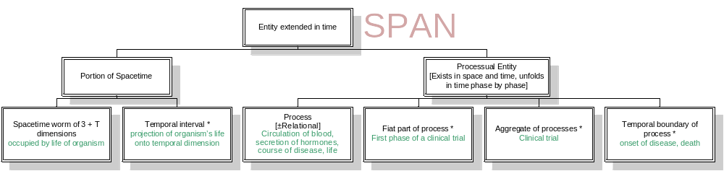
SPAN: Entities extended in time

Slide 82
Relations between SNAP and SPAN
SNAP-entities participate in processes
they have lives, histories

Slide 83
SPQR… entities and their SPAN realizations
the expression of a function
the exercise of a role
the execution of a plan
the realization of a disposition

Slide 84
SPQR… entities and their SPAN realizations
function
role
plan
disposition
therapy
disease
SNAP

Slide 85
SPQR… entities and their SPAN realizations
expression
exercise
execution
realization
application
course
SPAN

Slide 86
How are entities in the SNAP and SPAN ontologies related together?
via FORMAL RELATIONS
such as instantiation, part-whole, identity

Slide 87
A hypothesis (first rough version)
Formal relations are those relations which are not captured by either SNAP or SPAN
because they traverse the SNAP-SPAN divide
they glue SNAP and SPAN entities together
above all participation: Does(John,x)

Slide 88
The idea (modified version)
Formal relations are the relations that hold SNAP and SPAN entities/ontologies together
+ analogous relations that come for free, they do not add anything to being

Slide 89
Generating a typology
Two main types of formal relations:
inter-ontological („transcendental“): obtain between entities of different ontologies
intra-ontological: obtain between entities of the same ontology (intra-SNAP, intra-SPAN)

Slide 90
Substance->Process
PARTICIPATION
(a species of dependence)

Slide 91
Participation (SNAP-SPAN)
A substance (SNAP) participates in a process (SPAN)
A runner participates in a race

Slide 92
Axes of variation
activity/passivity (agentive)
direct/mediated
benefactor/malefactor
(conducive to existence) [MEDICINE]

Slide 93
SNAP-SPAN
Participation
Perpetration (+agentive)
Influence
Patiency
(-agentive)
Initiation
Termination
Facilitation
Perpetuation
Hindrance
Mediation

Slide 94
Participation
the tumor and its growth
the surgeon and the operation
the virus and its spread
the temperature and its rise
the disease and its course
the therapy and its application

Slide 95
Participation (genus)

Slide 96
Perpetration (species)
A substance perpetrates an action (direct and agentive participation in a process):
The referee fires the starting-pistol
The captain gives the order

Slide 97
Initiation (species)
A substance initiates a process:
The referee starts the race

Slide 98
Perpetuation (species)
A substance sustains a process:
The charged filament perpetuates the emission of light

Slide 99
Termination (species)
A substance terminates a process:
The operator terminates the projection of the film

Slide 100
Participation
Participation
Perpetration (+agentive)
Influence
Patiency
(-agentive)
Initiation
Termination
Facilitation
Perpetuation
Hindrance
Mediation

Slide 101
Signatures of meta-relations
SNAP Component
SPAN Component
Substances
Processuals
Processes
SPQR…
Events
Space Regions
Space-Time Regions
Notes:
This slide unfolds step-wise.

Slide 102
Signatures of meta-relations
SNAP Component
SPAN Component
Substances
Processuals
Processes
SPQR…
Events
Space Regions
Space-Time Regions
Notes:
This slide unfolds step-wise.

Slide 103
Signatures of meta-relations
SNAP Component
SPAN Component
Substances
Processuals
Processes
SPQR…
Events
Space Regions
Space-Time Regions
Notes:
This slide unfolds step-wise.

Slide 104
Signatures of meta-relations
SNAP Component
SPAN Component
Substances
Processuals
Processes
SPQR…
Events
Space Regions
Space-Time Regions
Notes:
This slide unfolds step-wise.

Slide 105
2nd Family
REALIZATION
from qualities, functions, roles (SNAP) to processes

Slide 106
Realization
the performance of a symphony
the projection of a film
the expression of an emotion
the utterance of a sentence
the application of a therapy
the course of a disease
the increase of temperature

Slide 107
Types of Formal Relation
Intracategorial
  Mereological (part)
  Topological (connected, temporally precedes)
  Dependency (e.g. functional ?)
Intercategorial
  Inherence (quality of)
  Location
  Participation (agent)
  Dependency (of process on substance)
Transcendentals
Identity

Slide 108

END
http://ontologist.com
http://ifomis.de

