Slide 1
From Layered Mereotopology to Dynamic Spatial Ontology
Maureen Donnelly and Barry Smith
Department of Philosophy, University at Buffalo
and
Institute for Formal Ontology and Medical Information Science,
University of Leipzig

Slide 2
Two entities coincide when they occupy overlapping regions
All entities coincide exactly with themselves
All pairs of overlapping entities coincide:
my hand coincides with my body
the European Union coincides with the British Commonwealth (United Kingdom … Malta, Cyprus)

Slide 3
Some entities coincide even though they share no parts
any material object coincides with its spatial region
a portion of food coincides with my stomach cavity

Slide 4
Holes may coincide with material objects
The hole in the chunk of amber coincides completely with, but does not overlap, the encapsulated insect which fills it
Sometimes holes and objects are moving independently (a bullet flying through a railway carriage moving through a tunnel)

Slide 5
Layered Ontology of Lakes
L1. a region layer
L2. a lake layer, consisting of a certain concave portion of the earth’s surface together with a body of water
L3. a fish layer
L4. a chemical contaminant layer

Slide 6
Layered Epidemiology Ontology
L1. a two-dimensional region layer in some undisclosed location
L2. a topographical layer, consisting of mountains, valleys, deserts, gullies
L3. a storm-system occupying sub-regions of L2
L4: an airborne cloud of smallpox virus particles.

Slide 7
Motivation
Each spatial domain is partioned into layers in such a way that only members of the same layer can stand in parthood and connection relations.
Entities of different ontological types (regions, objects, holes ... ) belong to different layers.

Slide 8
Layered Mereology
= General Extensional Mereology (GEM) with three small modifications

Slide 9
Parthood (P)
Parthood is a partial ordering:
(P1) Pxx (reflexive)
(P2) Pxy & Pyx −> x = y (antisymmetric)
(P3) Pxy & Pyz −> Pxz (transitive)
(P4) ~Pxy −> ∃z(Pzx & ~Ozy)
(the remainder principle: if x is not part of y, then x has a part that does not overlap y)

Slide 10
Defined Mereological Relations
Oxy =: ∃z (Pzx & Pzy) (x and y overlap)
Uxy =: ∃z (Pxz & Pyz) (x and y underlap)
No universal object.
P, O and U hold only among objects on the same layer.
Every object is part of its layer.

Slide 11
Layered Mereology
(P5) (Uxy & Uyz) → Uxz
(underlap is transitive)
FIRST DEVIATION FROM GEM
P5 implies that underlap is an equivalence relation.

Slide 12
Restricted Summation Principle
(P6) (∃x φ & ∀x,y( φ & φ/y → Uxy)) → ∃z (∀y (Oyz <−> ∃x (φ & Oyx))
For each satisfied layer-conform predicate φ there is a sum of φ-ers
SECOND DEVIATION FROM GEM

Slide 13
Formal Definition of Layer
x’s layer = the sum of all objects x underlaps
z is x’s layer:
Lxz =: ∀y (Oyz <−> ∃w (Uwx & Owy))
y is a layer:
Ly =: ∃x Lxy
Every object has a unique layer: l(x).

Slide 14
Some Theorems
Pxl(x) every object is part of its layer
Uxy ↔ l(x) = l(y) two objects underlap iff they have the same layer
Uxy ↔ Pyl(x) x underlaps y iff
y is part of x's layer
Lz ↔ z = l(z) z is a layer iff
z is its own layer

Slide 15
The Region Layer

Slide 16
co-located objects
layers
The region layer

Slide 17
The Region Function
r(x) = the region at which x is exactly located.
r is a new primitive
THIRD DEVIATION FROM GEM
r maps (collapses) entities on all higher layers onto the region layer

Slide 18
co-located objects
layers
The region layer

Slide 19
Axioms for the region function
(R1) Ry & Rz → Uyz
(all regions are located in the same layer)
(R2) Ry & Uyz → r(z) = z
(every member of the region layer is its own region)
(R3) Pxy → Pr(x)r(y)
(R4) Uxy & Or(x)r(y) → Oxy

Slide 20
Some Theorems
Ry → r(y) = y
(every region is located at itself)
(∃xφ & ∀x(φ → Rx) &
∀y (Oyz <−> ∃x (φ & Oyx))) → Rz
(every sum of regions is a region)

Slide 21
Layered Mereotopology
Cxy means: x is connected to y

Slide 22
Axioms for the Connection Relation
(C1) Cxx (connection is reflexive)
(C2) Cxy → Cyx (connection is symmetric)
(C3) Pxy → ∀z(Czx → Czy) (if x is part of y, then everything connected to x is connected to y)
(C4) Cxy → Uxy (if x and y are connected, then they are parts of the same layer)
(C5) Cxy → C(r(x), r(y)) (if x and y are connected, their regions are also connected)
(C6) Uxy & C(r(x), r(y)) → Cxy (if x and y are members of the same layer and their regions are connected, then x and y are connected)

Slide 23
Defined Relations
ECxy =: Cxy & ~ Oxy
(x and y are externally connected)
Axy =: EC(r(x), r(y))
(x and y abut)

Slide 24
Towards Dynamic Spatial Ontology

Slide 25
Objects move through space
An adequate ontology of motion requires at least two independent sorts of spatial entities:
1. locations, which remain fixed,
2. objects, which move relative to them.
many region-based approaches to spatial reasoning admit only the first type of entity,
they simulate motion, in the manner of cartoons, via successive assignments of attributes to a fixed frame of locations.

Slide 26
Region-based approaches
identify the relation of a fish to the lake it inhabits with the relation of a genuine part of a lake (a bay, an inlet) to the lake as a whole

Slide 27
The solution
is to recognize both objects and locations, on separate layers
and then we need a theory of coincidence and of layered mereotopology to do justice to the entities in these two categories
… BUT THERE IS MORE

Slide 28
Some entities coincide spatially even though they share no parts
a portion of food coincides with my stomach cavity at a certain time

Slide 29
Some entities coincide spatio-temporally even though they share no parts
the course of a disease coincides with the treatment of the disease
The Second World War coincides with a growth in popularity of the British Labour Party

Slide 30
Hypothesis: processes may coincide with objects
The Great Plague of 1664 coincides with, but does not overlap, Holland
A process of deforestation coincides with, but does not overlap, the forest
… but this is not quite right

Slide 31
A better hypothesis
The Great Plague of 1664 coincides with, but does not overlap, the history of Holland in the 17th century
A process of deforestation coincides with, but does not overlap, the history of the forest

Slide 32
Objects and processes do not coincide
For they are of different dimension:
Objects are 3-dimensional
Processes are 4-dimensional
Object-layers are always 3-dimensional
Process-layers are always 4-dimensional

Slide 33
Two ontologies of motion and change
series of samples, or snapshots
object x₁ is at region r₁ at time t₁
object x₂ is at region r₂ at time t₂
object x₃ is at region r₃ at time t₃
→ SNAP ontologies (ontologies indexed by times)

Slide 34
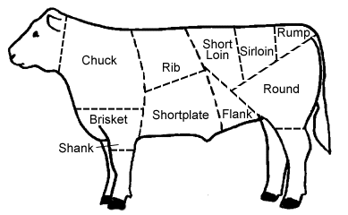
t₁

Slide 35
t₂

Slide 36
t₃

Slide 37
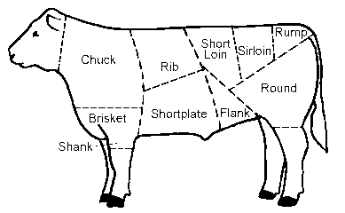
SPAN ontology

Slide 38
SNAP vs SPAN
Continuants vs Occurrents
(Sampling vs. Tracking)

Slide 39
SPAN ontology
is an ontology which recognizes processes, changes, themselves
= four-dimensional (spatio-temporal) entities
not via a sequence of instantaneous samplings but via extended observations

Slide 40
Many different interconnections traverse the SNAP-SPAN divide
But SNAP and SPAN entities are never related by part_of, connected_to or coincidence (layer) relations

Slide 41
Processes may coincide with each other
A process of absorption of a drug coincides, but does not share parts, with the disease processes which the drug is designed to alleviate
The manouvres of the coalition troops coincide, but do not share parts in common, with the activities of the terrorists

Slide 42
Processes may coincide with each other
Your hearing coincides with but does not share parts with my speaking

Slide 43
There are layers in both the SNAP (object) ontology and the SPAN (process) ontology
In SNAP the region layer = space
In SPAN the region layer = spacetime

Slide 44
But
SNAP layers are mostly bona fide
SPAN layers are mostly fiat
a matter of purpose- and context-based gerrymandering

Slide 45
One big difference between SNAP and SPAN
In SNAP, higher layers are categorially well-distinguished nicely separated (physical objects, holes, administrative entities …)
In SPAN, nearly
everything is flux

Slide 46
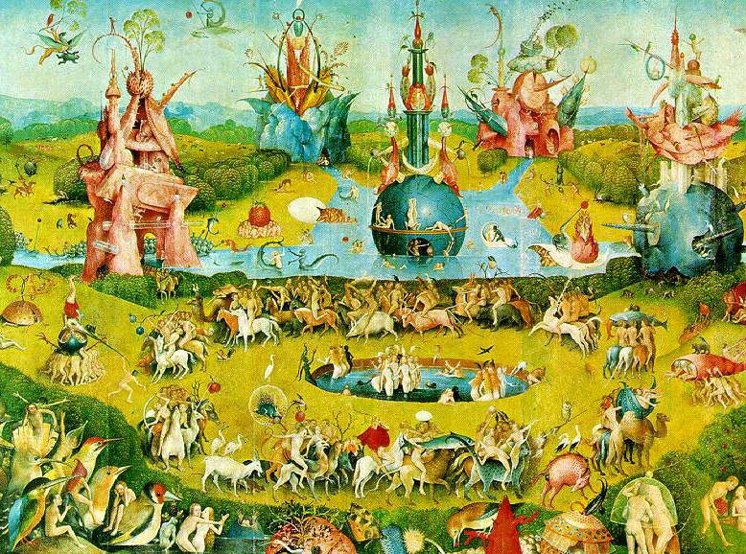
http://ontologist.com
E N D E

