Slide 1
Problems of Data Integration
Barry Smith
http://ifomis.de

Slide 2
Institute for Formal Ontology and Medical Information Science
(IFOMIS)
Faculty of Medicine
University of Leipzig
http://ifomis.de

Slide 3
The Idea
Computational medical research
will transform the discipline of medicine
… but only if communication problems can be solved

Slide 4
Medicine
desperately needs to find a way
to enable the huge amounts of data
resulting from trials by different groups
to be (f)used together

Slide 5
How resolve incompatibilities?
“ONTOLOGY” = the solution of first resort
(compare: kicking a television set)
But what does ‘ontology’ mean?
Current most popular answer: a collection of terms and definitions satisfying constraints of description logic

Slide 6
Some Scepticism
Ontology is too often not taken seriously, and only few people understand that. But there is hope:
The promise of Web Services, augmented with the Semantic Web, is to provide THE major solution for integration, the largest IT cost / sector, at $ 500 BN/year. The Web Services and Semantic Web trends are heading for a major failure (i.e., the most recent Silver Bullet). In reality, Web Services, as a technology, is in its infancy. ...

Slide 7
Some Scepticism
There is no technical solution (i.e., no basis) other than fantasy for the rest of the Web Services story. Analyst claims of maturity and adoption (...) are already false. ... Verizon must understand it so as not to invest too heavily in technologies that will fail or that will not produce a reasonable ROI.
Dr. Michael L. Brodie, Chief Scientist,
Verizon IT
OntoWeb Meeting, Innsbruck, Austria, December 16-18, 2002

Slide 8
Example: The Enterprise Ontology
A Sale is an agreement between two Legal-Entities for the exchange of a Product for a Sale-Price.
A Strategy is a Plan to Achieve a high-level Purpose.
A Market is all Sales and Potential Sales within a scope of interest.

Slide 9
Harvard Business Review,
October 2001
… “Trying to engage with too many partners too fast is one of the main reasons that so many online market makers have foundered. The transactions they had viewed as simple and routine actually involved many subtle distinctions in terminology and meaning”

Slide 10
Example: Statements of Accounts
Company Financial statements may be prepared under either the (US) GAAP or the (European) IASC standards
These allocate cost items to different categories depending on the laws of the countries involved.

Slide 11
Job:
to develop an algorithm for the automatic conversion of income statements and balance sheets between the two systems.
Not even this relatively simple problem has been satisfactorily resolved
… why not?

Slide 12
Example 1: UMLS
Universal Medical Language System
Taxonomy system maintained by National Library of Medicine in Washington DC
with thanks to Anita Burgun and Olivier Bodenreider

Slide 13
UMLS
134 semantic types
800,000 concepts
10 million interconcept relationships inherited from the source vocabularies.
Hierarchical relation (parent-daughter relations between concepts)

Slide 14
Example 2: SNOMED
Systematized Nomenclature of Medicine
adds relationships between terms
Legal force

Slide 15
SNOMED-Reference terminology
  121,000 concepts,
  340,000 relationships
  “common reference point for comparison and aggregation of data throughout the entire healthcare process”
  Electronic Patient Record – Interoperability

Slide 16
Problems with UMLS and SNOMED
Each is a fusion of several source vocabularies
They were fused without an ontological system being established first
They contain circularities, taxonomic gaps, unnatural ad hoc determinations

Slide 17
Example 3: GALEN
Ontology for medical procedures
SurgicalDeed which
isCharacterisedBy (performance which
isEnactmentOf ((Excising which playsClinicalRole SurgicalRole) which
actsSpecificallyOn (NeoplasticLesion whichG
hasSpecificLocation AdrenalGland)

Slide 18
Problems with GALEN
Ontology is ramshackle and has been subject to repeated fixes
Its unnaturalness makes coding slow and expensive

Slide 19
Patient vs. Doctor Ontology
UMLS vs. WordNet

Slide 20
UMLS
WordNet
[…]
[…]
Organism
microorganism
Virus
virus
animal virus
Species of LENTIVIRUS, subgenus primate lentiviruses (LENTIVIRUSES, PRIMATE), formerly designated T-cell lymphotropic virus type III/lymphadenopathy-associated virus (HTLV-III/LAV). […]
retrovirus
the virus that causes acquired immune deficiency syndrome (AIDS)
HIV
C0019682
00873852

Slide 21
UMLS
WordNet
Virus
virus
[…]
arbovirus C
animal virus
plant virus
[…]
Rhabdovirus group
retrovirus
picornavirus
[…]
human gammaherpesvirus 6
HIV
HTLV-1
enterovirus
[…]
infantile gastroenteritis virus
hepatitis A virus
[…]

Slide 22
Blood

Slide 23
Representation of Blood in WordNet
Entity
Physical Object
Substance
Body Substance
Body Fluid
the four fluids in the body whose balance was believed to determine our emotional and physical state
Humor
Blood
along with phlegm, yellow and black bile

Slide 24
Representation of Blood in UMLS
Entity
Physical Object
Anatomical Structure
Fully Formed Anatomical Structure
An aggregation of similarly specialized cells
and the associated intercellular substance.
Tissues are relatively non-localized in comparison to
body parts, organs or organ components
Tissue
Body Fluid
Soft Tissue
Body Substance
Blood
Blood as tissue

Slide 25
Representation of Blood in SNOMED
Substance
Substance categorized by physical state
Body Substance
Liquid Substance
Body fluid
As well as lymph, sweat, plasma, platelet rich plasma, amniotic fluid, etc
Blood

Slide 26
Unified Medical Language System (UMLS):
blood is a tissue
Systematized Nomenclature of Medicine (SNOMED):
blood is a fluid

Slide 27
Example: The Gene Ontology (GO)
hormone ; GO:0005179
%digestive hormone ; GO:0046659
%peptide hormone ; GO:0005180 %adrenocorticotropin ; GO:0017043 %glycopeptide hormone ; GO:0005181 %follicle-stimulating hormone ; GO:0016913

Slide 28
as tree
hormone
digestive hormone peptide hormone
adrenocorticotropin glycopeptide hormone
follicle-stimulating hormone

Slide 29
Problem: There exist multiple databases
genomic
cellular
structural
phenotypic
…
and even for each specific type of information, e.g. DNA sequence data, there exist several databases of different scope and organisation

Slide 30
What is a gene?
GDB: a gene is a DNA fragment that can be transcribed and translated into a protein
Genbank: a gene is a DNA region of biological interest with a name and that carries a genetic trait or phenotype
(from Schulze-Kremer)
GO does not tell us which of these is correct, or indeed whether either is correct, and it does not tell us how to integrate data from the corresponding sources

Slide 31
Example: The Semantic Web
Vast amount of heterogeneous data sources
Need dramatically better support at the level of metadata
The ability to query and integrate across different conceptual systems:
The currently preferred answer is The Semantic Web, based on description logic
will not work:
How tag blood? how tag gene?

Slide 32
Application ontology
cannot solve the problems of database integration
There can be no mechanical solution to the problems of data integration
in a domain like medicine
or in the domain of really existing commercial transactions

Slide 33
The problem in every case
is one of finding an overarching framework for good definitions,
definitions which will be adequate to the nuances of the domain under investigation

Slide 34
Application ontology:
Ontologies are Applications running in real time

Slide 35
Application ontology:
Ontologies are inside the computer
thus subject to severe constraints on expressive power
(effectively the expressive power of description logic)

Slide 36
Application ontology cannot solve the data-integration problem
because of its roots in knowledge representation/knowledge mining

Slide 37


different conceptual systems

Slide 38
need not interconnect at all

Slide 39
we cannot make incompatible concept-systems interconnect
just by looking at concepts,
or knowledge –
we need some tertium quid

Slide 40
Application ontology
has its philosophical roots in Quine’s doctrine of ontological commitment and in the ‘internal metaphysics’ of Carnap/Putnam
Roughly, for an application ontology the world and the semantic model are one and the same
What exists = what the system says exists

Slide 41
What is needed
is some sort of wider common framework
sufficiently rich and nuanced to allow concept systems deriving from different theoretical/data sources to be hand-callibrated

Slide 42
What is needed
is not an Application Ontology
but
a Reference Ontology
(something like old-fashioned metaphysics)

Slide 43
Reference Ontology
An ontology is a theory of a domain of entities in the world
Ontology is outside the computer
seeks maximal expressiveness and adequacy to reality
and sacrifices computational tractability for the sake of representational adequacy

Slide 44
Belnap
“it is a good thing logicians were around before computer scientists;
“if computer scientists had got there first, then we wouldn’t have numbers
because arithmetic is undecidable”

Slide 45
It is a good thing
Aristotelian metaphysics was around before description logic, because otherwise
we would have only hierarchies of
concepts/universals/classes and no individual instances …

Slide 46
Reference Ontology
a theory of the tertium quid
– called reality –
needed to hand-callibrate database/terminology systems

Slide 47
Methodology
Get ontology right first
(realism; descriptive adequacy; rather powerful logic);
solve tractability problems later

Slide 48
The Reference Ontology Community
IFOMIS (Leipzig)
Laboratories for Applied Ontology (Trento/Rome, Turin)
Foundational Ontology Project (Leeds)
Ontology Works (Baltimore)
BORO Program (London)
Ontek Corporation (Buffalo/Leeds)
LandC (Belgium/Philadelphia)

Slide 49
Domains of Current Work
IFOMIS Leipzig: Medicine
Laboratories for Applied Ontology
Trento/Rome: Ontology of Cognition/Language
Turin: Law
Foundational Ontology Project: Space, Physics
Ontology Works: Genetics, Molecular Biology
BORO Program: Core Enterprise Ontology
Ontek Corporation: Biological Systematics
LandC: NLP

Slide 50
Recall:
GDB: a gene is a DNA fragment that can be transcribed and translated into a protein
Genbank: a gene is a DNA region of biological interest with a name and that carries a genetic trait or phenotype
(from Schulze-Kremer)

Slide 51
Ontology
Note that terms like ‘fragment’, ‘region’, ‘name’, ‘carry’, ‘trait’, ‘type’
… along with terms like ‘part’, ‘whole’, ‘function’, ‘substance’, ‘inhere’ …
are ontological terms in the sense of traditional (philosophical) ontology

Slide 52
to do justice to the ways these terms work in specific discipline
the dichotomy of concepts and roles (DL), or of classes and properties (DAML+OIL)
is insufficiently refined

Slide 53
Basic Formal Ontology
BFO
The Vampire Slayer

Slide 54
BFO
not just a system of categories
but a formal theory
with definitions, axioms, theorems
designed to provide the resources for reference ontologies for specific domains
the latter should be of sufficient richness that terminological incompatibilities can be resolves intelligently rather than by brute force

Slide 55
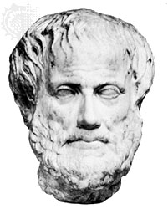
Aristotle
Aristotle
author of The Categories

Slide 56
From Species to Genera
animal
bird
canary

Slide 57
Species Genera as Tree
animal
bird
fish
canary
ostrich

Slide 58
Substances are the bearers of accidents
John
hunger
= relations of inherence
(one-sided existential dependence)

Slide 59
Both substances and accidents
instantiate universals at higher and lower levels of generality

Slide 60

species, genera
substance
organism
animal
mammal
cat
frog
siamese
instances

Slide 61
Common nouns
common
nouns
proper names
substance
organism
animal
mammal
cat
pekinese

Slide 62
types
substance
organism
animal
mammal
cat
frog
siamese
tokens

Slide 63
Our clarification
accidents to be divided into
two distinct families of
QUALITIES
and
PROCESSES

Slide 64
Substance universals
pertain to what a thing is at all times at which it exists:
cow man rock planet
VW Golf

Slide 65
Quality universals
pertain to how a thing is at some time at which it exists:
red hot suntanned spinning
Clintophobic Eurosceptic

Slide 66
Process universals
reflect invariants in the spatiotemporal world taken as an atemporal whole
football match
course of disease
exercise of function
(course of) therapy

Slide 67
Processes and qualities, too, instantiate genera and species
Thus process and quality universals form trees

Slide 68
Accidents: Species and instances
quality
color
red
scarlet
R232, G54, B24
this individual accident of redness
(this token redness – here, now)

Slide 69
Aristotle 1.0
an ontology recognizing:
substance tokens
accident tokens
substance types
accident types
Notes:
http://www.proformacorp.com/whtpap1.htm
Enterprise Application Modeling

Slide 70
Aristotle’s Ontological Square (full)
Not in a Subject
Substantial
In a Subject
Accidental
Said of a Subject
Universal, General,
Type
Second Substances
man,
horse,
mammal
Non-substantial Universals
whiteness,
knowledge
Not said of a Subject Particular, Individual,
Token
First Substances
this individual
man, this horse
this mind, this body
Individual Accidents
this individual
whiteness, knowledge
of grammar

Slide 71
Standard Predicate Logic – F(a), R(a,b) ...
 | Substantial | Accidental
 |  | Attributes F, G, R
 | Individuals a, b, c this, that
Universal
Particular

Slide 72
Bicategorial Nominalism
 | Substantial | Accidental
 | First substance this man this cat this ox | First accident this headache this sun-tan this dread
Universal
Particular

Slide 73
Process Metaphysics
 | Substantial | Accidental
 |  | Events Processes “Everything is flux”
Universal
Particular

Slide 74
Three types of reference ontology
1. formal ontology = framework for definition of the highly general concepts – such as object, event, part – employed in every domain
2. domain ontology, a top-level theory with a few highly general concepts from a particular domain, such as genetics or medicine
3. terminology-based ontology, a very large theory embracing many concepts and inter-concept relations

Slide 75
MedO
including sub-ontologies:
cell ontology
drug ontology
protein ontology
gene ontology

Slide 76
and sub-ontologies:
anatomical ontology
epidemiological ontology
disease ontology
therapy ontology
pathology ontology
the whole designed to give structure to the medical domain
(currently medical education comparable to stamp-collecting)

Slide 77
If sub-domains like these
cell ontology
drug ontology
protein ontology
gene ontology
are to be knitted together within a single theory,
then we need also a theory of granularity

Slide 78
Testing the BFO/MedO approach
within a software environment for NLP of unstructured patient records
collaborating with
Language and Computing nv (www.landc.be)

Slide 79
L&C
LinKBase®: world’s largest terminology-based ontology
incorporating UMLS, SNOMED, etc.
+ LinKFactory®: suite for developing and managing large terminology-based ontologies

Slide 80
L&C’s long-term goal
Transform the mass of unstructured patient records into a gigantic medical experiment

Slide 81
LinKBase
LinKBase still close to being a flat list
BFO and MedO designed to add depth, and so also reasoning capacity
by tagging LinKBase terms with corresponding BFO/MedO categories
by constraining links within LinKBase
by serving as a framework for establishing relations between near-synonyms within LinKBase derived from different source nomenclatures

Slide 82
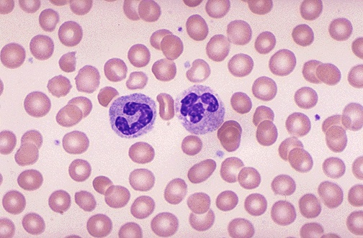
So what is the ontology of blood?

Slide 83
We cannot solve this problem just by looking at concepts (by engaging in further acts of knowledge mining)

Slide 84
concept systems may be simply incommensurable

Slide 85
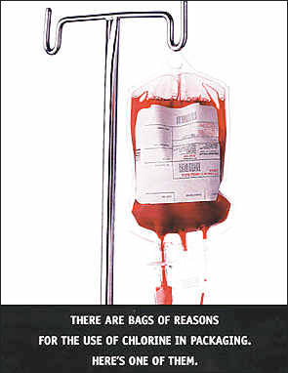
the problem can only be solved
by taking the world itself into account

Slide 86
A reference ontology
is a theory of reality
But how is this possible?

Slide 87
Shimon Edelman’s
Riddle of Representation
two humans, a monkey, and a robot are looking at a piece of cheese;
what is common to the representational processes in their visual systems?

Slide 88
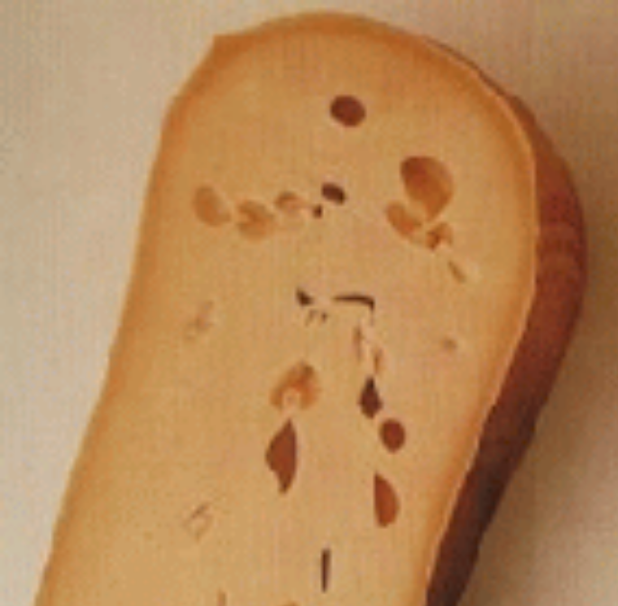
Answer:
The cheese, of course
Notes:
With thanks to Shimon Edelman. See http://www.ai.mit.edu/~edelman/archive.html

Slide 89
Maximally opportunistic
means:
don’t just look at beliefs
look at the objects themselves
from every possible direction,
formal and informal
scientific and non-scientific …

Slide 90
It means further:
looking at concepts and beliefs critically
and always in the context of a wider view which includes independent ways to access the objects at issue at different levels of granularity
including physical ways (involving the use of physical measuring instruments)

Slide 91
And also:
taking account of tacit knowledge of those features of reality of which the domain experts are not consciously aware
look not at concepts, representations, of a passive observer
but rather at agents, at organisms acting in the world

Slide 92
Maximally opportunistic
means:
look not at what the expert says
but at what the expert does
Experts have expertise = knowing how
Ontologists skilled in extracting knowledge that from knowing how
The experts don’t know what the ontologist knows

Slide 93
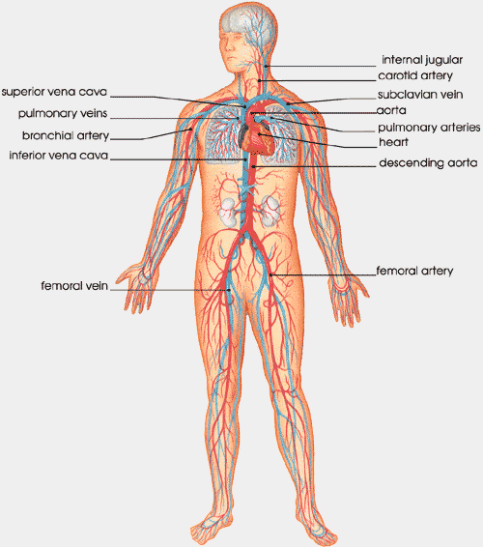
Maximally opportunistic
means:
look at the same objects at different levels of granularity:

Slide 94
We then recognize
that the same object can be apprehended at different levels of granularity:
at the perceptual level blood is a liquid
at the cellular level blood is a tissue

Slide 95
select out the good conceptualizations
those which have a reasonable chance of being integrated together into a single ontological system because they are
based on tested principles
robust
conform to natural science

Slide 96
Partitions should be cuts through reality
a good medical ontology should NOT be compatible with a conceptualization of disease as caused by evil spirits

Slide 97
Two concepts of London
John is in London
John saw London from the air
London ≠ London
IBM ≠ IBM
A is part of B vs. A is in the interior of B as a tenant is in its niche

Slide 98




Where are Niches?
Concrete Entity
[Exists in Space and Time]
Entity in 3-D Ontology
[Endure. No Temporal Parts]
Entity in 4-D Ontology
[Perdure. Unfold in Time]
Spatial Region
of Dimension 0,1,2,3
Dependent Entity
Independent Entity
Processual Entity
Spatio-Temporal Region
Dim = T, T+0, T+1, T+2, T+3
Quality (Your Redness, My Tallness)
[Form Quality Regions/Scales]
Substance
[maximally connected causal unity]
Process [Has Unity]
Clinical trial; exercise of role
Quasi-Quality
Prices, Values, Obligations
Aggregate of Substances *
(includes masses of stuff? liquids?)
Aggregate of Processes*
Role, Function, Power
Have realizations (called: Processes)
Fiat Part of Substance *
Nose, Ear, Mountain
Fiat Part of Process*
Quasi-Role/Function/Power
The Functions of the President
Boundary of Substance *
Fiat or Bona Fide or Mixed
Instantaneous Temporal Boundary of Process (= Ingarden’s 'Event’)*
Quasi-Substance
Church, College, Corporation
Quasi-Process
John’s Youth. John’s Life

Slide 99
SNAP: Ontology of entities enduring through time
Concrete Entity
[Exists in Space and Time]
Entity in 3-D Ontology
[Endure. No Temporal Parts]
Entity in 4-D Ontology
[Perdure. Unfold in Time]
Spatial regions of dimension
0,1,2,3
Dependent Entity
Independent Entity
Processual Entity
Spatio-Temporal Region
Dim = T, T+0, T+1, T+2, T+3
Quality (Your Redness, My Tallness)
[Form Quality Regions/Scales]
Substance
[maximally connected causal unity]
Process [Has Unity]
Clinical trial; exercise of role
Quasi-Quality
Prices, Values, Obligations
Aggregate of Substances *
(includes masses of stuff? liquids?)
Aggregate of Processes*
Role, Function, Power
Have realizations (called: Processes)
Fiat Part of Substance *
Nose, Ear, Mountain
Fiat Part of Process*
Quasi-Role/Function/Power
The Functions of the President
Boundary of Substance *
Fiat or Bona Fide or Mixed
Instantaneous Temporal Boundary of Process (= Ingarden’s 'Event’)*
Quasi-Substance
Church, College, Corporation
Quasi-Process
John’s Youth. John’s Life

Slide 100
Where are Places?
Concrete Entity
[Exists in Space and Time]
Entity in 3-D Ontology
[Endure. No Temporal Parts]
Entity in 4-D Ontology
[Perdure. Unfold in Time]
Spatial Region
of Dimension 0,1,2,3
Dependent Entity
Independent Entity
Processual Entity
Spatio-Temporal Region
Dim = T, T+0, T+1, T+2, T+3

Slide 101
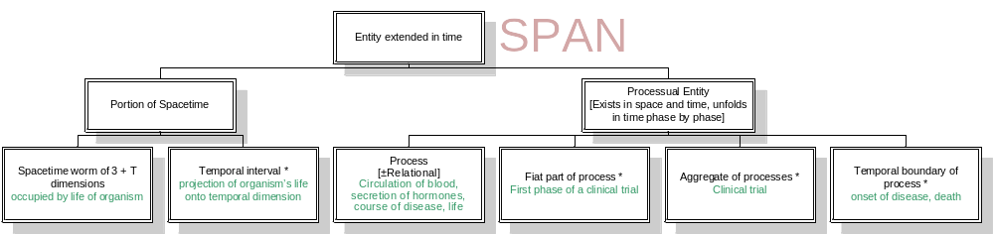
Where are behavior-settings?
spatio-
temporal
volumes

Slide 102
SPAN: Ontology of entities extended in time
spatio-
temporal
volumes
standardized
patterns of
behavior

Slide 103
Three Main Ingredients to the SNAP/SPAN Framework
Independent SNAP entities: Substances
Dependent SNAP entities: powers, qualities, roles, functions
SPAN entities: Processes

Slide 104
Gene Ontology
Cellular Component Ontology: subcellular structures, locations, and macromolecular complexes;
examples: nucleus, telomere
Molecular Function Ontology: tasks performed by individual gene products;
examples: transcription factor, DNA helicase
Biological Process Ontology: broad biological goals accomplished by ordered assemblies of molecular functions;
examples: mitosis, purine metabolism

Slide 105
Three Main Ingredients to the SNAP/SPAN Framework
Independent SNAP entities: Molecular Components
Dependent SNAP entities: Functions
SPAN entities: Processes

Slide 106
Use-Mention Confusions
On Sunday, Feb 23, 2003, at 18:29 US/Eastern, Barry Smith wrote:
Not sure you can help me with this, but I was looking at
http://www.cs.vu.nl/~frankh/postscript/AAAI02.pdf
which seems to be a quite coherent statement from the DAML+OIL camp. It seems to me to imply that for DAML+OIL the world is made of classes, but Chris Menzel insists I am misinterpreting. What do you think?

Slide 107
Here some passages with my comments:
As it is an ontology language, DAML+OIL is designed
to describe the structure of a domain. DAML+OIL takes an
object oriented approach, with the structure of the domain
being described in terms of classes and properties. An ontology
consists of a set of axioms that assert characteristics
of these classes and properties.
This sounds to me as if the intended interpretation is a world consisting of classes and properties
Properties are later defined as mappings, i.e. they themselves are understood class-theoretically.
There is clearly double-speak going on here. First they say that classes and properties are part components of description then they talk about an ontology being something that asserts characteristics of the classes and properties. In the latter sense they clearly are referring to elements in the universe of discourse. Another strange phenomenon with DAML+OIL in particular and DLs in general is that these classes and properties cannot themselves be quantified over, which would lead one to think they are not meant to be in the UoD.
So, I am as confused as you are. By the way, I'm working on a paper (not for publication - yet - but I will offer it up to you to collaborate with me on it) in response to a comparison Mike Uschold of Boeing did between FaCT (the OIL reasoner from Manchester) and OW's product - IODE. My comments so far in that paper address much of your confusion and are intended to draw attention to the weaknesses of DL wrt a proper treatment of universals. My main beefs (if one is generous enough to call DL classes universals) are:
* They cannot be quantified over
* There is no treatment of modality
* They exist eternally (and necessarily). Thus no room for relational universals
Anyway, I will send that along if you are interested once I have a rough draft.
As in a DL, DAML+OIL
classes can be names (URI?in the case of DAML+OIL) or
expressions, and a variety of constructors are provided for
building class expressions.
'classes can be names ... or expressions'
Why is this not a criminal confusion which we teach our first-year students to avoid?
Again only classes and properties belong to the intended interpretation
Well, I'm not sure. Classes and properties enter into the formal semantics of DLs but they themselves cannot be quantified over, as I mentioned above. Purveyors of DLs actually make no explicit ontological commitment whatsoever as to what counts as a piece of the world and what doesn't. This is one of my fundamental problems with them.
The expressive power of the language
is determined by the class (and property) constructors
provided, and by the kinds of axioms allowed.
This confuses me further because the class and property constructors are all one has to make axioms in a DL. There are no additional axioms as far as I know.
The formal semantics of the class constructors is
given by DAML+OIL?model-theoretic semantics8 or can
be derived from the specification of a suitably expressive DL
(e.g., see (Horrocks & Sattler 2001)).
So semantics is something else. (Yet more classes, of course, but that is not my point -- and they can't squirm out of it by saying that the semantics is set-theoretic and the intended interpretation not.)
I think you're hoping for too much from them - they don't care about intended interpretations. IMHO, the whole DL community expends great energy trying to conceal the fact that they don't care about Ontology. DLs, again IMHO, are just another in a long line of logic-like hacking tools following the Tarskian GOFAI tradition. I really believe that they think they have a handle on what "ontology" is all about and are trying to draw an identity between DL and "ontology" in order to corner the intellectual (and commercial) market, thereby pushing aside the influence of Ontology.
Note that this is a different position than I (and OW) take where we realize we have to try to squeeze Ontology into a Tarskian world if we are to compute with it. But we never confuse the two.
Figure 2 summarises the axioms allowed in DAML+OIL.
These axioms make it possible to assert subsumption or
equivalence with respect to classes or properties, the disjointness
of classes, the equivalence or non-equivalence of
individuals (resources), and various properties of properties.
so that an instance of an object class (e.g., the individual
쉴alycan never have the same denotation as a value of
a datatype (e.g., the integer 5), and that the set of object
properties (which map individuals to individuals) is disjoint
from the set of datatype properties (which map individuals
to datatype values).
Individuals get a look in, here, but in the formalism only as singletons
I don't get that from the above passage but I'll go with your judgement on that. Note that if they are confusing individuals with singletons, they are doing it for the reasons that Chris mentioned - computational tractability. Again, they really don't care how muddied the Ontological waters get so long as they can do subsumption quickly.
DAML+OIL treats individuals occurring
in the ontology (in oneOf constructs or hasValue
restrictions) as true individuals (i.e., interpreted as single
elements in the domain of discourse) and not as primitive
concepts as is the case in OIL. This weak treatment of the
oneOf construct is a well known technique for avoiding
the reasoning problems that arise with existentially defined
classes,
Can you explain to me what this last phrase means?
It seems like DAML+OIL has a semantics that rides on top of OIL semantics, whereby individuals in DAML+OIL interpretations are mapped to singletons in OIL. Beyond that I can't add much.
Comments to Chris's comments below...
(Below is the prior mail exchange with Menzel)
> My issue is rather with the timeless (and spaceless) -ness of sets (and
> their intensional counterparts).
> Real objects can survive gain and loss of parts; sets cannot survive gain
> and loss of elements.
True enough, but I'm not sure I get the objection. The member of a
singleton class can gain and lose parts without affecting the existence
of the class. Wouldn't the OILers just represent changes in
indivivduals over time in terms of changes in the corresponding
singleton classes over time? Not that I think this is a good idea, mind
you...
I don't get this.
> >So the upshot is that even the semantics in this paper needn't be
> >understood as set theoretic.
> >
> >> Can you explain what I am missing.
> >> Would it helped if I accused them of doing class theory?
> >
> >I don't see how that would help unless you could demonstrate a
> >commitment to extensionalism that I just don't see. (I'm not wild about
> >DAML+OIL, mind you, and I think a lot of their expository documents are
> >terrible; but, again, I don't think the "it's all set theory" charge
> >will stick.)
>
> Do they hold that if CLASS A and CLASS B have the same elements then they
> are identical?
They don't specify their underlying class theory, so it seems to me that
they do not. And that is no surprise, as the assumption is simply not
needed for their semantics.
Depends on the kinds of class one is talking about. For primitive classes, one could have A and B have the same members but not be identical. [Note: there is no quantification amongst classes and thus no identity relation among them so any talk of identity is metatheoretical]. However, I have seen written that two *complex* classes A and B are to be taken as *identical* iff they subsume each other. Consider the following:
Class A
prop1: all Class C
Class B
prop2: all Class C
Now 'A' /= 'B' *but*, according to DL semantics, the denotation, V, of A is the same as V(B) in all interpretations. Thus, ceteris paribus, A subsumes B and B subsumes A. I believe, but am not sure, that at least the operational semantics of DL classifiers treats this situation as an "error" which can be rectified by using only one or the other of the classes.
Well, that's about all for now. Please let me know if you want to work on that anti-DL paper.
Still languishing in training at beautiful Fort Polk, Louisiana.
.bill

Slide 108
* They cannot be quantified over
* There is no treatment of modality
* They exist eternally (and necessarily). Thus no room for relational universals
Anyway, I will send that along if you are interested once I have a rough draft.
As in a DL, DAML+OIL
classes can be names (URI?in the case of DAML+OIL) or
expressions, and a variety of constructors are provided for
building class expressions.
'classes can be names ... or expressions'
Why is this not a criminal confusion which we teach our first-year students to avoid?
Again only classes and properties belong to the intended interpretation
Well, I'm not sure. Classes and properties enter into the formal semantics of DLs but they themselves cannot be quantified over, as I mentioned above. Purveyors of DLs actually make no explicit ontological commitment whatsoever as to what counts as a piece of the world and what doesn't. This is one of my fundamental problems with them.
The expressive power of the language
is determined by the class (and property) constructors
provided, and by the kinds of axioms allowed.
This confuses me further because the class and property constructors are all one has to make axioms in a DL. There are no additional axioms as far as I know.
The formal semantics of the class constructors is
given by DAML+OIL?model-theoretic semantics8 or can
be derived from the specification of a suitably expressive DL
(e.g., see (Horrocks & Sattler 2001)).

Slide 109
So semantics is something else. (Yet more classes, of course, but that is not my point -- and they can't squirm out of it by saying that the semantics is set-theoretic and the intended interpretation not.)
I think you're hoping for too much from them - they don't care about intended interpretations. IMHO, the whole DL community expends great energy trying to conceal the fact that they don't care about Ontology. DLs, again IMHO, are just another in a long line of logic-like hacking tools following the Tarskian GOFAI tradition. I really believe that they think they have a handle on what "ontology" is all about and are trying to draw an identity between DL and "ontology" in order to corner the intellectual (and commercial) market, thereby pushing aside the influence of Ontology.
Note that this is a different position than I (and OW) take where we realize we have to try to squeeze Ontology into a Tarskian world if we are to compute with it. But we never confuse the two.
Figure 2 summarises the axioms allowed in DAML+OIL.
These axioms make it possible to assert subsumption or
equivalence with respect to classes or properties, the disjointness
of classes, the equivalence or non-equivalence of
individuals (resources), and various properties of properties.
so that an instance of an object class (e.g., the individual
쉴alycan never have the same denotation as a value of
a datatype (e.g., the integer 5), and that the set of object
properties (which map individuals to individuals) is disjoint
from the set of datatype properties (which map individuals
to datatype values).
Individuals get a look in, here, but in the formalism only as singletons
I don't get that from the above passage but I'll go with your judgement on that. Note that if they are confusing individuals with singletons, they are doing it for the reasons that Chris mentioned - computational tractability. Again, they really don't care how muddied the Ontological waters get so long as they can do subsumption quickly.
DAML+OIL treats individuals occurring
in the ontology (in oneOf constructs or hasValue
restrictions) as true individuals (i.e., interpreted as single
elements in the domain of discourse) and not as primitive
concepts as is the case in OIL. This weak treatment of the
oneOf construct is a well known technique for avoiding
the reasoning problems that arise with existentially defined
classes,
Can you explain to me what this last phrase means?
It seems like DAML+OIL has a semantics that rides on top of OIL semantics, whereby individuals in DAML+OIL interpretations are mapped to singletons in OIL. Beyond that I can't add much.
Comments to Chris's comments below...
(Below is the prior mail exchange with Menzel)
> My issue is rather with the timeless (and spaceless) -ness of sets (and
> their intensional counterparts).
> Real objects can survive gain and loss of parts; sets cannot survive gain
> and loss of elements.
True enough, but I'm not sure I get the objection. The member of a
singleton class can gain and lose parts without affecting the existence
of the class. Wouldn't the OILers just represent changes in
indivivduals over time in terms of changes in the corresponding
singleton classes over time? Not that I think this is a good idea, mind
you...
I don't get this.

Slide 110
> >So the upshot is that even the semantics in this paper needn't be
> >understood as set theoretic.
> >
> >> Can you explain what I am missing.
> >> Would it helped if I accused them of doing class theory?
> >
> >I don't see how that would help unless you could demonstrate a
> >commitment to extensionalism that I just don't see. (I'm not wild about
> >DAML+OIL, mind you, and I think a lot of their expository documents are
> >terrible; but, again, I don't think the "it's all set theory" charge
> >will stick.)
>
> Do they hold that if CLASS A and CLASS B have the same elements then they
> are identical?
They don't specify their underlying class theory, so it seems to me that
they do not. And that is no surprise, as the assumption is simply not
needed for their semantics.
Depends on the kinds of class one is talking about. For primitive classes, one could have A and B have the same members but not be identical. [Note: there is no quantification amongst classes and thus no identity relation among them so any talk of identity is metatheoretical]. However, I have seen written that two *complex* classes A and B are to be taken as *identical* iff they subsume each other. Consider the following:
Class A
prop1: all Class C
Class B
prop2: all Class C
Now 'A' /= 'B' *but*, according to DL semantics, the denotation, V, of A is the same as V(B) in all interpretations. Thus, ceteris paribus, A subsumes B and B subsumes A. I believe, but am not sure, that at least the operational semantics of DL classifiers treats this situation as an "error" which can be rectified by using only one or the other of the classes.
Well, that's about all for now. Please let me know if you want to work on that anti-DL paper.

