Slide 1
How to Organize the World of Ontologies
Barry Smith
http://ontology.buffalo.edu/smith

Slide 2
Why build ontologies?
To solve the data silo problem – there are too many ways to create terminologies and databases
We need to constrain terminologies and databases so that they converge
Make them conform to a single evolving consistent set of ontologies covering the whole of reality
Make all these ontologies conform to a common set of tested guidelines

Slide 3
NCOR
National Center for Ontological Research, Buffalo
Core ontologies and associated development guidelines:
Basic Formal Ontology (BFO) ,2002-
Relation Ontology (RO), 2004-
Ontology for Biomedical Investigations (OBI), 2005-
Information Artifact Ontology (IAO), 2008

Slide 4
NCOR goals
Formulate and test guidelines
  for building ontologies
  for linking ontologies
  for evaluating ontologies
  for applying ontologies
  Establish and disseminate best practices

Slide 5
OBO Foundry
Ontology development guidelines being tested in a large community of users of ontologies in addressing the retrieval and integration biomedical data
Model now being followed also e.g. in NIH Neuroscience Information Framework Foundry, in MIBBI (Minimal Information about a Biological and Biomedical Investigation) Foundry

Slide 6
A success story in information integration
OBO Foundry network of interoperable ontology modules (http://obofoundry.org)
All modules configured as extensions of BFO as common top-level semantic layer simple enough to be used by biologists who are not IT experts
All modules subjected to joint evolution and peer review
Used by 1000s of researchers to promote semantic interoperability of experimental data in scores of high-throughput domains of biology and medicine
Ontologists are abandoning local ontologies to support common resources

Slide 7
Unifying goal: integration of data
  within and across domains
  across different species
  across levels of granularity (organ, organism, cell, molecule)
  across different perspectives (physical, biological, clinical)

Slide 8
Basic Formal Ontology (BFO)
top level
mid-level
domain level
Information Artifact Ontology (IAO) | Ontology for Biomedical Investigations (OBI) | Spatial Ontology (BSPO)
Anatomy Ontology (FMA*, CARO) |  | Environment Ontology (EnvO) | Infectious Disease Ontology (IDO*) | Biological Process Ontology (GO*)
Cell Ontology (CL) | Cellular Component Ontology (FMA*, GO*)
 |  |  | Phenotypic Quality Ontology (PaTO)
Subcellular Anatomy Ontology (SAO)
Sequence Ontology (SO*) |  |  | Molecular Function (GO*)
Protein Ontology (PRO*)
OBO Foundry Modular Organization
Notes:
* = dedicated NIH funding

Slide 9
RELATION
TO TIME
 | CONTINUANT |  |  |  | OCCURRENT
 | INDEPENDENT |  | DEPENDENT
ORGAN AND ORGANISM | Organism (NCBI Taxonomy) | Anatomical Entity (FMA, CARO) | Organ Function (FMP, CPRO) | Phenotypic Quality (PaTO) | Organism-Level Process (GO)
CELL AND CELLULAR COMPONENT | Cell (CL) | Cellular Component (FMA, GO) | Cellular Function (GO) |  | Cellular Process (GO)
MOLECULE | Molecule (ChEBI, SO, RnaO, PrO) |  | Molecular Function (GO) |  | Molecular Process (GO)
GRANULARITY
obofoundry.org

Slide 10
Principal BFO Types
CONTINUANT (endures through time ≈ UCore “Entity”) |  |  | OCCURRENT (occurs in time ≈ UCore “Event”)
INDEPENDENT | DEPENDENT | SPATIAL | PROCESS | TEMPORAL
Object: Person, Rock, Vehicle | Attribute: Quality, Role, Capability | Spatial Region | Speaking, Walking, Flying | Temporal Interval, Spatiotemporal Region

Slide 11
Two Examples
OBI: Ontology for Biomedical Investigations
IDO: Infectious Disease Ontology
CL: The Cell Ontology

Slide 12
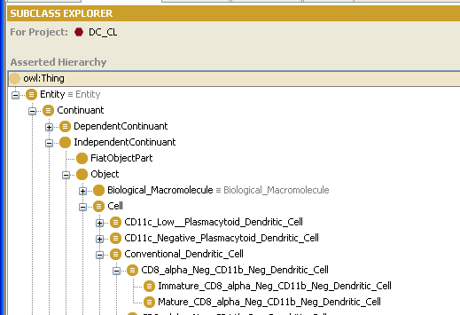
Example: The Cell Ontology

Slide 13
OBI Collaborating Communities
Environmental Genomics MGED RSBI Group
Genomic Standards Consortium (GSC)
HUPO Proteomics Standards Initiative (PSI)
Immunology Database and Analysis Portal
Immune Epitope Database and Analysis Resource (IEDB)
International Society for Analytical Cytology
Metabolomics Standards Initiative (MSI),
Neurogenetics, Biomedical Informatics Research Network (BIRN)
Nutrigenomics MGED RSBI Group
Toxicogenomics MGED RSBI Group
Transcriptomics MGED Ontology Group

Slide 14
IDO (Infectious Disease Ontology) Consortium
MITRE, Mount Sinai, UTSouthwestern – Influenza
IMBB/VectorBase – Vector borne diseases (A. gambiae, A. aegypti, I. scapularis, C. pipiens, P. humanus)
Colorado State University – Dengue Fever
Duke University – Tuberculosis, Staph. aureus
Cleveland Clinic – Infective Endocarditis
University of Michigan – Brucilosis
University of Michigan – Vaccine Ontology

Slide 15
Three criteria of a successful standard
intelligibility to users, consistent use of terms like ‘term’, ‘class’, ‘entity’, ‘object’ …)
track record of lessons learned (GO has 10 years of hard user testing)
lots of existing users (ontologies are like telephone networks)

