Slide 1
BIOLOGICAL DOMAIN ONTOLOGIES &
BASIC FORMAL ONTOLOGY
Barry Smith

Slide 2
SIMPLE TOP BIO
very-top - A few very general categories
  top-self-standing - The heart of the real top ontology
    additional-self-standing - Some additional things that may be more controversial
      refining-entities-and-properties - the key modifiers
        quantities - a very basic ontology of quantities sufficient for demo only
        basic-substances - the basic notions of substances including water

Slide 3
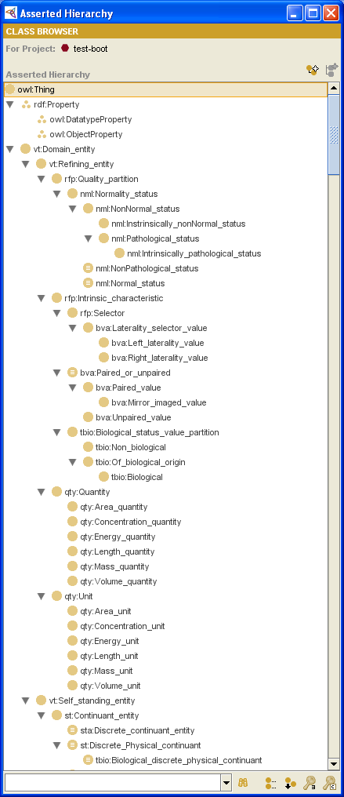
Implementation independence

Slide 4
ontologies should consist of singular count nouns

Slide 5
non-nouns mixed with nouns

Slide 6
what is ‘intrinsic’?

Slide 7
Divide the labor

Slide 8
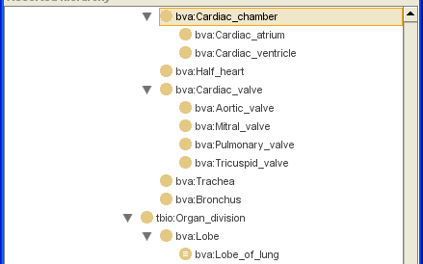
Divide the labor

Slide 9
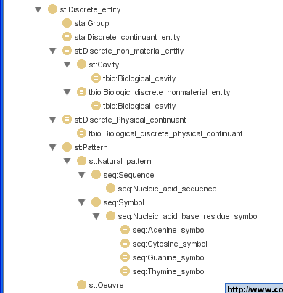
What is ‘natural’?

Slide 10
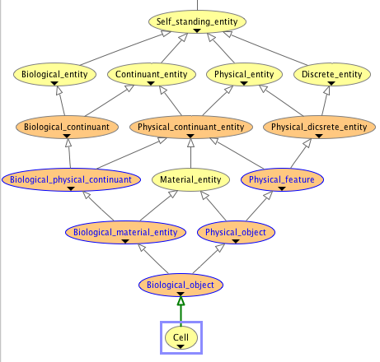
is it significant that this was not produced by a human being?

Slide 11
Why give non-gurus so little guidance?

Slide 12
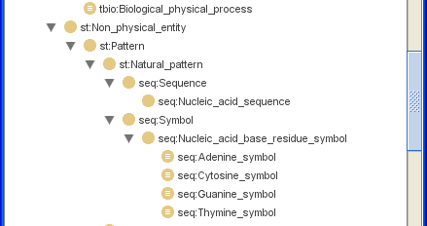
even ‘examples’ can cause problems if they are not part of an effort to build unitary consensus

Slide 13
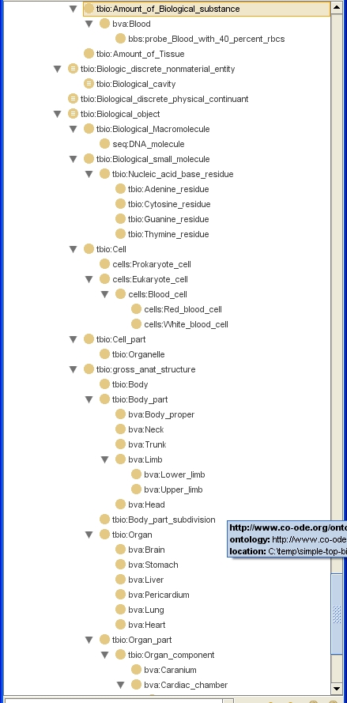

Slide 14
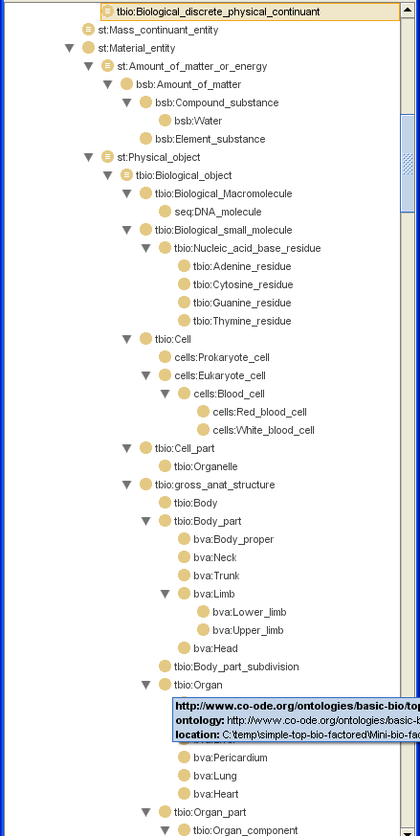

Slide 15
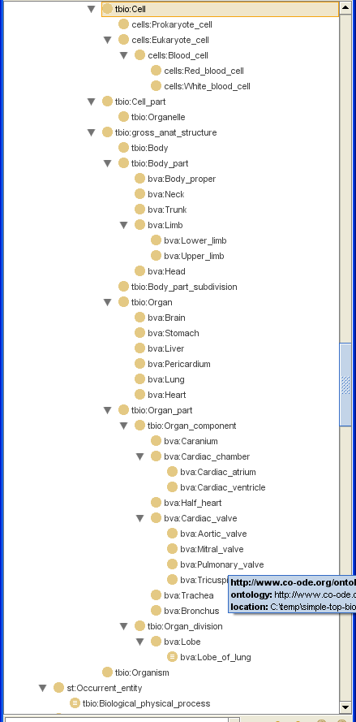

Slide 16
The practical problem of ontology integration
will get worse
Gene Ontology
OBO Foundry
OBI (Ontology for Biomedical Investigations)
... SNOMED CT
The leaders in the field should be enforcing decisions where multiple choices are available which would be of equal worth
Enforcement is a public good
Cf. International Standardized System of Units

Slide 17
OBO-UBO
= BFO + root nodes of OBO Foundry Ontologies
Why BFO? Very small [ < 40 nodes]
(contra SIMPLETOPBIO and BIOTOP)
Realist (contra DOLCE = Descriptive Ontology for Linguistic and Cognitive Engineering)
Onto-Clean and other constraints built in

Slide 18
BFO Top-Level Ontology
Continuant
Occurrent
(always dependent
on one or more
independent
continuants)
Independent
Continuant
Dependent
Continuant

Slide 19
= A representation of top-level types
Continuant
Occurrent
biological process
biological process
Independent
Continuant
Dependent
Continuant
cell component
molecular function

Slide 20
Top-Level Ontology
Continuant
Occurrent
Independent
Continuant
Dependent
Continuant
Side-Effect,
Stochastic
Process, ...
Function
Functioning

Slide 21
Top-Level Ontology
Continuant
Occurrent
Independent
Continuant
Dependent
Continuant
Functioning
Side-Effect,
Stochastic
Process, ...
Function

Slide 22
Top-Level Ontology
Continuant
Occurrent
Independent
Continuant
Dependent
Continuant
Functioning
Side-Effect,
Stochastic
Process, ...
Quality
Function
Spatial
Region
instances (in space and time)

Slide 23
Dependent Continuants
Continuant
Independent
Continuant
Dependent
Continuant
Quality
Realizable
Dependent
Continuant

Slide 24
Dependent Continuants
Dependent
Continuant
Qualities:
unary: my temperature
relational: John’s love for Mary
Quality
Realizable
Dependent
Continuant

Slide 25
Dependent
Continuants
Dependent
Continuant
Quality
Function
Unary
Quality
Relational
Quality
unary quality: my temperature
relational quality: John’s love for Mary

Slide 26
Dependent
Continuants
Dependent
Continuant
Realizable
Dependent
Continuant
Quality
Unary
Quality
Relational
Quality

Slide 27
Dependent
Continuants
Dependent
Continuant
Realizable
Dependent
Continuant
Quality
Function
Disposition
Plan
Role

Slide 28
No need for a top-level bio-ontology
Continuant
Occurrent
GO-biological process
Independent
Continuant
Dependent
Continuant
GO-cell component
GO-molecular function
OBO-UBO = BFO + add granularity

Slide 29
RELATION TO TIME GRANULARITY | CONTINUANT |  |  |  | OCCURRENT
 | INDEPENDENT |  | DEPENDENT
ORGAN AND ORGANISM | Organism (NCBI Taxonomy) | Anatomical Entity (FMA, CARO) | Organ Function (FMP, CPRO) | Phenotypic Quality (PaTO) | Biological Process (GO)
CELL AND CELLULAR COMPONENT | Cell (CL) | Cellular Component (FMA, GO) | Cellular Function (GO)
MOLECULE | Molecule (ChEBI, SO, RnaO, PrO) |  | Molecular Function (GO) |  | Molecular Process (GO)
Building out from the original GO

Slide 30
Ontology | Scope | URL | Custodians
Cell Ontology (CL) | cell types from prokaryotes to mammals | obo.sourceforge.net/cgi- bin/detail.cgi?cell | Jonathan Bard, Michael Ashburner, Oliver Hofman
Chemical Entities of Bio- logical Interest (ChEBI) | molecular entities | ebi.ac.uk/chebi | Paula Dematos, Rafael Alcantara
Common Anatomy Refer- ence Ontology (CARO) | anatomical structures in human and model organisms | (under development) | Melissa Haendel, Terry Hayamizu, Cornelius Rosse, David Sutherland,
Foundational Model of Anatomy (FMA) | structure of the human body | fma.biostr.washington. edu | JLV Mejino Jr., Cornelius Rosse
Ontology for Biomedical Investigations | design, protocol, data instrumentation, and analysis | obi.sf.net | OBI Working Group
Gene Ontology (GO) | cellular components, molecular functions, biological processes | www.geneontology.org | Gene Ontology Consortium
Phenotypic Quality Ontology (PaTO) | qualities of anatomical structures | obo.sourceforge.net/cgi -bin/ detail.cgi? attribute_and_value | Michael Ashburner, Suzanna Lewis, Georgios Gkoutos
Protein Ontology (PrO) | protein types and modifications | (under development) | Protein Ontology Consortium
Relation Ontology (RO) | relations | obo.sf.net/relationship | Barry Smith, Chris Mungall
RNA Ontology (RnaO) | three-dimensional RNA structures | (under development) | RNA Ontology Consortium
Sequence Ontology (SO) | properties and features of nucleic sequences | song.sf.net | Karen Eilbeck

Slide 31
Information objects
pdf file
poem
symphony
algorithm
symbol
sequence
molecular structure

Slide 32
Specifically Dependent Continuants
Specifically
Dependent
Continuant
if any bearer ceases to exist, then the quality or function ceases to exist
Quality
Realizable
Dependent
Continuant

Slide 33
Generically Dependent Continuants
Generically
Dependent
Continuant
if one bearer ceases to exist, then an information object can survive, because there are other bearers
Information
Object
Sequence

Slide 34
Generically dependent continuants
are realized through being concretized in specifically dependent continuants
(the plan in your head, the protocol being realized by your research team)

Slide 35
Generically dependent continuants are distinct from types / universals
they have a different kind of provenance
  ‘a’ as universal (type)
  ‘a’ as letter of the Roman alphabet
  aspirin as product of Bayer GmbH
  aspirin as molecular structure

Slide 36
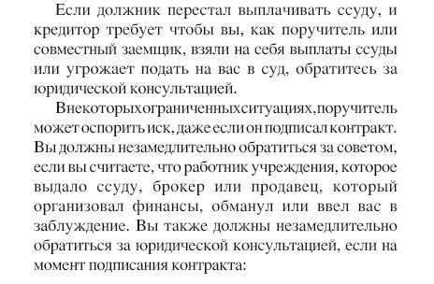

Slide 37
Generically Dependent Continuants
Generically
Dependent
Continuant
Information
Object
Sequence
.pdf file
.doc file
instances

