Slide 1
The Logic of Biological Classification
Barry Smith
http://ontologist.com

Slide 2
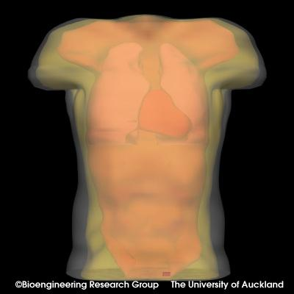
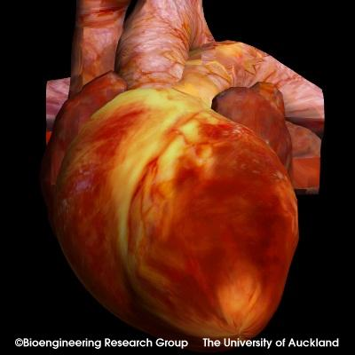
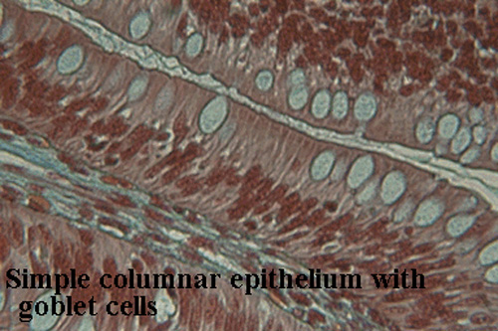
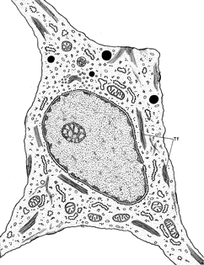
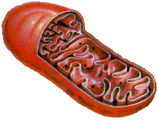
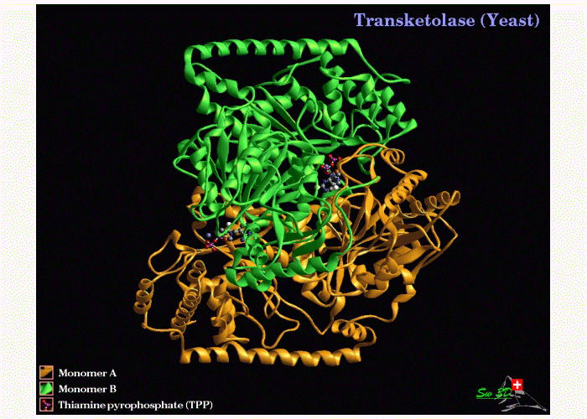
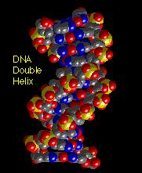
Organism
Organ
Tissue
10⁻¹ m
Cell
Organelle
10⁻⁵ m
Protein
DNA
10⁻⁹ m

Slide 3
A new golden age of classification
30,000 genes in human
200,000 proteins
100s of cell types
100,000s of disease types
1,000,000s of biochemical pathways (including disease pathways)
… legacy of Human Genome Project

Slide 4
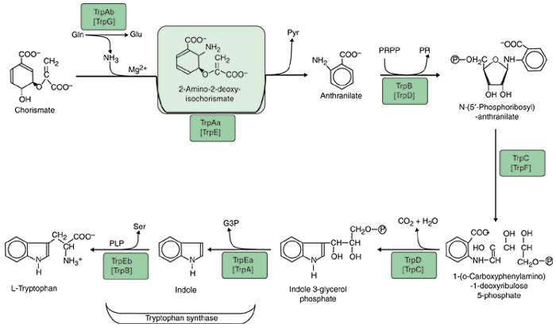

Slide 5
“annotations”
controlled vocabularies

Slide 6
How overcome incompatibilities between different scientific index terms?
immunology
genetics
cell biology

Slide 7
An alternative answer:
“Ontology”

Slide 8
Ontology, roughly:
Overcome terminological incompatibilities by creating a standardized terminology into which diverse vocabularies can be mapped
Can we do better ?

Slide 9
Unified Medical Language System (UMLS)
UMLS Metathesaurus:
1 million biomedical concepts
2.8 million concept names
from more than 100 controlled vocabularies and classifications
built by US National Library of Medicine

Slide 10
To reap the benefits of standardization
we need to make ONE SYSTEM out of many different terminologies
= UMLS “Semantic Network”
nearest thing to an “ontology” in the UMLS

Slide 11
UMLS SN
134 Semantic Types
54 types of edges (relations)
yielding a graph containing more than 6,000 edges

Slide 12
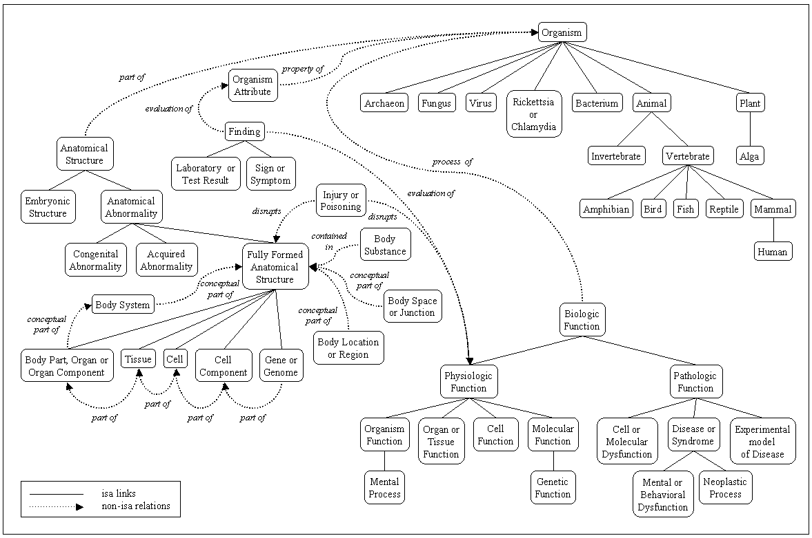
Fragment of UMLS SN

Slide 13
UMLS Semantic Network
entity
physical conceptual
object entity
organism
is_a

Slide 14
Fruit
similarTo
Vegetable
NarrowerTerm
Orange
Apfelsine
synonymWith
Graph with labels edges (similarTo, Narrower, synonymWith)
Fixed set of edge labels (a.k.a. relations)
Goble & Shadbolt

Slide 15
UMLS SN
is_a =_{def.}
If one item ‘is_a’ another item then the first item is more specific in meaning than the second item. (Italics added)

Slide 16
fish is_a vertebrate
copulation is_a biological process
both testes is_a testis
plant parts is_a plant

Slide 17
Fragment of UMLS SN

Slide 19
What are the nodes in this graph?
Almost all nodes are linked to other nodes by a multiplicity of different types of edges
Compare: swimming is healthy
swimming has 8 letters

Slide 20
Semantic Network Definition:
Concept =_{def.} An abstract concept, such as a social, religious, or philosophical concept
UMLS Definition:
Concept =_{def.} A class of synonymous terms

Slide 22
How can concepts figure as relata of these relations?
part_of = def. Composes, with one or more other physical units, some larger whole
causes =def. Brings about a condition or an effect.
contains =def. Holds or is the receptacle for fluids or other substances.

Slide 23
How can a set of synonymous terms serve as a receptacle for fluids or other substances?
How can sets of synonymous terms stand in relations such as affects or causes?

Slide 24
connected_to =def.
Directly attached to another physical unit as tendons are connected to muscles.
How can a concept be directly attached to another physical unit?

Slide 25
What are the relata which are linked by the edges in the SN graph?

Slide 26
To answer this question
we need to distinguish clearly between concepts and classes:
concepts are creatures of cognition
classes are invariants (types, kinds, universals) out there in reality

Slide 27
If ontologies are about meanings / concepts
it becomes impossible to deal coherently with those relations between entities in reality which involve appeal to both classes and their instances.

Slide 28
Illustration re: part_of
heart part_of human
human heart part_of human
testis part_of human
human testis part_of human

Slide 29
Almost all of the 54 types of edges in SN are dealt with incoherently
part_of HAS INVERSE has_part
nucleus part_of cell
cell has_part nucleus

Slide 30
Experimental Model of Disease affects Fungus
Bacterium causes Experimental Model of Disease
Biomedical or Dental Material causes Mental or Behavioral Dysfunction
Manufactured Object causes Disease or Syndrome

Slide 31
How to do better?

Slide 32
How to do better?
How to create a network of biomedically relevant terms/classes, with coherently defined relations between them, to which expert terms of the UMLS can be assigned in a maximally intelligible way?

Slide 33
How to understand biological classes?
Classes are not concepts but universals in re
Class hierarchies reflect invariants in reality
(cf. the Periodic Table of the Elements)

Slide 34
biological classes are universals
not sets

Slide 35
sets are timeless
A set is an abstract structure, existing outside time and space. The set of human beings existing at t is (timelessly) a different entity from the set of human beings existing at t′ because of births and deaths.
Biological classes exist in time

Slide 36
Sets are mathematical entities
A set with n members has in every case exactly 2n subsets
The subclasses of a class are limited in number
(which classes are subsumed by a larger class is a matter for empirical science to determine)
Classes reflect a sparse ontology à la David Lewis / David Armstrong

Slide 37
Entities

Slide 38
Entities
universals (classes, types, taxa, …)
particulars (individuals, tokens, instances …)
Axiom: Nothing is both a universal and a particular

Slide 39
Two Kinds of Elite Entities
classes, within the realm of universals
instances within the realm of particulars

Slide 40
Entities
classes

Slide 41
Entities
classes*
*natural kinds, biological universals

Slide 42
Entities
classes of objects, substances
need modified axioms for classes of functions, processes, pathways, reactions, etc.

Slide 43
Entities
classes
instances

Slide 44
Classes are natural kinds
Instances are natural exemplars of natural kinds
(problem of non-standard instances)
Not all individuals are instances of classes

Slide 45
Entities
classes
instances
instances
penumbra of borderline cases

Slide 46
Primitive relations: inst and part
inst(Jane, human)
part(Jane’s heart, Jane’s body)
A class is anything that is instantiated
An instance as anything (any individual) that instantiates some class

Slide 47
Entities
human
inst
Jane

Slide 48
Entities
human
Jane’s heart part_ofJane

Slide 49
part_of as a relation between individuals
subject to the usual axioms of mereology
inst
a relation between an instance and a class

Slide 50
is_a
a relation between one class and another parent class

Slide 51
A is_a B
genus(A)
species(A)
classes
instances

Slide 52
is_a
genus(A)=def class(A) ∧ ∃B (B is_a A ∧ B ≠ A)
species(A)=def class(A) ∧ ∃B (A is_a B ∧ B ≠ A)

Slide 53
nearest species
nearestspecies(A, B)=_{def} A is_a B &
∀C ((A is_a C & C is_a B) → (C = A or C = B)
B
A

Slide 54
Definitions
highest genus
lowest species
instances

Slide 55
Axioms
Every class has at least one instance
Distinct lowest species never share instances
SINGLE INHERITANCE:
Every species is the nearest species to exactly one genus

Slide 56
Axioms governing inst
genus(A) & inst(x, A) →
∃B nearestspecies(B, A) & inst(x, B)
EVERY GENUS HAS AN INSTANTIATED SPECIES
nearestspecies(A, B) → A’s instances are properly included in B’s instances
EACH SPECIES HAS A SMALLER CLASS OF INSTANCES THAN ITS GENUS

Slide 57
Axioms
nearestspecies(B, A)
→ ∃C (nearestspecies(C, A) & B ≠ C)
EVERY GENUS HAS AT LEAST TWO CHILDREN
nearestspecies(B, A) & nearestspecies(C, A) & B ≠ C) → not-∃x (inst(x, B) & inst(x, C))
SPECIES OF A COMMON GENUS NEVER SHARE INSTANCES

Slide 58
Theorems
(genus(A) & inst(x, A)) → ∃B (lowestspecies(B) & B is_a A & inst(x, B))
EVERY INSTANCE IS ALSO AN INSTANCE OF SOME LOWEST SPECIES
(genus(A) & lowestspecies(B) & ∃x(inst(x, A) & inst(x, B)) → B is_a A)
IF AN INSTANCE OF A LOWEST SPECIES IS AN INSTANCE OF A GENUS THEN THE LOWEST SPECIES IS A CHILD OF THE GENUS

Slide 59
Theorems
class(A) & class(B) → (A = B or A is_a B or B is_a A or not-∃x(inst(x, A) & inst(x, B)))
DISTINCT CLASSES EITHER STAND IN A PARENT-CHILD RELATIONSHIP OR THEY HAVE NO INSTANCES IN COMMON

Slide 60
Open Biological Ontologies Consortium
Gene Ontology
Cell Ontology
Sequence Ontology
Mouse Anatomy Ontology
etc.
http://obo.sourceforge.net/

Slide 61
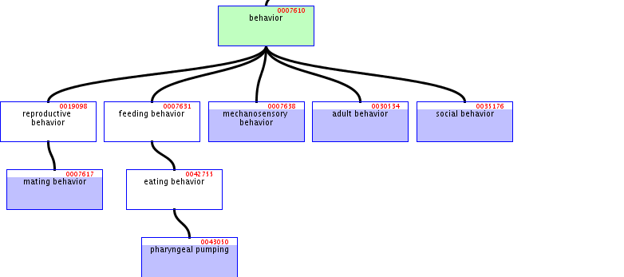

Slide 62
Ten OBO relations
is_a
part_of
three spatial relations:
located_at
contained_in
adjacent_to
three temporal relations:
transformation_of
derives_from
preceded_by
two participation relations
has_participant
functioning_of

Slide 63
The ontologies in OBO are designed to serve as controlled vocabularies for the expression of the results of biological science.
‘A relation B’ expresses some general truth about the biological classes A and B.
Facts about corresponding instances or tokens (for example about the mass of this particular tissue sample taken from this particular lung), while indispensable to biomedical research, do not belong to the general truths of biological science
But the logical vocabulary for talking about such instances is still needed

Slide 64
Types of Relations
<class, class>: for example the is_a relation obtaining the class exocytosis and the class secretion
<instance, class>: for example the relation instance_of obtaining between this particular vesicle membrane and the class vesicle membrane
<instance, instance>: for example the instance-level part_of relation obtaining between this particular vesicle membrane and the endomembrane system in the corresponding cell

Slide 65
Components vs. processes
continuants (things, objects, endurants) vs. occurrents (activities, events, perdurants).
components can be material (a nucleus, a cell), or immaterial (a pleural cavity).
both distinguished from spatial regions
Components preserve their identity through time while undergoing changes
Processes unfold themselves from one temporal instant to the next
Both spatial regions and times can be thought of as special kinds of instances

Slide 66
Variables
C, C1, ... to range over classes of components;
P, P1, ... to range over classes of processes;
c, c1, ... to range over instances of components;
p, p1, ... to range over instances of processes;
r, r1, ... to range over three-dimensional spatial regions;
t, t1, ... to range over times.

Slide 67
9 Primitive Instance-Level Relations
c instance_of C at t;
p instance_of P
c part_of c1 at t
p part_of p1
r part_of r1
c located_at r at t
r adjacent_to r1
t earlier t1
p has_participant c at t

Slide 68
4. Is_a
It is commonly assumed in the literature of knowledge representation that the relation is_a can be identified with the subset or set inclusion relation with which we are familiar from mathematical set theory. <Stoll> This would yield a definition of A is_a B along the lines of:
for all x, if x instance_of A, then x instance_of B,
where instance_of functions as the counterpart of the usual set-theoretic membership relation. Unfortunately, this reading provides at best a necessary condition for the truth of A is_a B. It falls short of providing a sufficient condition (1) because it fails to take account of time, so that when applied to classes of components it yields false positives such as adult is_a child; and (2) because it admits cases of contingent inclusion – such as: mammal in Saarbrücken is_a mammal, or: mammal is_a mammal weighing less than 2000Kg – which would not normally be admitted as is_a relations in biological ontologies because they do not reflect biological truths. Examples of the given kind are problematic also because they give rise to cases of multiple inheritance – where a given class stands in an immediate is_a relation to a plurality of parent classes – and this is, for a variety of reasons, something which should be avoided in the treatment of is_a relations in bio-ontologies <Smith, Köhler, Kumar>.
We resolve problem (1) by exploiting our machinery for taking account of time in the assertion of is_a relations involving components. We can go some way to resolving problem (2) by insisting that our variables, C, C1, … , P, P1, … range only over genuine biological classes, i.e., again, over those classes which are referred to by the general terms used in textbooks of biology.
We can then define:

Slide 69
Is_a
C is_a C1 =def. given any c and any t, if c instance_of C at t then c instance_of C1 at t.
P is_a P1 =def. given any p, if p instance_of P then p instance_of P1.
Abbreviations
Cct := c instance-of C at t
Pp := p instance_of P

Slide 70
Is_a
C is_a C1 =def. ∀c ∀t, Cct → Cc₁t
P is_a P1 =def. ∀p, Pp → P₁p

Slide 71
Instance-Level Parthood
primitives
c part_of c1 at t
p part_of p1
reflexive
anti-symmetric
transitive
p₁ overlap p₂ =def. ∃p (p part_of p₁ & p part_of p₂)
p₁ discrete_from p₂ =def. ¬ (p₁ overlap p₂)

Slide 72
Parthood as a Relation Between Classes
C part_of C₁ =def. ∀c ∀t, Cct → ∃c₁ (C₁c₁t₁ & c part_of c₁ at t )
P part_of P₁ =def. ∀p, Pp → ∃p₁ (P₁p₁ & p part_of p₁ )
A part_of B in either case an assertion about As
Remember: human testis part_of human

Slide 73
Located_at
primitive c located_at r at t (exact location)
define:
c located_at c1 at t =def. ∀r∀r₁ [(c located_at r at t & c₁ located_at r₁ at t) → r part_of r₁]
e.g.
a portion of fluid exactly fills a cavity,
brain in head
c part_of c₁ at t → c located_at c₁ at t

Slide 74
Located_at as a Relation between Classes
C located_at C₁ =def. ∀c∀t [Cct → ∃c₁ (C₁c₁t & c located_at c₁ at t )
Examples: DNA located_at nucleus, ribosome located_at cytoplasm.
Note that C located_at C1 is an assertion about Cs only; it does not tell us that C1s have Cs located in them.

Slide 75
Contained_in
lung contained_in thoracic cavity
bladder contained in pelvic cavity
c contained_in c₁ at t =def. c located_at. c₁ at t & ¬ (c part_of c₁ at t )
On the class level:
C contained_in C₁ =def. ∀c∀t Cct → ∃c₁ (C₁c₁t and c contained_in c₁ at t )

Slide 76
Adjacent_to
primitive: r₁ adjacent_to r₂
axiom: r₁ adjacent_to r₂ → ¬ (r₁ overlap r₂)
c₁ adjacent_to c₂ at t
=def. ∃r₁∃ r₂ (c₁ located_at r₁ at t & c₂ located_at r₂ at t & r₁ adjacent_to r₂ )

Slide 77
Class-level adjacency
right pulmonary artery adjacent_to right principal bronchus
C₁ touches C₂
=def. ∀c₁∀t [C₁c₁t, → ∃c₂(C₂c₂t &
c₁ adjacent _to c₂ at t )
C₁ touches C₂ is an assertion about C₁s
C₁ adjacent_to C₂ =def. C₁ touches C₂ & C₂ touches C₁

Slide 78
Transformation_of
a component preserves its identity while instantiating distinct classes at distinct times
larval oenocyte transformation_of embryonic oenocyte
mature RNA transformation_of pre-RNA
At higher levels of granularity transformation is called development e.g. of fetus from embryo, of child from fetus, of adult from child
C transformation_of C₁ =def. ∀c∀t [Cct → ∃ t₁ (C₁ct₁ & t₁ earlier t)
C transformation_of C1 is a statement about Cs

Slide 79
Derives_from
fetus derives_from adult
zygote derives_from ovum
corpse derives_from adult
neuron derives_from neuroblast
muscle cell derives_from myoblast

Slide 80
Derives_from
Three cases:
a sharing of parts between two components across a temporal threshold (example: derivation of embryo from zygote);
a separation or fission of one or more parts within the earlier component (example: budding in yeast);
the fusion of two or more components into one successor component.
all have in common that the first phase of the derived component’s existence occurs within some one or more predecessor components
Thus the first phase of the erythroblast occurs within the locus of the proerythroblast.

Slide 81
C derives_ from C₁
=def. ∀c∀t [Cct → ∃c₁∃t₁ (C₁c₁t₁ &
t₁ earlier t &
c derives_from c₁)]
Lineages (ancestral of derives_from)
human derives_from immediate biological ancestor

Slide 82
C₁
c₁ at t₁
C
c at t
C₁
c₁ at t₁
C₁
c₁ at t
C
c at t

Slide 83
Preceded_by
Primitives: earlier, has_participant
Define: p occurring_at t
=def ∃c (p has_participant c at t )
t first_instant p =def. p occurring_at t &
∀t₁(t₁ earlier t → ¬ (p occurring_at t₁)
t last_instant p =def. p occurring_at t & ∀t₁(t earlier t₁ → ¬ (p occurring_at t₁)
p preceded_by p₁ =def. ∀t∀t₁ [(t first_instant p & t₁ last_instant p₁ ) → t₁ earlier t ]

Slide 84
preceded_by as a relation between classes
P preceded_by P₁ =def. ∀p [Pp → ∃p₁ (P₁p₁ and p preceded_by p₁)]
translation preceded_by transcription
aging preceded_by development
death preceded_by birth
If cells of type C1 derive_from cells of type C, then any cell division involving an instance of C1 in a given lineage is preceded by a cell division involving an instance of C.
Note also that P preceded_by P1 tells us something about instances of P.
preceded_by is a rather weak relation

Slide 85
Has_participant
primitive instance-level relation, e.g.:
this particular process of oxygen exchange across this particular alveolar membrane has_participant this particular sample of hemoglobin at this particular time.

Slide 86
has_participant as a relation between classes
P has_participant C =def. ∀p [Pp → ∃t ∃c (Cct & p has_participant c at t)]
cell transport has_participant cell
death has_participant organism
breathing has_participant thorax.
agent or patient participation
special types of agency include: regulation, promotion, inhibition, functioning

Slide 87
Functioning_of
this process of pumping functioning_of this heart.
P functioning_of C =def. given any p, if Pp then there is some c and some t such that Cct and p functioning_of c at t.
dormant and unrealized functions, for example of a sperm: to penetrate the ovum
malfunctioning, for example when your heart pumps blood weakly or irregularly.
Functions are dependent continuants

Slide 88
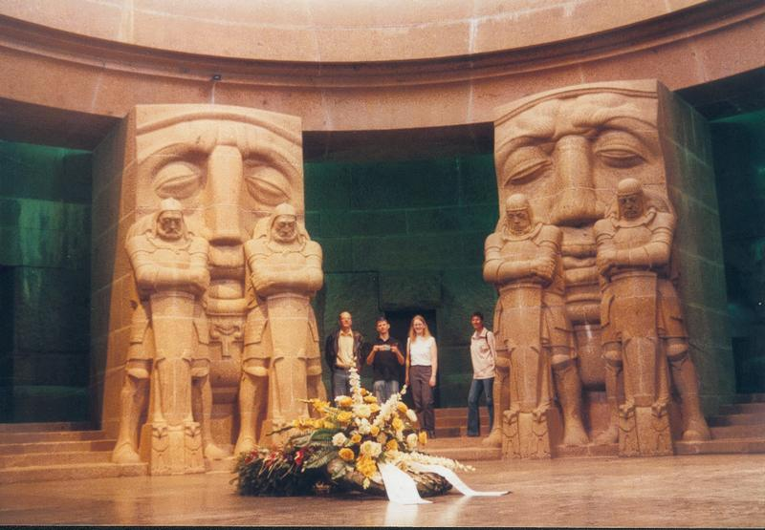
The End

