Slide 1
A taxonomy of granular partitions
Thomas Bittner and Barry Smith
Northwestern University,
NCGIA and SUNY Buffalo

Slide 2
Overview
Introduction
The theory of granular partitions - overview
Granular partitions and their projective relation to reality
A classification of granular partitions
Conclusions

Slide 3
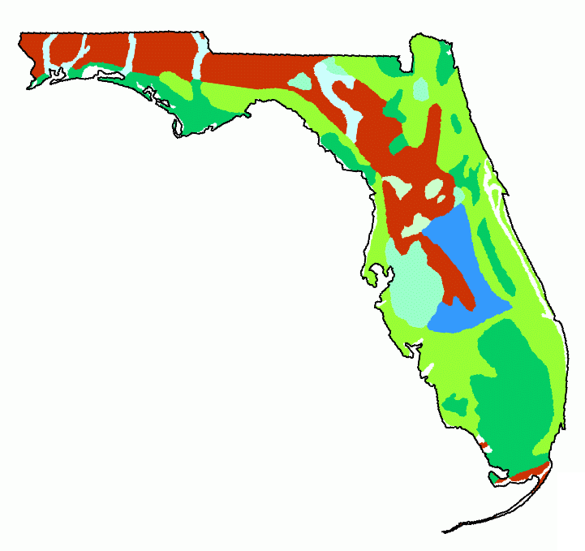
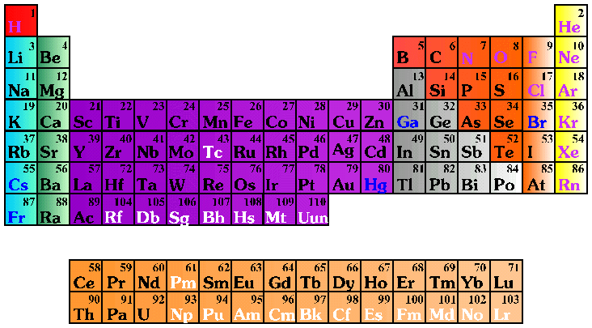
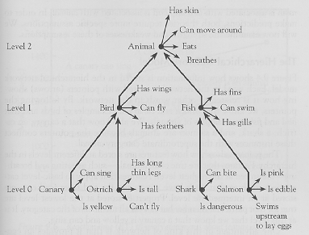
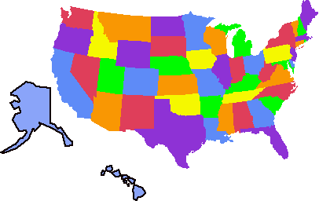
Granular Partitions

Slide 4
Theory of granular partitions
Goals
  A theory of our listing, sorting, cataloguing, categorizing, and mapping human activities
  explain the selectivity of these cognitive activities
  extend mereology with the feature of granularity
  and provide an alternative to set theory as a tool to formalize common sense

Slide 5
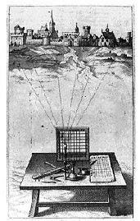
Theory of granular partitions (2)
Major assumptions:
There is a projective relation between cognitive subjects and reality
Humans ‘see’ reality through a grid
The ‘grid’ is usually not regular and raster shaped

Slide 6
Theory of granular partitions (3)
Major assumptions
  This projective relation can reflect the mereological structure of reality
  Projection is an active process:
    it brings certain features of reality into the foreground of our attention (and leaves others in the background)
    it brings fiat objects into existence
  Granular partitions are only distantly related to (mathematical) partitions formed by equivalence relations

Slide 7
Projective relation to reality

Slide 8

Projection of cells (1)
Cell structure
Projection
Targets in reality
Hydrogen
Lithium

Slide 9
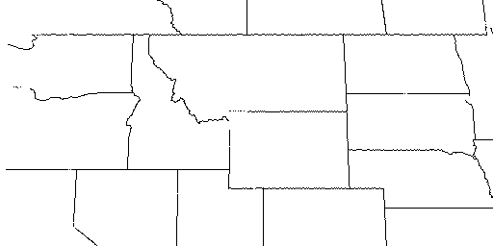
Projection of cells (2)
Cell structure
Projection
North America
…
Montana
Idaho
Wyoming
…

Slide 10
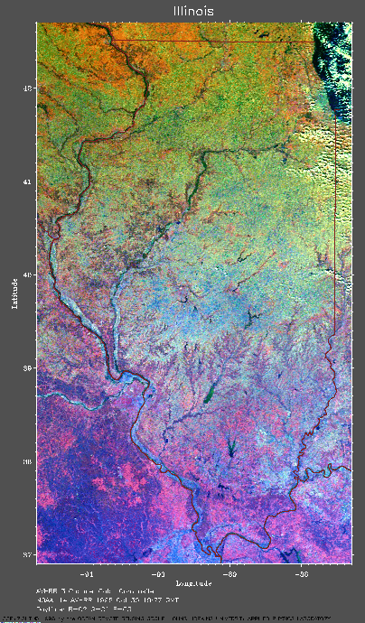
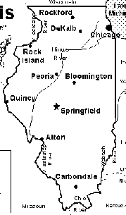
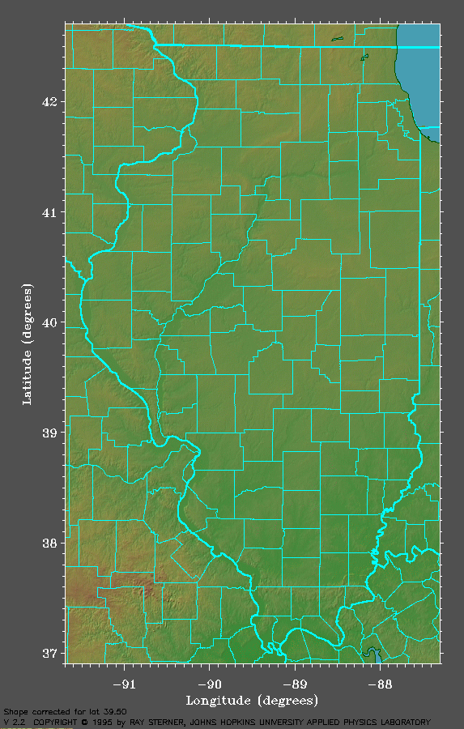
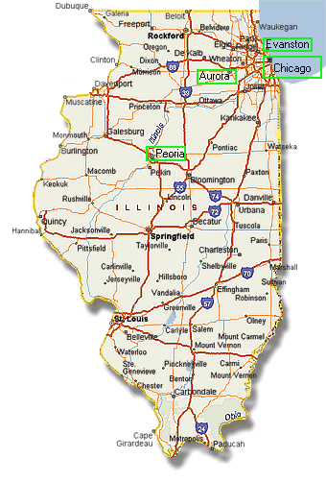
Multiple ways of projecting
Big city
partition
County
partition
Highway
partition

Slide 11
Theory of granular partitions (4)
Core components (master conditions)
  Cell structures (Theory A)
    Subcell relation
    Minimal, maximal cell
    Trees, Venn-diagrams
  Projective relation to reality (Theory B)
    Projection and location
    Projection is a partial, functional, (sometimes) mereology-preserving relation

Slide 12
Theory A

Slide 13
Systems of cells
Subcell relation
  Reflexive, transitive, antisymmtric
The cell structure of a granular partition
  Has a unique maximal cell
    ‘Idaho’ in the county partition of Idaho
    The periodic table as a whole
  Each cell is connected to the root by a finite chain
  Every pair of cells is either in subcell or disjointness relation

Slide 14
Cell structures and trees
Cell structures can be represented as trees and vice versa
Animal
Bird
Fish
Canary
Shark
Ostrich
Salmon

Slide 15
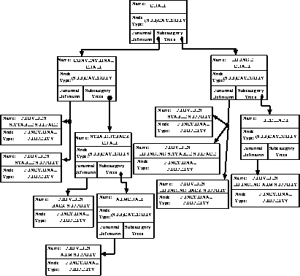
A category tree

Slide 16
Theory B

Slide 17

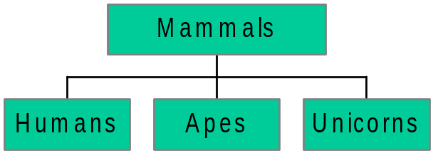

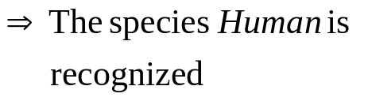
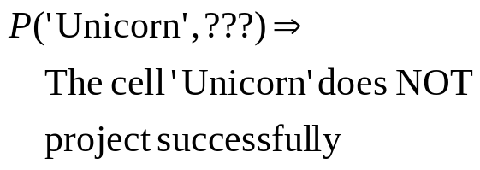
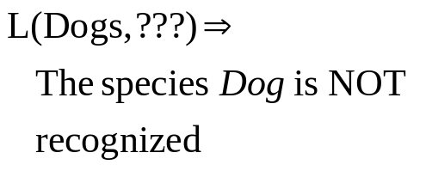
Projection and location
Humans
Apes
Dogs
Mammals

Slide 18
Misprojection
…
Idaho
Montana
Wyoming
…
P(‘Idaho’,Montana) but NOT L(Montana,’Idaho’)
P(‘Montana’,Idaho) but NOT L(Idaho,’Montana’)
P(‘Wyoming’,Wyoming) AND L(Wyoming,’Wyoming’)

Slide 19
Transparency of projection (1)
A granular partition projects transparently onto reality if and only if
  Location presupposes projection
  L(o,z) ⇒ P(z,o)
  There is no misprojection
  P(z,o) ⇒ L(o,z)

Slide 20
Transparency of projection (2)
Still: there may be irregularities of correspondence
  There may be cells that do not project (e.g. ‘unicorn’)
  Multiple cells may target the same object
  There may be ‘forgotten’ objects (e.g. the species dog above)

Slide 21
Functionality constraints (1)
Two cells projecting onto the same object
Morning Star
Evening Star
Venus
Location is functional:
If an object is located in two cells then these cells are identical, i.e., L(o,z₁) and L(o,z₂) ⇒ z₁ = z₂

Slide 22
Functionality constraints (2)
The same name for the two different things:
Republic of China
China
People’s Republic of China
Projection is functional:
If two objects are targeted by the same cell then they are identical, I.e., P(z,o₁) and P(z,o₂) ⇒ o₁ = o₂

Slide 23

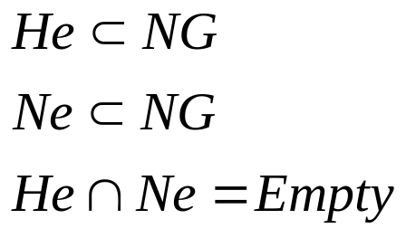
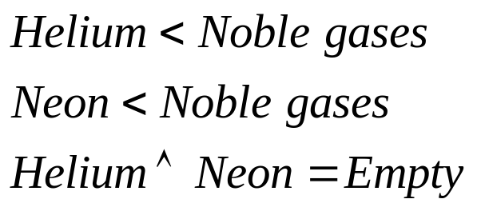
Preserve mereological structure
Helium
Neon
Noble gases
Potential of preserving mereological structure

Slide 24
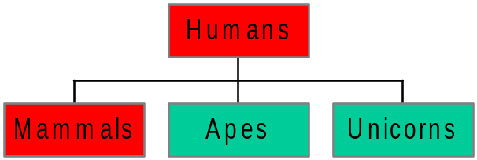
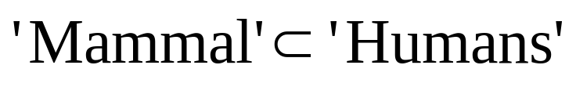
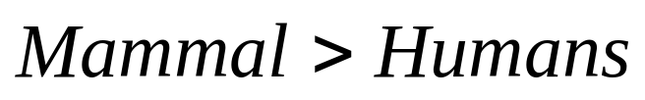
Partitions should not distort mereological structure
distortion
Humans
Apes
Dogs
Mammals
If a cell is a proper subcell of another cell then the object targeted
by the first is a proper part of the object targeted by the second.

Slide 25
Features of granular partitions
Selectivity
  Only a few features are in the foreground of attention
Granularity
  Recognizing a whole without recognizing all of its parts
Preserve mereological structure

Slide 26
Selectivity

Slide 27
Granularity
Recognizing a whole without recognizing all of its parts

Slide 28
Classification of granular partitions

Slide 29
Theory of granular partitions (4)
Classes of granular partitions according to
  Degree of preservation of mereological structure
  Degree of completeness of correspondence
  Degree of redundancy

Slide 30
Mereological monotony
…
Helium
Noble gases
Neon
…
Helium
Neon
Noble gases
Projection preserves mereological structure
Projection does not distort mereological structure

Slide 31
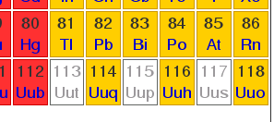

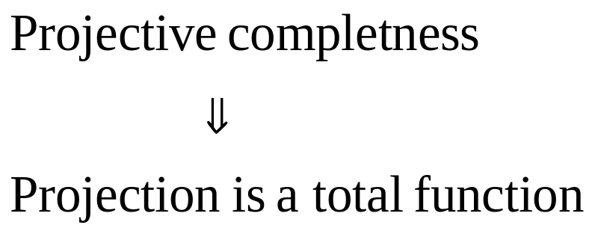
Projective completeness
In every cell there is
in object located, i.e.,
Empty cells
www.webelements.com

Slide 32
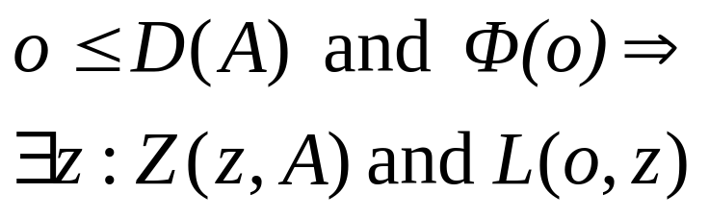
Exhaustiveness
Everything of kind ϕ in the
domain of the partition A
is recognized by some cell in A
Humans
Apes
Dogs
Mammals

Slide 33
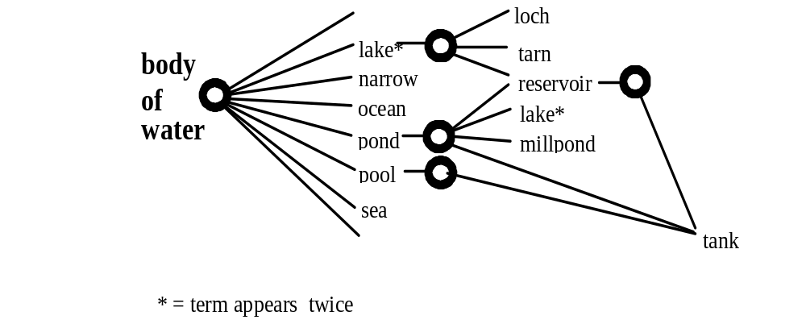
Example partitions:

Slide 34
Properties of cadastral partitions
Cell structure: stored in database
Projection carves out land-parcels (geodetic projection)
Properties
  Transparent: projection and location are total functions
  Exhaustive (no no-mans lands)
  Mereologically monotone

Slide 35
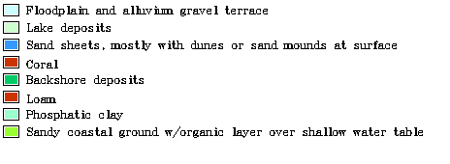
Categorical coverages
Two reciprocally dependent partitions:
Partition of an attribute domain
  E.g., land use or soil types
  Legend in a categorical map
Partition of the surface of earth into zones
  Zones of sand or clay
  Spatial subdivision

Slide 36
Properties
Attribute partition
Spatial partition
Exhaustive relative to the spatial component
Complete (no empty cell)
Exhaustive (no no-mans lands)
Projection and location are functional
Projection and location are total functions and mutually inverse
Potentially partial
Not necessarily mereologically monotone
Mereologically monotone
Regularity of structure and correspondence is due to the
fiat character of the subdivision

Slide 37

Folk categorization of water bodies
double cell-labels
at different levels
of hierarchy
Distorts mereological
Structure
Location is not a function
Not a tree +

Slide 38
Conclusions
Formal ontology of granular partitions
Theory underlying listing, sorting, cataloguing, categorizing, and mapping human activities
Built upon mereology
Enriches mereology with the features of selectivity and granularity
Two major parts:
  Theory A: the structure of systems of cells
  Theory B: projective relation to reality
Granular partitions can be classified regarding: completeness and exhaustiveness

Slide 39
Ongoing work
Folk and common-sense categories have weaker structure
A theory of granularity, vagueness, and approximation based on partition theory

