Slide 1
Quantum Mechanics:
No comfort for Kantians
BARRY SMITH
Institute for Formal Ontology and Medical Information Science
http://ifomis.de

Slide 2
The existence of computers
allows us to express old philosophical problems in a new light

Slide 3
Example:
The problem of the unity of science
The logical positivist solution to this problem addressed a world in which sciences are identified with
printed texts
What if sciences are identified with
Large Databases ?

Slide 4
The Database Tower of Babel Problem
Each family of databases has its own idiosyncratic terms and concepts
by means of which it represents the information it receives
How to resolve the incompatibilities which result when databases need to be merged?
Compare: how to unify biology and chemistry?

Slide 5
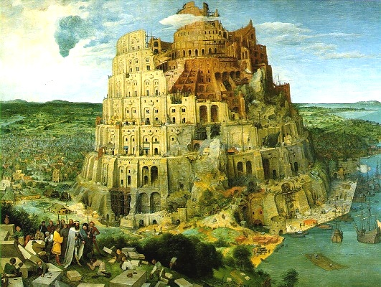

Slide 6
Another problem:
database classifications are crisp

Slide 7
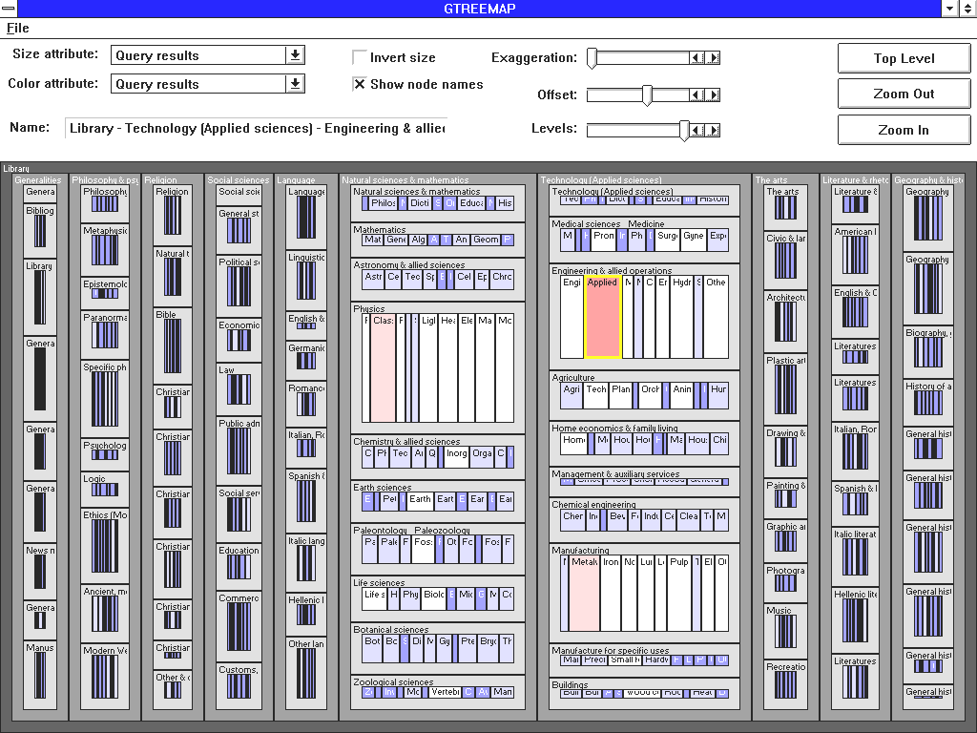
Dewey Decimal Classification as Map
Notes:
http://www2.iicm.edu/ivis/ivis/node25.htm

Slide 8
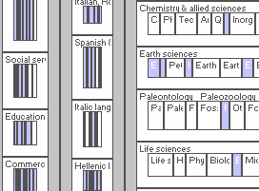
Dewey Decimal Classification (Detail)
Notes:
http://www2.iicm.edu/ivis/ivis/node25.htm

Slide 9
No borderline cases in the closed world of a database
Every book is assigned a determinate Dewey Classification Number at birth
111.560xxx

Slide 10
... and always up-to-date
To be a book = to have a reference number in the Catalogue System
Each of the ontologies produced by ontological engineers deals with objects which are constructed (Kantians would say ‚constituted‘) by the database itself

Slide 11
Sharpness of database reality vs. vagueness of flesh and blood reality
How to deal with the problem
of conceptual vagueness?
Notes:
Ontologie Eins Null

Slide 12

Theory of vagueness
How can -based
concepts be transparent, if the world is shaped like this:
?

Slide 13
the vagueness problem arises with other sort of concepts too:
dog
cat
fish
what about whales?
bird
what about ostriches?

Slide 14
Kantianism:
we shape the world (of experience) to fit our concepts
we build special worlds
(analogous to database worlds)

Slide 15
we impose concepts on reality
Reality in itself exists behind a veil
(The best we can do is tell conceptual stories ...)
Midas-touch epistemology

Slide 16
Reality itself exists behind a veil
Ontology is impossible

Slide 17
But there is an alternative
Ontological realism:
reality exists behind a
transparent grid
like a pair of spectacles

Slide 18
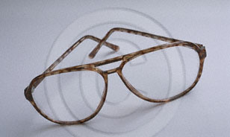

Slide 19
Thesis of ontological realism
We can grasp the world directly via many many different sorts of
transparent partitions
at many different levels of granularity

Slide 20
... | rook | bishop | pawn | knight | ...
 | John | Paul | George | Ringo
... | up | down | charm | strange | ...

Slide 21
From Species to Genera
Aristotelian hierarchical classification
bird
canary
what about ostriches?

Slide 22
Natural categories have borderline cases
bird
ostrich

Slide 23
How to deal with vagueness?
by recognizing, with Aristotle, that natural concepts come ready-equipped with a distinction between a core of prototypical instances and a penumbra of non-standard, borderline instances

Slide 24
Natural categories have a kernel/penumbra structure
penumbra of borderline cases
kernel of focal
instances

Slide 25
Every cell in a partition directed towards flesh and blood objects is subject to the same kernel/penumbra structure

Slide 26
Objects do not have to fit into their cells exactly
... as guests do not have to fit exactly in their hotel rooms

Slide 27
Modulo the kernel/penumbra structure of their constituent categories ...
all transparent partitions capture some part or dimension of reality at some level of granularity

Slide 28
The fundamental thesis of ontological realism
that many of our natural-language partitions are transparent to reality
is in fact quite trivial
it is as trivial as:
mothers exist

Slide 29
are our scientific partitions truly transparent to an independent reality ?

Slide 30
... what about quantum mechanics ?

Slide 31
D’Espagnat: Veiled Reality
Heisenbergian uncertainty implies that our cognition of physical reality
is opaque
∴ at least quantum mechanics
lends support to Kantianism

Slide 32
Surely there are no veridical (transparent) partitions at the quantum level

Slide 33
Well ...

Slide 34
... | rook | bishop | pawn | knight | ...
 | John | Paul | George | Ringo
... | up | down | charm | strange | ...

Slide 35
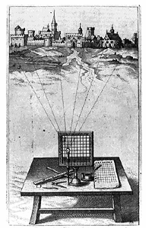

Slide 36
Coarse-grained Partition

Slide 37
Fine-Grained Partition

Slide 38
Manipulation of partitions
refinement
coarsening
gluing
restricting

Slide 39
Refinement
a partition can be refined or coarsened by adding or subtracting from its constituent cell-divisions

Slide 40
Enlargement of a partition
Partition A is enlarged by partition B iff
1. the domain of A is included in the domain of B, and,
2. A and B coincide on the domain which they share in common

Slide 41
Coarse-grained Partition

Slide 42
Coarse-grained Partition

Slide 43
Coarse-grained Partition

Slide 44
Extension of Partitions (via refinement or enlargement)
A partition A is extended by partition B if all the cells of A are cells of B
A  B

Slide 45
The realist’s ideal
A total partition of the universe, a super-partition satisfying:
“Every element of the physical reality must have a counterpart in the physical theory.”
(Einstein-Podolsky-Rosen 1935)

Slide 46
A universal partition
eine Aufteilung, die genau auf die Wirklichkeit paßt, so, alb ob kariertes Papier über die Welt wie senkrechte und wagrechte Linien gelegt wird und die Welt an ihren Gelenken aufteilt
(Hypothesis of universal realism)

Slide 47
A universal partition
Well: why not just take the product of all partitions covering each successive domain and glue them all together ?

Slide 48
Epistemological Problems
Measurement instruments are imprecise
Heisenberg swamped by this
∴ coarse-grained partitions are in any case the best that we can achieve

Slide 49
Granularity of measurement
... -20➢-10 -10 ➢ 0 0 ➢ 10 10 ➢ 20 ...
massively
increased
... normal increased
chronic ...

Slide 50
So
... can we not just take the product of all transparent partitions above a certain level of granularity and make a super-partition which would comprehend the whole of reality ?

Slide 51
Ontological Problems
In the quantum domain not all partitions are consistent

Slide 52
Consistency of Partitions
Two partitions are consistent iff there is some third partition which extends them both:
A Δ B =_{df.} ∃C(A  C ∧ B  C)

Slide 53
From Photograph to Film
From instantaneous partitions to temporally extended histories
A history is a sequence of one or more partitions at successive reference times

Slide 54
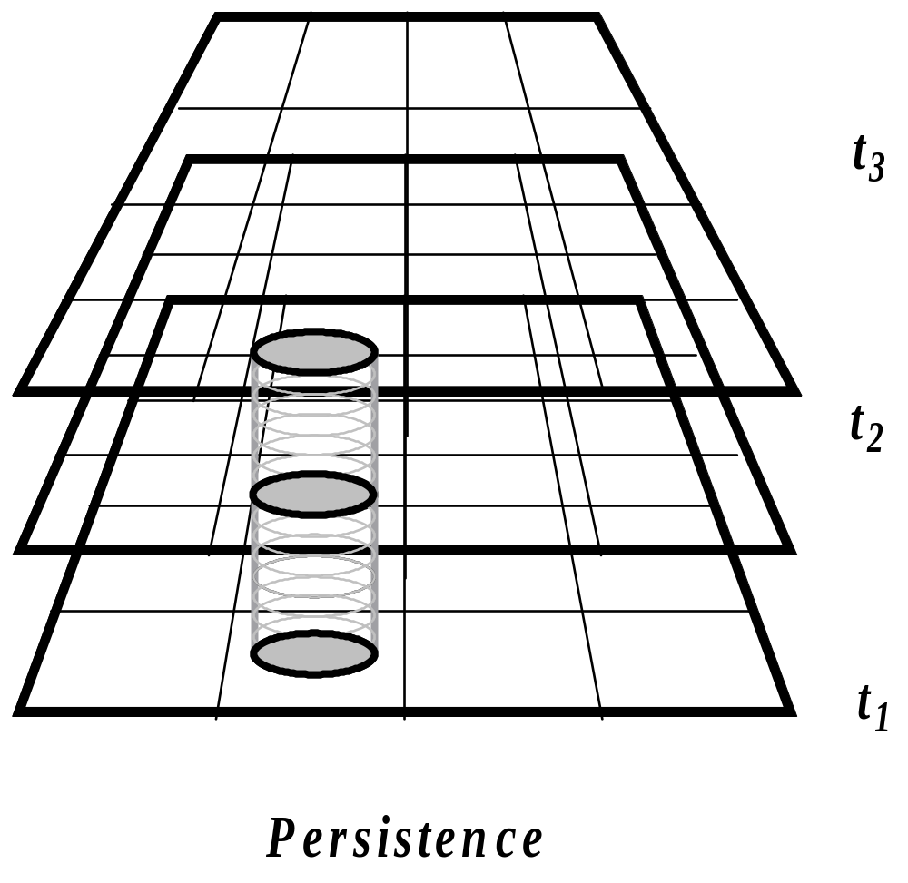
Example: Persistence

Slide 55
Example: tossing a coin 3 times
Heads
Tails
Heads

Slide 56
Example: a chess game
W: Pawn to King4
B: Pawn to Queen’s Bishop 3
W. Pawn to Queen 3
...

Slide 57
Example: An airline ticket
7:00am LH 465 Vienna
arrive London Heathrow 8:15am
9:45am LH 05 London Heathrow
arrive New York (JFK) 3:45pm
5:50pm UA 1492 New York (JFK)
arrive Columbus, OH 7:05pm

Slide 58
Example: An airline ticket
7:00am LH 465 Vienna
arrive London Heathrow 8:15am
9:45am LH 05 London Heathrow
arrive New York (JFK) 3:45pm
5:50pm UA 1492 New York (JFK)
arrive Columbus, OH 7:05pm

Slide 59
Example: An airline ticket
7:00am LH 465 Vienna
arrive London Heathrow 8:15am
9:45am LH 05 London Heathrow
arrive New York (JFK) 3:45pm
5:50pm UA 1492 New York (JFK)
arrive Columbus, OH 7:05pm

Slide 60
Example: An airline ticket
7:00am LH 465 Vienna
arrive London Heathrow 8:15am
9:45am LH 05 London Heathrow
arrive New York (JFK) 3:45pm
5:50pm UA 1492 New York (JFK)
arrive Columbus, OH 7:05pm

Slide 61
Example: An airline ticket
7:00am LH 465 Vienna
arrive London Heathrow 8:15am
9:45am LH 05 London Heathrow
arrive New York (JFK) 3:45pm
5:50pm UA 1492 New York (JFK)
arrive Columbus, OH 7:05pm

Slide 62
Example: An airline ticket
7:00am LH 465 Vienna
arrive London Heathrow 8:15am
9:45am LH 05 London Heathrow
arrive New York (JFK) 3:45pm
5:50pm UA 1492 New York (JFK)
arrive Columbus, OH 7:05pm

Slide 63
A history may or may not be realized

Slide 64
Manipulation of histories
refinement
– add more reference-times
– add more cells
coarsening
gluing
restricting
Cartesian product

Slide 65
Example: Persistence

Slide 66
Refinement of Histories
A history G is refined by history H if for all reference times t, all the cells of H at t are also cells of G at t
G  H

Slide 67
Library of histories
Complete set of alternative histories for a given granularity of partitions and system of reference times
(compare Leibniz’s totality of all possible worlds)

Slide 68
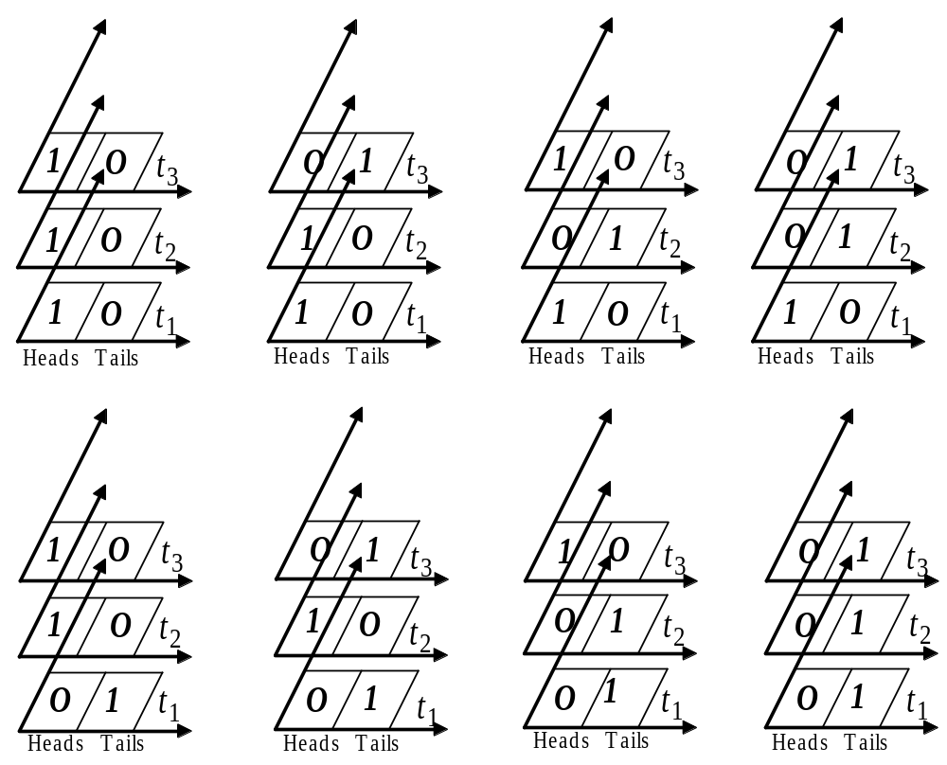
Coin-tossing

Slide 69
Analogy with truth-tables

Slide 70
A simple nuclear reaction
a neutron-proton-collision, which leads to a deuteron plus a gamma ray:
n + p = d + γ

Slide 71

n + p = d + γ
reactor
shielding
diffracting crystal
photomultipier
n
γ
window
p
target

Slide 72
A history with 5 reference times
reactor
shielding
diffracting crystal
photomultipier
n
γ
window
p
target
t₁
t₂
t₃
t₄
t₅

Slide 73
An alternative history with the same 5 reference times
reactor
shielding
diffracting crystal
photomultipier
n
window
p
target
t₁
t₂
t₃
t₄
t₅

Slide 74
Coin-tossing with probabilities assigned
0.125
0.125
0.125
0.125
0.125
0.125
0.125
0.125

Slide 75
Assigning probabilities to alternative histories
reactor
shielding
diffracting crystal
photomultipier
n
0.267
γ
0.594
window
0.211
p
target
t₁
t₂
t₃
t₄
t₅

Slide 76
Probabilities are assigned
... not to every possible history
... but to bands of alternatives (to cells within a coarse-grained partition) at specific reference times
... -20➢-10 -10 ➢ 0 0 ➢ 10 10 ➢ 20 ...

Slide 77
In the world of classical physical phenomena only one alternative history is realized

Slide 78
In the world of quantum physical phenomena it is as if all probabilities are realized

Slide 79
Until a system is measured, or otherwise disturbed its states, are probabilistic through and through

Slide 80
From histories to libraries
The Griffiths–Gell-Mann–Hartle–Omnès consistent histories interpretation of quantum mechanics
Gell-Mann: Not ‘many worlds’ (Everett) but many alternative histories of the actual world

Slide 81
Definition of a library
A library is a maximal consistent family of mutually exclusive and exhaustive histories
with a probability distribution, which satisfies the following:
    1. The probabilities are positive.
    2. The probabilities are additive.
    3. The probabilities add up to 1.

Slide 82
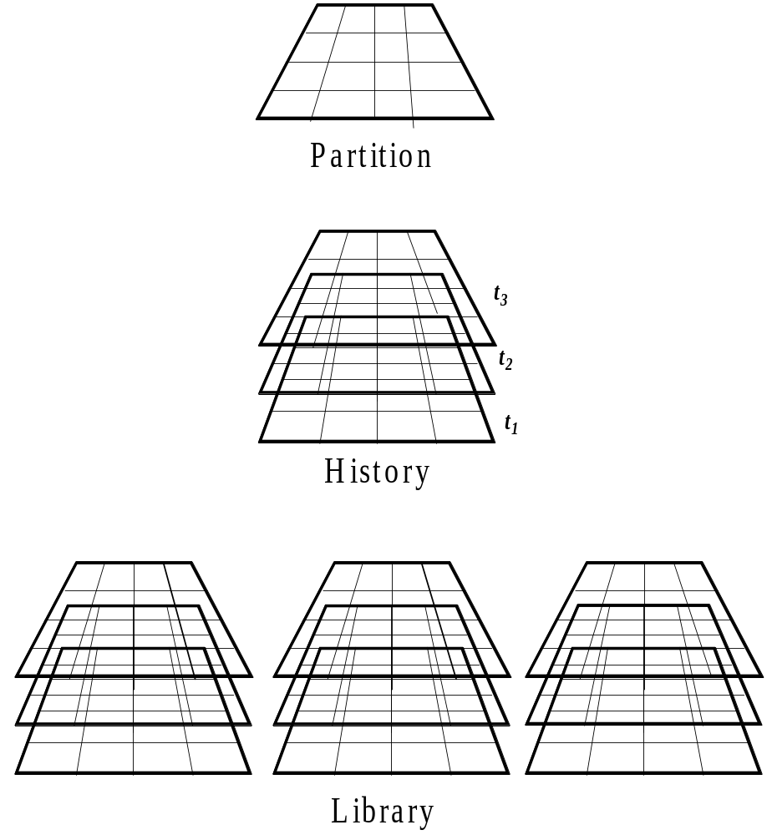
Partition, History, Library

Slide 83
Extension of Libraries
A library L is extended by partition L′ iff all the histories in L are histories in L′
L  L′

Slide 84
Consistency of libraries
L and L′ are consistent with each other:
L Δ L′ =_{df} ∃L″ (L  L″ ∧ L′  L″ )
= they can be glued together to constitute a larger library.

Slide 85
Libraries which describe non-interacting systems are always consistent with each other.

Slide 86
But:
Not all libraries which we need to describe quantum systems are consistent with each other.
Libraries, which are not consistent with each other are called complementary.
... wave-particle dualism; superpositions, cat states

Slide 87
The tale of two physicists
John and Mary work within different libraries
John believes in particles, has the laboratory on Wednesdays
Mary believes in waves, has the laboratory on Thursdays

Slide 88
Mary’s history with an interferometer
reactor
shielding
diffracting crystal
window
t₁
t₂
t₃
t₄
t₅

Slide 89
Mary’s history with an interferometer
reactor
shielding
diffracting crystal
n
window
t₁
t₂
t₃
t₄
t₅

Slide 90
A history with interferometer
reactor
shielding
diffracting crystal
n
window
t₁
t₂
t₃
t₄
t₅

Slide 91
A history with interferometer
reactor
shielding
diffracting crystal
n
window
t₁
t₂
t₃
t₄
t₅

Slide 92
A history with interferometer
reactor
shielding
diffracting crystal
n
window
t₁
t₂
t₃
t₄
t₅

Slide 93
A history with interferometer
reactor
shielding
diffracting crystal
n
window
t₁
t₂
t₃
t₄
t₅

Slide 94
A history with interferometer
reactor
shielding
diffracting crystal
n
window
t₁
t₂
t₃
t₄
t₅

Slide 95
A history with interferometer
reactor
shielding
diffracting crystal
n
window
t₁
t₂
t₃
t₄
t₅

Slide 96
The tale of two physicists
John believes that the system verifies p, and he derives from p fantastically exact predictions which are repeatedly verified
Mary believes that the same system verifies q, and she derives from q fantastically exact predictions which are repeatedly verified

Slide 97
Both are right
Or at least: no experiment could ever be performed which would allow us to choose between them. The system verifies both p and q

Slide 98
Both are right
Or at least: no experiment could ever be performed which would allow us to choose between them. The system verifies both p and q
But p and q are logically inconsistent

Slide 99
Ways to resolve this problem:
1. Griffiths: Whereof we cannot speak, thereof we must be silent. (Inferences are allowed only within some given library.)
2. Superpositions are unnatural tricks, borderline cases constructible only in laboratories (Ian Hacking, Nancy Cartwright)

Slide 100
Ways to resolve this problem (continued)
3.Paraconsistent logic: p, ¬p
BUT NOT (p ∧ ¬p)
4. Omnès: there are not only ‘elements of reality’ but also border-line elements, whose postulation as theoretical entities is needed in order to make good predictions, but they are not real.

Slide 101
Hypotheses of Realism
Objects are real = their supposition supports reliable predictions
A partition is transparent if it allows us to follow the causal outcomes on the side of the objects in its domain

Slide 102
Kriterien der Bewertung von Aufteilungen
Eine Aufteilung, die das Verfolgen der kausalen Entwicklungen seitens der Gegenstände in ihrer Domäne ermöglicht, ist eine transparente Aufteilung.

Slide 103
E-P-R Realism
“If, without in any way disturbing a system, we can predict with certainty (i.e. with probability equal to unity) the value of a physical quantity, then there exists an element of physical reality corresponding to this physical quantity.” (Einstein-Podolsky-Rosen 1935)

Slide 104
E-P-R Realism
fails for the quantum world

Slide 105
But still:
In relation to all higher granularities ontological realism holds with unrestricted validity
indeed we can derive the truths of folk physics rigorously from quantum mechanical laws
... by moving from finer-grained to coarser-grained histories

Slide 106
In the quantum world
we need to accept superpositions: which means we need to augment our standard notions of truth and/or reality

Slide 107
realism fails
But still:
for the realm of quantum phenomena

Slide 109
But:
this is not because we have too little knowledge of reality in itself on the quantum level -- rather we have enormous amounts of knowledge ...
we have too much knowledge
Thus quantum mechanics lends no support at all for any sort of Kantian view

Slide 110
Coda:
The Evolution of Cognition
Both singly and collectively we are examples of the general class of complex adaptive information gathering and utilizing systems (IGUSes).

Slide 111
IGUS = information gathering and utilizing system
An IGUS can reason about histories in a coarse-grained fashion: ‘it utilizes only a few of the variables in the universe.’

Slide 112
Why do IGUSes exist ?
The reason IGUSes exist, functioning in such a fashion, is to be sought in their evolution within the universe. They evolved to make predictions because it is adaptive to do so. The reason, therefore, for their focus on Newtonian-like variables is that these are the only variables for which predictions can be made.

Slide 113
Why do IGUSes exist ?
Only histories of a quasi-Newtonian domain present enough regularity over time to permit the generation of models with significant predictive power.
… we IGUSes evolved to exploit a particularity of the quasi-Newtonian domain (Gell-Man and Hartle 1991)

Slide 114
Lifeworld of Classical Newtonian Physics
The lifeworld is classical, not because it is some sort of subjective projection (Kant, Bohr, Husserl?), but because its classical character follows rigorously from the quantum mechanical laws governing the physical systems from out of which it is built.

Slide 115
We evolved
... with the cognitive apparatus we have, because the ability to make predictions about the future is adaptive
We can only make predictions about coarse-grained physical phenomena because only of such phenomena does Newtonian physics hold

Slide 116
Not: the lifeworld has been constituted by cognitive agents (Kant)
Rather: we cognitive agents have been constructed by the lifeworld of deterministic (= predictable) physics

Slide 117
We have been constructed
to be Aristotelians

