Slide 1
A taxonomy of granular partitions
Thomas Bittner and Barry Smith
Northwestern University,
NCGIA and SUNY Buffalo

Slide 2
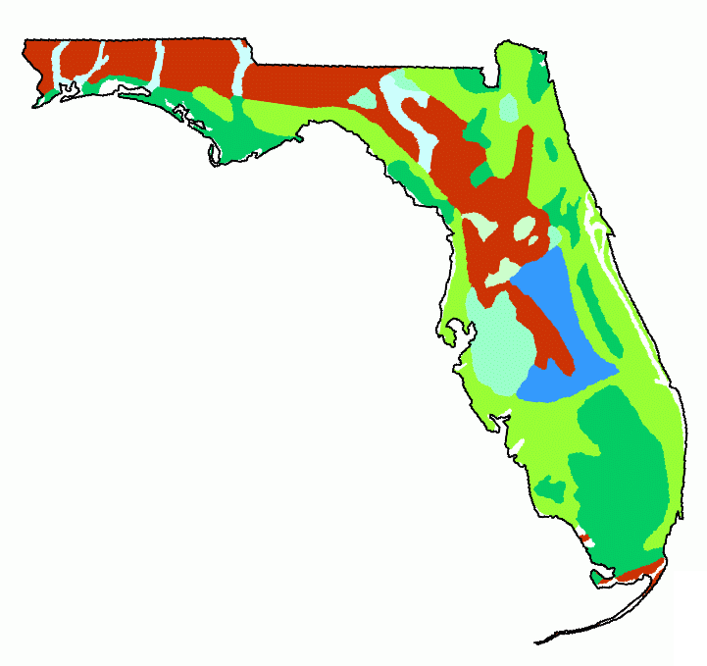
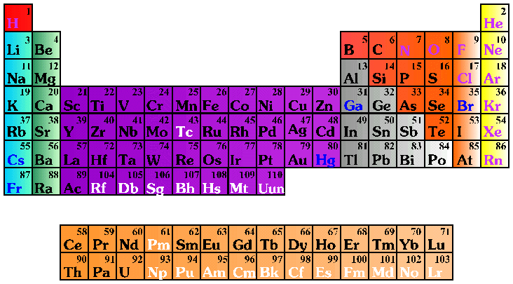
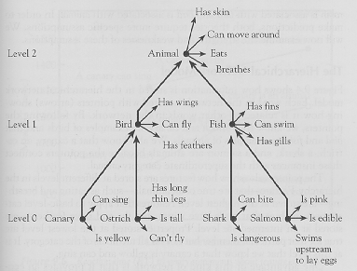
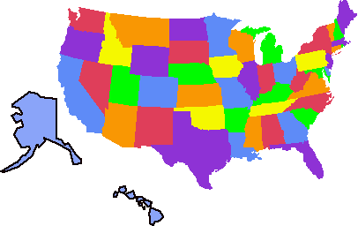
Granular Partitions
The theory of granular partition aims to provide a unifying framework.

Slide 3
Theory of granular partitions
Goals
  A theory of human listing, sorting, cataloguing, categorizing, and mapping activities
  explain the selectivity of these cognitive activities
  extend mereology with the feature of granularity
  and provide an alternative to set theory as a tool to formalize common sense and science

Slide 4
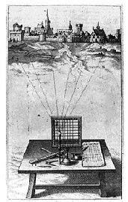
Theory of granular partitions (2)
Major assumptions:
There is a projective relation between cognitive subjects and reality
Humans ‘see’ reality through a grid
The grid can be regular or irregular

Slide 5
Grids can be of different granularities

Slide 6
Grids can be of different granularities

Slide 7
Theory of granular partitions (3)
Major assumptions
  The projective relation can reflect the mereological structure of reality
  Projection is an active process:
    it brings certain features of reality into the foreground of our attention (and leaves others in the background)
    it can bring fiat objects into existence (e.g. Erie County)
  Granular partitions are only distantly related to (mathematical) partitions formed by equivalence relations

Slide 8
Projective relation to reality

Slide 9

Projection of cells (1)
Cell structure
Projection
Targets in reality
Hydrogen
Lithium

Slide 10

Projection of cells (2)
Cell structure
Projection
North America
…
Montana
Idaho
Wyoming
…

Slide 11
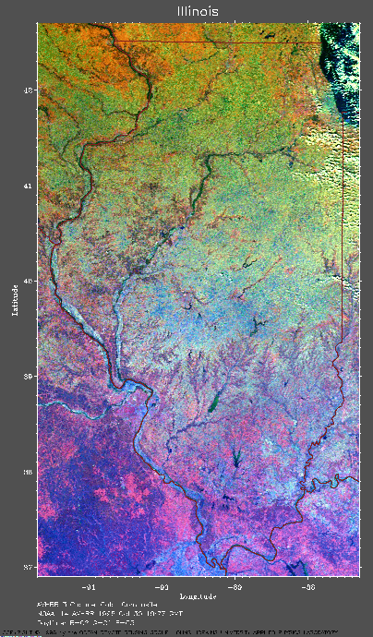
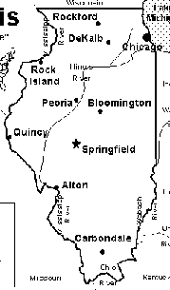
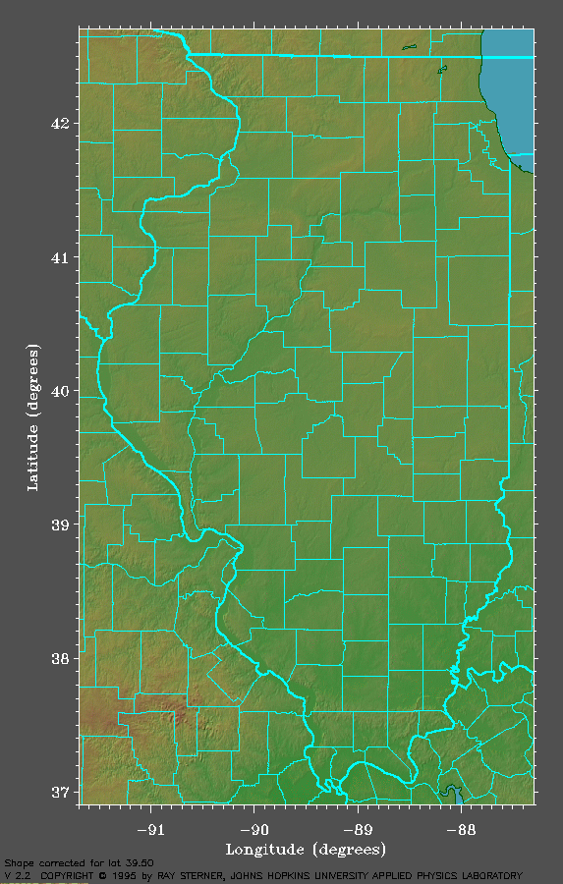
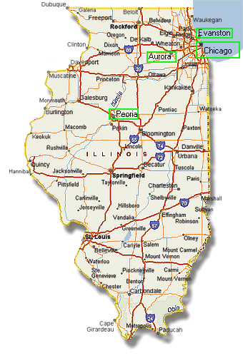
Multiple ways of projecting
Big city
partition
County
partition
Highway
partition
₁

Slide 12
Theory of granular partitions (4)
Core components (master conditions)
  Cell structures (Theory A)
    Subcell relation ⊆
    Minimal, maximal cell
    Trees, Venn-diagrams
  Projective relation to reality (Theory B)
    Projection and location (two aspects of ∈)
    Projection is a partial, functional, (sometimes) mereology-preserving relation

Slide 13
Theory A

Slide 14
Systems of cells
Subcell relation ⊆
  Cell ‘H’ is a subcell of the periodic table
  Reflexive, transitive, antisymmetric
The cell structure of a granular partition
  Has a unique maximal cell or root
    ‘Illinois’ in the county partition of the State of Illinois
    The periodic table as a whole
  Each cell is connected to the root by a finite chain
  Every pair of cells is either in a subcell or a disjointness relation

Slide 15
Cell structures and trees
Cell structures can be represented as trees and vice versa
Animal
Bird
Fish
Canary
Shark
Ostrich
Salmon

Slide 16
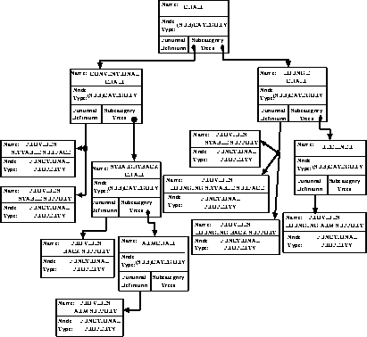
A category tree

Slide 17
Theory B

Slide 18

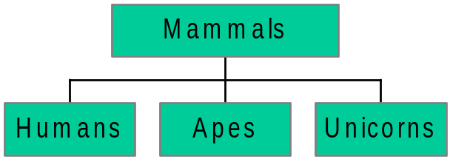

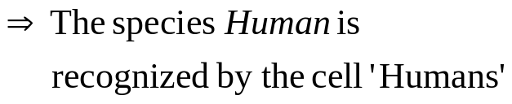
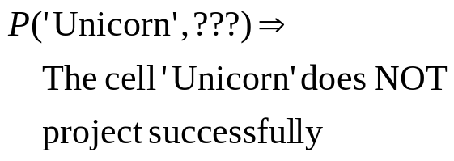
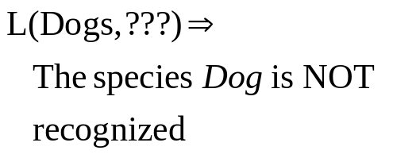
Projection and location
Humans
Apes
Dogs
Mammals

Slide 19
Misprojection
…
Idaho
Montana
Wyoming
…
P(‘Idaho’,Montana) but NOT L(Montana,’Idaho’)
Location is what results when projection succeeds

Slide 20
Transparency of projection (1)
A granular partition projects transparently onto reality if and only if
  Objects are only located in a cell if they were targeted by this cell:
  location presupposes projection
  L(o,z) ⇒ P(z,o)
  There is no misprojection
  P(z,o) ⇒ L(o,z)

Slide 21
Transparency of projection (2)
Still: there may be irregularities of correspondence
  There may be cells that do not project (e.g. ‘unicorn’)
  Multiple cells may target the same object
  There may be ‘forgotten’ objects (e.g. the species dog above)

Slide 22
Functionality constraints (1)
Two cells projecting onto the same object
Morning Star
Venus
Evening Star
Location is functional:
If an object is located in two cells then these cells are identical, i.e., L(o,z₁) and L(o,z₂) ⇒ z₁ = z₂

Slide 23
Functionality constraints (2)
The same name for the two different things:
Republic of China
China
People’s Republic of China
Projection is functional:
If two objects are targeted by the same cell then they are identical, i.e., P(z,o₁) and P(z,o₂) ⇒ o₁ = o₂

Slide 24

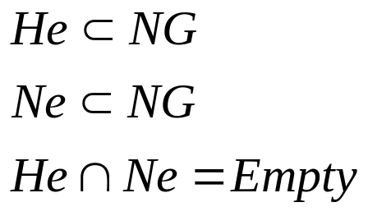
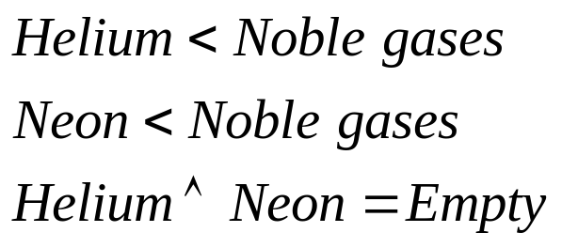
Preserve mereological structure
Helium
Neon
Noble gases
Potential of preserving mereological structure

Slide 25
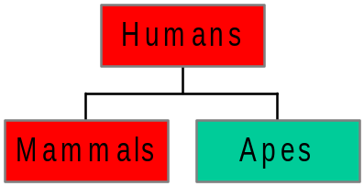
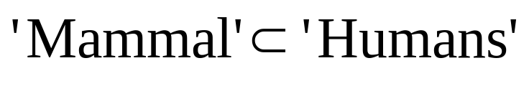
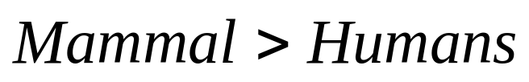
Partitions should not distort mereological structure
distortion
Humans
Apes
Dogs
Mammals
If a cell is a proper subcell of another cell then the object targeted
by the first is a proper part of the object targeted by the second.

Slide 26
Features of granular partitions
Selectivity
  Only a few features are in the foreground of attention
Granularity
  Recognizing a whole without recognizing all of its parts
Preserve mereological structure

Slide 27
Classification of granular partitions

Slide 28
Theory of granular partitions (4)
Classes of granular partitions according to
  Degree of preservation of mereological structure
  Degree of completeness of correspondence
  Degree of redundancy

Slide 29
Mereological monotony
…
Helium
Noble gases
Neon
…
Helium
Neon
Noble gases
Projection preserves mereological structure
Projection does not distort mereological structure

Slide 30
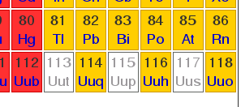

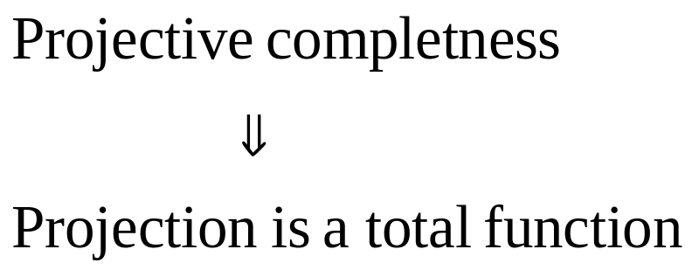
Projective completeness
In every cell there is
an object located, i.e.,
Empty cells
www.webelements.com

Slide 31
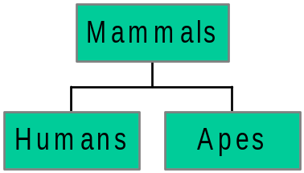
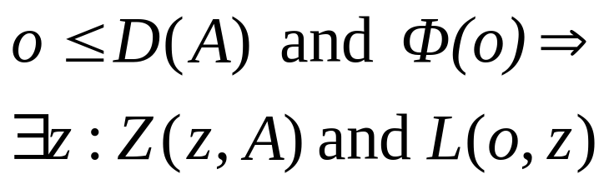
Exhaustiveness
Do the objects targeted by cells exhaust a domain ?
Everything of kind ϕ in the
domain of the partition A
is recognized by some cell in A
Humans
Apes
Dogs
Mammals

Slide 32
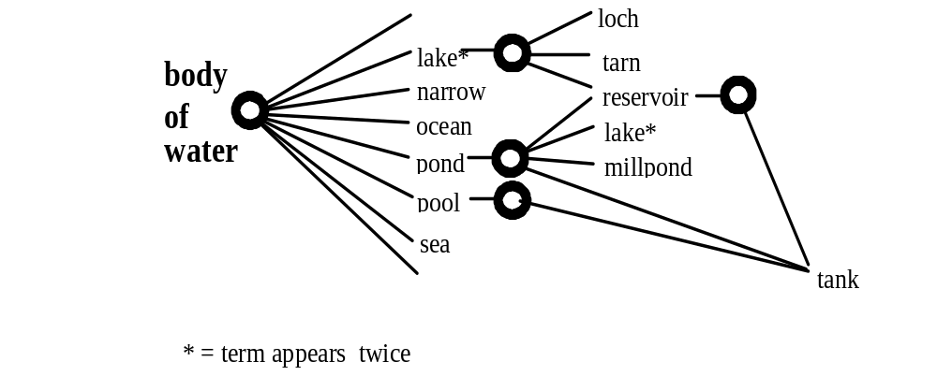
Example partitions:

Slide 33
Properties of cadastral partitions
Cell structure: stored in database
Projection carves out land-parcels (geodetic projection)
Properties
  Transparent: projection and location are functions
  Exhaustive (no no-mans lands)
  Mereologically monotone

Slide 34
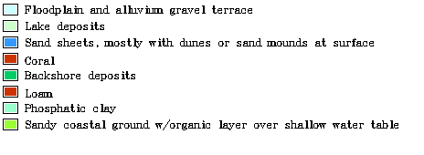
Categorical coverages
Two reciprocally dependent partitions:
Partition of an attribute domain
  E.g., land use or soil types
  Legend in a categorical map
Partition of the surface of earth into zones
  Zones of sand or clay
  Spatial subdivision

Slide 35
Properties
Attribute partition
Spatial partition
Exhaustive relative to the spatial component
Complete (no empty cell)
Exhaustive (no no-mans lands)
Projection and location are functional
Projection and location are total functions and mutually inverse
Potentially partial
Not necessarily mereologically monotone
Mereologically monotone
Regularity of structure and correspondence is due to the
fiat character of the subdivision

Slide 36

Folk categorization of water bodies
double cell-labels
at different levels
of hierarchy
Distorts mereological
structure
Location is not a function
Not a tree +

Slide 37
Conclusions
Formal ontology of granular partitions
Theory underlying listing, sorting, cataloguing, categorizing, and mapping human activities
Built upon mereology
Enriches mereology with the features of selectivity and granularity
Two major parts:
  Theory A: the structure of systems of cells
  Theory B: projective relation to reality
Granular partitions can be classified regarding: completeness and exhaustiveness

Slide 38
Ongoing work
Folk and common-sense categories have weaker structure
A theory of granularity, vagueness, and approximation based on partition theory

