Slide 1
A Unified Theory of Granularity, Vagueness and Approximation
Thomas Bittner and Barry Smith
Northwestern University
NCGIA and SUNY Buffalo

Slide 2
Overview
Introduction
Vagueness and truth
Granular partitions and context
Vagueness and granular partitions
Boundaries and contexts
Approximation
Conclusions

Slide 3

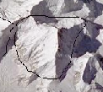


Three people and a mountain
J = ‘We will cross the boundary of Mount
Everest within the next hour’
Judging subject
wants to determine the truth of J by using reference semantics
Semantic theorist
wants to determine the truth of J by using partition theory
Partition theorist

Slide 4
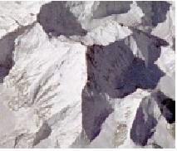
Vagueness
Where is the boundary of Everest?
Boundary is subject to vagueness
The boundary of Everest IS vague:
broad or fuzzy boundary
Vague objects and boundaries
as ontological primitives
Vagueness is a semantic property
There is a multitude of equally
good crisp candidates of reference
Extend semantics: supervaluation

Slide 5
Supervaluation (Fine 1975)
Extension of reference semantics to vagueness
Takes multiplicity of candidate referents of vague names into account
S = ‘X is a part of Mount Everest’
  Truth value of S is determined for all candidate referents of ‘Mount Everest’
  S is supertrue if it is true for all candidates
  S is superfalse if it is true for no candidate
  S is indeterminate otherwise

Slide 6
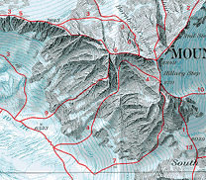
Vagueness and truth
S = ‘We will cross the boundary
of Everest within the next hour’
S is superfalse
S is indeterminate
S is supertrue

Slide 7
Vagueness and truth
S = ‘We will cross the boundary
of Everest within the next hour’
?
?
?
S is supertrue

Slide 8


Sentences vs. Judgments
(Smith & Brogaard 2001)
Sentence: ‘There is no beer in the glass.’
Hygiene inspector:
Drunkard:
(super) false
The glass contains tiny
amounts of beer,
microbes, mold, …
(super) true
The glass does not contain
(drinkable amounts of) beer
Judgments = Sentence + Context

Slide 9
Granular partitions a formally tractable proxy for the notion of context

Slide 10
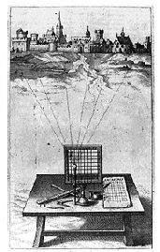
Theory of granular partitions
Major assumptions:
There is a projective relation between cognitive subjects and reality
Humans ‘see’ reality through a grid
The ‘grid’ is usually not regular and raster shaped

Slide 11
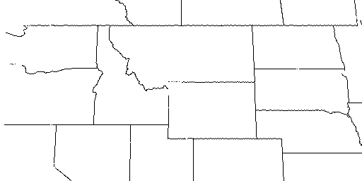
Projection of cells
Cell structure
Projection
North America
…
Montana
Idaho
Wyoming
…

Slide 12
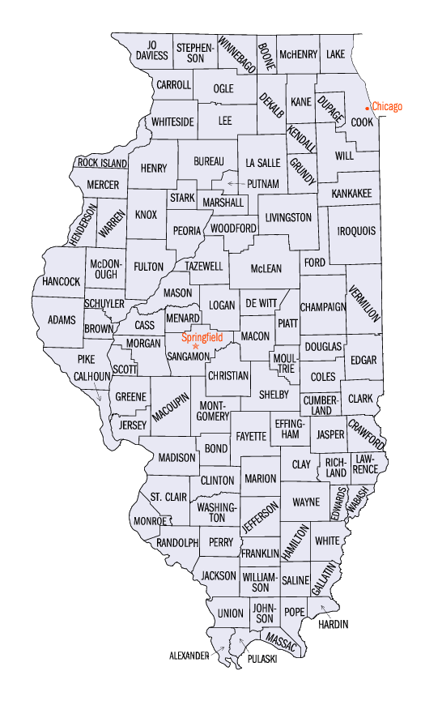
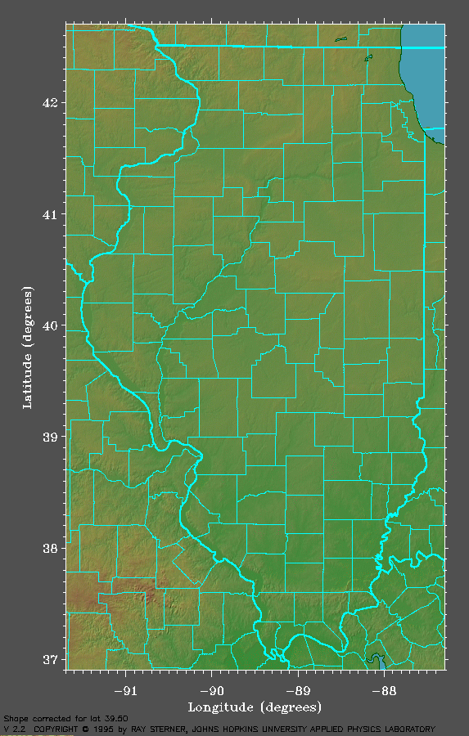
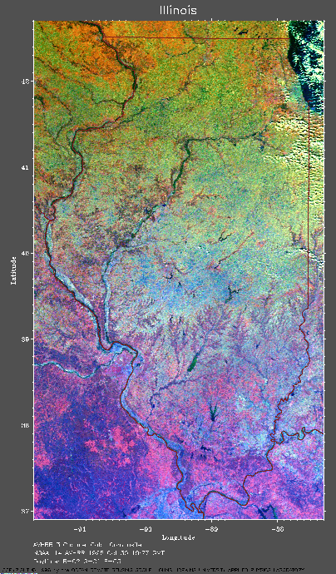
Projection establishes fiat boundaries
Part of the surface of the Earth
photographed from space
Cell structure
P
no counties
no county boundaries
Map =
Representation
of cell structure
County boundaries
in reality

Slide 13
Partitions and context
J = (‘There is no beer in the glass’, Partition)
probe
Glass
Glass
Beer
Beer
Cell ‘Beer’ does not project
Cell ‘Beer’ does project
J is true in this context
J is false in this context

Slide 14
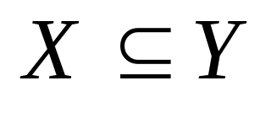
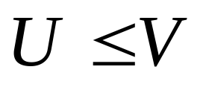
Judgments about mereological structure
J = (‘X is part of Y’, Pt) = true
Labeling of
names in
S onto
cells in Pt
Y
projection
X
U
V

Slide 15
Vagueness and granular partitions

Slide 16

Crisp and vague projection
…
Montana
…
crisp
Himalayas
P1
vague
Everest
Pn
Vague reference is always reference to fiat boundaries!

Slide 17
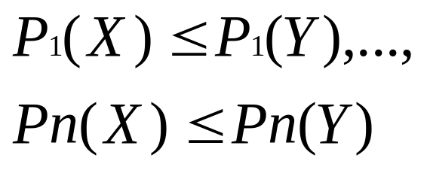
Vague judgments about mereological structure
J = (‘X^{V} is part of Y’, Pt^{V}) = supertrue
Labeling of
names in
S onto
cells in Pt
Y
P₁
X
P_{n}

Slide 18
Vagueness and truth
J = (‘We will cross the boundary
of Everest within the next hour’, Pt)
Whether or not
indeterminacy can
arise depends on
the projection of
the boundaries!
?
?
?

Slide 19
Boundaries and contexts

Slide 20
Boundaries and contexts
  We distinguish:
  contexts in which our use of a vague term brings:
  a single crisp fiat boundary
  a multiplicity of crisp fiat boundaries
  into existence

Slide 21
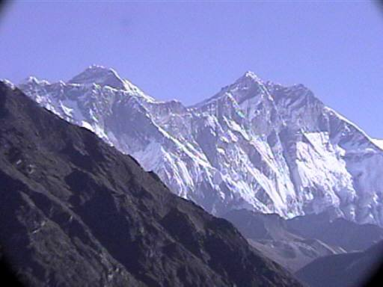
The single crisp boundary case
J = (‘This is the boundary of
Mount Everest’, Pt)
The judging subject must have the authority
(the partitioning power) to impose this boundary
e.g., she is a member of some government agency
Vagueness is resolved. J has a determinate truth value

Slide 22
The multiple boundary case
The subject (restaurant owner) judges:
J = (‘The boundary of the smoking zone
goes here’, Pt)
while vaguely pointing across the room.
Vague projection brings a multitude of boundary
candidates into existence
Truth-value indeterminacy can potentially arise
To show: naturally occurring contexts are such that
truth-value indeterminacy does not arise.

Slide 23
The multiple boundary case
The subject (restaurant owner) judges:
J = (‘The boundary of the smoking zone
goes here’, Pt)
while vaguely pointing across the room.
Claim:
The judgment can be uttered only in contexts
(1) Where it is precise enough to be (super)true
(2) but: not precise enough for indeterminacy to arise

Slide 24
The multiple boundary case
The subject (restaurant owner) judges:
J = (‘The boundary of the smoking zone goes here’, Pt)
while vaguely pointing across the room.
Context 1:
To advise the staff where
to put the ashtrays
Context 2:
To describe where nicotine
molecules are
The projection must be just
precise enough to determine
on which table to put an ashtray
truth-value indeterminacy
can potentially occur
But: nobody can seriously
utter such a judgment in
naturally occurring contexts
No truth-value
indeterminacy

Slide 25
Approximation; or how to make vague reference in a determinate fashion

Slide 26
Boundaries limiting vagueness
S = ‘We will cross the boundary
of Everest within the next hour’
Two partitions:
candidate i
(1) a vague partition
candidate k
Carving out candidate
referents for the
vague name ‘Everest’
core
Exterior b.
now
in one hour,
interior boundary
(2) a partition projecting
along the way ahead
direction of travel
Where-the-boundary-candidates are
Limits admissible candidate
referents for ‘Everest’

Slide 27
Approximating judgments
S = ‘We will cross the boundary
of Everest within the next hour’
Truth of J depends on the relationships
between
Pt^{V} and Pt^{R}
J = (S, Pt^{V}, Pt^{R})
candidate i
candidate k
core
Exterior b.
now
in one hour,
interior boundary
direction of travel
Where-the-boundary-candidates are

Slide 28
Truth of approximating judgments
An approximating judgment J = (S, Pt^{V}, Pt^{R}) is:
Supertrue: all candidate referents projected onto
by Pt^{V} are within the limits given by Pt^{R}
Superfalse: no candidate referent projected onto
by Pt^{V} is within the limits given by Pt^{R}
Indeterminate: some candidate referents projected
onto by Pt^{V} are within the limits
given by Pt^{R} and others are not.

Slide 29
Truth-value indeterminacy of approximating judgments …
… does not actually occur in
naturally occurring contexts
?

Slide 30
Truth value indeterminacy ??
Why can ‘We will cross the boundary of Everest within the
next hour’ not be judged in these contexts ?
Judger has the freedom
to choose appropriate
delimiting boundaries.
?
Why should she use
ridiculous ones which
do not make sense ?
?
Why should she use
ones subject to
indeterminacy ?
?

Slide 31
Higher order vagueness
Boundaries that delimit vagueness of reference
What if these boundaries are subject to
vagueness themselves?
S = ‘We will cross the boundary
of Everest within the next hour or so’
Higher-order vagueness

Slide 32
Higher order vagueness
S = ‘We will cross the boundary
of Everest within the next hour or so’
To show:
Higher order vagueness does not cause truth-value
indeterminacy in naturally occurring contexts
Two classes of contexts:
those which re-use existing boundaries
(2) those which create new fiat boundaries

Slide 33
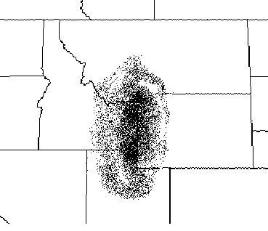
Re-using existing boundaries
J = (‘The area of
bad weather extends
over parts of Wyoming,
Montana, Idaho, and
Utah’, Pt^{V}, Pt^{R})
The re-used boundaries are crisp.
No truth value indeterminacy

Slide 34
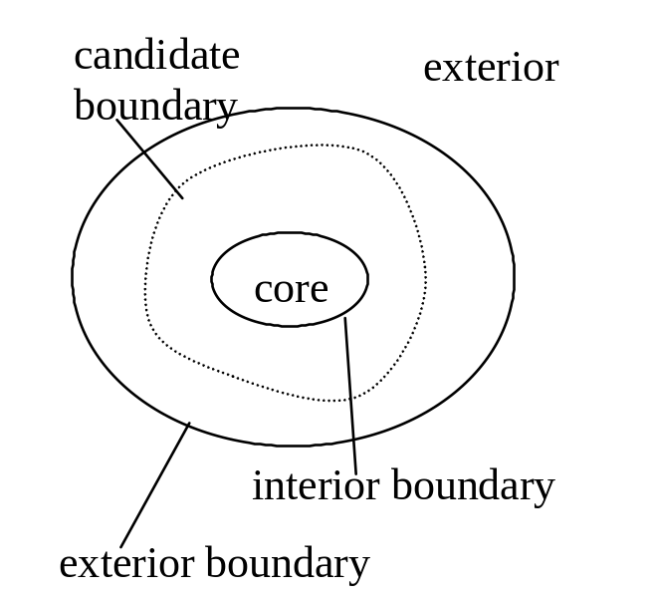
Create new fiat boundaries
S = ‘We will cross the boundary
of Everest within the next hour or so’
Multiplicity of
candidate
referents
Judging subject must
choose limiting boundaries
much crisper than the
degree of vagueness they
limit

Slide 35
Conclusions
Theory of granular partitions provides a tool to understand granularity, vagueness, indeterminacy and the relationships between them
Context is critical when analyzing truth-values of judgments
In naturally occurring contexts truth-value indeterminacy does not occur
Formalism – see paper
Partition-theoretic solution to the Sorites paradoxes – see paper

