Slide 1
Common Sense and Quantum Mechanics
Barry Smith
http://ontology.buffalo.edu
Notes:
Ontologie Eins Null

Slide 2

Theory of vagueness
How can -based
concepts be transparent, if the world is shaped like this:
?

Slide 3
Theory of vagueness
How can -based
concepts be transparent, if the world is shaped like this:
?

Slide 4
problem arises with other concepts too:
dog
cat
fish
whale
bird
ostrich

Slide 5
we impose concepts on reality
(tell stories ...)
Reality exists behind a veil

Slide 6
veiled reality
Kantianism
Midas-touch epistemology

Slide 7
From Species to Genera
animal
bird
canary

Slide 8
Natural categories have borderline cases
bird
ostrich

Slide 9
Natural categories have a kernel/penumbra structure
penumbra of borderline cases
kernel of focal
instances

Slide 10
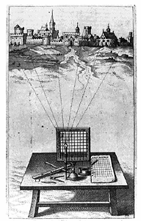
Alberti’s Grid c.1450

Slide 11
Coarse-grained Partition

Slide 12
Fine-Grained Partition

Slide 13
Perspectivalism
An organism is a totality of atoms
An organism is a totality of molecules
An organism is a totality of cells
... all veridical partitions

Slide 14
every cell is subject to the kernel/penumbra structure

Slide 15
Partitions need not be regular

Slide 16
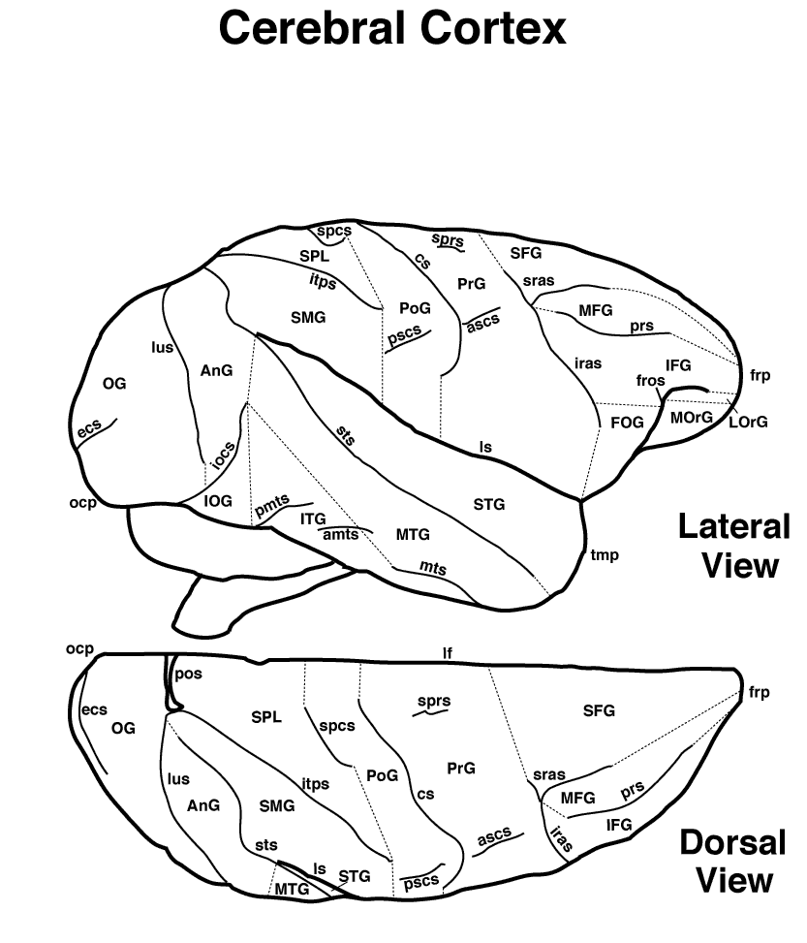
Cerebral Cortex
Notes:
http://rprcsgi.rprc.washington.edu/~atlas

Slide 17
Partitions standardly come with labels and an address system

Slide 18
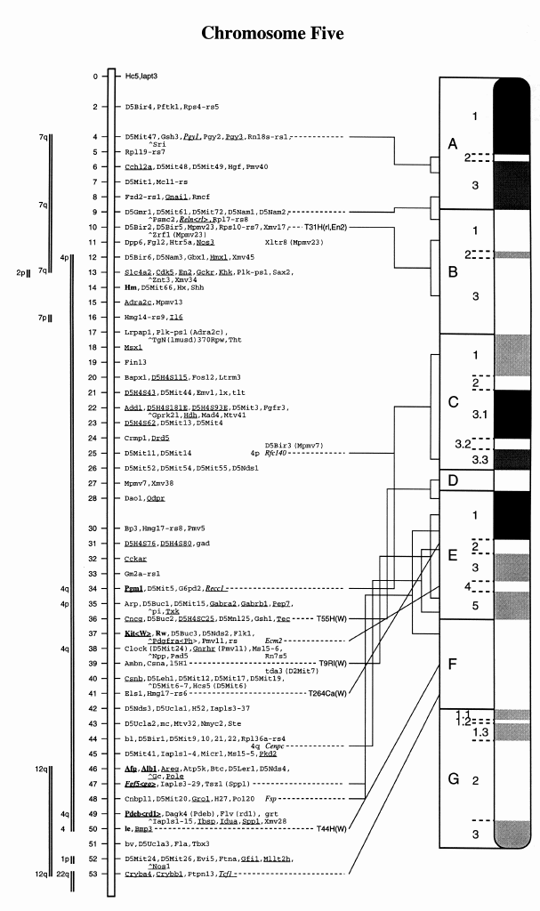
Mouse
Chromosome 5

Slide 19
Modulo the kernel/penumbra structure of their constituent categories ...
all transparent partitions capture some part or dimension of reality at some level of granularity
All veridical perspectives are equal, but some are more equal than others

Slide 20
The DER-DIE-DAS partition
DER (masculine) moon lake atom | DIE (feminine) sea sun earth | DAS (neuter) girl fire dangerous thing

Slide 21
This is the gospel of realism
... how far does it hold ?

Slide 22
the common sense conceptualization
(folk physics, folk psychology, folk biology, is transparent
(common sense is true)
otherwise we would all be dead

Slide 23
Mothers exist

Slide 24
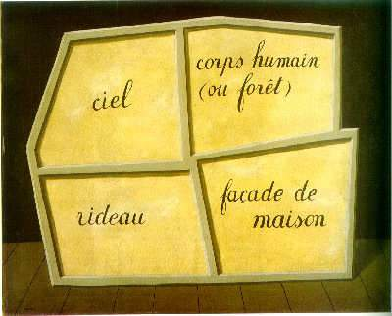
The Empty Mask (Magritte)
milk
mama
Mount Washington
mouse
Notes:
The Empty Mass (Magritte)

Slide 25
But what about science ?

Slide 26
are our scientific partitions truly transparent to an independent reality ?

Slide 27
D’Espagnat: Veiled Reality
Heisenbergian uncertainty:
surely our cognition of physical reality
is opaque
... surely at least quantum mechanics
lends support to Kantianism

Slide 28
Surely there are no veridical (transparent) partitions at the quantum level

Slide 29
Well ...

Slide 31
Coarse-grained Partition

Slide 32
Fine-Grained Partition

Slide 33
Manipulation of partitions
refinement
coarsening
gluing
restricting
Cartesian product

Slide 34
Refinement
a partition can be refined or coarsened by adding or subtracting from its constituent cell-divisions

Slide 35
Enlargement of a partition
= expansion of domain with constant granularity
A partition A is enlarged by partition B iff
1. the domain of A is included in the domain of B and A and
2. is such that A and B coincide on the domain which they share in common

Slide 36
Coarse-grained Partition

Slide 37
Coarse-grained Partition

Slide 38
Coarse-grained Partition

Slide 39
Extension of Partitions (via refinement or enlargement)
A partition A is extended by partition B if all the cells of B are cells of A
A  B

Slide 40
The realist’s ideal
A total partition of the universe, a super-partition satisfying:
“Every element of the physical reality must have a counterpart in the physical theory.”
(Einstein-Podolsky-Rosen 1935)

Slide 41
A universal partition
a partition which fits exactly to reality, as though we placed graph paper upon the world in such a way that it would fit the world exactly at its joints
(Hypothesis of universal realism)
Well: why not just take the product of all partitions covering each successive domain and glue them all together ?

Slide 42
Epistemological Problems
Measurement instruments are imprecise
Heisenberg
coarse-grained partitions are the best that we can achieve

Slide 43
Granularity of measurement
... -20➢-10 -10 ➢ 0 0 ➢ 10 10 ➢ 20 ...
massively
increased
... normal increased
chronic ...

Slide 44
So
... can we not just take the product of all transparent partitions above a certain level of granularity and make a super-partition which would comprehend the whole of reality ?

Slide 45
Consistency of Partitions
Two partitions are consistent iff there is some third partition which extends them both:
A Δ B =_{df.} ∃C(A  C ∧ B  C)

Slide 46
Ontological Problems
In the quantum domain not all partitions are consistent

Slide 47
From the Photograph to the Film
From instantaneous partitions to temporally extended histories
A history is a sequence of one or more partitions at successive reference times

Slide 48
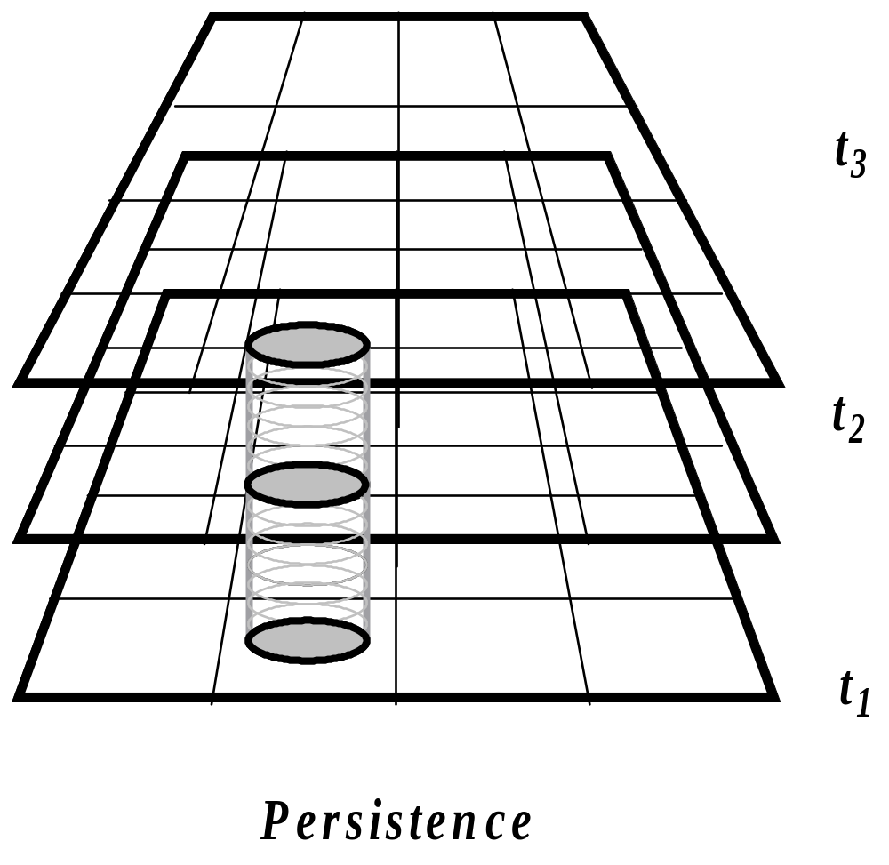
Example: Persistence

Slide 49
Example: tossing a coin 3 times
Heads
Tails
Heads

Slide 50
Example: a chess game
W: Pawn to King4
B: Pawn to Queen’s Bishop 3
W. Pawn to Queen 3
...

Slide 51
Example: An airline ticket
7:00am LH 465 Vienna
arrive London Heathrow 8:15am
9:45am LH 05 London Heathrow
arrive New York (JFK) 3:45pm
5:50pm UA 1492 New York (JFK)
arrive Columbus, OH 7:05pm

Slide 52
Example: An airline ticket
7:00am LH 465 Vienna
arrive London Heathrow 8:15am
9:45am LH 05 London Heathrow
arrive New York (JFK) 3:45pm
5:50pm UA 1492 New York (JFK)
arrive Columbus, OH 7:05pm

Slide 53
Example: An airline ticket
7:00am LH 465 Vienna
arrive London Heathrow 8:15am
9:45am LH 05 London Heathrow
arrive New York (JFK) 3:45pm
5:50pm UA 1492 New York (JFK)
arrive Columbus, OH 7:05pm

Slide 54
Example: An airline ticket
7:00am LH 465 Vienna
arrive London Heathrow 8:15am
9:45am LH 05 London Heathrow
arrive New York (JFK) 3:45pm
5:50pm UA 1492 New York (JFK)
arrive Columbus, OH 7:05pm

Slide 55
Example: An airline ticket
7:00am LH 465 Vienna
arrive London Heathrow 8:15am
9:45am LH 05 London Heathrow
arrive New York (JFK) 3:45pm
5:50pm UA 1492 New York (JFK)
arrive Columbus, OH 7:05pm

Slide 56
Example: An airline ticket
7:00am LH 465 Vienna
arrive London Heathrow 8:15am
9:45am LH 05 London Heathrow
arrive New York (JFK) 3:45pm
5:50pm UA 1492 New York (JFK)
arrive Columbus, OH 7:05pm

Slide 57
A history may or may not be realized

Slide 58
Manipulation of histories
refinement
– add more reference-times
– add more cells
coarsening
gluing
restricting
Cartesian product

Slide 59
Refinement of Histories
A history G is refined by history H if for all reference times t, all the cells of H at t are also cells of G at t
G  H

Slide 60
Library of histories
Complete set of alternative histories for a given granularity of partitions and system of reference times
(compare Leibniz’s totality of all possible worlds)

Slide 61
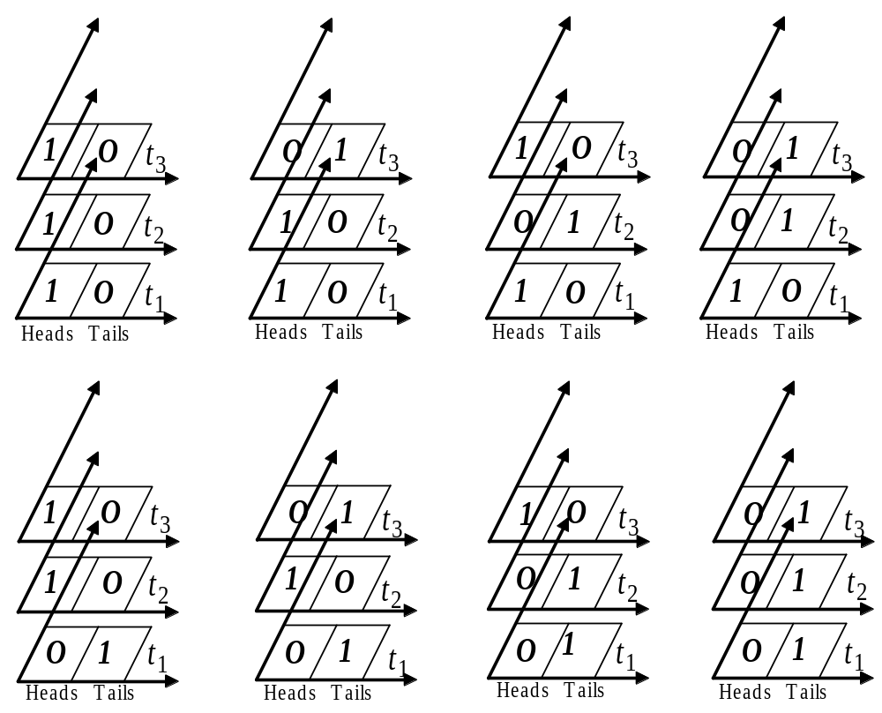
Coin-tossing

Slide 62
Analogy with truth-tables

Slide 63
A simple nuclear reaction
a neutron-proton-collision, which leads to a deuteron plus a gamma ray:
n + p = d + γ

Slide 64

n + p = d + γ
reactor
shielding
diffracting crystal
photomultipier
n
γ
window
p
target

Slide 65
A history with 5 reference times
reactor
shielding
diffracting crystal
photomultipier
n
γ
window
p
target
t₁
t₂
t₃
t₄
t₅

Slide 66
A history with interferometer
reactor
shielding
diffracting crystal
n
window
t₁
t₂
t₃
t₄
t₅

Slide 68
An alternative history with the same 5 reference times
reactor
shielding
diffracting crystal
photomultipier
n
window
p
target
t₁
t₂
t₃
t₄
t₅

Slide 69
Coin-tossing with probabilities assigned
0.125
0.125
0.125
0.125
0.125
0.125
0.125
0.125

Slide 70
Assigning probabilities to alternative histories
reactor
shielding
diffracting crystal
photomultipier
n
0.267
γ
0.594
window
0.211
p
target
t₁
t₂
t₃
t₄
t₅

Slide 71
Probabilities are assigned
... not to every possible history
... but to bands of alternatives (to cells within a coarse-grained partition) at specific reference times
... -20➢-10 -10 ➢ 0 0 ➢ 10 10 ➢ 20 ...

Slide 72
In the world of classical physical phenomena only one alternative history is realized

Slide 73
In the world of quantum physical phenomena all probabilities are realized
The quantum world is probabilistic
through and through
0.267
the same particle is in all
of these places at once
0.594
0.211

Slide 74
From histories to libraries
The Griffiths–Gell-Mann–Hartle–Omnès consistent histories interpretation of quantum mechanics
Gell-Mann: Not ‘many worlds’ (Everett) but many alternative histories of the actual world

Slide 75
Definition of a library
A library is a maximal consistent family of mutually exclusive and exhaustive histories
with a probability distribution, which satisfies the following:
    1. The probabilities are positive.
    2. The probabilities are additive. For two histories H and H′ , which do not overlap, we have: p(H) + p(H′ ) = p(H + H′ )
    3. The probabilities add up to 1.

Slide 76
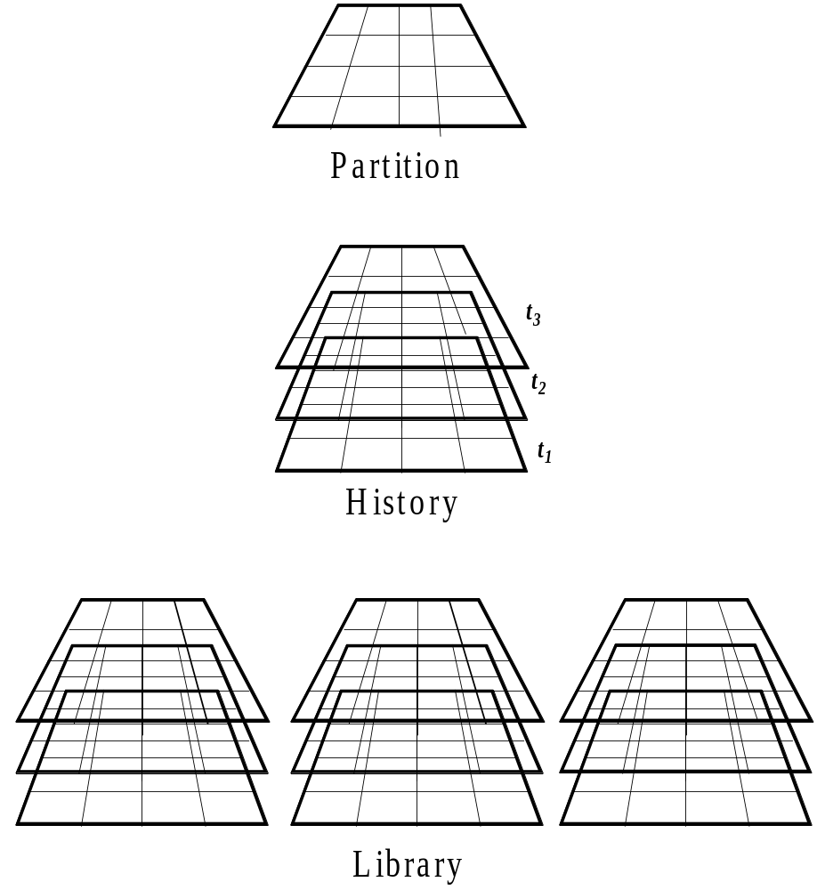
Partition, History, Library

Slide 77
Example:
a simple library with one reference time and two histories
1. x is in region R
2. x is in region -R
then:
p(x is in region R) + p(x is in region -R) = 1

Slide 78
Extension of Libraries
A library L is extended by partition L′ iff all the histories of L are cells of L′
L  L′

Slide 79
Consistency of libraries
L and L′ are consistent with each other:
L Δ L′ =_{df} ∃L″ (L  L″ ∧ L′  L″ )
= they can be glued together to constitute a larger library.

Slide 80
Libraries which describe non-interacting systems are always consistent with each other.

Slide 81
But:
Not all libraries which we need to describe quantum systems are consistent with each other.
Libraries, which are not consistent with each other are called complementary.
... wave-particle dualism; superpositions, cat states

Slide 82
But at the quantum level superpositions exist

Slide 83
The tale of two physicists
John and Mary work within different libraries
John believes in particles, has the laboratory on Wednesdays
Mary believes in waves, has the laboratory on Thursdays

Slide 84
A history with interferometer
reactor
shielding
diffracting crystal
n
window
t₁
t₂
t₃
t₄
t₅

Slide 85
A history with interferometer
reactor
shielding
diffracting crystal
n
window
t₁
t₂
t₃
t₄
t₅

Slide 86
A history with interferometer
reactor
shielding
diffracting crystal
n
window
t₁
t₂
t₃
t₄
t₅

Slide 87
A history with interferometer
reactor
shielding
diffracting crystal
n
window
t₁
t₂
t₃
t₄
t₅

Slide 88
A history with interferometer
reactor
shielding
diffracting crystal
n
window
t₁
t₂
t₃
t₄
t₅

Slide 89
The tale of two physicists
John believes that the system verifies p, and he derives from p fantastically exact predictions which are repeatedly verified
Mary believes that the same system verifies ¬p, and she derives from ¬p fantastically exact predictions which are repeatedly verified

Slide 90
Both are right
Or at least: no experiment could ever be performed which would allow us to choose between them. The system verifies both p and ¬p

Slide 91
Ways to resolve this problem:
1. Griffiths: Whereof we cannot speak, thereof we must be silent. (Inferences are allowed only within some given library.)
2. Superpositions are unnatural tricks, borderline cases constructible only in laboratories (Ian Hacking, Nancy Cartwright)

Slide 92
Ways to resolve this problem (continued)
3.Paraconsistent logic: p, ¬p
but NOT (p ∧ ¬p)
4. Omnès: there are not only ‘elements of reality’ but also border-line elements, whose postulation as theoretical entities is needed in order to make good predictions, but they are not real.

Slide 93
Hypotheses of Realism
Objects are real = their supposition supports reliable predictions
A partition is transparent if it allows us to follow the causal outcomes on the side of the objects in its domain

Slide 94
E-P-R Realism
“If, without in any way disturbing a system, we can predict with certainty (i.e. with probability equal to unity) the value of a physical quantity, then there exists an element of physical reality corresponding to this physical quantity.” (Einstein-Podolsky-Rosen 1935)

Slide 95
But:
In relation to the lifeworld of common sense realism holds with unrestricted validity -- we can derive the truths of folk physics rigorously from quantum mechanical laws

Slide 96
In the quantum world
we need to accept superpositions: which means we need to revise our standard notions of truth and/or reality

Slide 97
But:
We have not too little knowledge of reality on the quantum level -- rather we have enormous amounts of knowledge ... we have too much knowledge
Thus quantum mechanics lends no support at all for any sort of Kantian view

Slide 98
The Evolution of Cognition
Both singly and collectively we are examples of the general class of complex adaptive systems. When they are considered within quantum mechanics as portions of the universe, making observations, we refer to such complex adaptive systems as information gathering and utilizing systems (IGUSes).

Slide 99
IGUS = information gathering and utilizing system
Probabilities of interest to the IGUS include those for correlations between its memory and the external world. …
An IGUS can reason about histories in a coarse-grained fashion: ‘it utilizes only a few of the variables in the universe.’

Slide 100
Why do IGUSes exist ?
The reason such systems as IGUSes exist, functioning in such a fashion, is to be sought in their evolution within the universe. It seems likely that they evolved to make predictions because it is adaptive to do so. The reason, therefore, for their focus on decohering variables is that these are the only variables for which predictions can be made.

Slide 101
Why do IGUSes exist ?
The reason for their focus on the histories of a quasiclassical domain is that these present enough regularity over time to permit the generation of models (schemata) with significant predictive power.
… the IGUS evolves to exploit a particular quasiclassical domain or set of such domains (Gell-Man and Hartle 1991)

Slide 102
Lifeworld of Classical Newtonian Physics
The lifeworld is classical, not because it is some sort of subjective projection (Kant, Bohr, Husserl?), but because its classical character follows rigorously from the quantum mechanical laws governing the physical systems from out of which it is built.

Slide 103
Not: the lifeworld has been constituted by cognitive agents
Rather: we cognitive agents have been constructed by the lifeworld of deterministic (= predictable) physics

Slide 104
Refinement
Eine Aufteilung kann verfeinert oder vergröbert werden, indem wir die Anzahl der dazugehörigen Unterteilungen vergrößern oder verkleinern.

Slide 105
A universal partition
eine Aufteilung, die genau auf die Wirklichkeit paßt, so, alb ob kariertes Papier über die Welt wie senkrechte und wagrechte Linien gelegt wird und die Welt an ihren Gelenken aufteilt
(Hypothesis of universal realism)

Slide 106
Epistemologische Probleme
Ungenauigkeit des Messens
Heisenberg
Grobkörnige Aufteilungen sind das beste, das wir erreichen können

Slide 107
Ontologische Probleme
Es gibt Quantensuperpositionen, d.h. Sachverhalte der Form
P(x) ∧ ¬ P(x)
In the quantum domain not all partitions are consistent

Slide 108
Von der Fotografie zum Film
Von momentanen Aufteilungen bis zeitlich ausgedehnten Geschichten
Eine Geschichte ist eine Sequenz von Aufteilungen

Slide 109
Ontologische Probleme
Es gibt Quantensuperpositionen, d.h. Sachverhalte der Form
P(x) ∧ ¬ P(x)
In the quantum domain not all partitions are consistent

Slide 110
Von der Fotografie zum Film
Von momentanen Aufteilungen bis zeitlich ausgedehnten Geschichten
Eine Geschichte ist eine Sequenz von Aufteilungen

Slide 111
Kriterien der Bewertung von Aufteil ungen
Eine Aufteilung, die das Verfolgen der kausalen Entwicklungen seitens der Gegenstände in ihrer Domäne ermöglicht, ist eine transparente Aufteilung.
Objects are real = their supposition supports reliable predictions

Slide 112
In the quantum world
we need to accept superpositions: which means we need to revise our standard notions of truth and/or reality

Slide 113
realism fails
for the realm of quantum phenomena

Slide 115
But:
In relation to the lifeworld of common sense
... realism holds with unrestricted validity
... we can derive the truths of folk physics rigorously from quantum mechanical laws

Slide 116
Lifeworld of Classical Newtonian Physics
The lifeworld is classical, not because it is some sort of subjective projection (Kant, Bohr, Husserl?), but because its classical character follows rigorously from the quantum mechanical laws governing the physical systems from out of which it is built.

Slide 117
Moreover :
We have not too little knowledge of reality on the quantum level -- rather we have enormous amounts of knowledge ... we have too much knowledge
Thus quantum mechanics lends no support at all for any sort of Kantian view

Slide 118
Murray Gell-Man:
Human beings are IGUSes
IGUS = information gathering and utilizing system

Slide 119
We evolved
with the cognitive apparatus we have, because the ability to make predictions about the future is adaptive
We can only make predictions about coarse-grained physical phenomena because only of such phenomena does Newtonian physics hold

Slide 120
Not: the lifeworld has been constituted by cognitive agents à la Kant
Rather: we cognitive agents have been constructed by the lifeworld of deterministic (= predictable) physics

Slide 121
We have been constructed to be Aristotelians

