Slide 1
JOBS FOR PHILOSOPHERS

Slide 2
PUT YOUR PHILOSOPHY TRAINING TO USE IN THE
HI-TECH WORLD !
www.kanisa.com
“is looking for people who can organize information into carefully defined hierarchical categorization schemes.
„The information architecture model we employ is rather like an Aristotelian category schema in which information is grouped into genus-species relationships.”

Slide 3
www.kanisa.com
“We are looking for people with at least a Masters degree, Ph.D. preferred,in philosophy or a related field, e.g., linguistics.”
Contact:
richard.beatch@kanisa.com

Slide 4
jobs@ontologyworks.com
employment@bowstreet.com
hr@yahoo-inc.com
www.ontek.com

Slide 5
What do ontological engineers do?
They build catalogue systems for given domains of reality
for example: meat.com
... a catalogue system for an entire industry

Slide 6
... a catalogue system
... designed to allow customers, suppliers, insurers, subcontractors, shippers, BSE-technicians, ...
to find their way about the world of
meat
... as readers find their way about the world of books in a library

Slide 7
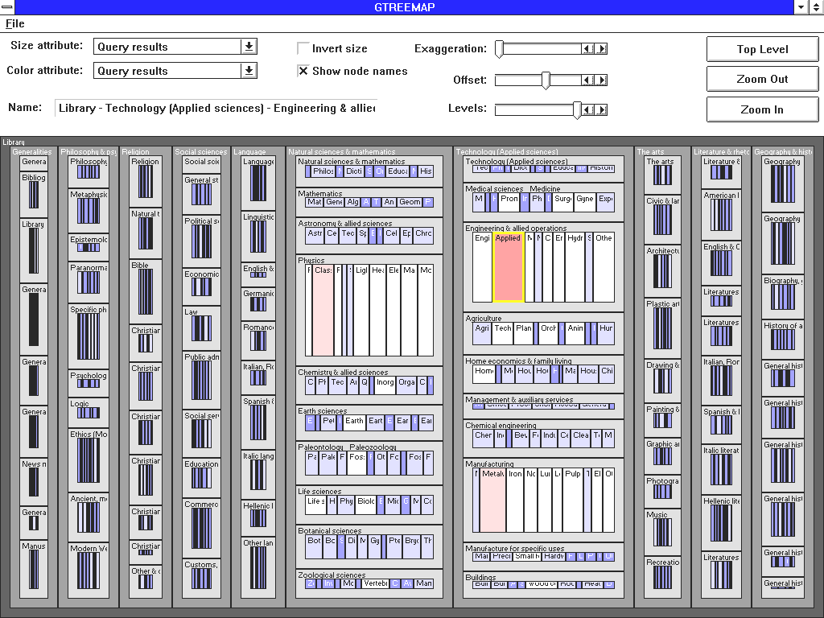
Dewey Decimal Classification as Map
Notes:
http://www2.iicm.edu/ivis/ivis/node25.htm

Slide 8
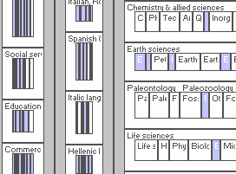
Dewey Decimal Classification (Detail)
Notes:
http://www2.iicm.edu/ivis/ivis/node25.htm

Slide 9
No borderline cases in the closed world of a database
Every book is assigned a determinate Dewey Classification Number at birth
111.560xxx
this yields a classification
that is completely crisp

Slide 10
... and always up-to-date
To be a book = to have a reference number in the Catalogue System
Each of the ontologies produced by ontological engineers deals with objects which are constructed (Kant would say ‚constituted‘) by the database itself

Slide 11
Sharpness of database reality vs. vagueness of flesh and blood reality
How to deal with the problem
of conceptual vagueness?
= How to extend ontology beyond the
quasi-Kantian realm of database engineers
Notes:
Ontologie Eins Null

Slide 12

Theory of vagueness
How can -based
concepts be transparent, if the world is shaped like this:
?

Slide 13
the vagueness problem arises with other sort of concepts too:
dog
cat
fish
what about whales?
bird
what about ostriches?

Slide 14
Kantianism:
we shape the world (of experience) to fit our concepts

Slide 15
we impose concepts on reality
Reality in itself exists behind a veil
(The best we can do is tell conceptual stories ...)
Midas-touch epistemology

Slide 16
Reality itself exists behind a veil
Ontology is impossible
But there is an alternative
Semantic realism:
reality exists behind a transparent grid

Slide 17
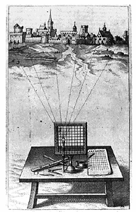
Alberti‘s Grid

Slide 18
How far can semantic realism go?

Slide 19
From Species to Genera
Aristotelian hierarchical classification
bird
canary
what about ostriches?

Slide 20
How deal with vagueness?
by recognizing, with Aristotle, that natural concepts come ready-equipped with a distinction between a core of prototypical instances and a penumbra of non-standard, borderline instances

Slide 21
Natural categories have borderline cases
bird
ostrich

Slide 22
Natural categories have a kernel/penumbra structure
penumbra of borderline cases
kernel of focal
instances

Slide 23
Every cell in a partition directed towards flesh and blood objects is subject to the same kernel/penumbra structure

Slide 24
Objects do not have to fit into their cells exactly
... as a guest does not have to fit exactly in a hotel room

Slide 25
Modulo the kernel/penumbra structure of their constituent categories ...
all transparent partitions capture some part or dimension of reality at some level of granularity

Slide 26
All veridical perspectives are equal
... but some are more equal than others

Slide 27
Mothers exist

Slide 28
The common sense partitions of folk physics, folk psychology, folk biology, are transparent to reality
In Defence of Aristotle
Common sense is true
otherwise we would all be dead

Slide 29
but so is the DER-DIE-DAS partition
DER (masculine) moon lake atom | DIE (feminine) sea sun earth | DAS (neuter) girl fire dangerous thing

Slide 30
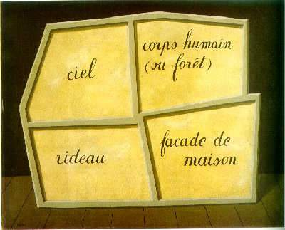
The Empty Mask (Magritte)
milk
mama
Mount Washington
mouse
Notes:
The Empty Mass (Magritte)

Slide 31
... | rook | bishop | pawn | knight | ...
 | John | Paul | George | Ringo
... | up | down | charm | strange | ...

Slide 32
The fundamental thesis of semantic realism
that many of our natural-language partitions are transparent to reality
is in fact quite trivial

Slide 33
are our scientific partitions truly transparent to an independent reality ?

Slide 34
... what about quantum mechanics ?

Slide 35
D’Espagnat: Veiled Reality
Heisenbergian uncertainty implies that our cognition of physical reality
is opaque
∴ at least quantum mechanics
lends support to Kantianism

Slide 36
Surely there are no veridical (transparent) partitions at the quantum level

Slide 37
Well ...

Slide 39
Coarse-grained Partition

Slide 40
Fine-Grained Partition

Slide 41
Manipulation of partitions
refinement
coarsening
gluing
restricting

Slide 42
Refinement
a partition can be refined or coarsened by adding or subtracting from its constituent cell-divisions

Slide 43
Enlargement of a partition
Partition A is enlarged by partition B iff
1. the domain of A is included in the domain of B, and,
2. A and B coincide on the domain which they share in common

Slide 44
Coarse-grained Partition

Slide 45
Coarse-grained Partition

Slide 46
Coarse-grained Partition

Slide 47
Extension of Partitions (via refinement or enlargement)
A partition A is extended by partition B if all the cells of A are cells of B
A  B

Slide 48
The realist’s ideal
A total partition of the universe, a super-partition satisfying:
“Every element of the physical reality must have a counterpart in the physical theory.”
(Einstein-Podolsky-Rosen 1935)

Slide 49
A universal partition
eine Aufteilung, die genau auf die Wirklichkeit paßt, so, alb ob kariertes Papier über die Welt wie senkrechte und wagrechte Linien gelegt wird und die Welt an ihren Gelenken aufteilt
(Hypothesis of universal realism)

Slide 50
A universal partition
Well: why not just take the product of all partitions covering each successive domain and glue them all together ?

Slide 51
Epistemological Problems
Measurement instruments are imprecise
Heisenberg swamped by this
∴ coarse-grained partitions are the best that we can achieve

Slide 52
Granularity of measurement
... -20➢-10 -10 ➢ 0 0 ➢ 10 10 ➢ 20 ...
massively
increased
... normal increased
chronic ...

Slide 53
So
... can we not just take the product of all transparent partitions above a certain level of granularity and make a super-partition which would comprehend the whole of reality ?

Slide 54
Consistency of Partitions
Two partitions are consistent iff there is some third partition which extends them both:
A Δ B =_{df.} ∃C(A  C ∧ B  C)

Slide 55
Ontological Problems
In the quantum domain not all partitions are consistent

Slide 56
From Photograph to Film
From instantaneous partitions to temporally extended histories
A history is a sequence of one or more partitions at successive reference times

Slide 57
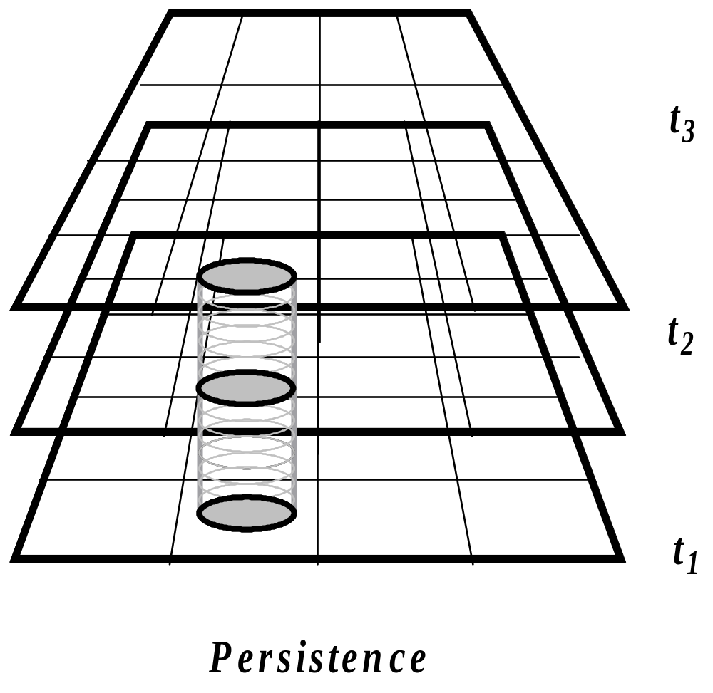
Example: Persistence

Slide 58
Example: tossing a coin 3 times
Heads
Tails
Heads

Slide 59
Example: a chess game
W: Pawn to King4
B: Pawn to Queen’s Bishop 3
W. Pawn to Queen 3
...

Slide 60
Example: An airline ticket
7:00am LH 465 Vienna
arrive London Heathrow 8:15am
9:45am LH 05 London Heathrow
arrive New York (JFK) 3:45pm
5:50pm UA 1492 New York (JFK)
arrive Columbus, OH 7:05pm

Slide 61
Example: An airline ticket
7:00am LH 465 Vienna
arrive London Heathrow 8:15am
9:45am LH 05 London Heathrow
arrive New York (JFK) 3:45pm
5:50pm UA 1492 New York (JFK)
arrive Columbus, OH 7:05pm

Slide 62
Example: An airline ticket
7:00am LH 465 Vienna
arrive London Heathrow 8:15am
9:45am LH 05 London Heathrow
arrive New York (JFK) 3:45pm
5:50pm UA 1492 New York (JFK)
arrive Columbus, OH 7:05pm

Slide 63
Example: An airline ticket
7:00am LH 465 Vienna
arrive London Heathrow 8:15am
9:45am LH 05 London Heathrow
arrive New York (JFK) 3:45pm
5:50pm UA 1492 New York (JFK)
arrive Columbus, OH 7:05pm

Slide 64
Example: An airline ticket
7:00am LH 465 Vienna
arrive London Heathrow 8:15am
9:45am LH 05 London Heathrow
arrive New York (JFK) 3:45pm
5:50pm UA 1492 New York (JFK)
arrive Columbus, OH 7:05pm

Slide 65
Example: An airline ticket
7:00am LH 465 Vienna
arrive London Heathrow 8:15am
9:45am LH 05 London Heathrow
arrive New York (JFK) 3:45pm
5:50pm UA 1492 New York (JFK)
arrive Columbus, OH 7:05pm

Slide 66
A history may or may not be realized

Slide 67
Manipulation of histories
refinement
– add more reference-times
– add more cells
coarsening
gluing
restricting
Cartesian product

Slide 68
Refinement of Histories
A history G is refined by history H if for all reference times t, all the cells of H at t are also cells of G at t
G  H

Slide 69
Library of histories
Complete set of alternative histories for a given granularity of partitions and system of reference times
(compare Leibniz’s totality of all possible worlds)

Slide 70
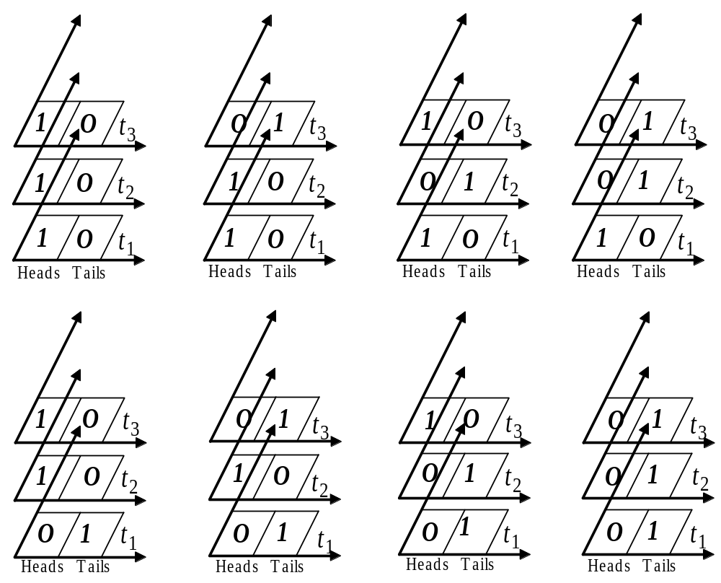
Coin-tossing

Slide 71
Analogy with truth-tables

Slide 72
A simple nuclear reaction
a neutron-proton-collision, which leads to a deuteron plus a gamma ray:
n + p = d + γ

Slide 73

n + p = d + γ
reactor
shielding
diffracting crystal
photomultipier
n
γ
window
p
target

Slide 74
A history with 5 reference times
reactor
shielding
diffracting crystal
photomultipier
n
γ
window
p
target
t₁
t₂
t₃
t₄
t₅

Slide 75
An alternative history with the same 5 reference times
reactor
shielding
diffracting crystal
photomultipier
n
window
p
target
t₁
t₂
t₃
t₄
t₅

Slide 76
Coin-tossing with probabilities assigned
0.125
0.125
0.125
0.125
0.125
0.125
0.125
0.125

Slide 77
Assigning probabilities to alternative histories
reactor
shielding
diffracting crystal
photomultipier
n
0.267
γ
0.594
window
0.211
p
target
t₁
t₂
t₃
t₄
t₅

Slide 78
Probabilities are assigned
... not to every possible history
... but to bands of alternatives (to cells within a coarse-grained partition) at specific reference times
... -20➢-10 -10 ➢ 0 0 ➢ 10 10 ➢ 20 ...

Slide 79
In the world of classical physical phenomena only one alternative history is realized

Slide 80
In the world of quantum physical phenomena it is as if all probabilities are realized

Slide 81
Until a system is measured, or otherwise disturbed its states, are probabilistic through and through

Slide 82
From histories to libraries
The Griffiths–Gell-Mann–Hartle–Omnès consistent histories interpretation of quantum mechanics
Gell-Mann: Not ‘many worlds’ (Everett) but many alternative histories of the actual world

Slide 83
Definition of a library
A library is a maximal consistent family of mutually exclusive and exhaustive histories
with a probability distribution, which satisfies the following:
    1. The probabilities are positive.
    2. The probabilities are additive.
    3. The probabilities add up to 1.

Slide 84
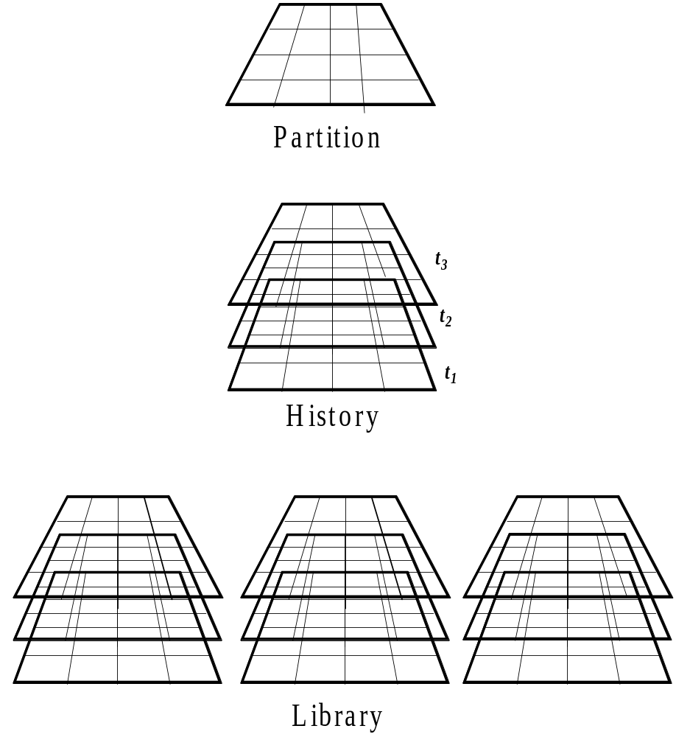
Partition, History, Library

Slide 85
Extension of Libraries
A library L is extended by partition L′ iff all the histories of L are cells of L′
L  L′

Slide 86
Consistency of libraries
L and L′ are consistent with each other:
L Δ L′ =_{df} ∃L″ (L  L″ ∧ L′  L″ )
= they can be glued together to constitute a larger library.

Slide 87
Libraries which describe non-interacting systems are always consistent with each other.

Slide 88
But:
Not all libraries which we need to describe quantum systems are consistent with each other.
Libraries, which are not consistent with each other are called complementary.
... wave-particle dualism; superpositions, cat states

Slide 89
The tale of two physicists
John and Mary work within different libraries
John believes in particles, has the laboratory on Wednesdays
Mary believes in waves, has the laboratory on Thursdays

Slide 90
Mary’s history with an interferometer
reactor
shielding
diffracting crystal
window
t₁
t₂
t₃
t₄
t₅

Slide 91
Mary’s history with an interferometer
reactor
shielding
diffracting crystal
n
window
t₁
t₂
t₃
t₄
t₅

Slide 92
A history with interferometer
reactor
shielding
diffracting crystal
n
window
t₁
t₂
t₃
t₄
t₅

Slide 93
A history with interferometer
reactor
shielding
diffracting crystal
n
window
t₁
t₂
t₃
t₄
t₅

Slide 94
A history with interferometer
reactor
shielding
diffracting crystal
n
window
t₁
t₂
t₃
t₄
t₅

Slide 95
A history with interferometer
reactor
shielding
diffracting crystal
n
window
t₁
t₂
t₃
t₄
t₅

Slide 96
A history with interferometer
reactor
shielding
diffracting crystal
n
window
t₁
t₂
t₃
t₄
t₅

Slide 97
A history with interferometer
reactor
shielding
diffracting crystal
n
window
t₁
t₂
t₃
t₄
t₅

Slide 98
The tale of two physicists
John believes that the system verifies p, and he derives from p fantastically exact predictions which are repeatedly verified
Mary believes that the same system verifies q, and she derives from q fantastically exact predictions which are repeatedly verified

Slide 99
Both are right
Or at least: no experiment could ever be performed which would allow us to choose between them. The system verifies both p and q

Slide 100
Both are right
Or at least: no experiment could ever be performed which would allow us to choose between them. The system verifies both p and q
But p and q are logically inconsistent

Slide 101
Ways to resolve this problem:
1. Griffiths: Whereof we cannot speak, thereof we must be silent. (Inferences are allowed only within some given library.)
2. Superpositions are unnatural tricks, borderline cases constructible only in laboratories (Ian Hacking, Nancy Cartwright)

Slide 102
Ways to resolve this problem (continued)
3.Paraconsistent logic: p, ¬p
BUT NOT (p ∧ ¬p)
4. Omnès: there are not only ‘elements of reality’ but also border-line elements, whose postulation as theoretical entities is needed in order to make good predictions, but they are not real.

Slide 103
Hypotheses of Realism
Objects are real = their supposition supports reliable predictions
A partition is transparent if it allows us to follow the causal outcomes on the side of the objects in its domain

Slide 104
Kriterien der Bewertung von Aufteilungen
Eine Aufteilung, die das Verfolgen der kausalen Entwicklungen seitens der Gegenstände in ihrer Domäne ermöglicht, ist eine transparente Aufteilung.
Objects are real = their supposition supports reliable predictions

Slide 105
E-P-R Realism
“If, without in any way disturbing a system, we can predict with certainty (i.e. with probability equal to unity) the value of a physical quantity, then there exists an element of physical reality corresponding to this physical quantity.” (Einstein-Podolsky-Rosen 1935)

Slide 106
E-P-R Realism
fails for the quantum world

Slide 107
But still:
In relation to the lifeworld of common sense realism holds with unrestricted validity -- indeed we can derive the truths of folk physics rigorously from quantum mechanical laws
... by moving from finer-grained to coarser-grained histories

Slide 108
In the quantum world
we need to accept superpositions: which means we need to revise our standard notions of truth and/or reality

Slide 109
But:
this is not because we have too little knowledge of reality on the quantum level -- rather we have enormous amounts of knowledge ... we have too much knowledge
Thus quantum mechanics lends no support at all for any sort of Kantian view

Slide 110
realism fails
But still:
for the realm of quantum phenomena

Slide 112
Coda:
The Evolution of Cognition
Both singly and collectively we are examples of the general class of complex adaptive information gathering and utilizing systems (IGUSes).

Slide 113
IGUS = information gathering and utilizing system
An IGUS can reason about histories in a coarse-grained fashion: ‘it utilizes only a few of the variables in the universe.’

Slide 114
Why do IGUSes exist ?
The reason IGUSes exist, functioning in such a fashion, is to be sought in their evolution within the universe. They evolved to make predictions because it is adaptive to do so. The reason, therefore, for their focus on Newtonian-like variables is that these are the only variables for which predictions can be made.

Slide 115
Why do IGUSes exist ?
Only histories of a quasi-Newtonian domain present enough regularity over time to permit the generation of models with significant predictive power.
… we IGUSes evolved to exploit a particularity of the quasi-Newtonian domain (Gell-Man and Hartle 1991)

Slide 116
Lifeworld of Classical Newtonian Physics
The lifeworld is classical, not because it is some sort of subjective projection (Kant, Bohr, Husserl?), but because its classical character follows rigorously from the quantum mechanical laws governing the physical systems from out of which it is built.

Slide 117
We evolved
... with the cognitive apparatus we have, because the ability to make predictions about the future is adaptive
We can only make predictions about coarse-grained physical phenomena because only of such phenomena does Newtonian physics hold

Slide 118
Not: the lifeworld has been constituted by cognitive agents (Kant)
Rather: we cognitive agents have been constructed by the lifeworld of deterministic (= predictable) physics

Slide 119
We have been constructed
to be Aristotelians

