Slide 1
How to Make a Promise:
Law, Trust and the Ontology of Human Interaction
Barry Smith

Slide 2
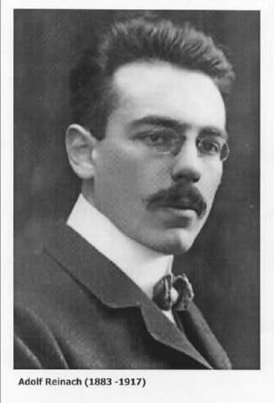

Slide 3
Adolf Reinach
The A Priori Foundations of the Civil Law – 1913
A study of the ontology of the promise and related social phenomena
Cf. Kevin Mulligan, “Promisings and other Social Acts: Their Constituents and Structure”

Slide 4
From:
K. Mulligan (ed.),
Speech Act and Sachverhalt: Reinach and the Foundations of Realist Phenomenology, 1987

Slide 5
Munich School of Phenomenology
Adolf Reinach
Alexander Pfänder
Max Scheler
Roman Ingarden
Edith Stein
(… Karol Wojtyła)

Slide 6
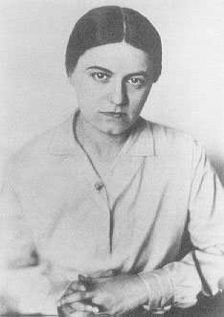
Edith Stein
beatified by John Paul II in 1987

Slide 7
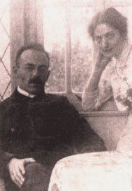

Slide 8
The Munich School
applied the realist ontological method sketched by Husserl in the Logical Investigations to different material domains:
Reinach: Law
Ingarden: Art and Aesthetics
Stein: The State and the Individual
Scheler: The Germans and the English

Slide 9
Realism
Munich phenomenologists’ method of passive faithfulness to what is given in reality
with no attempt at reductionism
but seeking rather to apprehend each kind of entity on its own terms
and to apprehend the relations between them on their own terms

Slide 10
Speech Acts
Examples: requesting, questioning, answering, ordering, imparting information, promising, commanding, baptising
“‘acts of the mind’ which do not have in words and the like their accidental additional expression”
Social acts which “are performed in the very act of speaking”

Slide 11
Reinach descriptive ontology of social acts
Compare Austin: “The total speech‑act in the total speech situation is the only actual phenomenon which, in the last resort, we are engaged in elucidating” (How to do Things with Words)

Slide 12
Part of a “general ontology of social interaction”
Die apriorische Grundlagen des bürgerlichen Rechts
Reinach employs a theory of ontological structure
Austin, on the other hand, is concerned to combat a view of language
(the view of Aristotle, Frege)

Slide 13
Austin: the primary unit of philosophical analysis is linguistic
Reinach: language, psychology, action (and ontological structure) (and law) all matter
Reinach and Austin come to more or less the same conclusions about the traits of speech acts

Slide 14
Reinach on States of Affairs
“On the Theory of the Negative Judgment” (1911)
English translation in Parts and Moments.
Anticipates Wittgenstein’s Tractatus

Slide 15
The kinds of judgment
Simple positive judgment: This rose is red
Polemical negative judgment:
[John is wrong] The rose is not red
Simple negative judgment
Polemical positive judgment

Slide 16
Frege
_{¬ p}
p

Slide 17
Theory of judgment and negation
as part of the theory of speech acts

Slide 18
What makes a negative judgment true
“This rose is not red”
Non-redness in the ontological orbit of the rose
Can we read off non-redness from reality?
Reinach’s Platonistic theory
Ingarden’s theory of states of affairs

Slide 19
Reinach’s typology of acts
spontaneous acts
= acts which consist in a subject’s bringing something about within his own psychic sphere,
as contrasted with passive experiences of feeling a pain or hearing a noise

Slide 20
Spontaneous acts and language
internal vs. external
internal = the act’s being brought to expression is non-essential
external = the act only exist in its being brought to expression

Slide 21
Self-directability
self-directable vs. non-self-directable
self-directable: love, hate, fear
non-self-directable: commanding, requesting

Slide 22
Non-self-directable external spontaneous acts
can be IN NEED OF UPTAKE:
the issuer of a command must not merely utter the command in public;
he must direct this utterance to its addressees in such a way that it is received and understood by them in an appropriate way.

Slide 23
Reinach:
A command is neither a purely external action nor is it a purely inner experience, nor is it the announcing (kundgebende Ausserung) to another person of such an experience.
Commanding … does not involve an experience which is expressed but which could have remained unexpressed,
…there is nothing about commanding which could rightly be taken as the pure announcing of an internal experience.

Slide 24
Reinach:
Commanding is rather an experience all its own, a doing of the subject to which in addition to its spontaneity, its intentionality and its other-directedness, the need to be grasped is also essential
Commanding, requesting, warning …
are all social acts, which by the one who performs them and in the performance itself, are cast towards another person in order to fasten themselves in his soul.

Slide 25
social acts have an inner and an outer side
‘If I say “I am afraid” or “I do not want to do that”, this is an utterance referring to experiences which would have occurred even without any such utterance.
‘But a social act, as it is performed between persons, does not divide into an independent performance of an act and an accidental statement about it;
‘it rather forms an inner unity of voluntary act and voluntary utterance.’

Slide 26
THE PARTS OF PROMISES AND OTHER SOCIAL ACTS
The linguistic component
Reinach: The same words, ‘I want to do this for you’, can … function both as the expression of a promise and as the informative expression of an intention.

Slide 27
THE PARTS OF PROMISES AND OTHER SOCIAL ACTS
The experiential component:
Austin: ‘mental actions’ are ‘commonly necessary’ to the performance of speech acts

Slide 28
THE PARTS OF PROMISES AND OTHER SOCIAL ACTS
Reinach: all social acts presuppose specific types of internal experiences
-- relation of one-sided ontological dependence
-- Brentano/Husserl descriptive psychology part of an ontology
(Theory of dependence originally introduced in context of psychology)

Slide 29
THE PARTS OF PROMISES AND OTHER SOCIAL ACTS
Social Act Experience
informing conviction
asking a question uncertainty
requesting wish
commanding will
promising will
enactment will

Slide 30
THE PARTS OF PROMISES AND OTHER SOCIAL ACTS
Social Act Experience
informing state conviction
asking a question state uncertainty
requesting wish
commanding will
promising will
enactment will

Slide 31
THE PARTS OF PROMISES AND OTHER SOCIAL ACTS
Social Act Experience
informing state conviction
asking a question state uncertainty
requesting event wish
commanding event will
promising event will
enactment event? will

Slide 32
CONTENT
Mental states and mental events can share the same content
Husserl: content vs. quality of an act
p
p!
p?

Slide 33
Reinach:
the intentional content of the underlying experience
the intentional content of the social act
the content of the action to be performed (in the case of promises, requests, commands …)

Slide 34
Social acts depend on uptake
(contrast: envy, forgiveness)
social acts must be both
addressed to other people
and
registered by their addressees

Slide 35
Some social acts not other-directed
and thus not in need of uptake:
waiving a claim
enacting a law
I promise you that p
I ask you whether p
(3) I order you to F
(4) I hereby enact that p

Slide 36
Enactments
BGB §1: “The ability of man to be a subject of rights begins with the completion of birth”
This is ‘not any sort of judgement’
Valid laws shape/create environments:
‘If a state of affairs stands for a group of subjects as objectively required in virtue of an enactment, then action realizing the state of affairs is consequently required of these subjects.’

Slide 37
FOUNDING RELATIONS FOR SOCIAL ACTS
Commands, marryings, baptisings
depend on
i. relations of authority
ii. appropriate attitudes
iii. appropriate environment
The simultaneous basis of the speech act

Slide 38
Grounding Social Acts
Reinach:
‘A question is grounded insofar as the state of affairs which it puts into question is objectively doubtful; an enactment is grounded insofar as the norm which is enacted, objectively ought to be.’

Slide 39
SUCCESSOR STATES FOR SOCIAL ACTS
Assertion gives rise to CONVICTION
Promise gives rise to
CLAIM and OBLIGATION
(not experiences)

Slide 40
Non-Physical Social Entities:
relations of authority …
(SIMULTANEOUS BASIS)
claims, obligations …
(SUCCESSOR STATES)
Compare: Searle’s deontic powers

Slide 41
The Structure of Social Acts
‘Insofar as philosophy is ontology or the a priori theory of objects, it has to do with the analysis of all kinds of objects as such.’ (GS 172).
The a priori theory of objects is formal ontology and not to be confused with the different material ontologies that result from applying the formal theory to the domain of mental acts or social acts (GS 431).

Slide 42
PARTS OF SOCIAL ACTS: Tendencies
Promising, commands, requests gives rise to a tendency to realization
Genes have a tendency to be expressed in the form of proteins
Bodies have a tendency to fall when dropped
Tendencies can be blocked …

Slide 43
Munich School Formal Ontology
derived from Husserl’s theory of part, whole and dependence in the 3rd Logical Investigation

Slide 44
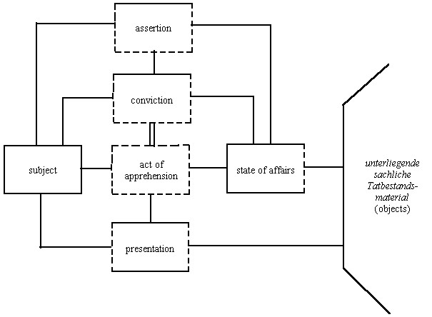
Assertion

Slide 45
Types of Temporal Entity
episode enduring
non‑psychological
state
event process short‑lived
psychological state
[–temporal [+actual [+possible [+possible
parts] temporal temporal temporal
parts] parts] parts]
[+heterogeneous [+homogeneous [+homogeneous
parts] parts] parts]

Slide 46
event
state
event
process

Slide 47
Bunge-Wand-Weber (BWW) Ontology
Endurants created, destroyed, changed by events.
Record of a history is an endurant
Histories started stopped by events

Slide 48
event
state
?
?
event
?
process

Slide 49
THE BACKGROUND
Cristiano Castelfranchi :
INFORMATION IS BASED ON TRUST

Slide 50
Events give rise to states
Assertion gives rise to CONVICTION as its successor state
(if it does not, it is not an assertion)
John sees that Mary is swimming
Promising gives rise to CLAIM and OBLIGATION as its successor state

Slide 51
The Structure of the Promise
the promise
promiser
promisee
relations of one-sided
dependence

Slide 52
The Structure of the Promise
act of speaking
promiser
act of registering
promisee
content
three-sided mutual
dependence

Slide 53
The Structure of the Promise
act of speaking
promiser
act of registering
promisee
content
two-sided mutual dependence
oblig-ation
claim

Slide 54
The Structure of the Promise
action: do F
act of speaking
promiser
act of registering
promisee
content F
tendency towards realization
oblig-ation
claim

Slide 55
action: do F
act of speaking
promiser
act of registering
promisee
content F
oblig-ation
claim
sincere intention
The Background (Environment)

Slide 56
The structure of social acts
Promiser Promise Promissee
Act of speaking Act of hearing
Uptake, Registering
Experience, intention
Obligation Claim
Tendency to realize content
Underlying intentions, The Background
Environment

Slide 57
Modifications of Social Acts
Sham promises
Lies as sham assertions (cf. a forged signature); rhetorical questions
Social acts performed in someone else’s name (representation, delegation)
Social acts with multiple addresses
Conditional social acts

Slide 58
Collective social acts
Singing in a choir
Conversation
Dancing
Arguing
Religious rituals

Slide 59
action: do F
act of speaking
promiser
act of registering
promisee
content F
oblig-ation
claim
sincere intention
How modific-ations occur
The Background (Environment)

Slide 60
action: do F
act of speaking
promiser
act of registering
promisee
content F
oblig-ation
claim
sincere intention
How modific-ations occur
The Background (Environment)

Slide 61
action: do F
act of speaking
promiser
act of registering
promisee
content F
oblig-ation
claim
sincere intention
How modific-ations occur
The Background (Environment)

Slide 62
action: do F
act of speaking
promiser
act of registering
promisee
content F
oblig-ation
claim
sincere intention
How modific-ations occur
The Background (Environment)

Slide 63
action: do F
act of speaking
promiser
act of registering
promisee
content F
oblig-ation
claim
sincere intention
The Background (Environment, External Memory)
TRUST

Slide 64
The Ontology of Claims and Obligations (Endurants)
Debts
Offices, roles
Licenses
Prohibitions
Rights
Laws

Slide 65
Three sorts of objects
1. Necessary Objects (intelligible; timeless) – e.g. the number 7 (Plato)
2. Contingent Objects (knowable only through observation; historical; causal) – e.g. Bill Clinton (positivists)
3. Objects of the third kind (intelligible, but have a starting point in time) – e.g. my debts, Karl Popper’s knighthood (Adolf Reinach, Roman Ingarden)

Slide 66
Three sorts of history
1.
2.
3.

Slide 67
Three sorts of history
1.
2.
3.
The number 7
Bill Clinton
Clinton’s Presidency

Slide 68
Two sorts of social science
Micro-Economics
Micro vs. Macro
Micro deals with intelligible ontological structures
Macro deals with causal/historical regularities
Law and Ethics both Micro-Disciplines
foundations for Macro Disciplines (e.g. Legal History)

Slide 69
A priori law vs. positive law
Positive law = historical modifications of a priori legal structures
A priori law: A promise gives rise to a claim and obligation
Positive law:
Signing a contract before witnesses counts as making a contract
Contracts signed by minors are not valid
Contracts not co-signed by a notary public are not valid

Slide 70
Apriorism
Reinach's a priori theory of law provides universal grammar of the (micro-)legal realm, or of human (micro-)institutions in general.
Austrian school of economics provides universal grammar of the micro-economic realm

Slide 71
Carl Menger and the Austrian School of Economics
Austrian Economics = study of the necessary dependence relations amongst the various constituent parts of the economic domain
apriorism – these dependence relations are intelligible
An exchange depends upon an exchanger and an exchangee

Slide 72
Coulomb’s Agent Communities
bill
deliver
est-cust
identify-product-price
order
offer-product
purchase
pay

Slide 73
Carl Menger:
A good exists as such only if the following are simultaneously present:
1. A need on the part of some human being.
2. Properties of the object in question which render it capable of being brought into a causal connection with the satisfaction of this need.
3. Knowledge of this causal connection on the part of the person involved.
4. Command of the thing sufficient to direct it to the satisfaction of the need

Slide 74
Other aprioristic micro-disciplines
a priori disciplines:
mereology
rational kinaesiology
geometry
chronometry mechanics

Slide 75
Other aprioristic micro-disciplines
aesthesiologies (theories of secondary qualities):
colourology
tone-theory
haptology (the theory of warmth and cold, textures)

Slide 76
Other aprioristic micro-disciplines
rational psychology:
theory of beliefs and desires
theory of feelings
theory of values and valuings
(Scheler’s material ethics and formal axiology )
theory of will
theory of imperatives
theory of speech acts
theory of norms
aesthetics

Slide 77
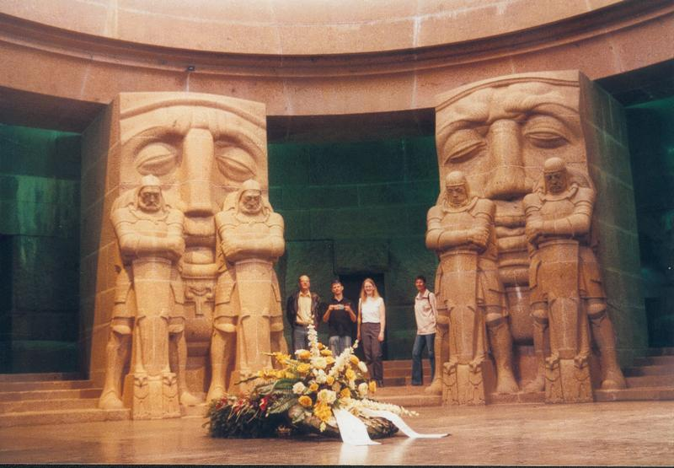

Slide 78
Could the world of social entities (deontic powers) be entirely conventional ?
Oughtness a function of (collective) belief
Tokens – this obligation exists = people believe this obligation exists
Types – this type of obligation exists = people believe this type of obligation exists

Slide 79
Searle
The institutions of marriage, money, and promising are like the institutions of baseball and chess in that they are systems of …constitutive rules or conventions.

Slide 80
Information Systems Ontology
Ontology of constructed (database) worlds
of administrative realities …

Slide 81
Reinach:
Some institutional concepts are purely conventional: endowment mortgage, junk bond derivatives trader, football team-manager
But not all of them can be
Consider the concept of convention

Slide 82
Reinach:
Basic institutional concepts: convention, ownership, obligation, uptake, agreement, sincerity,
rule, breaking a rule, authority, consent, jurisdiction
These are primitive = not capable of being defined in terms of more basic notions

Slide 83
Reinach:
Basic institutional concepts: convention, ownership, obligation, uptake, agreement, sincerity,
breaking a rule, authority, consent, jurisdiction
… the basic structural building-blocks of social reality

Slide 84
The Basic Structures of Social Reality
Propositions about basic institutional concepts,
e.g.: an acknowledgement is different from an obligation
cannot be true purely as a matter of convention
For the very formulation and adoption of conventions presupposes concepts of the given sort.

Slide 85
Most philosophers
have dealt with the world as if it were structured by monocategorial relations
physicalist reductionism
mentalism/idealism
the mind/body problem as the paradigm of a philosophical problem

Slide 86
Most information systems ontologies
have dealt with the world as if it were structured by monocategorial relations
everything is a string
everything is a process within an information system
everything is a record
everything is a specification of a process within an information system

Slide 87
Contexts for Social Acts
X counts as Y in context C

Slide 88
Lecture 4: An Ontology of Contexts

Slide 89
Contexts can be Nested One Inside Another
Many settings occur in assemblies:
A unit in the middle range of a nesting structure is simultaneously both circumjacent and interjacent,
both whole and part,
both entity and environment.

Slide 90
The bonds
established by Reinach’s proto-structures of promise, claim and obligation …
can normally arise only within miniature civil societies,
within which special sorts of environmental conditions are satisfied

Slide 91
Large-scale social organizations
are held together by micro-social bonds
The whole held together via a nesting structure

Slide 92
Nothing is certain except death and taxes

Slide 93
How can we even understand taxes?
How can we do justice ontologically to the fact of social complexity?
How do separate persons, such as you and me, become joined together into transcategorial social wholes of such diverse types -- committees, teams, battalions, meetings, conversations, football games, wars, treaty negotiations, ontological disputes?

Slide 94
Already every single act of promising
manifests a tremendous transcategorial complexity, embracing constituents of a linguistic, psychological, quasi-legal and quasi-ethical sort, as well as more narrowly physical constituents of different types (including vibrations in the air and ear and associated electrical and chemical events in the brain).
How is this complexity possible?

Slide 95
This complex feat,
which is performed almost effortlessly dozens if not hundreds of times every day, must be rooted in capacities established biologically (hard-wired)

Slide 96
A simple mechanism
we need efficient ways to categorize people as friends or enemies
each group evolves norms regarding adoption, food, clothing, marriage, dowry, inheritance, defence, language …
These signal-systems, eac group marries its daughters out to those who share the same group norms
Those groups survive who perform this selection process most efficiently (keep out cheaters)
Its descendants have been genetically built to take up these norms into themselves (Chomsky …)

Slide 97
Gradually group size grows larger
from small tribes
to large-scale social organizations
(towns, provinces, nations, civilizations)
as norms become more abstract

Slide 98
But for certain purposes
we still need to be able to recognize members of our group in a local sense (cheater-detector mechanisms)
as group size grows, groups settle down into nesting structures (spatial hierachies) and we preserve the capacity to apprehend groups at different levels of granularity within such structures:
family, friends, community, nation, large-scale political organizations

Slide 99
we must be tuned, automatically, to social reality
J. J. Gibson’s ecological psychology – lecture 4

Slide 100
Commitments
families,friendship communities, work communities
creating miniature civil societies through entering into commitments
we can make commitments only because we are continuants
by making commitments we become involved in stories (Geschichten)

Slide 101
Schapp
real commitments/stories are endurants
Wilhelm Schapp, In Geschichten verstrikt
in chess verstrickt
in marriage verstrikt
in ontology verstrikt

Slide 102
The global system of stories
The global system of pathways across the hillside arises as an unintended consequence of many actions carried out on a local scale.
Hayek: a range of cultural phenomena, including law, language, religion and the market, likewise owe their origin to an unplanned cumulation of the effects of individual decisions and actions over time.

Slide 103
What can we conclude from all of this as ontologists?
Recall the Munich phenomenologists’ method of passive faithfulness to what is given in reality

Slide 104
At each level within this hierarchy of human groups we apprehend the world as containing NORMS
THE ONTOLOGY OF THE COMMON-SENSE WORLD COMPREHENDS ALSO: NORMS
Ontological realism; maximal descriptive adequacy
Not reductionism
Except to the degree that we can learn from attempts at reduction

