Slide 1
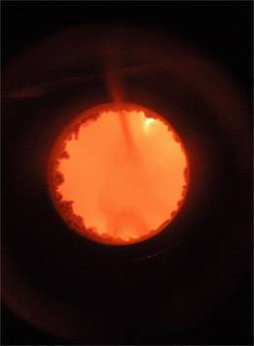
A General Introduction to Biomedical Ontology
Barry Smith
http://ontology.buffalo.edu/smith

Slide 2
Problem
How to create the conditions for a step-by-step evolution towards high quality ontologies in the biomedical domain
which will serve as stable attractors for clinical and biomedical researchers in the future?

Slide 3
Answer:
Ontology development should cease to be an art, and become a science
= embrace the scientific method
If two scientists have a dispute, then they resolve it

Slide 4
Scientific ontologies have special features
Computational concerns are not considerations relevant to the truth of an assertion in the ontology
Myth, fiction, folklore are not considerations relevant to the truth of an assertion in the ontology
Every entity referred to by a term in a scientific ontology must exist

Slide 5
A problem of terminologies
Concept representations
Conceptual data models
Semantic knowledge models
...
Information consists in representations
of entities in a given domain
what, then, is an information representation?

Slide 6
Problem of ensuring sensible cooperation in a massively interdisciplinary community
concept
type
instance
model
representation
data

Slide 7
A basic distinction
universal vs. instance
science text vs. clinical document
man vs. Musen

Slide 8
Instances are not represented in an ontology built for scientific purposes
It is the generalizations that are important
(but instances must still be taken into account)

Slide 9
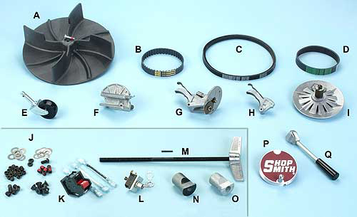
Catalog vs. inventory
A | 515287 | DC3300 Dust Collector Fan
B | 521683 | Gilmer Belt
C | 521682 | Motor Drive Belt

Slide 10
Ontology universals Instances

Slide 11
Ontology = A Representation of universals

Slide 12
Ontology = A Representation of universals
Each node of an ontology consists of:
preferred term (aka term)
term identifier (TUI, aka CUI)
synonyms
definition, glosses, comments

Slide 13
Each term in an ontology represents exactly one universal
It is for this reason that ontology terms should be singular nouns
National Socialism is_a Political Systems

Slide 14
An ontology is a representation of universals
We learn about universals in reality from looking at the results of scientific experiments in the form of scientific theories – which describe not what is particular in reality but rather what is general
Ontologies need to exploit the evolutionary path to convergence created by science

Slide 15

universals
substance
organism
animal
mammal
cat
leaf class
frog
siamese
instances

Slide 16
Rules for formating terms
Terms should be in the singular
Terms should be lower case
Avoid abbreviations even when it is clear in context what they mean (‘breast’ for ‘breast tumor’)
Avoid acronyms
Avoid mass terms (‘tissue’, ‘brain mapping’, ‘clinical research’ ...)
Treat each term ‘A’ in an ontology is shorthand for a term of the form ‘the universal A’

Slide 17
Problem of ensuring sensible cooperation in a massively interdisciplinary community
concept
type
instance
model
representation
data

Slide 18
Problem of ensuring sensible cooperation in a massively interdisciplinary community
concept representation
data type
data instance
conceptual knowledge model

Slide 19
Three Levels to Keep Straight
Level 1: the reality on the side of the organism (patient)
Level 2: cognitive representations of this reality on the part of clinicians
Level 3: publicly accessible concretisations of these cognitive representations in textual, graphical and digital artifacts
We are all interested primarily in Level 1

Slide 20
Three Levels to Keep Straight
Level 1: the reality on the side of the organism (patient)
Level 2: cognitive representations of this reality on the part of clinicians
Level 3: publicly accessible concretisations of these cognitive representations in textual, graphical and digital artifacts
We (scientists) are all interested primarily in Level 1

Slide 21
Entity =def
anything which exists, including things and processes, functions and qualities, beliefs and actions, documents and software (Levels 1, 2 and 3)

Slide 22
Three Levels to Keep Straight
Level 1: the reality on the side of the organism (patient)
Level 2: cognitive representations of this reality on the part of clinicians
Level 3: publicly accessible concretisations of these cognitive representations in textual, graphical and digital artifacts

Slide 23
A scientific ontology
is about reality (Level 1)
= the benchmark of correctness

Slide 24
Ontology development
starts with Level 2 = the cognitive representations of clinicians or researchers as embodied in their theoretical and practical knowledge of the reality on the side of the patient

Slide 25
Ontology development
results in Level 3 representational artifacts
comparable to
clinical texts
basic science texts
biomedical terminologies

Slide 26
Domain =def
a portion of reality that forms the subject-matter of a single science or technology or mode of study;
proteomics
radiology
viral infections in mouse

Slide 27
Representation =def
an image, idea, map, picture, name or description ... of some entity or entities.

Slide 28
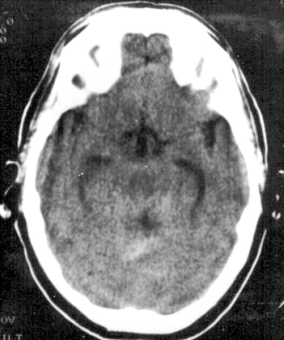
Analogue representations

Slide 29
Representational units =def
terms, icons, alphanumeric identifiers ... which refer, or are intended to refer, to entities

Slide 30
Composite representation =def
  representation
  (1) built out of representational units
  which
  (2) form a structure that mirrors, or is intended to mirror, the entities in some domain

Slide 31
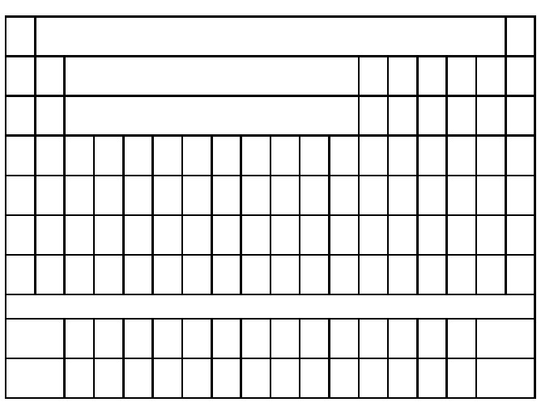
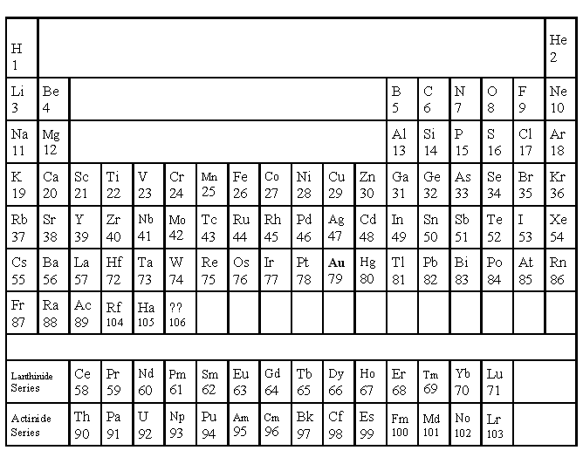
Periodic Table
The Periodic Table

Slide 32
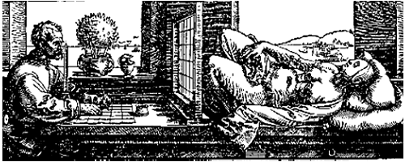
Two kinds of composite representations
Cognitive representations (Level 2)
Representational artefacts (Level 3)
The reality on the side of the patient (Level 1)

Slide 33
Ontologies are here

Slide 34
or here

Slide 35
Ontologies are representational artifacts

Slide 36
What do ontologies represent?

Slide 37
A | 515287 | DC3300 Dust Collector Fan
B | 521683 | Gilmer Belt
C | 521682 | Motor Drive Belt

Slide 38
instances
A | 515287 | DC3300 Dust Collector Fan
B | 521683 | Gilmer Belt
C | 521682 | Motor Drive Belt
universals

Slide 39
Two kinds of composite representational artifacts
Databases, inventories: represent what is particular in reality = instances
Ontologies, terminologies, catalogs: represent what is general in reality = universals

Slide 40
Ontologies do not represent concepts in people’s heads

Slide 41
Ontologies represent universals in reality

Slide 42
“lung” is not the name of a concept
concepts do not stand in
part_of
connectedness
causes
treats ...
relations to each other

Slide 43
Ontology is a tool of science
Scientists do not describe the concepts in scientists’ heads
They describe the universals in reality, as a step towards finding ways to reason about (and treat) instances of these universals

Slide 44
people who think ontologies are representations of concepts make mistakes
congenital absent nipple is_a nipple
failure to introduce or to remove other tube or instrument is_a disease
bacteria causes experimental model of disease

Slide 45
An ontology is like a scientific text; it is a representation of universals in reality

Slide 46
The clinician has a cognitive representation which involves theoretical knowledge derived from textbooks

Slide 47
Two kinds of composite representational artifacts
Databases represent instances
Ontologies represent universals

Slide 48
Instances stand in similarity relations
Frank and Bill are similar as humans, mammals, animals, etc.
Human, mammal and animal are universals at different levels of granularity

Slide 49
How do we know which general terms designate universals?
Roughly: terms used in a plurality of sciences to designate entities about which we have a plurality of different kinds of testable proposition
(compare: cell, electron ...)

Slide 50
universals
substance
organism
animal
“leaf node”
mammal
cat
frog
siamese
instances

Slide 51
Class =def
a maximal collection of particulars determined by a general term (‘cell’, ‘oophorectomy’ ‘VA Hospital’, ‘breast cancer patient in Buffalo VA Hospital’)
the class A
= the collection of all particulars x for which ‘x is A’ is true

Slide 52
Defined class =def
a class defined by a general term which does not designate a universal
the class of all diabetic patients in Leipzig on 4 June 1952

Slide 53
terminology
a representational artifact whose representational units are natural language terms (with IDs, synonyms, comments, etc.) which are intended to designate defined classes.

Slide 54
universals < defined classes < ‘concepts’
Not all of those things which people like to call ‘concepts’ correspond to defined classes
“Surgical or other procedure not carried out because of patient's decision”

Slide 55
‘Concepts’
INTRODUCER, GUIDING, FAST-CATH TWO-PIECE GUIDING INTRODUCER (MODELS 406869, 406892, 406893, 406904), ACCUSTICK II WITH RO MARKER INTRODUCER SYSTEM, COOK EXTRA LARGE CHECK-FLO INTRODUCER, COOK KELLER-TIMMERMANS INTRODUCER, FAST-CATH HEMOSTASIS INTRODUCER, MAXIMUM HEMOSTASIS INTRODUCER, FAST-CATH DUO SL1 GUIDING INTRODUCER FAST-CATH DUO SL2 GUIDING INTRODUCER
is_a HCFA Common Procedure Coding System

Slide 56
Synonyms
INTRODUCER, GUIDING, FAST-CATH TWO-PIECE GUIDING INTRODUCER (MODELS 406869, 406892, 406893, 406904), ACCUSTICK II WITH RO MARKER INTRODUCER SYSTEM, COOK EXTRA LARGE CHECK-FLO INTRODUCER, COOK KELLER-TIMMERMANS INTRODUCER, FAST-CATH HEMOSTASIS INTRODUCER, MAXIMUM HEMOSTASIS INTRODUCER, FAST-CATH DUO SL1 GUIDING INTRODUCER FAST-CATH DUO SL2 GUIDING INTRODUCER

Slide 57
OWL is a good representation of defined classes
soft tissue tumor AND/OR sarcoma
cell differentiation or development pathway
other accidental submersion or drowning in water transport accident injuring other specified person
other suture of other tendon of hand

Slide 58
Definition of ‘ontology’
ontology =def. a representational artifact whose representational units (which may be drawn from a natural or from some formalized language) are intended to represent
1. universals in reality
2. those relations between these universals which obtain universally (= for all instances)
lung is_a anatomical structure
lobe of lung part_of lung

Slide 59
The OBO Relation Ontology
Genome Biology 2005, 6:R46

Slide 60
In every ontology
some terms and some relations are primitive = they cannot be defined (on pain of infinite regress)
Examples of primitive relations:
  identity
  instantiation
  instance-level part_of

Slide 61
is_a
A is_a B =def
For all x, if x instance_of A then x instance_of B
cell division is_a biological process
Here A and B are universals

Slide 62
Part_of as a relation between universals is more problematic than is standardly supposed
heart part_of human being ?
human heart part_of human being ?
human being has_part human testis ?
testis part_of human being ?

Slide 63
two kinds of parthood
between instances:
Mary’s heart part_of Mary
this nucleus part_of this cell
between universals
human heart part_of human
cell nucleus part_of cell

Slide 64
Definition of part_of as a relation between universals
A part_of B =Def. all instances of A are instance-level parts of some instance of B
human testis part_of adult human being
but not
adult human being has_part human testis

Slide 65
part_of for processes
A part_of B =def.
For all x, if x instance_of A then there is some y, y instance_of B and x part_of y
where ‘part_of’ is the instance-level part relation
EVERY A IS PART OF SOME B

Slide 66
part_of for continuants
A part_of B =def.
For all x, t if x instance_of A at t then there is some y, y instance_of B at t and x part_of y at t
where ‘part_of’ is the instance-level part relation
ALL-SOME STRUCTURE

Slide 67
is_a (for processes)
A is_a B =def
For all x, if x instance_of A then x instance_of B
cell division is_a biological process

Slide 68
is_a (for continuants)
A is_a B =def
For all x, t if x instance_of A at t then x instance_of B at t
abnormal cell is_a cell
adult human is_a human
but not: adult is_a child

Slide 69
These definitions allow automatic reasoning across ontologies
Whichever A you choose, the instance of B of which it is a part will be included in some C, which will include as part also the A with which you began
The same principle applies to the other relations in the OBO-RO:
located_at, transformation_of, derived_from, adjacent_to, etc.

Slide 70
A part_of B, B part_of C ...
The all-some structure of the definitions in the OBO-RO allows
cascading of inferences
(i) within ontologies
(ii) between ontologies
(iii) between ontologies and EHR repositories of instance-data

Slide 71
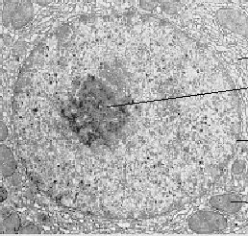
Instance level
this nucleus is adjacent to this cytoplasm
implies:
this cytoplasm is adjacent to this nucleus
universal level
nucleus adjacent_to cytoplasm
Not: cytoplasm adjacent_to nucleus

Slide 72
Applications
Expectations of symmetry e.g. for protein-protein interactions hmay hold only at the instance level
if A interacts with B, it does not follow that B interacts with A
if A is expressed simultaneously with B, it does not follow that B is expressed simultaneously with A

Slide 73
OBO Relation Ontology
Foundational | is_a part_of
Spatial | located_in contained_in adjacent_to
Temporal | transformation_of derives_from preceded_by
Participation | has_participant has_agent

Slide 74
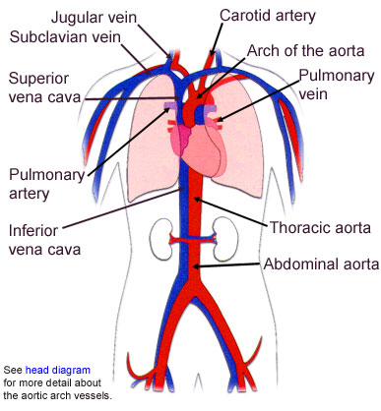
Fiat and bona fide boundaries

Slide 75
Continuity
Attachment
Adjacency

Slide 76
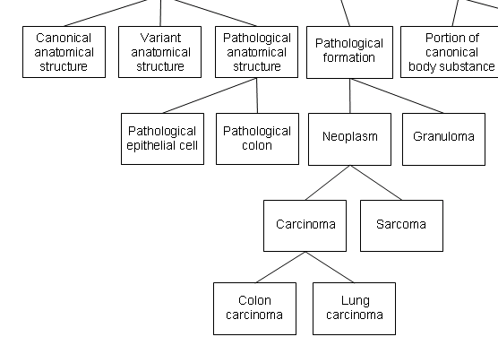
everything here is an independent continuant

Slide 77
structures vs. formations = bona fide vs. fiat boundaries

Slide 78
Modes of Connection
The body is a highly connected entity.
Exceptions: cells floating free in blood.

Slide 79
Modes of Connection
Modes of connection:
  attached_to (muscle to bone)
  synapsed_with (nerve to nerve, nerve to muscle)
  continuous_with (= share a fiat boundary)

Slide 80
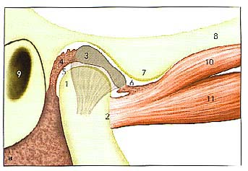
articular (glenoid)fossa
articular eminence
ANTERIOR
Attachment, location, containment

Slide 81
Containment involves relation to a hole or cavity
1: cavity
2: tunnel, conduit (artery)
3: mouth; a snail’s shell

Slide 82
Fiat vs. Bona Fide Boundaries
fiat
boundary
physical boundary

Slide 83
Double Hole Structure
Retainer
(a boundary of some
surrounding structure)
Medium
(filling the environing hole)
Tenant
(occupying the central hole)

Slide 84
head of condyle
fossa
fiat boundary
neck of condyle
the temporomandibular joint

Slide 85
a continuous_with b
= a and b are continuant instances which share a fiat boundary
This relation is always symmetric:
if x continuous_with y , then y continuous_with x

Slide 86
continuous_with
(relation between types)
A continuous_with B =Def.
for all x, if x instance-of A then there is some y such that y instance_of B and x continuous_with y

Slide 87
continuous_with is not always symmetric
Consider lymph node and lymphatic vessel:
  Each lymph node is continuous with some lymphatic vessel, but there are lymphatic vessels (e.g. lymphs and lymphatic trunks) which are not continuous with any lymph nodes

Slide 88
Adjacent_to as a relation between types is not symmetric
Consider
seminal vesicle adjacent_to urinary bladder
Not: urinary bladder adjacent_to seminal vesicle

Slide 89
instance level
this nucleus is adjacent to this cytoplasm
implies:
this cytoplasm is adjacent to this nucleus
type level
nucleus adjacent_to cytoplasm
Not: cytoplasm adjacent_to nucleus

Slide 90
Applications
Expectations of symmetry e.g. for protein-protein interactions may hold only at the instance level
if A interacts with B, it does not follow that B interacts with A
if A is expressed simultaneously with B, it does not follow that B is expressed simultaneously with A

Slide 91
transformation_of
same instance
C
c at t
C₁
c at t₁
time
pre-RNA
mature RNA
child
adult

Slide 92
transformation_of
A transformation_of B =Def.
Every instance of A was at some earlier time an instance of B
  adult transformation_of child

Slide 93
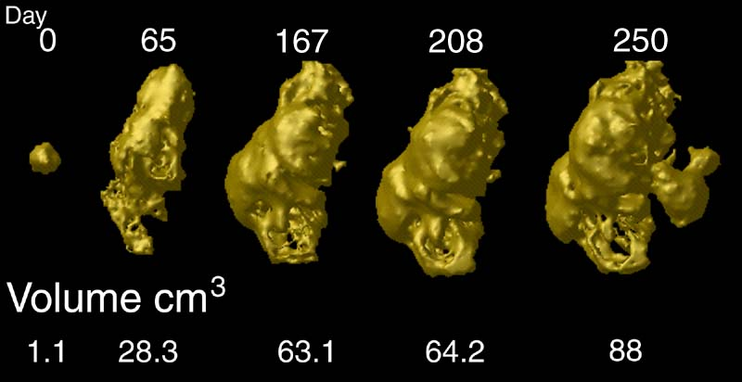
tumor development
C
c at t
C₁
c at t₁
Notes:
http://www.loni.ucla.edu/~thompson/HBM2000/tumor_volumes.jpg

Slide 94
derives_from
C
c at t
C₁
c₁ at t₁
time
C'
c' at t
instances
ovum
zygote derives_from
sperm

Slide 95
two continuants fuse to form a new continuant
C
c at t
C₁
c₁ at t₁
C'
c' at t
fusion

Slide 96
one initial continuant is replaced by two successor continuants
C
c at t
C₁
c₁ at t₁
C₂
c₁ at t₁
fission

Slide 97
one continuant detaches itself from an initial continuant, which itself continues to exist
C
c at t
c at t₁
C₁
c₁ at t
budding

Slide 98
one continuant absorbs a second continuant while itself continuing to exist
C
c at t
c at t₁
C'
c' at t
capture

Slide 99
To be added to the Relation Ontology
lacks (between an instance and a type, e.g. this fly lacks wings)
dependent_on (between a dependent entity and its carrier or bearer)
quality_of (between a dependent and an independent continuant)
functioning_of (between a process and an independent continuant)

Slide 100
New relations
instance to universal: lacks
continuant to continuant: connected_to
function to process: realized_by
process to function: functioning_of
function to continuant: function_of
continuant to function: has_function
quality to continuant: inheres_in (aka has_bearer)
continuant to quality: has_quality

Slide 101
Most important
These relations hold both within and between ontologies
For example the relations between ontologies at different levels of granularity (e.g. molecule and cell) can be captured by relations of part_of between the corresponding types

Slide 102
Definition of ‘ontology’
ontology =def. a representational artifact whose representational units (which may be drawn from a natural or from some formalized language) are intended to represent
1. universals in reality
2. those relations between these universals which obtain universally (= for all instances)
lung is_a anatomical structure
lobe of lung part_of lung

