Slide 1
Wüsteria
or :
International Standard Bad Philosophy
Barry Smith
http://ontologist.com

Slide 2
Infectious agent
Listeria
is_a
is_a
Wüsteria
Hysteria
cause_of

Slide 3
To ensure interoperability we need international standards for biomedical terminologies
ISO Technical Committee (TC) 37

Slide 4
ISO TC 37
founded in 1952
by Eugen Wüster (1898-1977)

Slide 5
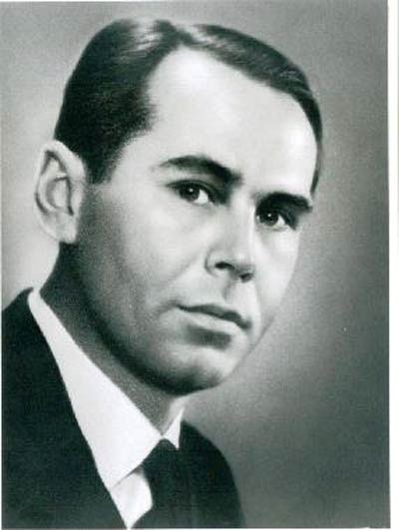
1935

Slide 6
Eugen Wüster
saw-manufacturer
professor of woodworking machinery
fan of the Vienna Circle unified science movement
devotee of Esperanto

Slide 7
1935

Slide 8
Eugen Wüster
chaired TC 37 for the first 20 years of its existence
wrote its seminal documents
astonishing influence due to normative character of ISO definitions

Slide 9
Wüster’s theory of concept acquisition
The new-born infant finds itself “constantly amidst a panoply of diverse sensory impressions”.

Slide 10
Wüster’s theory of concept acquisition
The child begins to mentally sub-divide the sensory mosaic into individual objects
Objects in reality are constructed by human beings

Slide 11
The child then starts to remember objects
Such memories are ‘individual concepts’
Examples: “‘Napoleon’ or the concept of my fountain pen.”

Slide 12
ISO CD 704.2 N 133 95 EN
If we discover or create a singular phenomenon (individual object, e.g., the planet Saturn, The Golden Gate Bridge, the society of a certain country), we form an individual concept in order to think about that object. For communication purposes we assign names to individual concepts so that we can talk or write about them.
Parents assign names, not to their children, but to the individual concepts which they have formed in their minds.

Slide 13
Communication
If “a speaker wishes to draw the attention of an interlocutor to a particular individual object, which is visible to both parties or which he carries with him, he only has to point to it”.

Slide 14
Otherwise, “the only thing available is the individual concept of the object
provided that it is readily accessible in the heads of both persons.”

Slide 15
The Academicians of Lagago
... held that since Words are only Names for Things, it would be more convenient for all Men to carry about them, such Things as were necessary to express the particular Business they are to discourse on

Slide 16
ISO’s Wüsterian Definition of ‘Object’
ISO / IEC JTC1 SC36 N0579:
“an object is anything that can be perceived or conceived.”
Some objects, concrete objects such as a machine, a diamond, or a river, shall be considered material; other objects are to be considered immaterial or abstract, such as each manifestation of financial planning, gravity, flowability, or a conversion ratio; still others are to be considered purely imagined, for example, a unicorn, a philosopher’s stone or a literary character.

Slide 17
Such definitions just bread confusion
Are processes objects? Are they concrete or abstract? Are dispositions, functions, qualities, limbs, organs, bodily cavities, blood flow, apoptosis objects?

Slide 18
Ontology, a branch of philosophy with the task of creating a coherent, principled framework in which coherent answers to such questions can be given

Slide 19
ISO/IEC JTC1 SC36 N0579:1999
“In the course of producing a terminology, philosophical discussions on whether an object actually exists in reality are beyond the scope of this standard and are to be avoided. Objects [including unicorns] are assumed to exist and attention is to be focused on how one deals with objects for the purposes of communication.”

Slide 20
The use-mention confusion
Swimming is healthy
Swimming has 8 letters
vacuum flask narrower_in_meaning_than bottle
vacuum flask contains liquid at high and low temperatures

Slide 21
What are concepts?
  −ideas or brain traces in people’s heads?
  meanings of words?
  data in information systems?
  properties or characteristics in the world?
  Conceptual modeling = stir randomly from these ingredients and add salt to taste

Slide 22
SNOMED-CT
  Disorder =_{def} a concept in which there is an explicit or implicit pathological process causing a state of disease
  Concept =_{def} a unique unit of thought
  Hence: all disorders are imagined.

Slide 23
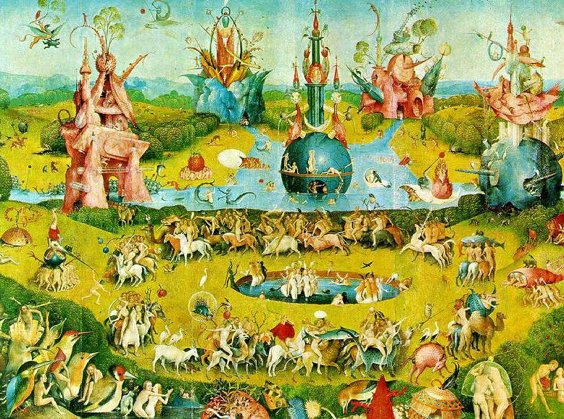
E N D E
http://ontologist.com

