Slide 1
Applying the Realism-Based Ontology-Versioning Method for Tracking Changes in the Basic Formal Ontology
Selja Seppälä, Barry Smith
and Werner Ceusters
September 24, 2014
FOIS 2014

Slide 2
background

Slide 3
The Basic Formal Ontology (BFO)
Realist, formal and domain-neutral upper level reference ontology
Represents types of things that exist in the world and relations that hold between them
Used by domain-specific ontologies for interoperability
Three versions: BFO 1.0, BFO 1.1 and BFO 2.0

Slide 4
Issue
Need to update lower-level ontologies accordingly to remain compatible with new ontologies using BFO 2.0
The BFO specifications and the BFOConvert mappings between versions offer limited explanations about the changes ➔ limited understanding of their impact on domain ontologies

Slide 5
Realism-Based Ontology Auditing
Applied already to GO and to SNOMED CT
Ceusters W. (2010) Applying Evolutionary Terminology Auditing to SNOMED CT. AMIA Annual Symposium Proceedings. p. 96.
Ceusters W. (2009) Applying evolutionary terminology auditing to the Gene Ontology. Journal of Biomedical Informatics. 42(3):518-29.
Here we extend the method to BFO

Slide 6
Realism-Based Ontology Versioning

Slide 7
A Qualitative Versioning Method
Considers representational elements (REs)
Representational units (RUs) (e.g. categories)
Representational configurations (RCs) ➔ ‘entity type + relation + entity type’ triples (e.g. ‘process is_a occurrent’)
Keeps track of changes
Between successive versions of the ontology
By tagging each RE in the earlier version as a match or mismatch with the corresponding POR/latest version
Changes explained by 17 configurations based on 5 types of errors

Slide 8
Explanations of Changes
Based on 5 types of errors:
Assertion errors: the previous version wrongly asserted the existence of some portion of reality (POR)
Relevance errors: the previous version wrongly considered some POR to be objectively relevant to the purposes of the ontology
Omission errors: a relevant POR failed to be represented
Encoding errors: some term in the previous version failed to refer to the intended POR due to encoding errors, such as spelling mistakes
Redundancy errors: two or more distinct terms in a previous version referred to the same POR
Notes:
Changes characterized as involving the correction of 5 types of errors.

Slide 9
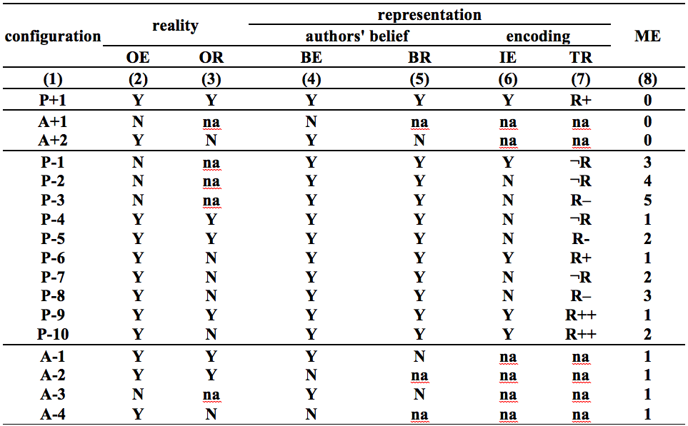
Original Coding Schema
Notes:
Configuration Types
Determine whether an RE denoting a POR is:
P: present in the ontology
P+: justifiably present
P–: unjustifiably present
A: absent from the ontology
A+: justifiably absent
A–: unjustifiably absent
Evaluation Criteria (1)
Determine at the level of reality
OE: objective existence of a POR (col. 2) (the POR exists independently of our perception or understanding thereof)
OR: Objective relevance of a POR to the purpose of the ontology (col. 3)
Evaluation Criteria (2)
Determine at the level of representation
Beliefs of the ontology authors in:
BE: existence of the represented POR (col. 4)
BR: relevance of the represented POR (col. 5)
Encoding itself (the RE)
IE: intended encoding or not (col. 6), e.g. typographic error: IE=N
TR: type of reference of the RE (col. 7)
R+: correctly refers
Incorrectly refers because the encoding:
¬R: does not refer
R–: does refer, but to a POR other than the one which was intended
R++: denotes redundantly
Scoring
For each RE
Determine its configuration by assigning values to columns (2) to (7)
Assign the related configuration score ➔ magnitude of error (ME, col. 8)
Ideal configurations (zero errors): P+1, A+1, and A+2 ➔ ME=0
The score is calculated by considering the number of values in columns (4) to (7) that differ from the ideal configurations P+1, A+1, and A+2
The pertinent ideal configuration for each P– and A– depends on the values in columns (2) and (3)
The value ‘na’ (not applicable) in the P– and A– rows counts as zero
TR=R– (col. 7) counts double

Slide 10
Original Coding Schema
Configuration types
P: present in the ontology
P+: justifiably present
P–: unjustifiably present
A: absent from the ontology
A+: justifiably absent
A–: unjustifiably absent
Notes:
Configuration Types
Determine whether an RE denoting a POR is:
P: present in the ontology
P+: justifiably present
P–: unjustifiably present
A: absent from the ontology
A+: justifiably absent
A–: unjustifiably absent

Slide 11
Original Coding Schema
Determine at the level of reality
OE: objective existence of a POR (the POR exists independently of our perception or understanding thereof)
OR: objective relevance of a POR to the purpose of the ontology
Notes:
Evaluation Criteria (1)
Determine at the level of reality
OE: objective existence of a POR (col. 2) (the POR exists independently of our perception or understanding thereof)
OR: Objective relevance of a POR to the purpose of the ontology (col. 3)

Slide 12
Original Coding Schema
Determine at the level of representation
Beliefs of the ontology authors
Encoding itself (the RE)
Notes:
Evaluation Criteria (2)
Determine at the level of representation
Beliefs of the ontology authors in:
BE: existence of the represented POR (col. 4)
BR: relevance of the represented POR (col. 5)
Encoding itself (the RE)
IE: intended encoding or not (col. 6), e.g. typographic error: IE=N
TR: type of reference of the RE (col. 7)
R+: correctly refers
Incorrectly refers because the encoding:
¬R: does not refer
R–: does refer, but to a POR other than the one which was intended
R++: denotes redundantly

Slide 13
Original Coding Schema
Beliefs of the ontology authors
BE: existence of the represented POR
BR: relevance of the represented POR
Notes:
Evaluation Criteria (2)
Determine at the level of representation
Beliefs of the ontology authors in:
BE: existence of the represented POR (col. 4)
BR: relevance of the represented POR (col. 5)

Slide 14
Original Coding Schema
Encoding itself (the RE)
IE: intended encoding or not, e.g. typographic error: IE=N
TR: type of reference of the RE
Notes:
Evaluation Criteria (2)
Determine at the level of representation
Encoding itself (the RE)
IE: intended encoding or not (col. 6), e.g. typographic error: IE=N
TR: type of reference of the RE (col. 7)
R+: correctly refers
Incorrectly refers because the encoding:
¬R: does not refer
R–: does refer, but to a POR other than the one which was intended
R++: denotes redundantly

Slide 15
Original Coding Schema
Type of reference
R+: correctly refers
Incorrectly refers because the encoding:
¬R: does not refer
R–: does refer, but to a POR other than the one which was intended
R++: denotes redundantly
Notes:
Evaluation Criteria (2)
Determine at the level of representation
TR: type of reference of the RE (col. 7)
R+: correctly refers
Incorrectly refers because the encoding:
¬R: does not refer
R–: does refer, but to a POR other than the one which was intended
R++: denotes redundantly

Slide 16
Original Coding Schema
Magnitude of error
(score related to each configuration)
Notes:
Scoring
For each RE
Determine its configuration by assigning values to columns (2) to (7)
Assign the related configuration score ➔ magnitude of error (ME, col. 8)
Ideal configurations (zero errors): P+1, A+1, and A+2 ➔ ME=0
The score is calculated by considering the number of values in columns (4) to (7) that differ from the ideal configurations P+1, A+1, and A+2
The pertinent ideal configuration for each P– and A– depends on the values in columns (2) and (3)
The value ‘na’ (not applicable) in the P– and A– rows counts as zero
TR=R– (col. 7) counts double
[MORE SLIDES AT THE END TO EXPLAIN THE DETAILS OF THE SCORING]

Slide 17
Measuring the Changes
Calculate the overall quality score for each version of the ontology
Two ways of scoring the overall quality of ontologies
Using reality as benchmark (allows assessing, e.g., how well given ontologies conform to the reality which they claim to represent)
Using the successive versions of the same ontology to measure its improvement in time
Latest version treated as a correct representation of reality (gold standard) against which the previous versions are evaluated
The scores are recalculated at each time t with respect to whatever is at t the latest version
Notes:
1. By adding the scores together.

Slide 18
Applying the qualitative versioning method to BFO

Slide 19
Preprocessing of the Data (1)
Extract all representational elements (REs) from the BFO 1.0, BFO 1.1 and BFO 2.0 OWL files
Our study focused only on:
BFO categories
Asserted and implied is_a relations

Slide 20
Preprocessing of the Data (2)
Disambiguate by assigning a unique identifier (ID) that allows ignoring any change at the terminological level
Check the disambiguation with:
BFOConvert mapping
BFO specifications
Authors of BFO
ID | BFO 1.0/BFO 1.1 | BFO 2.0
RU7 | processual entity | BFO2-process/BFO1-processual entity
RC7.1 | processual entity is_a entity | BFO2-process/BFO1-processual entity is_a entity
RC7.2 | processual entity is_a occurrent | BFO2-process/BFO1-processual entity is_a occurrent
RU16 | temporal instant | zero-dimensional temporal region
Notes:
To avoid considering any terminological changes as changes at the ontological level.

Slide 21
Determining the Configurations
A set of principles motivated by the realist approach applied alone or jointly allow to:
Assign default values to various columns (e.g. Y/N values for OE and OR columns depend on the latest version and apply to all versions)
Determine all P+1 configurations in all versions of BFO whenever the RE is present in the last version and some previous one
Predict the type of other configurations (P+/– or A+/–)
All other values assigned according to explanations in specifications and by the authors of BFO
Notes:
In all the other cases (the latter ones), the values in columns (2)-(7) are assigned according to explanations (1) in specifications and (2) by the authors of BFO

Slide 22
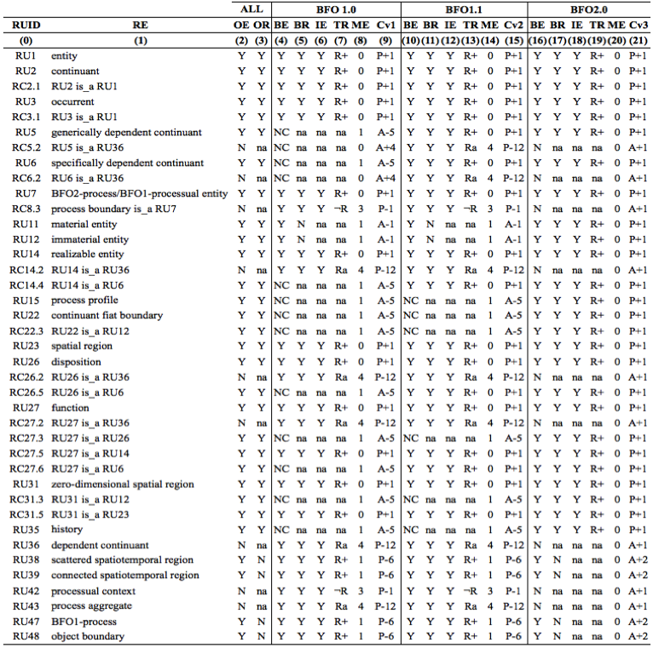
Examples from BFO at t3

Slide 23
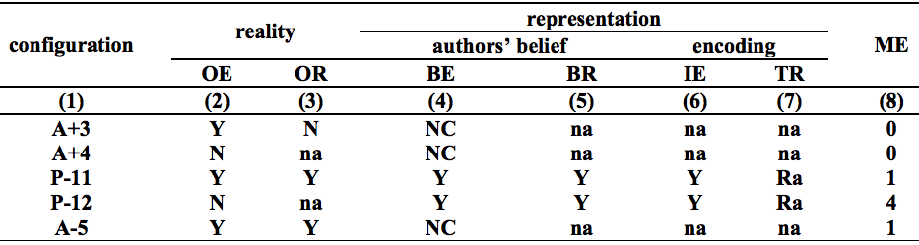
Extended Evaluation Method
Examination of REs in all BFO versions revealed limits to the original evaluation schema
New values and configurations added
not considered
ambiguous reference
Notes:
NC: ‘specifically’ and ‘generaically dependent continuant’ => were absent from BFO 1.0 not because they didn’t believe in their existence, but because their existence wasn’t yet considered by the authors.
Ra: e.g. ‘disposition’ (is in fact a defined class, not a universal) was deleted because it referred ambiguously to two different universals SDC and GDC.

Slide 24
Extended Evaluation Method
Examination of REs in all BFO versions revealed limits to the original evaluation schema
New values and configurations added
e.g. ‘specifically dependent continuant'
e.g. ‘disposition’
Notes:
NC: ‘specifically’ and ‘generaically dependent continuant’ => were absent from BFO 1.0 not because they didn’t believe in their existence, but because their existence wasn’t yet considered by the authors.
Ra: e.g. ‘disposition’ (is in fact a defined class, not a universal) was deleted because it referred ambiguously to two different universals SDC and GDC.

Slide 25
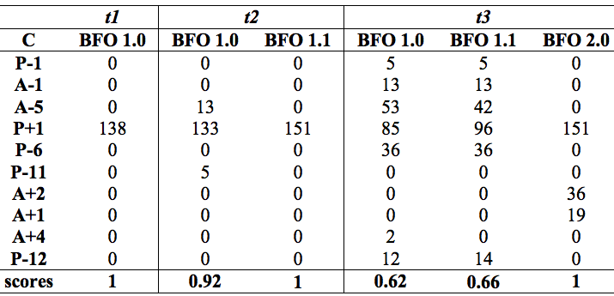
Results
Quality of BFO has considerably increased
Increasing scores suggest that BFO authors are consistent in their approach

Slide 26
Results at t3
# of REs | Configuration patterns | Explanations
81 | P+1 P+1 P+1 | No changes (e.g. ‘continuant’, ‘realizable entity’)
46 | A–5 A–5 P+1 | REs that were not considered at all were introduced in the last version (e.g. ‘continuant fiat boundray’)
40 | P–6 P–6 A+2 | REs previously considered objectively relevant are now considered not relevant (e.g. ‘BFO1-process’)
13 | A–1 A–1 P+1 | REs that were not believed to be relevant were introduced in the last version (e.g. ‘material entity’, ‘immaterial entity’)
12 | P–12 P–12 A+1 | REs that referred ambiguously were deleted in the latest version because the POR does in fact not objectively exist (e.g. dependent continuant’, ‘realizable entity is_a dependent continuant’ )
11 | A–5 P+1 P+1 | REs that were not considered at all were introduced in newer versions (e.g. ‘continuant fiat boundray is_a immaterial entity’)
5 | P–1 P–1 A+1 | REs were deleted in the latest version because the POR does in fact not objectively exist and the REs did not refer to anything (e.g. ‘processual context’)
2 | A+4 P–12 A+1 | REs that were not considered at all were introduced in a newer version and subsequently deleted because the POR did in fact not objectively exist (e.g. ‘GDC is_a dependent continuant’)
Notes:
Results at t3 reveal 8 configuration patterns & 7 explanations for the changes unergone by BFO, of which 4 result from our extension of the evaluation schema.
The last case shows how the introduction of the new NC value allows to give different explanations to the justified absence of some elements in BFO 1.0 and 2.0 at t3.

Slide 27
Conclusion
Identifying the motivations for changes (assigning the right configuration) is hard to do a posteriori
For a reliable assessment of the successive versions of an ontology, the method should be applied
In collaboration with its authors
During the revision process
The resulting quality assessment tables can be used to systematically complement the specifications with more detailed explanations on the changes
Notes:
What we can conclude from this study.
3. Once these quality assessment tables are established for each version, the authors can systematically complement the specifications with more detailed explanations.

Slide 29
Scoring
For each RE, determine its configuration by assigning values to columns (2) to (7)
Notes:
Scoring
For each RE
Determine its configuration by assigning values to columns (2) to (7)
Assign the related configuration score ➔ magnitude of error (ME, col. 8)
Ideal configurations (zero errors): P+1, A+1, and A+2 ➔ ME=0
The score is calculated by considering the number of values in columns (4) to (7) that differ from the ideal configurations P+1, A+1, and A+2
The pertinent ideal configuration for each P– and A– depends on the values in columns (2) and (3)
The value ‘na’ (not applicable) in the P– and A– rows counts as zero
TR=R– (col. 7) counts double

Slide 30
Scoring
Assign the related configuration score ➔ magnitude of error (ME, col. 8)
Notes:
Scoring
For each RE
Determine its configuration by assigning values to columns (2) to (7)
Assign the related configuration score ➔ magnitude of error (ME, col. 8)
Ideal configurations (zero errors): P+1, A+1, and A+2 ➔ ME=0
The score is calculated by considering the number of values in columns (4) to (7) that differ from the ideal configurations P+1, A+1, and A+2
The pertinent ideal configuration for each P– and A– depends on the values in columns (2) and (3)
The value ‘na’ (not applicable) in the P– and A– rows counts as zero
TR=R– (col. 7) counts double

Slide 31
Scoring
Ideal configurations (zero errors): P+1, A+1, and A+2 ➔ ME=0
Notes:
Scoring
For each RE
Determine its configuration by assigning values to columns (2) to (7)
Assign the related configuration score ➔ magnitude of error (ME, col. 8)
Ideal configurations (zero errors): P+1, A+1, and A+2 ➔ ME=0
The score is calculated by considering the number of values in columns (4) to (7) that differ from the ideal configurations P+1, A+1, and A+2
The pertinent ideal configuration for each P– and A– depends on the values in columns (2) and (3)
The value ‘na’ (not applicable) in the P– and A– rows counts as zero
TR=R– (col. 7) counts double

Slide 32
Scoring
Ideal configurations
The score is calculated by considering the number of values in columns (4) to (7) that differ from the ideal configurations P+1, A+1, and A+2
Notes:
Scoring
For each RE
Determine its configuration by assigning values to columns (2) to (7)
Assign the related configuration score ➔ magnitude of error (ME, col. 8)
Ideal configurations (zero errors): P+1, A+1, and A+2 ➔ ME=0
The score is calculated by considering the number of values in columns (4) to (7) that differ from the ideal configurations P+1, A+1, and A+2
The pertinent ideal configuration for each P– and A– depends on the values in columns (2) and (3)
The value ‘na’ (not applicable) in the P– and A– rows counts as zero
TR=R– (col. 7) counts double

Slide 33
Scoring
The pertinent ideal configuration for each P– and A– depends on the values in columns (2) and (3)
Notes:
Scoring
For each RE
Determine its configuration by assigning values to columns (2) to (7)
Assign the related configuration score ➔ magnitude of error (ME, col. 8)
Ideal configurations (zero errors): P+1, A+1, and A+2 ➔ ME=0
The score is calculated by considering the number of values in columns (4) to (7) that differ from the ideal configurations P+1, A+1, and A+2
The pertinent ideal configuration for each P– and A– depends on the values in columns (2) and (3)
The value ‘na’ (not applicable) in the P– and A– rows counts as zero
TR=R– (col. 7) counts double

Slide 34
Scoring
Ideal configuration for A–1
The value ‘na’ (not applicable) in the P– and A– rows counts as zero ➔ errors in columns (6) and (7) ➔ 0
Error in column (5) ➔ +1
Notes:
Scoring
For each RE
Determine its configuration by assigning values to columns (2) to (7)
Assign the related configuration score ➔ magnitude of error (ME, col. 8)
Ideal configurations (zero errors): P+1, A+1, and A+2 ➔ ME=0
The score is calculated by considering the number of values in columns (4) to (7) that differ from the ideal configurations P+1, A+1, and A+2
The pertinent ideal configuration for each P– and A– depends on the values in columns (2) and (3)
The value ‘na’ (not applicable) in the P– and A– rows counts as zero
TR=R– (col. 7) counts double

Slide 35
Scoring
Ideal configuration for P–3
Errors in columns (4) to (6) ➔ +1
TR=R– ➔ +2
Notes:
Scoring
For each RE
Determine its configuration by assigning values to columns (2) to (7)
Assign the related configuration score ➔ magnitude of error (ME, col. 8)
Ideal configurations (zero errors): P+1, A+1, and A+2 ➔ ME=0
The score is calculated by considering the number of values in columns (4) to (7) that differ from the ideal configurations P+1, A+1, and A+2
The pertinent ideal configuration for each P– and A– depends on the values in columns (2) and (3)
The value ‘na’ (not applicable) in the P– and A– rows counts as zero
TR=R– (col. 7) counts double

Slide 36
Principles for Determining the Configurations
Principle of Consistency with Established Science ➔ the latest version of BFO is most faithful to reality
Reference Ontology Principle ➔ include only general terms denoting universals in reality and assertions of relations between their instances
Principle of Obsoletion ➔ obsolete terms that fail in designation
Principle of Inertia of Existence ➔ entities in the latest version of BFO have always existed, exist now and will always exist in the future (OE)
Principle of Inertia of Relevance ➔ entities marked as OR in the latest version of BFO have been relevant throughout their entire existence

Slide 37
Issues Faced by the Application of the Evaluation Method to BFO
Changes in encoding/terminology
Alternative application of the evaluation method
Objective relevance and pragmatic considerations
Authors’ beliefs in existence of some type of thing
RE absent from initial version(s), introduced at some later point, and subsequently deleted
Ambiguous reference

Slide 38
References
Ceusters W, Smith B. A Realism-Based Approach to the Evolution of Biomedical Ontologies. AMIA Annual Symposium Proceedings. 2006. p. 121.
Ceusters W. Applying Evolutionary Terminology Auditing to SNOMED CT. AMIA Annual Symposium Proceedings. 2010. p. 96.
Ceusters W. Applying evolutionary terminology auditing to the Gene Ontology. Journal of Biomedical Informatics. 2009. 42(3):518-29.

