Slide 1
Ontology: The Good, the Bad, and the Ugly
Barry Smith
Department of Philosophy (Buffalo)
Institute for Formal Ontology and Medical Information Science (Leipzig)
ontology.buffalo.edu
ifomis.de

Slide 2
THREE USES OF ‘ONTOLOGY’
in philosophy
in anthropology
in information science

Slide 3
THREE USES OF ONTOLOGY
in philosophy
in anthropology
in information science

Slide 4
Ontology as a branch of philosophy
the science of what is
the science of the kinds and structures of objects, properties, events, processes and relations

Slide 5
Ontology seeks to provide a definitive and exhaustive classification of entities in all spheres of being.

Slide 6
It seeks to answer questions like this:
What classes of entities and relations are needed for a complete description and explanation of the goings-on in the universe?

Slide 7
Ontology is in many respects comparable to the theories produced by science
… but it is radically more general than these

Slide 8
It can be regarded as a kind of generalized chemistry or biology
(Aristotle’s ontology grew out of biological classification applied to what we would now call common-sense reality)
Classification of objects and processes,
and of the parts of objects and processes,
and of the relations between these

Slide 9
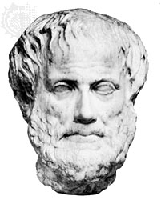
Aristotle
Aristotle
first ontologist

Slide 10
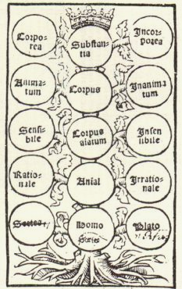
first ontology (from Porphyry‘s Commentary on Aristotle‘s Categories)
Notes:
Porphyry‘s Tree Ca. 1514

Slide 11
Ontology is distinguished from the special sciences in this:
it seeks to study all of the various types of entities existing at all levels of granularity

Slide 12
and to establish how these entities hang together to form complex wholes at different levels

Slide 13
Ontology is essentially cross-disciplinary

Slide 14
Methods of ontology:
the development of theories of wider or narrower scope
the testing and refinement of such theories
  by logical formalization (as a kind of “experimentation with diagrams” (Peirce))
  by measuring them up against difficult counterexamples and against the results of science and observation

Slide 15
Sources for ontological theorizing:
thought experiments
the study of philosophical texts
most importantly: the results of natural science
more recently: controlled experiments with domain ontologies

Slide 16
GOL
A General Ontological Language
Barbara Heller
Heinrich Herre
Barry Smith

Slide 17
GOL Hierarchy of Categories
Entity
Basic Relations
Set
Urelement
Universal
Individual
Substance
Moment
Chronoid
Topoid
Situoid
1-place
n-place (Material Relations)

Slide 18
GOL Hierarchy of Categories
Entity
Basic Relations
Set
Urelement
Universal
Individual
Substance
Moment
Chronoid
Topoid
Situoid
1-place
n-place (Material Relations)

Slide 19
Some Basic Relations
x is part of y
x is an instantiation of y
x inheres in y
x frames y
x is located in y
x is element of y

Slide 20
Aims of the Project GOL
Development of a well-founded ontological theory (a theory of everything) based on philosophical principles (truths)
Testing of this theory in the medical domain

Slide 21
EMPIRICAL TEST:
Standard classification systems in medicine such as GALEN, UMLS, SNOMED have a series of well-understood defects (they are based on pragmatically conceived set-theoretical modeling)
Question: Can we do better with a principled, top-level, theoretically grounded ontology?

Slide 22
EMPIRICAL TEST:
‘Better’ = more efficient information systems (in medicine)
more efficient searches …
more efficient communication between databases …
more efficient merging of databases derived from different sources …

Slide 23
What is the most suitable form of representation for knowledge?
Effective information systems are best arrived at by instilling as much knowledge of what into a system as possible.
Leading early proponents of this view in AI: Minsky, McCarthy, Pat Hayes, Doug Lenat (CYC)

Slide 24
Information systems are systems of representations:
Programs are representations of processes (e.g. in a bank),
Data structures are representations of objects (e.g. customers)

Slide 25
The Ontologist’s Credo:
To create effective representations
it is an advantage if one knows something about the objects and processes one is trying to represent.

Slide 26
The Ontologist’s Credo:
To create effective representations
it is an advantage if one knows something about the objects and processes one is trying to represent.

Slide 27
This means
  that one must know something about the specific token objects (employees, taxpayers, domestic partners) recorded in one’s database,
  but also
  something about objects, properties and relations in general, and also about the general types of processes in which objects, properties and relations are involved.

Slide 28
The growth of ontology in information science reflects efforts to solve

Slide 29
The Tower of Babel Problem
Different groups of system designers have their own idiosyncratic terms and concepts by means of which they represent the information they receive.
The problems standing in the way of putting this information together within a single system increase geometrically.
Methods must be found to resolve terminological and conceptual incompatibilities.

Slide 30
The term ‘ontology’
(taken over from Quine)
came to be used by information scientists in the 1990s to describe the construction of a canonical description of this sort.
An ontology is a dictionary of terms formulated in a canonical syntax and with commonly accepted definitions and axioms designed to yield a shared framework for use by different information systems communities.
Above all: to facilitate portability, mergeability of database content

Slide 31
Ontology in the Information Systems sense =
a concise and unambiguous description of the principal, relevant entities of an application domain and of their potential relations to each other

Slide 32
Some successes of ontology
LADSEB (Nicola Guarino)
ONTEK (Chuck Dement, Peter Simons)

Slide 33
ONTEK: Ontology of Aircraft Construction and Maintenance
Ontek’s PACIS system embraces within a single framework
  aircraft parts and functions
  raw-materials and processes involved in manufacturing
  the times these processes and sub-processes take
  job-shop space and equipment
  an array of different types of personnel
  the economic properties of all of these entities

Slide 34
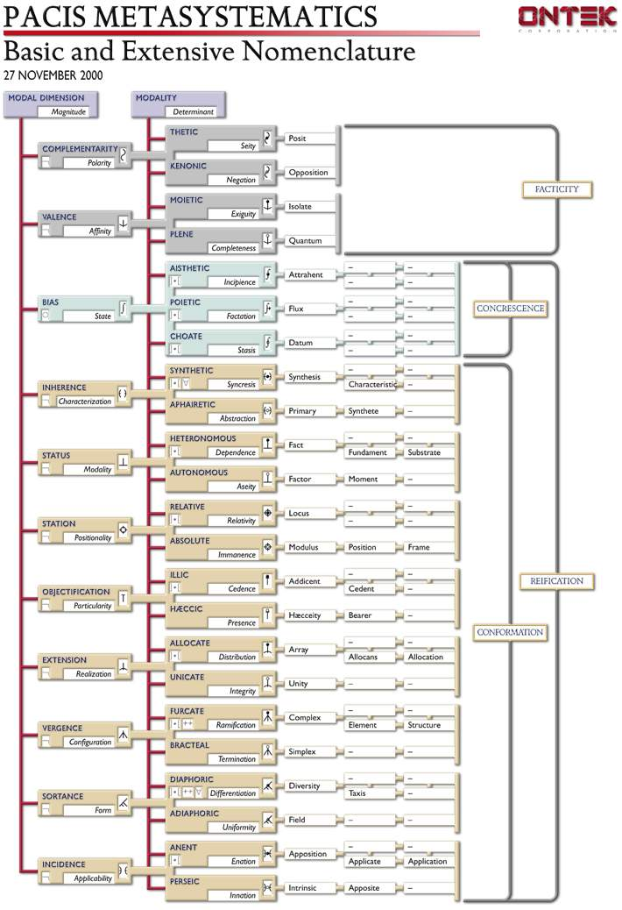
PACIS NOMENCLATURE

Slide 35
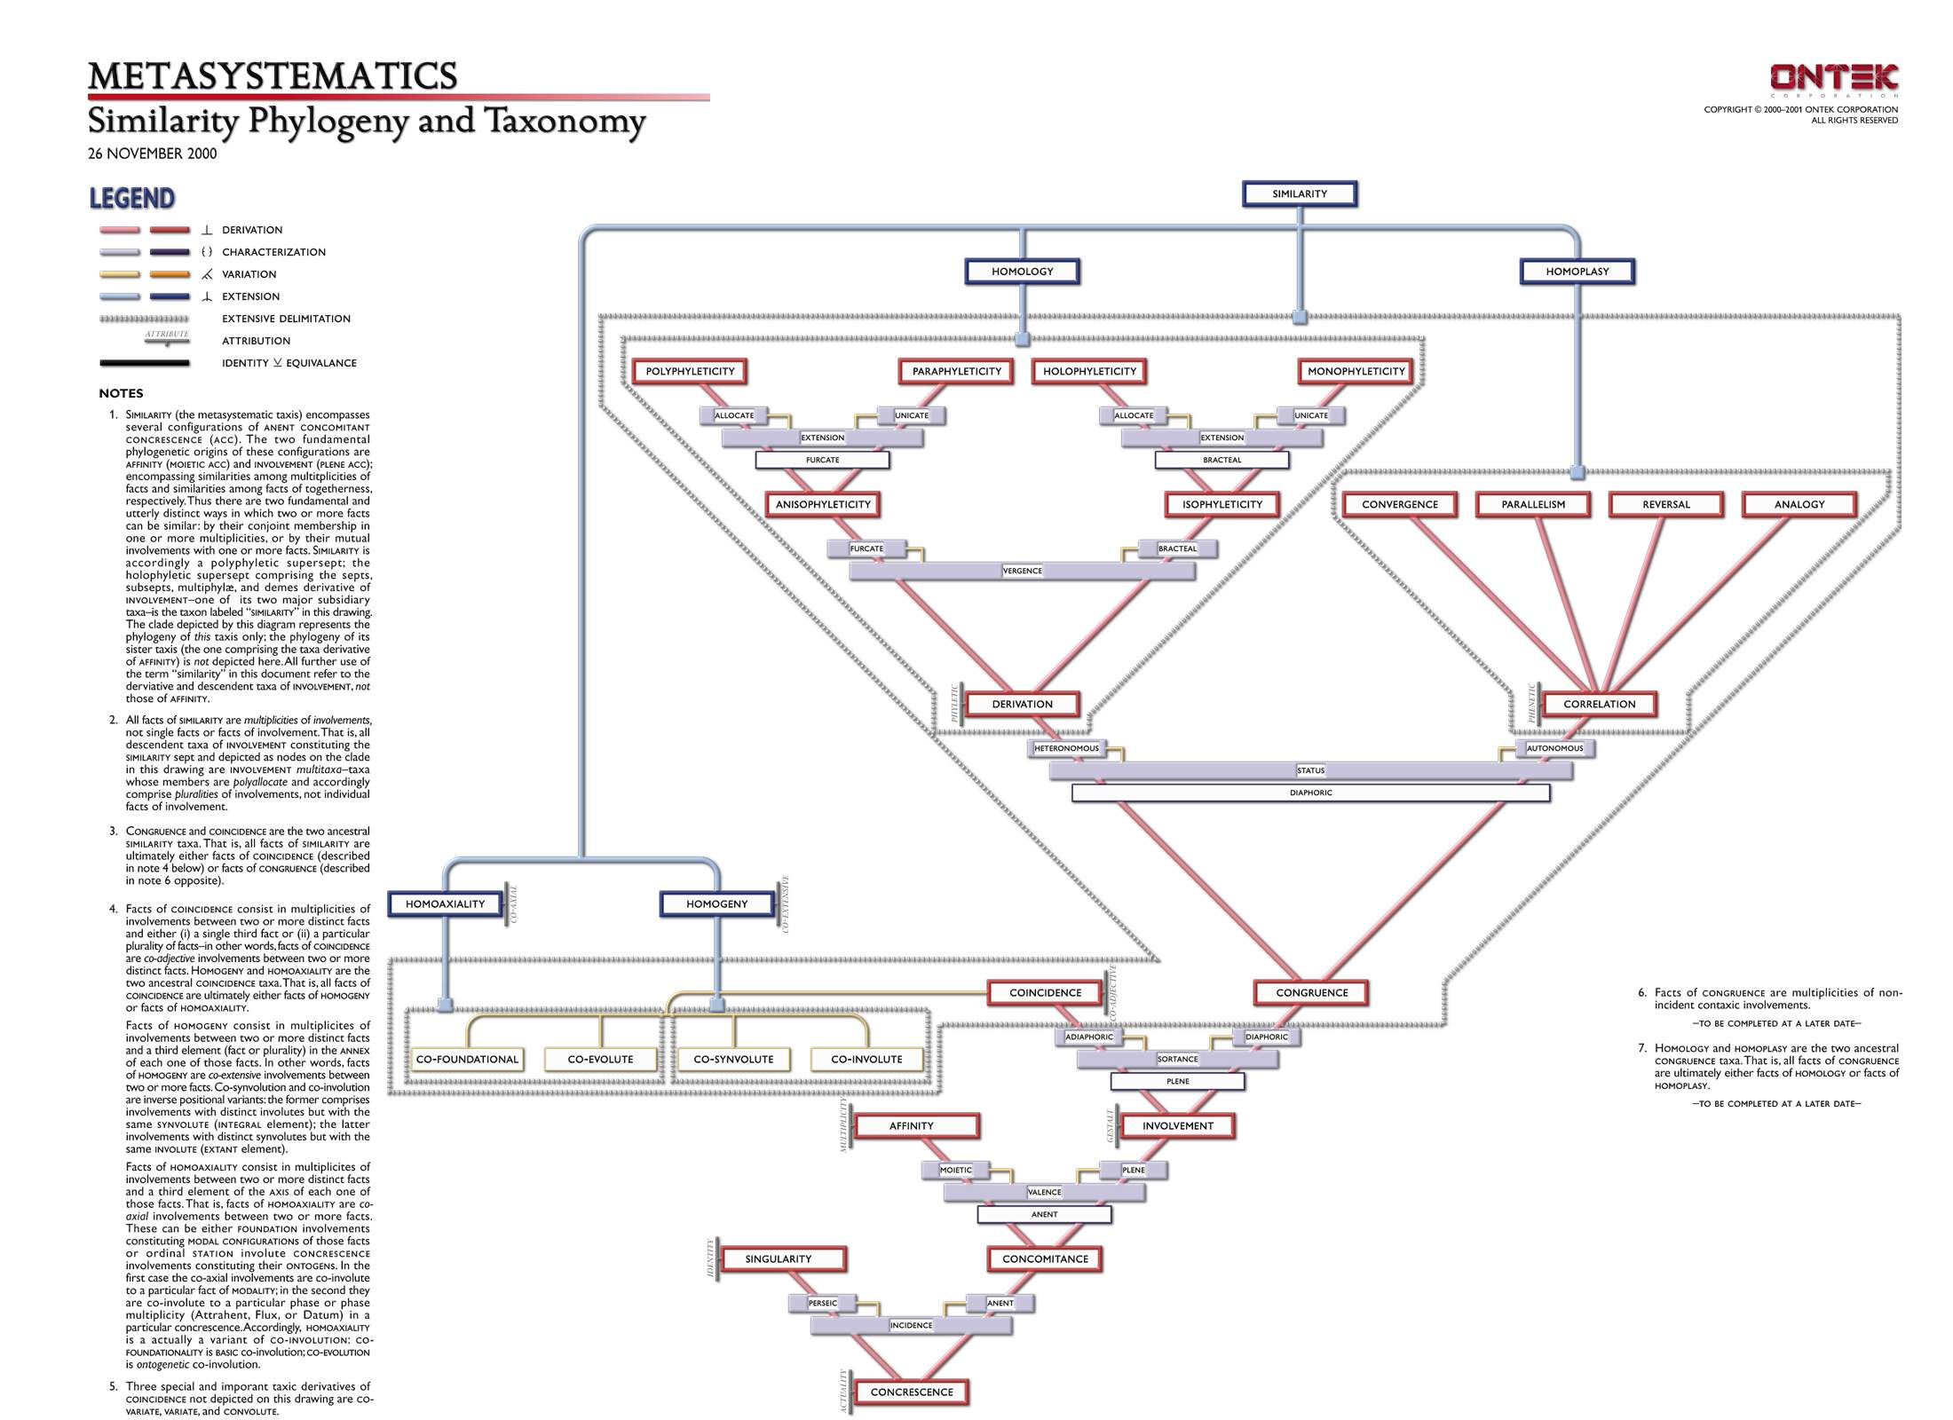
PACIS METASYSTEMATICS (CLADE)

Slide 36
THREE USES OF ONTOLOGY
in philosophy
in anthropology
in information science

Slide 37
Quine:
each natural science has its own preferred repertoire of types of objects to the existence of which it is committed (1952)

Slide 38
Quine:
From Ontology to Ontological Commitment
For Quineans, the ontologist studies, not reality,
but scientific theories
… ontology is then the study of the ontological commitments or presuppositions embodied in the different natural sciences

Slide 39
For Quine,
as for the followers of Aristotle,
the term ‘ontology’ can be used only in the singular
To talk of ‘ontologies’, in the plural, is analogous to confusing mathematics with ethnomathematics
There are not different biologies, but rather different branches of biology.

Slide 40
Quineanism: only natural sciences can be taken ontologically seriously
The way to do ontology is exclusively through the investigation of scientific theories
Assumption: All natural sciences are compatible with each other

Slide 41
Growth of Quine-style ontology outside philosophy:
In the 1970s psychologists and anthropologists sought to elicit the ontological commitments (‘ontologies’, in the plural) of different cultures and groups (… ‘folk’ ontologies)
They sought to establish what individual subjects, or entire human cultures, are committed to, ontologically, in their everyday cognition

Slide 42
Natural science:
All natural sciences are in large degree consistent with each other
Thus it is reasonable to identify ontology – the search for answers to the question: what exists? – with the study of the ontological commitments of natural scientists

Slide 43
+ common sense
The identification of ontology with the study of ontological commitments still makes sense when one takes into account also certain commonly shared commitments of common sense (for example that cows exist)
It is after all true that cows exist

Slide 44
PROBLEM:
this identification of ontology becomes strikingly less defensible when the ontological commitments of various specialist groups of non-scientists are allowed into the mix.

Slide 45
How, ontologically, are we to treat the commitments of astrologists?
or clairvoyants?
or believers in leprechauns?

Slide 47
THREE USES OF ONTOLOGY
in philosophy
in anthropology
in information science

Slide 48
The Birth of Ugly Ontology
In the 1980s “Ontology” begins to be used for a certain type of conceptual modeling
How to build ontologies?
By looking at the world, surely (= Good ontology)
Well, No
Let’s build ontologies by looking at what people think about the world

Slide 49
Ontology becomes a branch of Knowledge Representation
  Work on building ontologies as conceptual models pioneered in Stanford:
  KIF (Knowledge Interchange Format) (Genesereth)
  and Ontolingua (Gruber)

Slide 50
Ontology becomes a branch of Knowledge Representation
  Information systems ontologist took the folk ontologies of the anthropologists as their paradigm, rather than the realist ontological theories propounded by philosophers over the ages
The conceived ontology as … conceptual modeling

Slide 52
Arguments for Ontology as Conceptual Modeling
Philosophical ontology is hard.
Life is short.
Since the requirements placed on information systems change at a rapid rate, work on the construction of corresponding ontologies of real-world objects is unable to keep pace.
Therefore, we turn to conceptually defined surrogates for objects, which are easier modeling targets

Slide 53
In the world of information systems there are many surrogate world models and thus many ontologies

Slide 54
… and all ontologies are equal

Slide 55
Traditional ontologists are attempting to establish the truth about reality

Slide 56
Information systems ontologists have shorter time horizons …
this leads them to neglect the standard of truth in favor of other, putatively more practical standards, such as programmability

Slide 57
A good ontology
is built to represent some pre-existing domain of reality, to reflect the properties of the objects within its domain
For an information system
there is no reality other than the one created through the system itself, so that the system is, by definition, correct

Slide 58
Ontological engineers accept the closed world assumption:
a formula that is not true in the database is thereby false
The definition of a client of a bank is: “a person listed in the database of bank clients”

Slide 59
The system contains all the positive information about the objects in the domain
The system becomes a world unto itself
Compare: Kant’s ‘phenomenal world’

Slide 60
Only those objects exist which are represented in the system

Slide 61
Gruber (1995): ‘For AI systems what “exists” is what can be represented’

Slide 62
The objects in closed world models can possess only those properties which are represented in the system

Slide 63
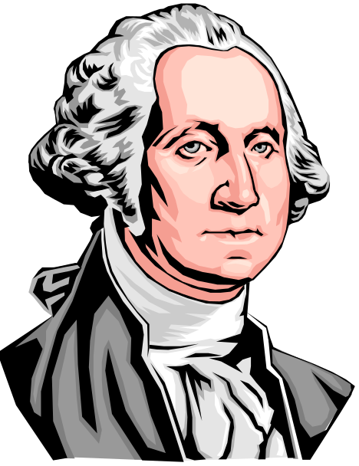
They are tuples
= <SSN, Name, Date of Birth, Date of Death, Name of Male Parent, Name of Female Parent>

Slide 64
But this means that these objects (for example people in a database) are not real objects of flesh and blood at all
They are denatured surrogates, possessing only a finite number of properties (sex, date of birth, social security number, marital status, employment status, and the like)

Slide 65
Tom Gruber: an ontology is:
‘the specification of a conceptualisation’
It is a description (like a formal specification of a program) of the concepts and relationships that can exist for an agent or a community of agents.
(Note confusion of ‘object’ and ‘concept’)

Slide 66
We engage with the world in a variety of different ways:
Gruber’s Idea:
We use maps, specialized languages, and scientific instruments. …
We engage in rituals, we tell stories.

Slide 67
Each way of behaving involves a certain conceptualisation:
a system of concepts or categories in terms of which the corresponding universe of discourse is divided up into objects, processes and relations

Slide 68
Examples of conceptualizations:
in a religious ritual setting we might use concepts such as God, salvation, and sin
in a scientific setting we might use concepts such as micron, force, and nitrous oxide
in a story-telling setting we might use concepts such as: magic spell, leprechaun, and witch

Slide 69
Such conceptualizations are often tacit
An ontology is the result of making them explicit (Gruber)

Slide 70
ontology concerns itself not at all with the question of ontological realism
It cares about “conceptualizations”
It does not care whether such conceptualizations are true of some independently existing reality.

Slide 71
ontology deals with ‘closed world data models’ devised with specific practical purposes in mind

Slide 72
And all of such surrogate created worlds are treated by the ontological engineer as being on an equal footing.

Slide 73
ATTEMPTS TO SOLVE THE
TOWER OF BABEL PROBLEM
VIA CONCEPTUAL MODELS HAVE FAILED
unfortunately

Slide 74
WHY?

Slide 75
LEPRECHAUNS AGAIN:
There are Good and Bad Conceptualizations

Slide 76
There need be no common factor between one conceptualization and the next
(there is no common factor between the conceptualization of atomic physics and the conceptualization of leprechauns)

Slide 77
Not all conceptualizations are equal.

Slide 78
There are bad conceptualizations, rooted in:
error
myth-making
astrological prophecy
hype
bad dictionaries
antiquated information systems
bad philosophy

Slide 79
These deal in large part only with created pseudo-domains, and not with any reality beyond

Slide 80
How to make an ‘ontology’
Take two or more large databases or standardized vocabularies relating to some domain
2. Use statistical or other methods to ‘merge’ them together

Slide 81
The result of integrating such errors and unclarities together is garbage

Slide 82
existing large databases and standardized vocabularies embody systematic errors and massive ontological unclarities
because

Slide 83
SIGNS OF HOPE:
Some ontological engineers (ONTEK, LADSEB) have recognized that they can improve their methods by drawing on the results of the philosophical work in ontology carried out over the last 2000 years

Slide 84
They have recognized
that the abandonment of the Closed World Assumption may itself have positive pragmatic consequences
What happens if ontology is directed not towards mutually inconsistent conceptualizations, but rather towards the real world of flesh-and-blood objects?
The likelihood of our being able to build a single workable system of ontology is much higher

Slide 85
It is precisely because good conceptualizations are transparent to reality
that they have a reasonable chance of being integrated together in robust fashion into a single unitary ontological system.
The real world thus itself plays a significant role in ensuring the unifiability of our separate domain ontologies

Slide 86
But this means
that we must
abandon the attitude of tolerance towards both good and bad conceptualizations

Slide 87
and return once more to

Slide 88
NEW SECTI ON
END

