Slide 1
What is a capability?
Barry Smith
April 2018

Slide 2
role capabilities – capable of performing a marriage
(realizing roles can bring benefits)

Slide 3
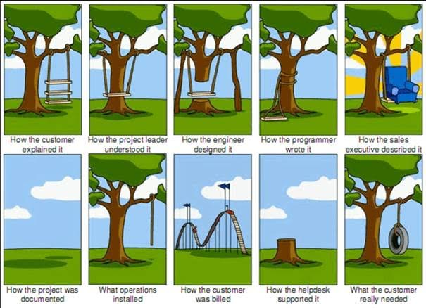
what happens without shared meanings of terms used in describing a project
Notes:
https://www.tamingdata.com/wp-content/uploads/2010/07/tree-swing-project-management-large.png

Slide 4
what happens without shared meanings of terms used in describing a project
Notes:
https://www.tamingdata.com/wp-content/uploads/2010/07/tree-swing-project-management-large.png

Slide 5
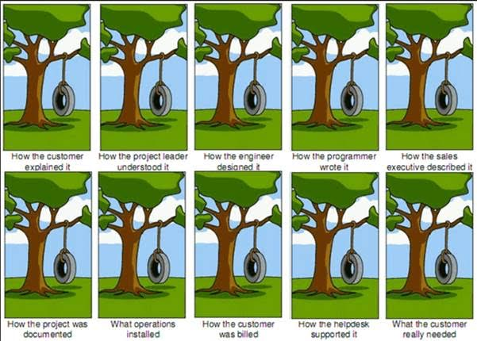
what happens with shared meanings
Notes:
https://www.tamingdata.com/wp-content/uploads/2010/07/tree-swing-project-management-large.png

Slide 6
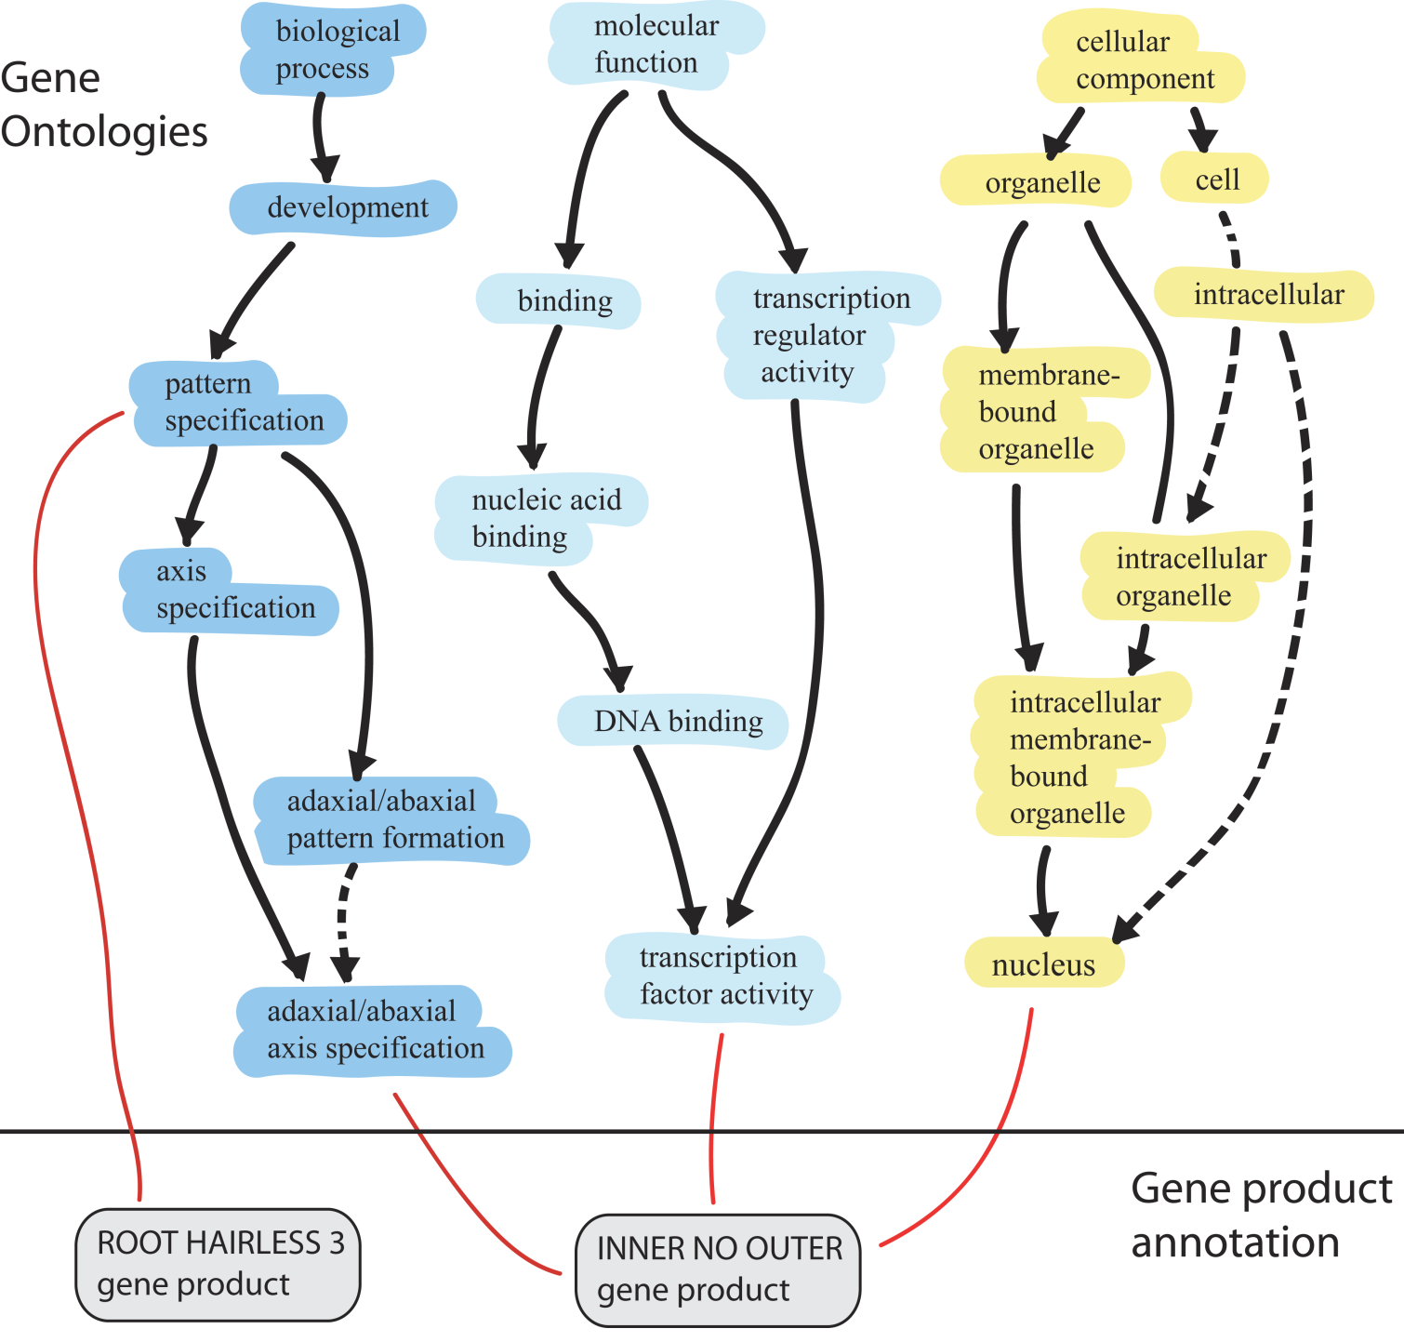
Gene Ontology (GO): three sub-ontologies
biological molecular cellular
process function component
is_a
is_a
part_of
Notes:
The gene ontology consortium develops ontologies and makes annotation of gene products to those ontologies. The ontologies are databases containing sets of biological processes, molecular functions, and cellular components and the relationships between them. Annotators within the consortium use these ontologies to categorise gene products. During my talk today I’m going to explain about the uses of GO and give a more detailed explanation of the ontolgoies and of the system of annotation. Then Harold Drabkin is going to talk in more detail about annotation and about how you can submit annotations of your own gene products of interest.

Slide 7
What Gene Ontology is for
Examples:
developing automated ways of deriving information about gene function from the literature
finding functional similarities in genes that are overexpressed or underexpressed in diseases and as we age
Notes:
http://geneontology.org/faq/what-are-all-possible-uses-go

Slide 8
For Gene Ontology ‘function’ is something good
an oncogene does not have a function (to transform a normal cell into a tumor cell)
an oncogene is a result of a mutation
it is something on the bad side
Notes:
http://geneontology.org/faq/what-are-all-possible-uses-go

Slide 9
Boorse: definition of disease (1977)
Disease =def. an internal state of an organism that depresses a functional ability below species-typical levels.
Health =def. statistical normality of function, i.e., the ability to perform all typical physiological functions with at least typical efficiency.
“Health as a Theoretical Concept”, Philosophy of Science 44 (4):542-573 (1977)

Slide 10
Function and capability
My digestive system has the function to digest food
Therefore, I have the capability to digest food

Slide 11
Many more capabilities than functions
I have the capability to digest tiramisu, but nothing in my body has the function to digest tiramisu
My car has the function to transport people, but it has the capability to transport people safely, to drive for 10,000 miles without an oil change, to connect to the internet, …, …

Slide 12
GO: capable of
if a Gene Product gp is capable of some GO:Molecular Function mf AND mf part of some GO:Biological Process bp
then GP has function in bp
http://wiki.geneontology.org/index.php/Relation_composition

Slide 13
Gene Ontology: capable_of
A relation between a material entity (such as a cell) and a process, in which the material entity has the ability to carry out the process.
go/extensions/legorel

Slide 14
what does ‘capability’ mean?
capability
capacity
ability
competence
proficiency

Slide 15
what does ‘capability’ mean?
capability
capacity
ability
competence
proficiency
Related terms:
adaptability credential performance readiness | suitability potential qualification expertise

Slide 16
Definitions
too often circular
Capability =def. a firm’s capacity to deploy resources …

Slide 17
The reality
Some use ‘capability’, some use ‘capacity’, some use ‘ability’ to mean more or less – but not quite – the same thing.
Some groups then define ‘credential’ in terms of ‘capability’, some in terms of ‘capacity’, some in terms of ‘ability’
When communication takes place, weird failures of understanding are built in.

Slide 18
The goal
Choose one major highly general term – we choose ‘capability’ – and define those other terms by specifying how they relate to that one major term, so that everyone will understand all the terms in the same way
Propagate the results through Industrial Ontologies Foundry, Open Biomedical Ontologies Foundry

Slide 19
Capability is something an entity has that endures through time
but is often described in terms of actions, experiences, … that occur in time

Slide 20
Compare how ‘function’ is often confused with ‘functioning’
Merriam-Webster
2: the action for which a person or thing is specially fitted
3: any of a group of related actions contributing to a larger action.
6: characteristic behavior of a chemical compound
An entity has its function even when the entity is not behaving at all.

Slide 21
Capabilities as Intangible Capital smarter-companies.com
Human Capital - This includes all the talent, competencies and experience of your employees and managers. This is the intangible capital that “goes home at night.” More on human capital
Relationship Capital – This includes all key external relationships that drive your business, with customers, suppliers, partners, outsourcing and financing partners, to name a few. This kind of capital also includes organizational brand and reputation. Due to the growing importance of networks in organizational structures, this is also sometimes called Network Capital. More on relationship capital
Structural Capital – This includes all knowledge that stays behind when your employees go home at the end of the day. There is significant structural capital in today’s organizations including recorded knowledge, processes, software and intellectual property. More on structural capital
Strategic Capital – This is a category that is not always included in academic definitions of IC. However, in our experience, this category of knowledge is the necessary complement to the others. It includes all the knowledge you have of your market and the business model that you have created to connect with market needs. The driving force behind Strategic Capital is purpose. It also includes culture. Culture and purpose are the glue that holds the rest of IC together. More on strategic capital
Notes:
https://www.smarter-companies.com/profiles/blogs/what-is-intangible-capital-part-one-of-a-series

Slide 22
Compare the way ‘function’ is often confused with ‘functioning’
Merriam-Webster definitions of ‘function’
2: the action for which a person or thing is specially fitted
3: any of a group of related actions contributing to a larger action.
6: characteristic behavior of a chemical compound
An entity has its function even when the entity is not behaving at all.

Slide 23
Capabilities as Intangible Capital from http://smarter-companies.com
Human Capital - all the talent, competencies and experience of your employees and managers.
‘experience’ is not a capability
Relationship / Network Capital – This includes all key external relationships that drive your business, with customers, suppliers, partners
‘external relationships’only if the related humans together have a certain joint capability, for instance to perform successful negotiations
Notes:
https://www.smarter-companies.com/profiles/blogs/what-is-intangible-capital-part-one-of-a-series

Slide 24
How can we standardize the language of capabilities?

Slide 25
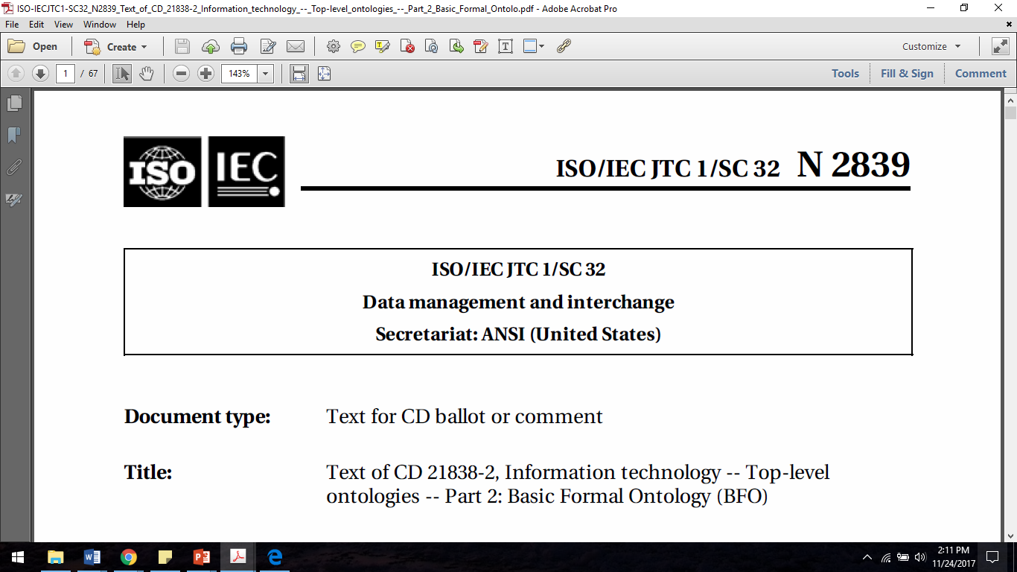
International Standards Organization (ISO) International Electrotechnical Commission (IEC)
ISO/IEC Joint Technical Committee JTC1: Information technology

Slide 26
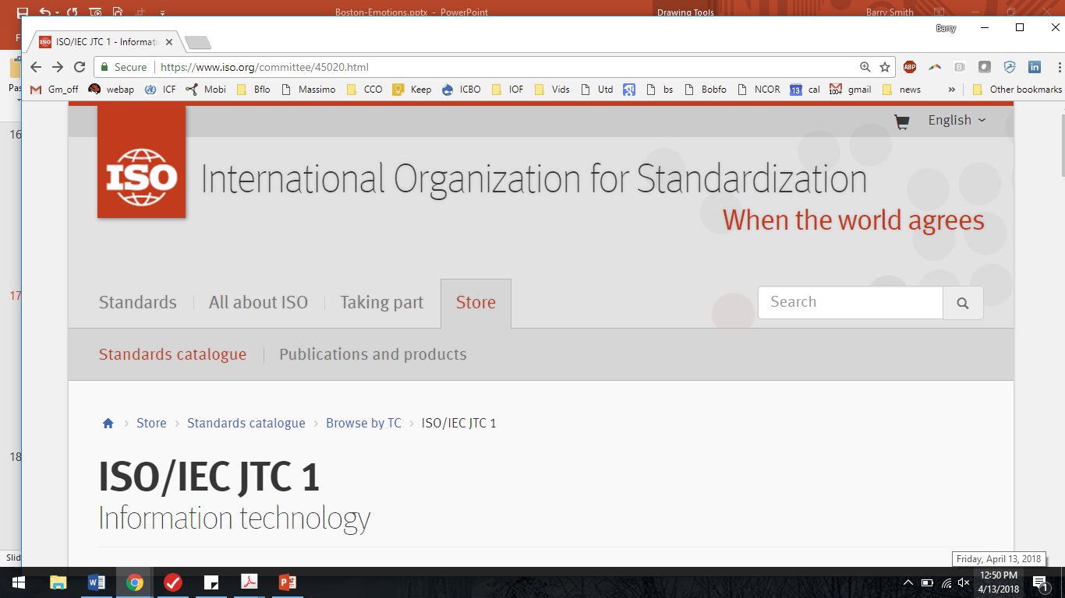

Slide 28
ISO/IEC 21838-1 Information technology — Ontologies — Top-level ontologies (TLO)

Slide 29
International Standards Organization (ISO)
Reference number of document: ISO/IEC DIS 21838-2
Date: 2017-08-28
SC32 Secretariat: US
Information technology — Ontologies — Top-level ontologies (TLO) – Basic Formal Ontology (BFO)

Slide 30
ISO/IEC 21838-2 (DIS) Information technology — Ontologies — Top-level ontologies (TLO) – Basic Formal Ontology (BFO)

Slide 31
BFO = Basic Formal Ontology
BFO:Entity
BFO:Continuant
BFO:Occurrent
BFO: Independent Continuant
BFO: Dependent Continuant
BFO:Process
BFO: Material Entity
BFO:Quality
BFO:Disposition
BFO:Role

Slide 32
BFO:Realizable Entities
attributes of a material bearer that only become manifest under certain conditions
externally grounded = role
internally grounded = disposition
You have the role of student even when you are asleep
You have the disposition to go bald even when you are still hirsute

Slide 33
BFO: Realizables and their Realizations
Continuants:
Realizables: Dispositions, Capabilities, Functions and Roles
Occurrents:
Realizations of Dispositions, Capabilities, Functions and Roles

Slide 34
Realizables and their realizations
An instance of a realizable entity type need not be realized
Each realizable entity type is associated with some BFO: process type
The disposition to go bald is associated with the process of losing hair

Slide 35
BFO:Disposition
=def. an attribute of a bearer that exists because of the physical make-up of the bearer
Examples:
to ripen, to go bald, to breathe, to speak Latin, to perform a symphony, to manufacture cars, to transmit torque, to generate heat, …

Slide 36
Capability Definition 0.1
capability =def. a disposition whose realization brings benefits
Examples:
to ripen, to go bald, to breathe, to speak Latin, to perform a symphony, to manufacture cars, to transmit torque, to generate heat, …

Slide 37
Benefit (primitive)
A process p brings benefit to an entity e if e is better off as a result of p than e would have been had p not happened
(This is an elucidation, not a definition)
If e benefits then e must continue to exist through time. Beneficiaries are BFO:continuants – organisms; what else?

Slide 38
Capabilities are somehow good
Dispositions which are typically bad/neutral for you and your community – disposition to spread diseases; disposition of fruit to rot – are not capabilities
Not every ‘capable of’ translates to ‘capability’ (‘capable of suicide’ means: has a risk factor for suicide above a certain threshold)

Slide 39
Capabilities: Human and Machine

Slide 40
Capabilities: Organism and Machine

Slide 41
Capabilities: 1. Organism
In case 1., the benefit goes to the bearer of the disposition, or to those who are on the side of the bearer (family, business partner, patient, employer, community, organization, …)
All organisms reap, through the realization of their capabilities, benefits relating to survival and reproduction.

Slide 42
Capabilities: 2. Machine
In case 2., the benefit goes to those in whose interest the artifact is used (for instance the owner of a watch, the owner of a factory in which a machine operates, a patient in an ICU, a passenger in a taxi)

Slide 43
Capability Definition 0.2
capability =def. a disposition whose realization brings benefits to an organism or group of organisms
‘group of organisms’ can include teams, organizations, colonies, nations, …

Slide 44
Speculation
All benefits reduce ultimately to either
for organisms in general: benefits connected with survival and reproduction
for human organisms: benefits associated with being an ultimate consumer of goods (~happiness)

Slide 45
Problem: your capabilities may not bring benefits
Your heart has the capability to pump
But it may realize this capability so poorly that this brings disbenefits both to the heart and to you
Similarly, if my brain realizes the capability to read and write poorly, this brings disbenefits associated with illiteracy

Slide 46
your capabilities may bring benefits to pathogens
weak immune systems …
in general weak realizations of capabilities can bring disbenefits

Slide 47
Your capabilities may bring benefits to your enemy
The warfighting capabilities of my homeland are capabilities, because their realization brings benefits to me/my country
But these capabilities may be realized very poorly, because my army is poorly trained. This brings benefits to my enemy.

Slide 48
Capabilities can be realized abnormally also through over-realization
exercising the capability to run in a marathon causes heart damage
exercising the capability to lift weights causes degenerative disc disease
Diseases:
gaming disorder
shopping addiction
…

Slide 49
Gradability
Hypothesis: Capabilities come with dimensions along which we can grade their realizations on a scale from zero to positive,
In the normal range realizations bring benefits more or less in proportion to their grade on the scale, but often there is an normal range outside which benefits turn into disbenefits

Slide 50
Capability Definition 0.3
capability =def. a disposition whose realizations 1. can be graded on a scale from zero to positive and 2. when in the normal range bring benefits to an organism or group of organisms
we call it a ‘capability’ because it is such that a normal realization will bring benefits

Slide 51
But what about the Mafia?
The putative capability to kill without feelings of guilt is not a capability in normal contexts
But it is a capability in Mafia contexts
Being able to hear is a benefit in the context of hearing persons, but it might be a disbenefit in certain deaf communities
In a distilling context, the disposition of fruit to rot is a capability

Slide 52
clusters of capabilities and disabilities
heavy drinking improves your ability to write poetry …
realization of the disposition to write poetry still brings benefits, independently of the other sorts of behavior which go hand in hand therewith

Slide 53
what about sadomasochistic implements?

Slide 54
Capability Definition 1.0
capability =def. a disposition whose realization in the normal case brings benefits to an organism or group of organisms
in the normal case means: not only in the normal range on the scale, but also in a context which is normal for the group to which the bearer/user belongs

Slide 55
Human Capability
human being x has capability y =def. x is the bearer of y
& y is a disposition
& the realization of y in the normal case brings benefits
to x, x’s family, group, community, …,

Slide 56
Machine Capability
machine x has capability y =def. x is the bearer of y
& y is a disposition
& the realization of y in the normal case brings benefits
to x’s user, owner, …

Slide 57
Capability Definition 1.0
capability =def. a disposition whose realization in the normal case brings benefits to an organism or group of organisms
a beach has a capability where the reference group is the associated community of sunbathers

Slide 58
Capabilities
Hypothesis: There are capabilities on Mars only if we have turned Mars into real estate
‘this shoreline has the capability to withstand storm surge of a Cat 5 hurricane’ makes sense only if there are people with interests (benefits)

Slide 59
Is this a problem?
if the shoreline becomes real estate, thereby gaining a capability "to withstand storm surge of a Cat 5 hurricane," then nothing about its intrinsic physical properties has changed, and yet it has gained a capability, which is supposed to be internally grounded.
Answer: the disposition always existed, and it remains the same disposition. But, it becomes a capability only because organisms with interests are involved
Notes:
Brian Donohue

Slide 60
one consequence of this approach
software does not have capabilities
capabilities are dispositions and dispositions depend on the physical makeup of the bearer

Slide 61
Capabilities
Organisms, groups of organisms, artifacts
Artifacts created by people
Factories, Infrastructure systems (air, water, transport, …)
Beaches, …

Slide 62
Utility of this approach
capabilities of people, groups, machines
all subject to testing for
reliability
adaptability
…
people and machines are nowadays being joined together in complex systems

Slide 63
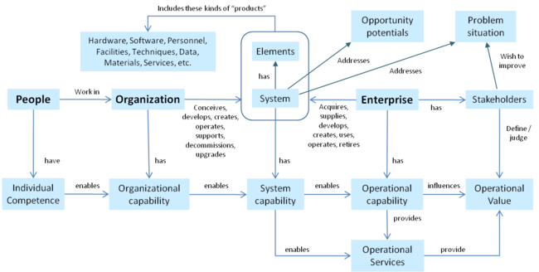
Capabilities Engineering
Notes:
http://sebokwiki.org/wiki/Enterprise_Systems_Engineering_Background

Slide 64
One idea for a schematic definition of ‘engineered system’
An engineered system s is an aggregate of engineered artifacts a₁, …, a_{m}
Each of the artifacts a_{i} has functions a_{i}:f₁, …, a_{i}:f_{n} and capabilities a_{i}:c₁, …, a_{i}:c_{p}
s itself has function f, and s exists because something was needed to realize function f, and f is realized through the coordinated realization of a_{i}:f₁, …, a_{i}:f_{n} and a_{i}:c₁, …, a_{i}:c_{p}

Slide 65
types of capabilities
biological capabilities
of single whole organisms (including humans)
of groups of organisms (ant colonies …)
of parts of organisms (cells, organs, …)
specifically human capabilities
capabilities of groups of humans
capabilities of machines
capabilities of engineered systems

Slide 66
Specifically human capabilities
capability to follow rules
capability to acquire further capabilities
teachability (capability to learn)
adaptability, intelligence …
capability to form groups, teams, companies
capability to grade (others’) capabilities (to rank, test, improve by competition, promote, award credentials …)

Slide 67
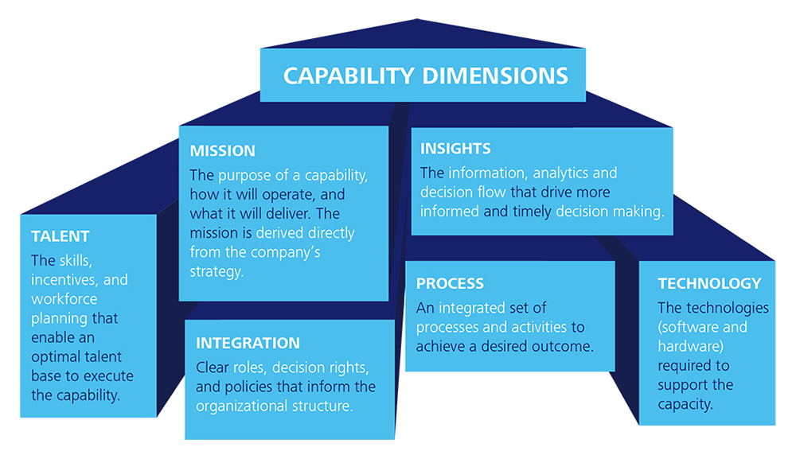

Capabilities of groups of humans
Notes:
https://www2.deloitte.com/us/en/pages/strategy/articles/strategic-capabilities-bridging-strategy-and-impact.html

Slide 68
Capabilities of members of groups, subgroups
leadership capabilities
managerial capabilities

Slide 69
Capabilities and functions

Slide 70
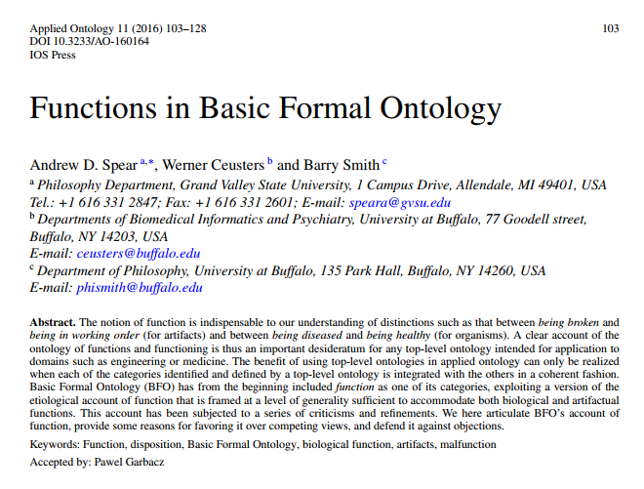

Slide 71
Function (a capability that is designed or selected for)
Function =def.
a capability that
exists in virtue of the bearer’s physical make-up,, and
this physical make-up is something the bearer possesses because it came into being, either through evolution (in the case of natural biological entities) or through intentional design (in the case of artifacts), in order to realize processes of a certain kind.

Slide 72
Artifacts have functions
An artifact’s function is the reason why the artifact was built (why the bearer of the function exists)
But artifacts also have capabilities (e.g. to operate at high temperature, to operate continuously,

Slide 73
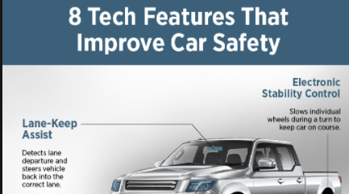
Artifacts have functions and other capabilities
An artifact’s function is the reason why the artifact was built (why the bearer of the function exists)
But artifacts also have capabilities (e.g. to operate at high temperature, to operate continuously, to operate safely, …)

Slide 74
What kinds of entities can have functions?
Organs, bodily systems, …
Machines, artifacts in general …
Hypothesis: people never have functions,
Organizations? (ant colonies …)
Not: organisms

Slide 75
What kinds of entities can have capabilities
Organs, bodily systems, parts of organisms in general…
Machines, artifacts in general …
Organisms, including people have capabilities
Groups of people
Complex artifacts typically have many capabilities in addition to the function for which they were designed

Slide 76
Capabilities
Do mountains have capabilities? Oceans? Are there capabilities on Mars?
Hypothesis: Only if we turn them into real estate (this shoreline has the capability to withstand storm surge of a Cat 5 hurricane)

Slide 77
But if the shoreline becomes real estate, thereby gaining a capability "to withstand storm surge of a Cat 5 hurricane," then nothing about its intrinsic physical properties has changed, and yet it has gained a capability, which is supposed to be internally grounded.
Notes:
Brian Donohue

Slide 78
Two kinds of capabilities
Direct capabilities whose acquisition involves physical changes in the bearer – for example learning to swim, learning to do long division
Indirect capabilities where pre-existing dispositions begin to offer benefits because of physical changes in the surrounding environment – the shoreline case

Slide 79
Summary
Disposition = a tendency that an entity has because of the way it is structured physically
Capability = a disposition whose realization in the normal case brings benefits to an organism or group of organisms
Function = a capability that an entity has because it was designed or selected to have it

Slide 80
Function
is_a
Capability
is_a
Disposition

Slide 81
Capability Definition 1.0
capability =def. a disposition whose realization in the normal case brings benefits to an organism or group of organisms
Consider: capability of a beach to afford sunbathing

Slide 82
Can ‘capability’ be added to BFO?
No. Because BFO is a realist ontology. It is designed to represent what really exists, independently of how it is viewed by, for example, organisms.

Slide 83
Function
is_a
Capability
is_a
Disposition
Some dispositions are capabilities only because of the presence of organisms who view them as beneficial (dispositions of shorelines, beaches, …)
All dispositions which are functions are functions independently of how any organisms view them

Slide 84
Then use etiology to define ‘function’
Functions = Capability + Reason for existing
Capabilities = Dispositions + Benefit from Normal Realizations
Dispositions

Slide 85
Two kinds of capabilities
Direct capabilities whose acquisition involves physical changes in the bearer – for example learning to swim, learning to do long division
Indirect capabilities where pre-existing dispositions begin to offer benefits because humans in the surrounding environment begin to view (and use) their bearers in a certain way – beaches, shorelines …

Slide 86

Found chop sticks
A pair of sticks found in the woods and used as chopsticks have indirect capabilities
All functions are direct capabilities

