Slide 1


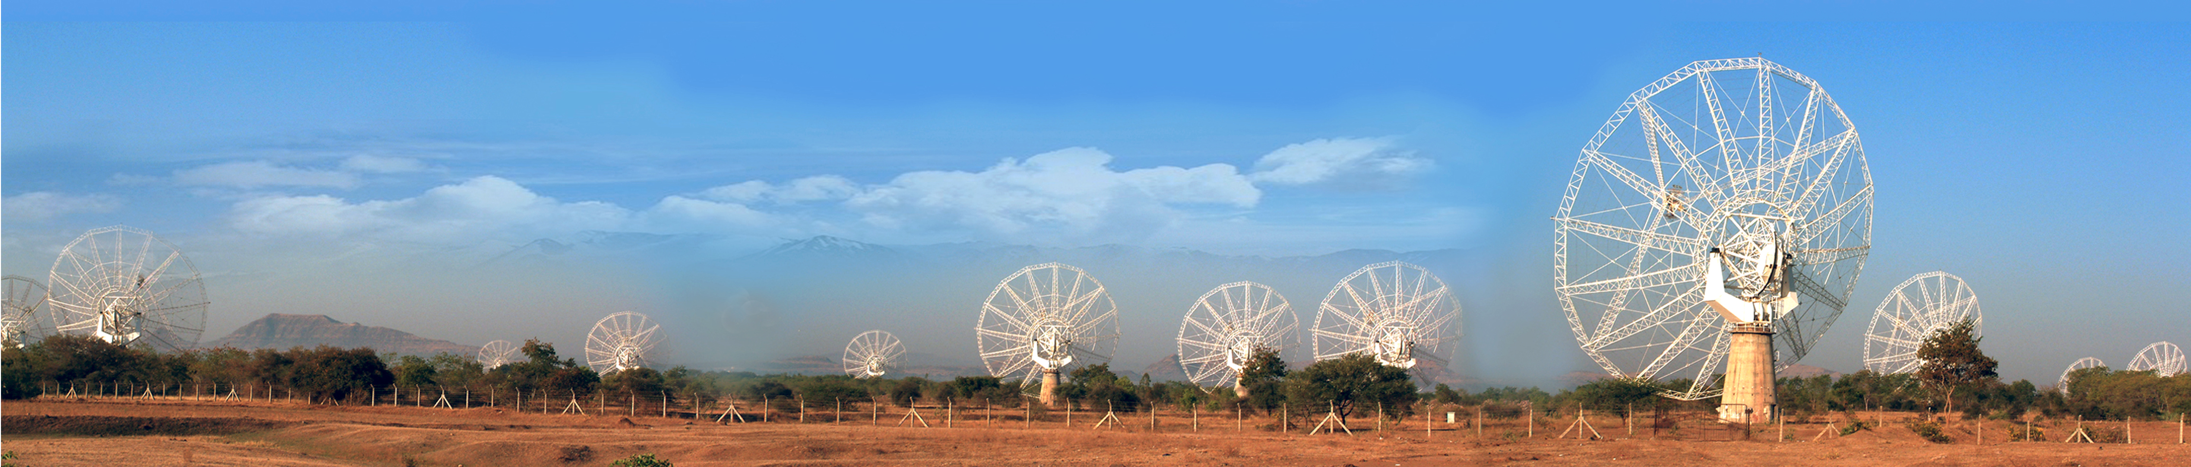
GMRT Automated Data Processing Utility
A project funded by National Centre for Radio Astrophysics (TIFR), Department of Atomic Energy, India.
In collaboration with Leiden University, The Netherlands.

Slide 2
Collaborators:
Dr. Yogesh Wadedakar
Dr. C.H. Ishwara Chandra
Dr. Huib Intema
Rathin Desai
Shubhankar Deshpande
Archit Sakhadeo
Shadab Shaikh

Slide 3
Index:
Overview of Radio Astrophysics
Radio Astronomy in India
Giant Metrewave Radio Telescope
Image Synthesis
Automated Data Processing
Future Expansion

Slide 4
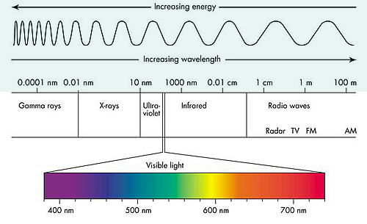
Overview:

Slide 5
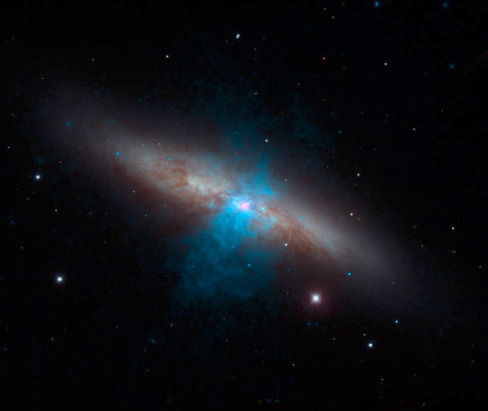
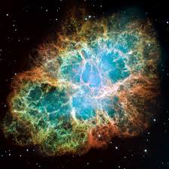
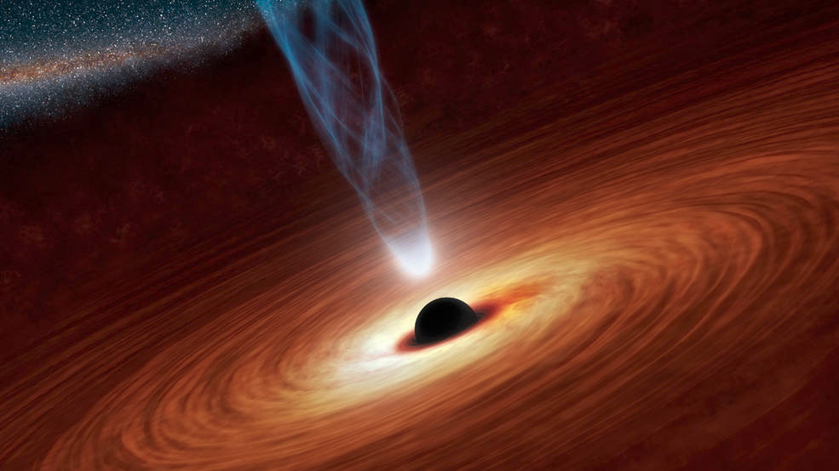
Overview:

Slide 6
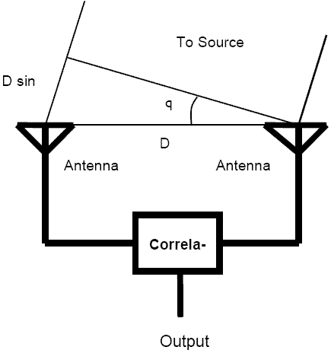
Overview:

Slide 7
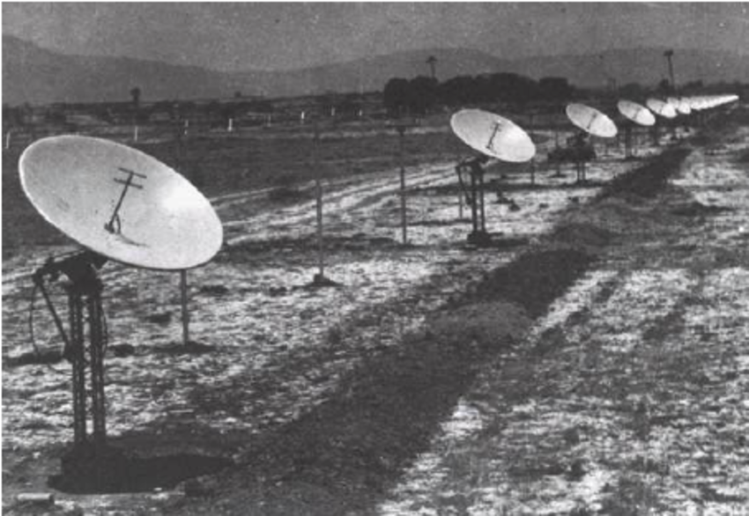
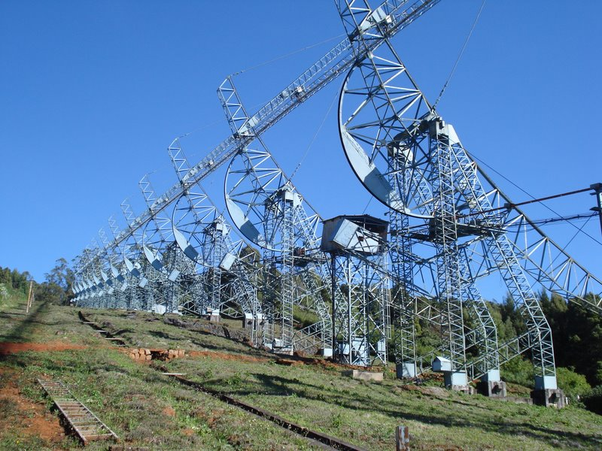
In India:

Slide 8
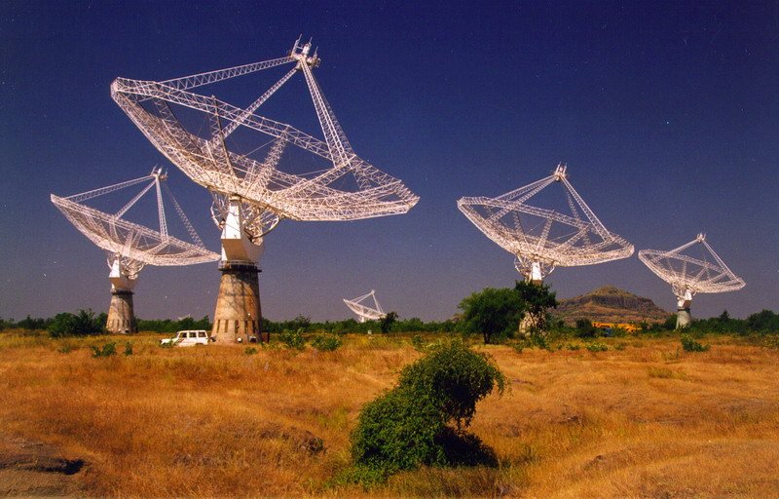
Giant Meterwave Radio Telescope:

Slide 9
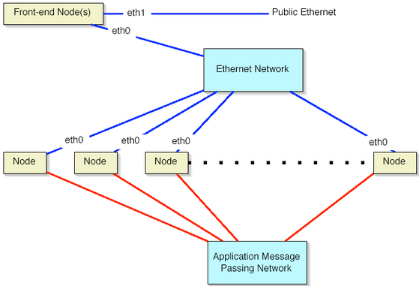
GADPU Automated Data Processing Utility:

Slide 10
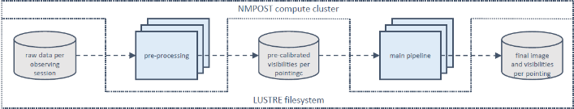
GADPU Automated Data Processing Utility:

Slide 11
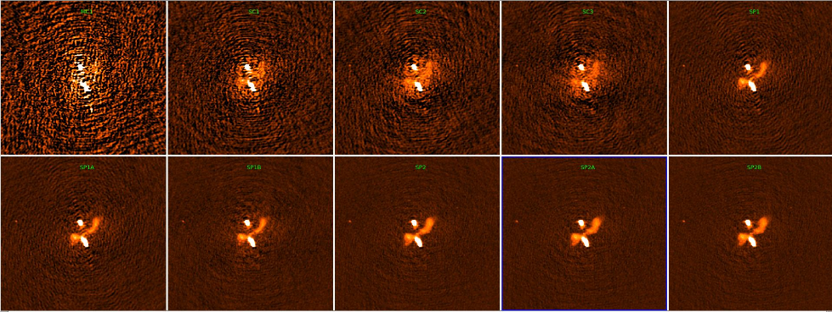
GADPU Automated Data Processing Utility:

