Slide 1
Making Network Graphs
Created by
James Cheng & Alison Blaine
Notes:
http://wwwp.oakland.edu/enp/

Slide 2
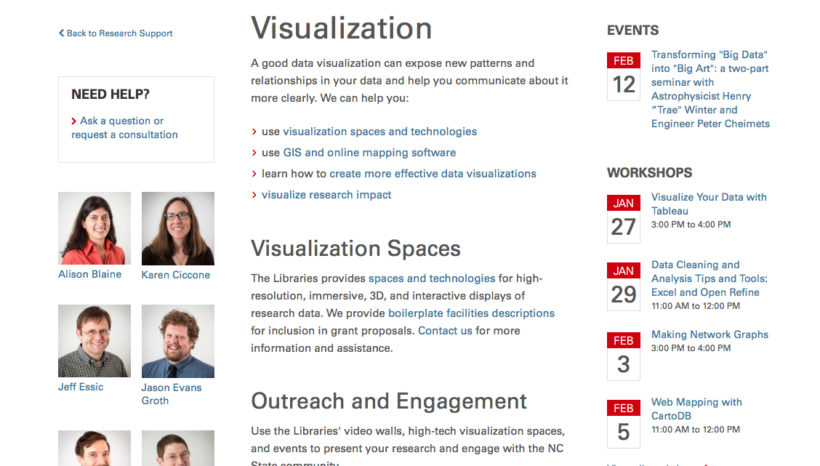
Data Visualization Services @ NCSU Libraries
lib.ncsu.edu/do/visualization

Slide 3
Overview
Examples
Terminology
Fusion Tables Activity
Measures and Statistics
Data Organization and Initial Preparation
Gephi Demo with Les Miserables data set
Further Resources and Workshops

Slide 4
Examples of
Network Graphs

Slide 5
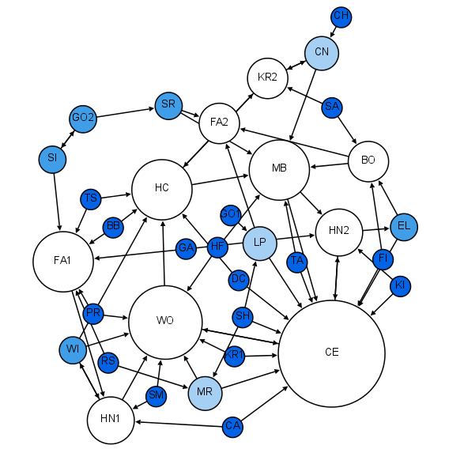
Moreno (1933), 1st grade friendships
Notes:
Moreno was a psychosociologist in early 21st century. He studied group interactions. One of the things he studied was the friendships between students at an elementary school over time.

Slide 6
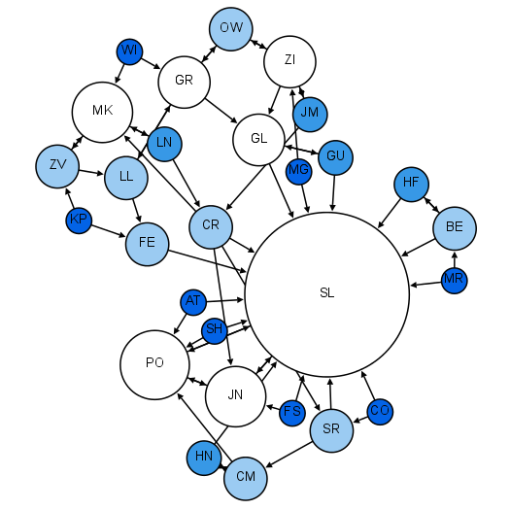
Moreno (1933), 2nd grade friendships

Slide 7
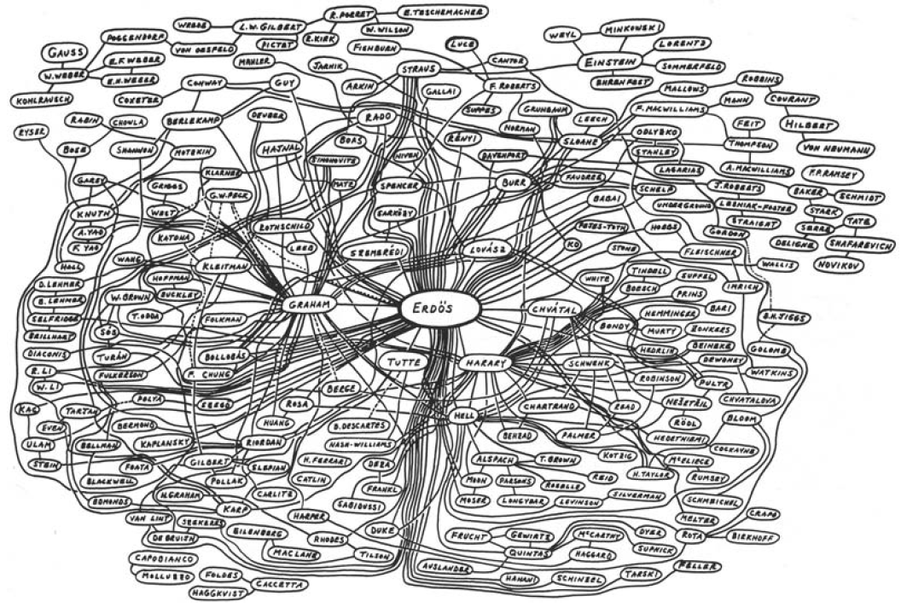
Notes:
erdos number is the number of steps (“collaborative distance” in terms of authorship of mathematical papers) away from erdos.

Slide 8
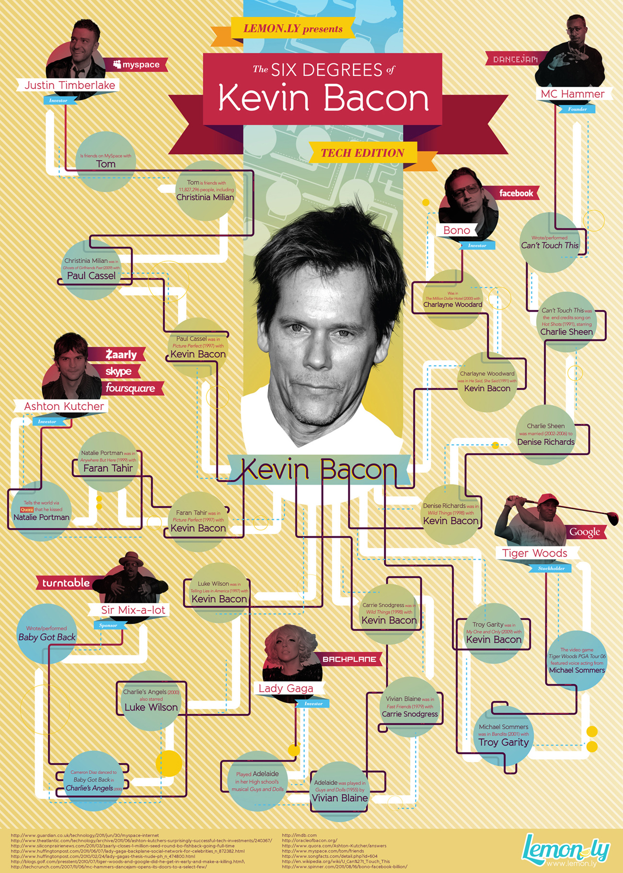
Notes:
Parlour games such as the Six Degrees of Kevin Bacon are an example of social networks.

Slide 9
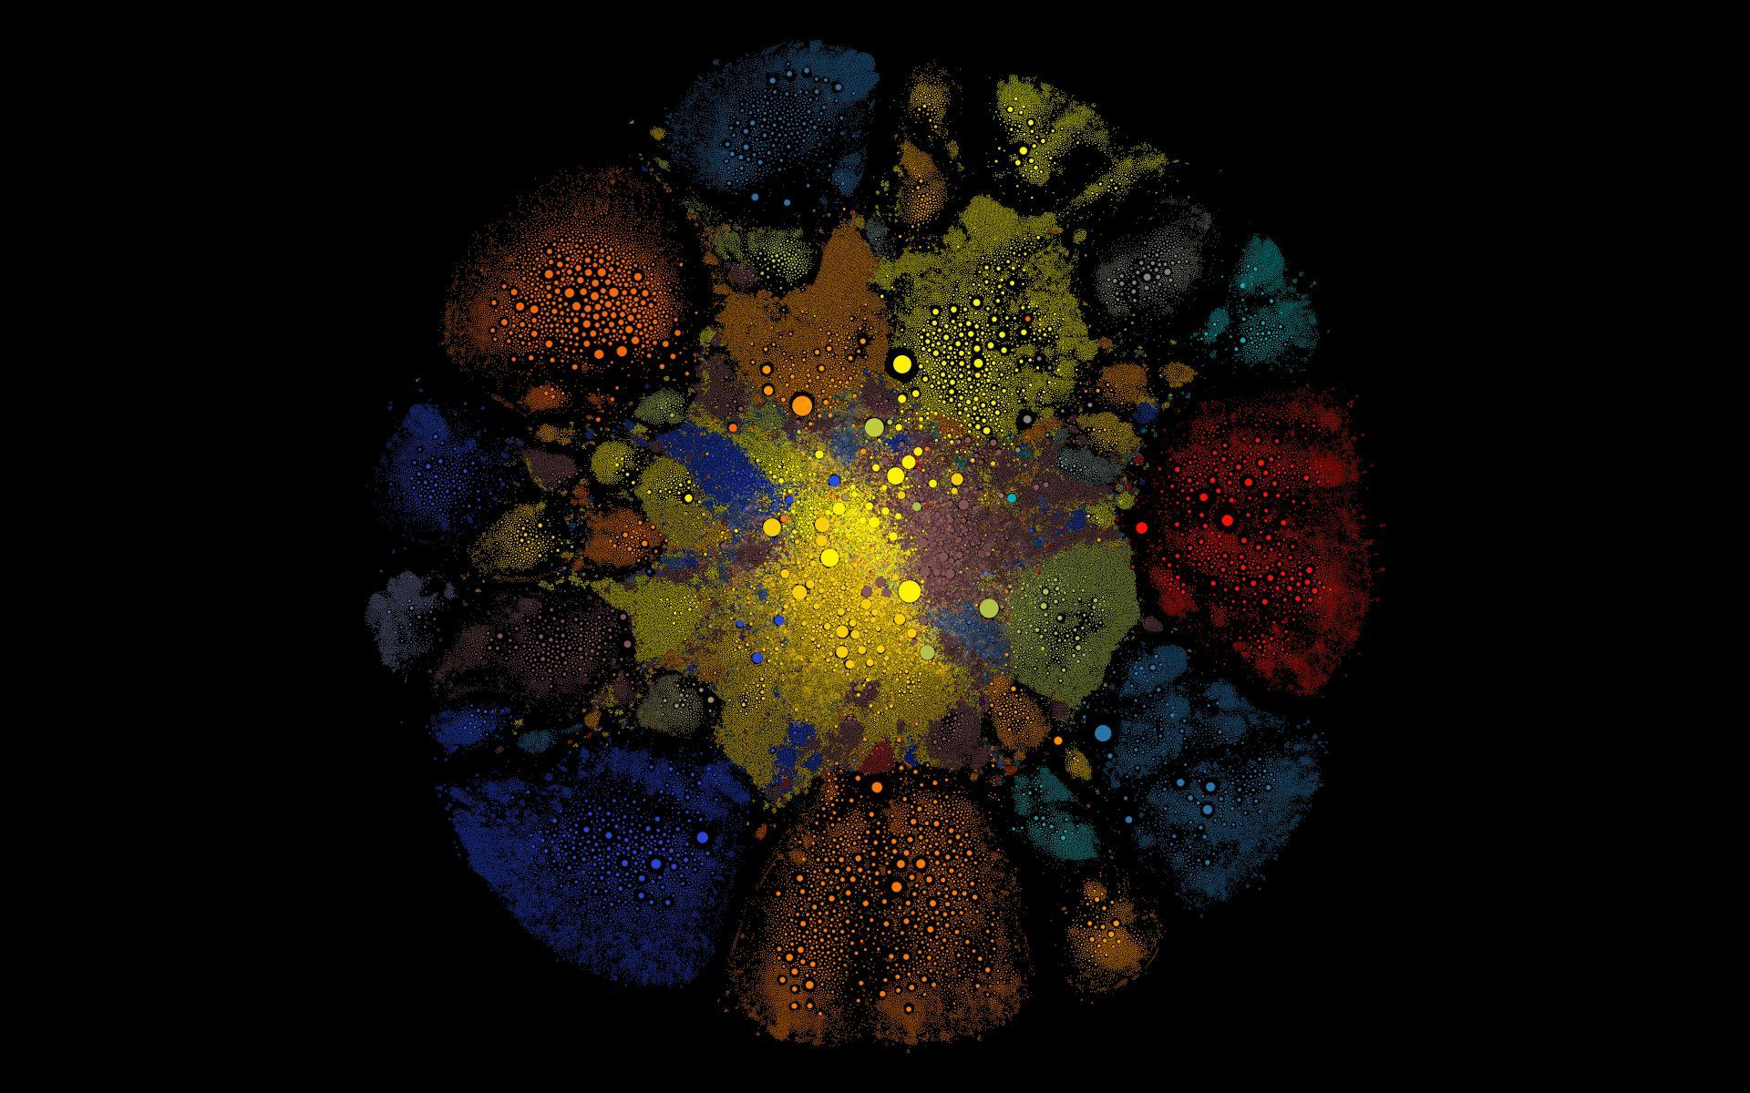
Notes:
Visualization of Steam communities. It is pretty.

Slide 10
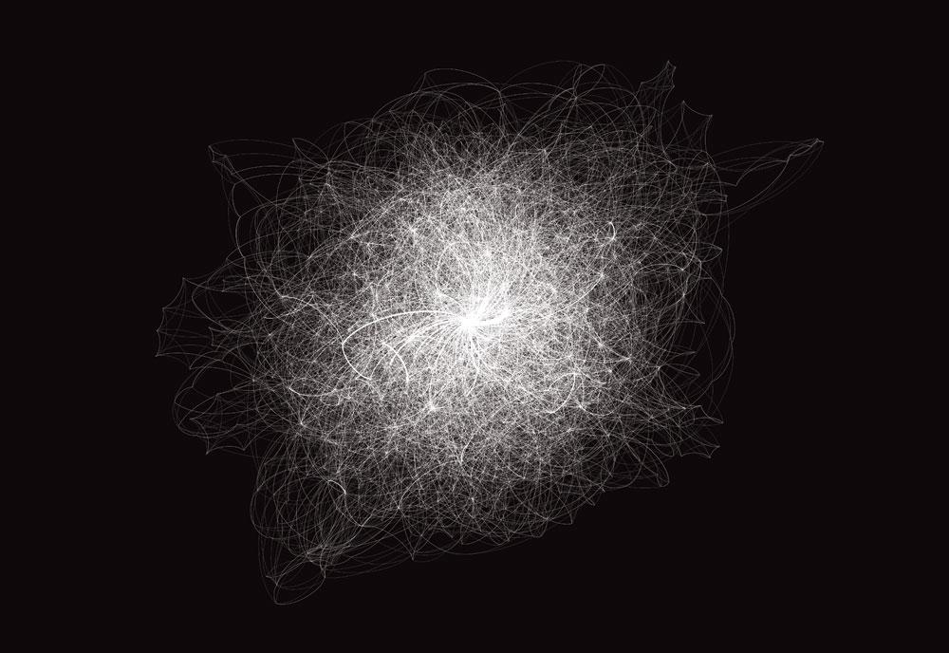
Notes:
Visualization of the text in the Quran. Also pretty. Also demonstrates that you can visualize anything.

Slide 11
Terminology

Slide 12
Madison
James
Nodes
(also known as: vertices, actors, agents, or points)
the objects in a graph which are connected to one another
Todd
Alison
Eka
Lauren

Slide 13
Madison
James
Edges
(also known as: links, relations, arcs, ties, or lines)
the connection between pairs of objects
Todd
Alison
Eka
Lauren

Slide 14
Madison
James
Directedness
whether the edges have a direction associated with them
Todd
Alison
Eka
Lauren

Slide 15
Madison
James
Graph
(also known as: network)
a set of objects where some pairs of objects are connected by links
Todd
Alison
Eka
Lauren

Slide 16
A simple directed graph
Nodes
Edges
Madison
James
Id | Label | Attribute
0 | Alison | 2
1 | Eka | 1
2 | James | 1
3 | Lauren | 1
4 | Madison | 1
5 | Todd | 0.5
Source | Target
0 | 1
0 | 2
0 | 3
0 | 4
0 | 5
1 | 3
1 | 5
2 | 5
3 | 5
4 | 5
Todd
Alison
Eka
Lauren

Slide 17
Fusion Tables

Slide 18
Google Fusion Tables
Tool for making quick visualizations in Google
You can make network graphs quickly using a spreadsheet
Accepts spreadsheets (.CSV, .XLS) files
Few options for changing look and feel of visualization

Slide 19
go.ncsu.edu/netgraphs
Link to workshop materials

Slide 20
Measures and Statistics

Slide 21
A simple directed graph with statistics
Graph-wide statistics
Madison
Average Degree | Network Diameter | Graph Density | Modularity
3.333 | 1 | 0.333 | 0.02
James
2
2
5
Todd
Individual level statistics
5
Alison
Label | Degree | Modularity | PageRank
Alison | 5 | 0 | 0.088872
Eka | 3 | 1 | 0.103988
James | 2 | 0 | 0.103988
Lauren | 3 | 1 | 0.148193
Madison | 2 | 0 | 0.103988
Todd | 5 | 0 | 0.450969
3
Eka
3
Lauren
Notes:
Average Degree: the mean number of edges connected to a node
Network Diameter: the number of steps from the two most distant nodes from each other
Modularity: a measure of how well the graph can be divided into “communities”
PageRank: a measure of a node’s importance within the graph

Slide 22
Modality
the number of different types of nodes in a graph
(single mode, bimodal, or multimodal)
Notes:
So far we’ve been talking in a single mode. Multimodal graphs also exists and are very tempting to use but do not. Stats break down in meaning with multiple modalities.

Slide 23
The difficulties of a multimodal graph
Consider degrees in the following network...
5
2
3
1
1
1
5
7
1
1
5
4
2
11
1
4
4
3
4
6
3
1
15
1
2
3
4
4
3
2
Notes:
Suppose the bigger circles with dark colors are departments and the smaller circles with light colors are individuals within the department. The edges represent collaborations between individuals. What might be an issue in terms of statistics? Answer: over inflation of the degree for department nodes. Edges between departments are not collaborations and are conceptually different. Statistics break down.

Slide 24
Data formats for Gephi
Spreadsheets
Graphml
Nodes spreadsheet
Edges spreadsheet
<!-- nodes -->
<node id="n0">
<data key="label">Freeman, Leb</data>
<data key="number_of_authored_works">10</data>
<data key="times_cited">7</data>
</node>
<node id="n1">
<data key="label">Silver, Sr</data>
<data key="number_of_authored_works">1</data>
<data key="times_cited">0</data>
</node>
<!-- edges -->
<edge id="e0" source="n0" target="n1">
<data key="number_of_coauthored_works">1</data>
<data key="weight">1</data>
</edge>
<edge id="e1" source="n0" target="n2">
<data key="number_of_coauthored_works">1</data>
<data key="weight">1</data>
</edge>
Id | Label | Attribute
0 | Alison | 2
1 | Eka | 1
2 | James | 1
3 | Lauren | 1
4 | Madison | 1
5 | Todd | 0.5
Source | Target
0 | 1
0 | 2
0 | 3
0 | 4
0 | 5
1 | 3
1 | 5
2 | 5
3 | 5
4 | 5
Notes:
Two types of formats we’ll be using. Spreadsheets are separated into nodes spreadsheet and edges spreadsheets and have columns and rows. Graphml is essentially XML and looks like that.

Slide 25
Gephi Activity: Les Miserables

Slide 26


Further resources
Scott Weingart’s series of blog posts on network visualizations, including a guide to creating coauthor networks
http://www.scottbot.net/
Introduction to network visualization and analysis using Gephi by Martin Grandjean.
http://www.martingrandjean.ch/
gephi-introduction/
Notes:
Check out these things

