Slide 1

Visualizing Data with Tableau
By:
Alison Blaine (ablaine@ncsu.edu)
Jennifer Garrett (jigarret@ncsu.edu)

Slide 2
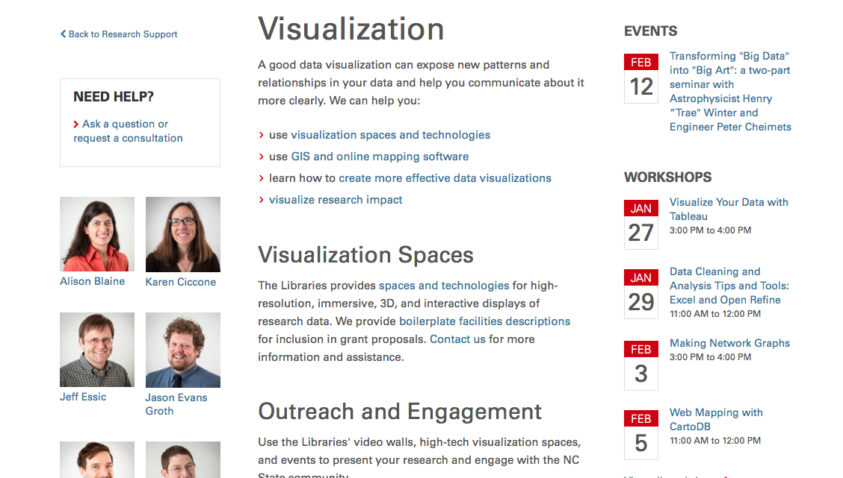
Data Visualization Services lib.ncsu.edu/do/visualization

Slide 3
Learning Outcomes
After today, you should be able to:
upload a dataset to Tableau
learn about the visualization types available in Tableau
create multiple visualizations and a dashboard
publish a visualization
identify a datapoint as a "Measure" or a "Dimension"
use an appropriate chart for a given datatype
find further assistance
If you have any questions, please raise your hand!

Slide 4
What is Tableau? www.tableau.com
Interactive data visualization and analytics application
Free and paid versions
Tableau Public is free for everyone
Tableau Desktop is free for students
(http://www.tableau.com/academic/students)
You can create and share graphs, maps, live dashboards
You can publish anywhere on the web using Tableau Public

Slide 5
How to Use Tableau Public
Go to this website and create your own account: public.tableau.com
Download and install the application
You will use the application to make the visualizations, and then save them to the web.

Slide 6
Tableau Gallery
Let’s see some examples!
public.tableau.com/s/gallery

Slide 7
Today’s workshop materials
go.ncsu.edu/tableauworkshop

Slide 8
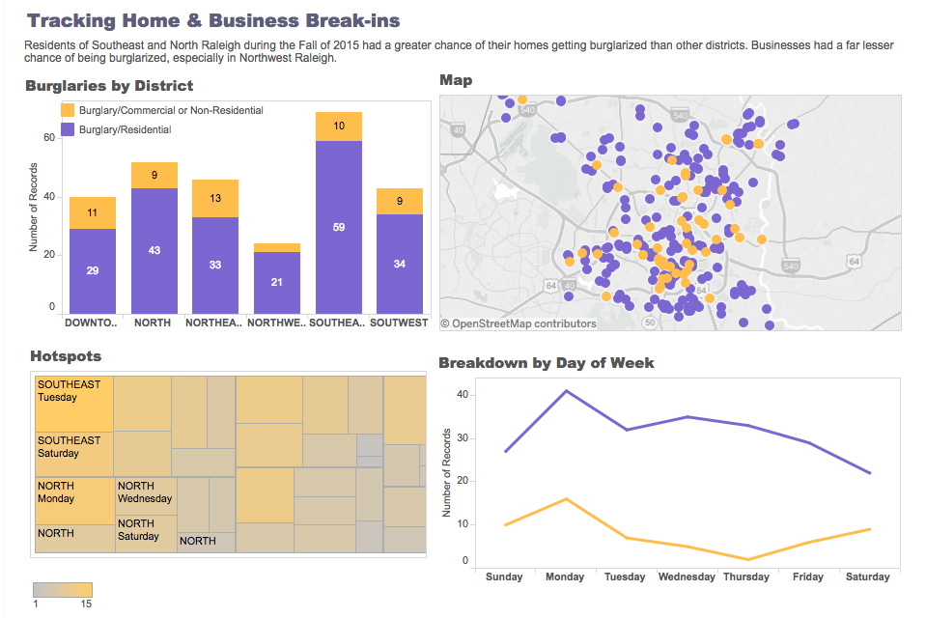
Demo of what we are making today

Slide 9
Getting started questions
Where did the most residential burglaries take place?
On what days did most burglaries take place -- does this vary by type of burglary?
What geographic trends are there?

Slide 10
Tableau sample data sets
public.tableau.com/s/resources

