Slide 1
Heading 1
Heading 2

Slide 2
Heading 2
Body text

Slide 3
Design Guidelines
Focus on bold imagery, not text
Use high resolution imagery – the native resolution of the Commons Wall is 2880 pixels wide x 2400 pixels tall
Make sure ALL animations and movies start automatically when you advance to the next slide

Slide 4
Design Guidelines
This .pptx is formatted in the aspect ratio of the Commons Wall
Dark backgrounds and saturated colors work best on the Christie MicroTiles display
White backgrounds will look bad

Slide 5
Text Guidelines
The less text the better
The Commons Wall has VERY long sightlines, so the text needs to be huge to be legible from far away
The font sizes in this .pptx use our recommendations
Do not use serif fonts
Additional text guidelines can be found on our GitHub page

Slide 6
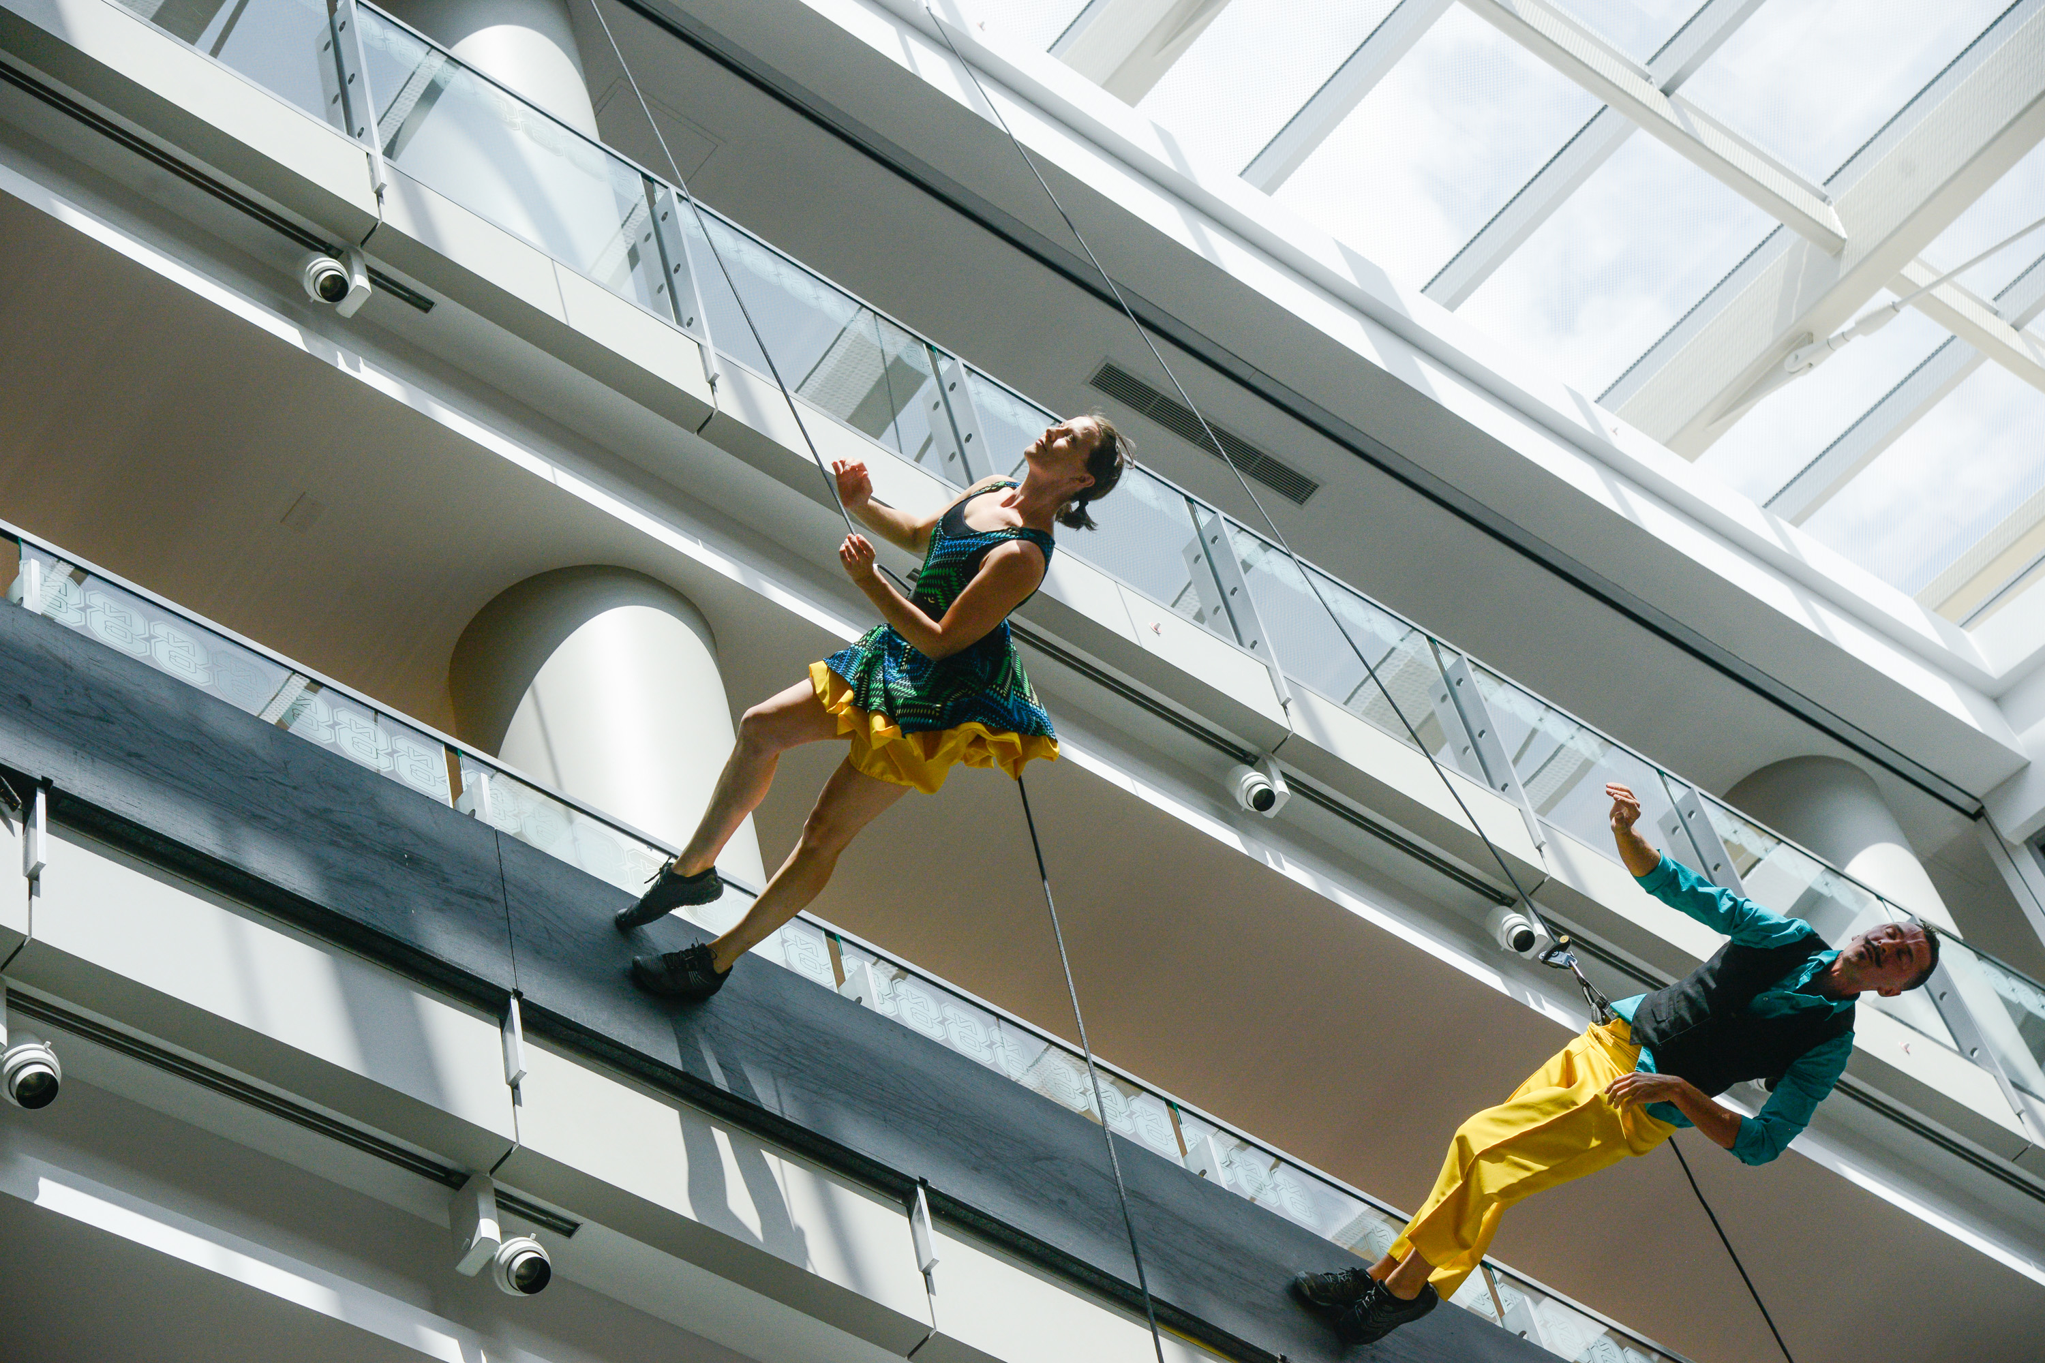

Slide 7
