Slide 1
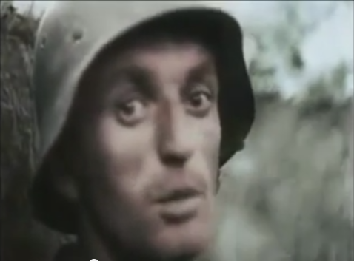
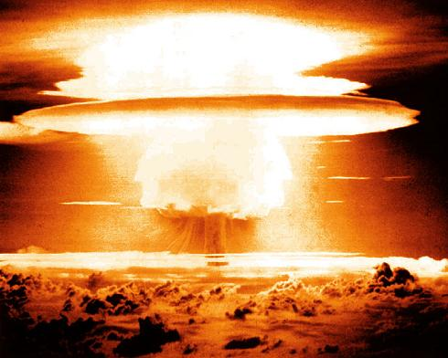
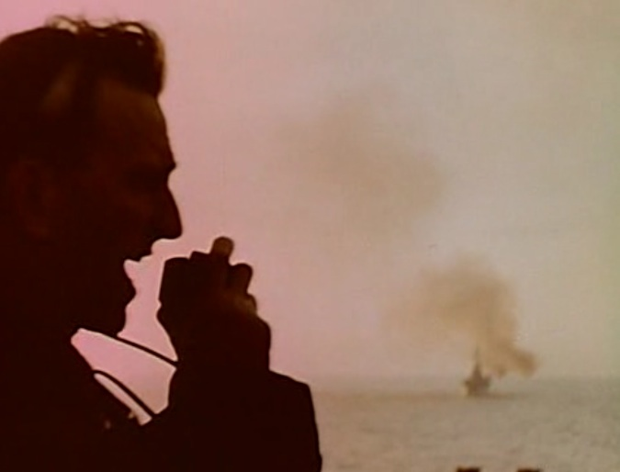
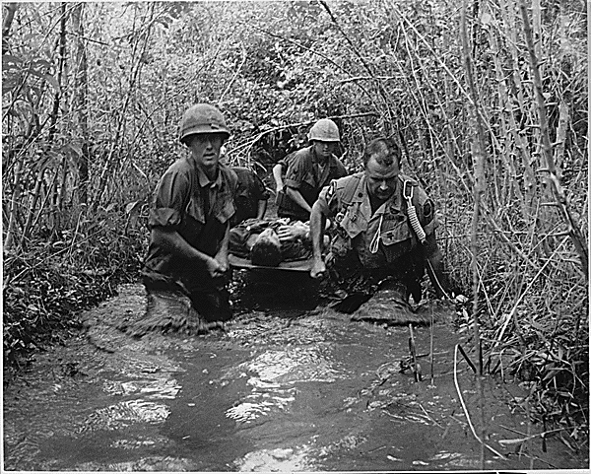
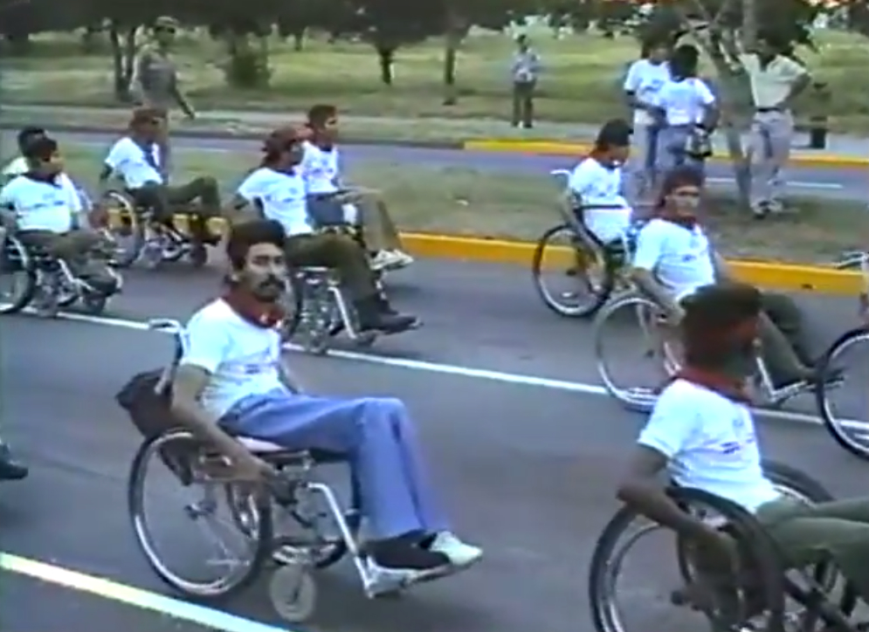
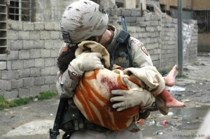
SHOOTING WARS
DOCUMENTARY IMAGES OF AMERICAN MILITARY CONFLICTS
WORLD WAR II
THE COLD WAR
THE KOREAN WAR
THE VIETNAM WAR
THE CONTRAS
THE WAR ON TERROR

Slide 2
SHOOTING WARS
DOCUMENTARY IMAGES OF AMERICAN MILITARY CONFLICTS
WORLD WAR II
THE COLD WAR
THE KOREAN WAR
THE VIETNAM WAR
THE CONTRAS
THE WAR ON TERROR

Slide 3
SHOOTING WARS
DOCUMENTARY IMAGES OF AMERICAN MILITARY CONFLICTS
WORLD WAR II
THE COLD WAR
THE KOREAN WAR
THE VIETNAM WAR
THE CONTRAS
THE WAR ON TERROR

Slide 4
SHOOTING WARS
DOCUMENTARY IMAGES OF AMERICAN MILITARY CONFLICTS
WORLD WAR II
THE COLD WAR
THE KOREAN WAR
THE VIETNAM WAR
THE CONTRAS
THE WAR ON TERROR

Slide 5
SHOOTING WARS
DOCUMENTARY IMAGES OF AMERICAN MILITARY CONFLICTS
WORLD WAR II
THE COLD WAR
THE KOREAN WAR
THE VIETNAM WAR
THE CONTRAS
THE WAR ON TERROR

Slide 6
SHOOTING WARS
DOCUMENTARY IMAGES OF AMERICAN MILITARY CONFLICTS
WORLD WAR II
THE COLD WAR
THE KOREAN WAR
THE VIETNAM WAR
THE CONTRAS
THE WAR ON TERROR

Slide 7
SHOOTING WARS
DOCUMENTARY IMAGES OF AMERICAN MILITARY CONFLICTS
WORLD WAR II
THE COLD WAR
THE KOREAN WAR
THE VIETNAM WAR
THE CONTRAS
THE WAR ON TERROR

Slide 8
SHOOTING WARS
DOCUMENTARY IMAGES OF AMERICAN MILITARY CONFLICTS
WORLD WAR II
THE COLD WAR
THE KOREAN WAR
THE VIETNAM WAR
THE CONTRAS
THE WAR ON TERROR

Slide 9
SHOOTING WARS
DOCUMENTARY IMAGES OF AMERICAN MILITARY CONFLICTS
WORLD WAR II
THE COLD WAR
THE KOREAN WAR
THE VIETNAM WAR
THE CONTRAS
THE WAR ON TERROR

Slide 10
SHOOTING WARS
DOCUMENTARY IMAGES OF AMERICAN MILITARY CONFLICTS
WORLD WAR II
THE COLD WAR
THE KOREAN WAR
THE VIETNAM WAR
THE CONTRAS
THE WAR ON TERROR

Slide 11
SHOOTING WARS
DOCUMENTARY IMAGES OF AMERICAN MILITARY CONFLICTS
WORLD WAR II
THE COLD WAR
THE KOREAN WAR
THE VIETNAM WAR
THE CONTRAS
THE WAR ON TERROR

Slide 12
SHOOTING WARS
DOCUMENTARY IMAGES OF AMERICAN MILITARY CONFLICTS
WORLD WAR II
THE COLD WAR
THE KOREAN WAR
THE VIETNAM WAR
THE CONTRAS
THE WAR ON TERROR

