Slide 1
NEURAL NETWORKS | ECE 542
Neural Sequence Modeling for Advanced Microarchitectural Branch Prediction
Baseline ML Models Implementation
· Shreeya Ranwadkar · Advika Metre · Prajna Hassan Umesh

Slide 2
MOTIVATION & PROBLEM STATEMENT
Why Does Branch Prediction Matter?
15–20%
~30%
15+ cycles
of instructions
are branches
of total CPU cycles
wasted on mispredictions
penalty per
mispredicted branch
Problem Statement
Modern CPUs rely on branch predictors to speculatively execute instructions. Incorrect predictions stall the pipeline and degrade performance. Traditional predictors (bimodal, gshare) use fixed heuristics. We ask: can machine learning models learn branch behavior from historical traces and outperform a trivial always-predict baseline?

Slide 3
BACKGROUND
How Branch Prediction Works
Fetch
Predict
Execute
Commit/
Flush
PC address
Taken / Not Taken?
Evaluate branch
Correct or penalize
Taken (label = 1)
Not-Taken (label = 0)
Branch jumps to target address
Branch falls through sequentially
Loop back-edges, if-conditions
Straight-line code continues
Pipeline must flush if wrong
~51% of gcc trace branches

Slide 4
PRIOR WORK
Prior Work by Team Members
Branch Predictor Simulator
Modeled Bimodal, Gshare, and Hybrid branch predictors with 2-bit Smith counters
Simulated over 0.2 million branch traces to evaluate predictor behavior
Analyzed prediction accuracy by adjusting simulator parameters (history bits, table sizes)
This prior work established the hardware context for this project: understanding how classical predictors like Bimodal and Gshare work — using fixed-width counters and history registers — directly informed the feature design (PC history + outcome history) used in our ML models.

Slide 5
DATASET
gcc_trace — Prior Coursework Dataset
Source
500,000
80 / 20%
Branch trace dataset from prior coursework (ECE 563)
Generated as part of a branch predictor simulation project
Total Branches
Train / Test Split
First 500k used (temporal order)
No shuffle — preserves time order
Entry Format & Encoding
Each entry contains: Program Counter (PC) address + branch outcome (t = taken, n = not taken)
Data converted to binary: taken → 1, not taken → 0
Sequential trace preserves execution order
Used to model real program control-flow behavior
57.3%
42.7%
Taken (label=1)
Not-Taken (label=0)
Majority class in training set
Minority class in training set

Slide 6
BASELINE & METRICS
Trivial Baseline + Evaluation Metrics
Trivial Baseline
Evaluation Metrics
Always predicts the majority class from training. Train set has 57.3% Taken — so trivial predictor always predicts Taken.
Misprediction Rate
F1-Score
(1 − Acc) × 100. Primary metric. Maps to CPU pipeline stalls.
Harmonic mean of Precision and Recall. Balances both.
Accuracy: 51.48% · Misprediction: 48.52%
Accuracy
Confusion Matrix
Fraction of branches correctly predicted overall.
TN / FP / FN / TP breakdown — reveals bias toward Taken class.
This is the floor — any useful ML model must beat this. It represents zero learning: no history, no patterns, pure majority vote.
Precision
Parameter Footprint
TP / (TP+FP). Of predicted Taken, how many were actually Taken?
# weights (LR) or tree nodes (DT/RF). Hardware budget proxy.
Recall
Training Time
TP / (TP+FN). Of actual Taken branches, how many did we catch?
Wall-clock seconds. Reflects model complexity at scale.

Slide 7
BASELINE MODELS
Three Classical ML Approaches
Logistic Regression
Decision Tree
Random Forest
65 parameters
5,119 nodes
666,102 nodes
Config: solver=saga, C=1.0, max_iter=300
Config: max_depth=15
Config: 100 trees, max_depth=15
Learns a linear decision boundary in the 64-dimensional feature space. Assigns a probability to the 'Taken' class using a sigmoid function.
Recursively splits feature space on thresholds. Each path from root to leaf is a prediction rule based on PC history and branch outcomes.
Ensemble of 100 decision trees. Each tree sees a random subset of features. Final prediction is a majority vote across all trees.
✓ Extremely lightweight — closest to hardware-deployable
✓ Interpretable — rules can be inspected
✓ Best accuracy — captures complex patterns
✗ Cannot model non-linear branch patterns
✗ Prone to overfitting; single tree is brittle
✗ Very large parameter footprint; slow (74s)

Slide 8
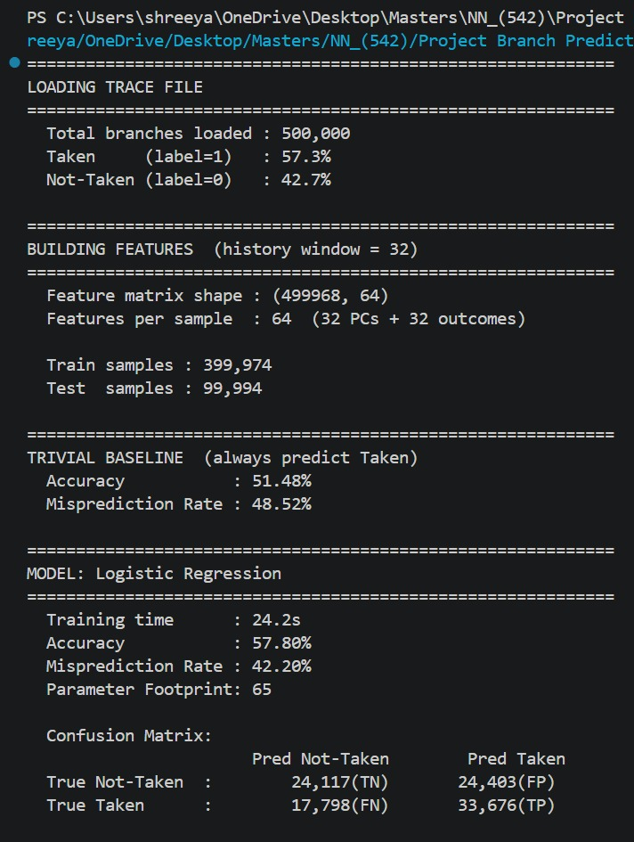
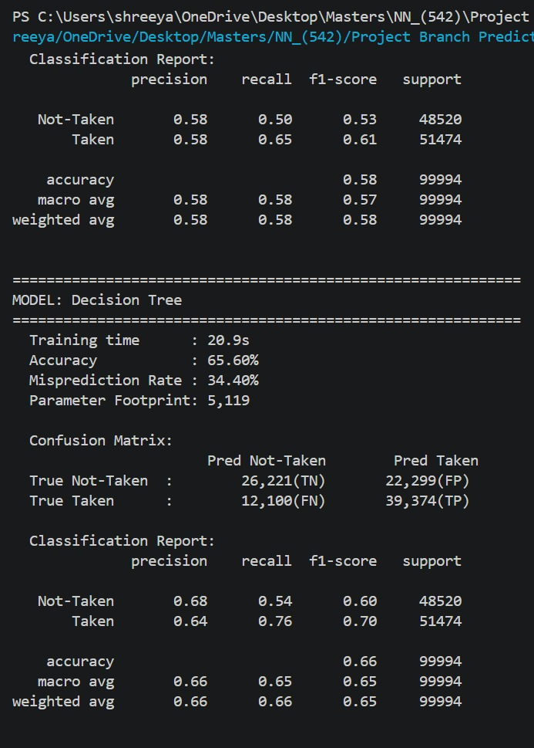
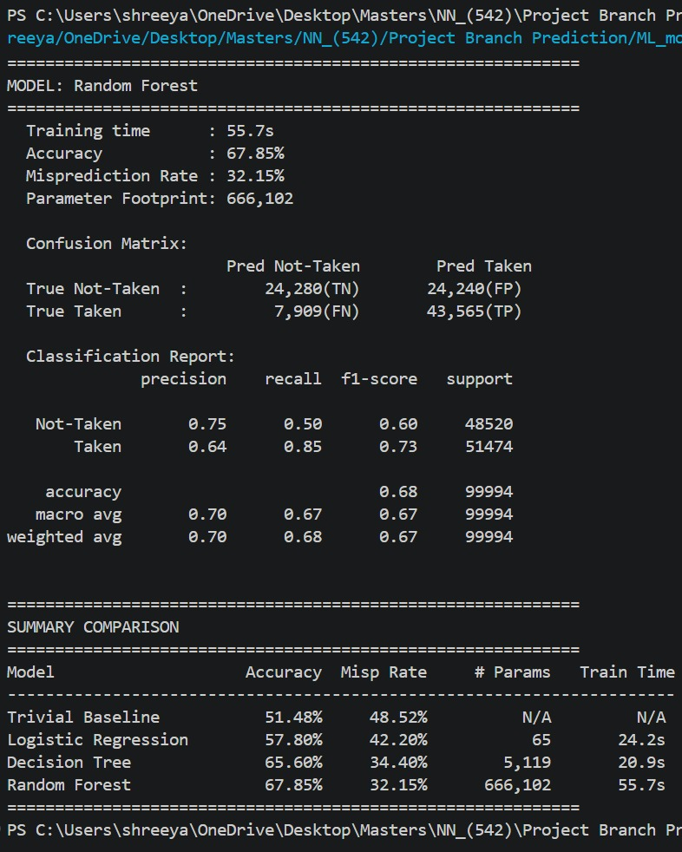
OUTPUT

Slide 9
RESULTS
Performance Summary
Model | Accuracy | Mispred. Rate | # Params | Train Time
Trivial Baseline | 51.48% | 48.52% | — | —
Logistic Regression | 57.80% | 42.20% | 65 | 24.2s
Decision Tree | 65.60% | 34.40% | 5,119 | 20.9s
Random Forest ★ | 67.85% | 32.15% | 666,102 | 55.7s
Classification Reports (from actual run)
Logistic Regression
Decision Tree
Random Forest
Not-Taken P:0.58 R:0.50 F1:0.53
Not-Taken P:0.68 R:0.54 F1:0.60
Not-Taken P:0.75 R:0.50 F1:0.60
Taken P:0.58 R:0.65 F1:0.61
Taken P:0.64 R:0.76 F1:0.70
Taken P:0.64 R:0.85 F1:0.73
TN=24,117 FP=24,403
FN=17,798 TP=33,676
TN=26,221 FP=22,299
FN=12,100 TP=39,374
TN=24,280 FP=24,240
FN=7,909 TP=43,565

Slide 10
NEXT STEPS
Neural Network Extensions
LSTM
MLP
Long Short-Term Memory
Multi-Layer Perceptron
Designed for sequential data — ideal for branch histories
Fully connected deep network on the same 64-feature input
Remembers long-range correlations across hundreds of branches
Multiple hidden layers capture non-linear branch interactions
Hidden state acts as a learned branch history register
Faster to train than LSTM; good accuracy-cost tradeoff
Expected: significantly lower misprediction rate vs. RF
Can be quantized for approximate hardware deployment

Slide 11
REFERENCES
References
[1] gcc_trace Dataset — Branch trace from prior coursework (ECE 563), NC State ECE.
Generated as part of a branch predictor simulation project. Used with permission. [2] Jiménez, D. A., & Lin, C. (2001). Dynamic branch prediction with perceptrons. Proceedings HPCA Seventh International Symposium on High-Performance Computer Architecture. [3] Elbtity, M. B. E., et al. (2023). An LSTM-based Branch Predictor for Modern Microprocessors. IEEE International Symposium on Circuits and Systems (ISCAS)

