Slide 1

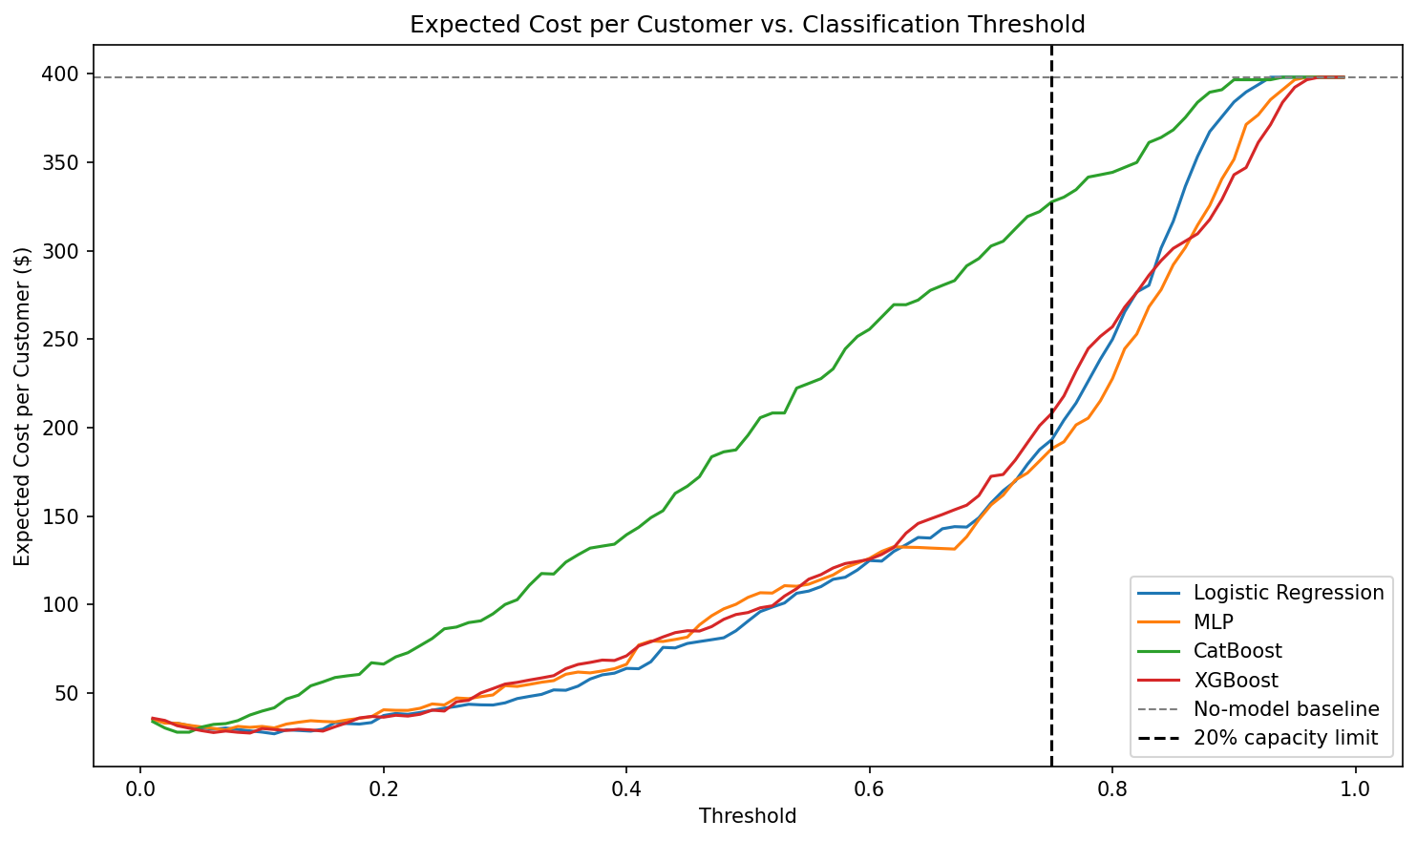
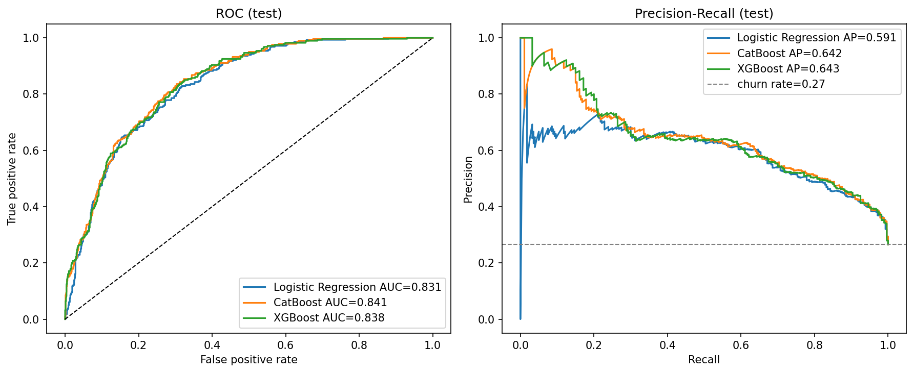
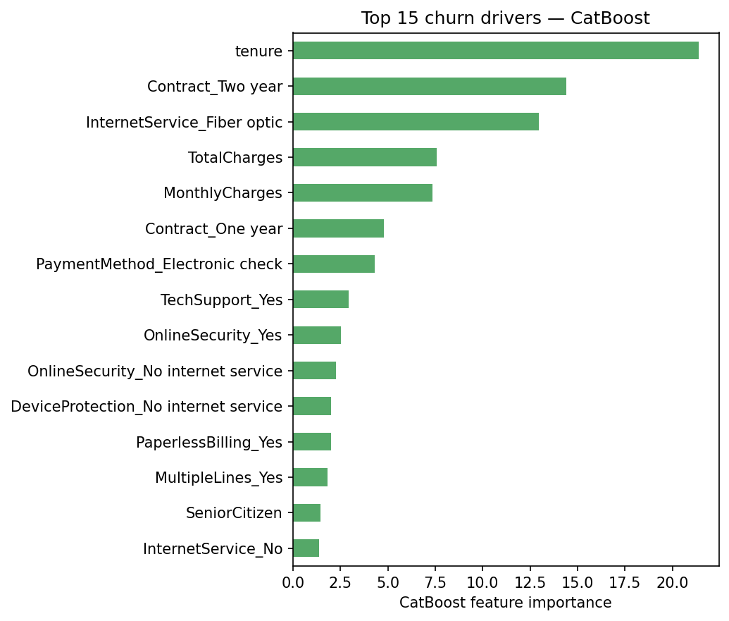
AI Student Symposium 2026
Course ID : ECE525
Poster 60
Cost-Aware Customer Churn Prediction for Telecom Industry
Motivation & Problem
Sree Vathsa Kashyap Mydugolam (smydugo) | Srinidhi Shivashankar (sshivas) | Deekshith Anantha (dananth)
Department of Electrical and Computer Engineering, NC State University
Customer churn — when a paying subscriber leaves a service — is one of the most expensive problems in telecom. Acquiring a new customer costs 5×–7× more than retaining an existing one, so identifying customers who are about to leave is directly tied to revenue.
The challenge:
The signal is imbalanced: only 26% of customers churn.
The cost is asymmetric: missing a churner ($1,500 lifetime value lost) is 30× worse than a false alarm ($50 retention call).
Default model thresholds (0.5) ignore both, so even a "good" model can be a poor business tool.
Our contribution: We build and compare four churn classifiers — Logistic Regression, a custom MLP, CatBoost, and XGBoost — under a cost-aware evaluation that ties model probabilities to dollars. We show that the right operating threshold matters more than the choice of architecture.
Some considerations:
Text – Text should be at least 36 point for normal reading otherwise your audience will be squinting and miss your content. For ease of viewing, utilize ample (and consistent) imagery – a picture tells a thousand words, and nobody is going to read a thousand words on your poster.
Images – Utilize JPG or PNG images – other formats may look fine; however, they may pose issues when printing. Images should be either original (your work) or appropriately credited licensed imagery. Photos should be at a 220-dpi resolution – even though a lower resolution image may look fine on the screen (72 dpi), they will look poor in print.
Color - Avoid a high percentage of colored background. If you absolutely have to have a lot of color in the background use Wolf Xpress. The paper we normally use will not support high color density, nor will our ink budget.
Data & EDA
Dataset. IBM Telco Customer Churn — 7,032 customers × 19 features after cleaning. Demographics, account info, service mix, charges. Target: Churn (Yes/No).
Class imbalance: 5,163 stayed (73.4%) · 1,869 churned (26.6%).
Top churn drivers (from EDA):
Contract type — Month-to-month customers churn at 43%; two-year contracts at 3%.
Tenure — churners cluster in the first 12 months.
Internet service — Fiber optic users churn at 42% vs DSL at 19%.
Payment method — Electronic check at 45%; auto-pay <20%.
Approach
Evaluation Plan and Results
Stratified 70 / 15 / 15 train-validation-test split. StandardScaler fit on training fold ONLY (no leakage).
Compare four models: Logistic Regression, custom MLP, CatBoost, XGBoost (matched preprocessing for fair comparison).
Tune decision threshold on validation (max F1) - apply once to test.
Cost-aware analysis: sweep threshold under FN=$1500 / FP=$50 cost, with and without 20% capacity constraint.
Model | F1 | ROC-AUC | PR-AUC | Brier | Recall | Precision
CatBoost | 0.624 | 0.841 | 0.642 | 0.139 | 0.768 | 0.526
Logistic Regression | 0.610 | 0.831 | 0.591 | 0.176 | 0.746 | 0.516
XGBoost | 0.608 | 0.838 | 0.643 | 0.169 | 0.725 | 0.523
MLP (custom NN) | 0.603 | 0.826 | 0.592 | 0.177 | 0.789 | 0.488
Network Architecture
Custom MLP - course requirement (no pretrained / foundation models):
Input (45 one-hot features) -> Linear(128) -> ReLU -> Dropout(0.2) -> Linear( 64) -> ReLU -> Dropout(0.2) -> Linear(1)
Loss: BCEWithLogitsLoss with pos_weight = neg / pos to balance churn class.
Optimizer: Adam (lr 1e-3, weight_decay 1e-4); early stopping (patience 30) on validation BCE.
Boosted trees: grid search over depth / lr / l2 / iterations; selection criterion = validation PR-AUC.
Test metrics with validation-tuned threshold. CatBoost wins on F1 + Brier; XGBoost ties PR-AUC.
Model | Optimal threshold | Net value / 1,000 customers
Logistic Regression | 0.11 | $371,043
XGBoost | 0.09 | $370,616
CatBoost | 0.03 | $370,142
MLP (custom NN) | 0.07 | $368,910
Cost-aware optima ($1500 FN / $50 FP). Architecture gap < 1% - threshold dominates.
Findings:
1. CatBoost is the strongest classifier (F1 0.624, ROC-AUC 0.841, lowest Brier 0.139).
2. Custom MLP does NOT beat logistic regression - nonlinear capacity adds little on small one-hot tabular data.
3. Cost-aware threshold tuning recovers ~$370K / 1,000 customers across all 4 models; architecture gap < 1%.
4. CatBoost importance + counterfactual map model output to specific retention actions (contract upgrade, internet downgrade).
Next steps: stacking ensemble; cost-sensitive loss inside MLP training; live A/B test of threshold; monthly recalibration.
Main References
[1] Verbeke, W. et al. (2012). New insights into churn prediction in telecommunications. Eur. J. Operational Research, 218(1), 211-229.
[2] Prokhorenkova, L. et al. (2018). CatBoost: unbiased boosting with categorical features. NeurIPS.
[3] Chen, T. & Guestrin, C. (2016). XGBoost: a scalable tree-boosting system. KDD.
Dataset: IBM Telco Customer Churn (Kaggle: blastchar/telco-customer-churn). Acknowledgements: Dr. Edgar Lobaton (instructor, ECE 525).
Net business value vs threshold - all four models converge to ~$370K / 1,000 customers

