Slide 1

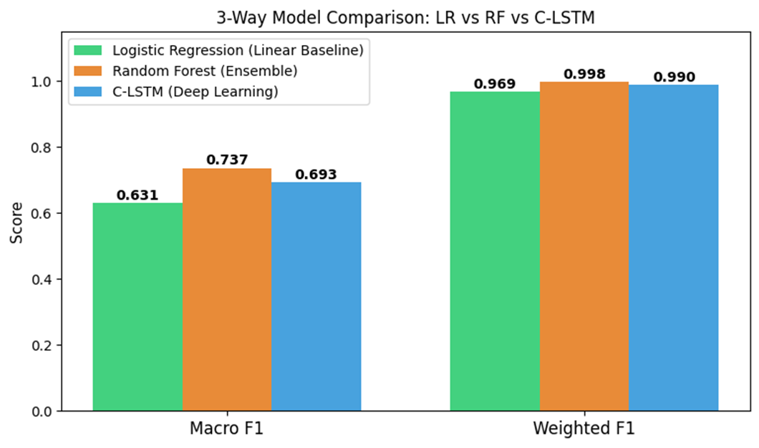
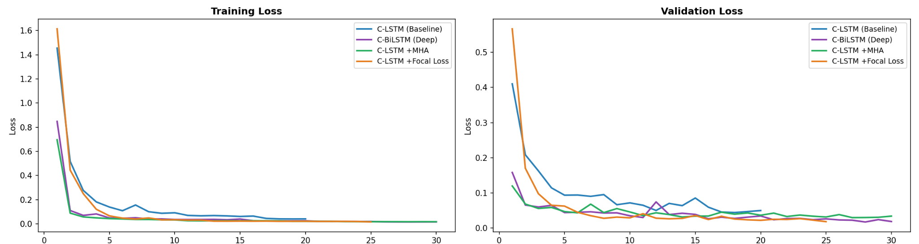
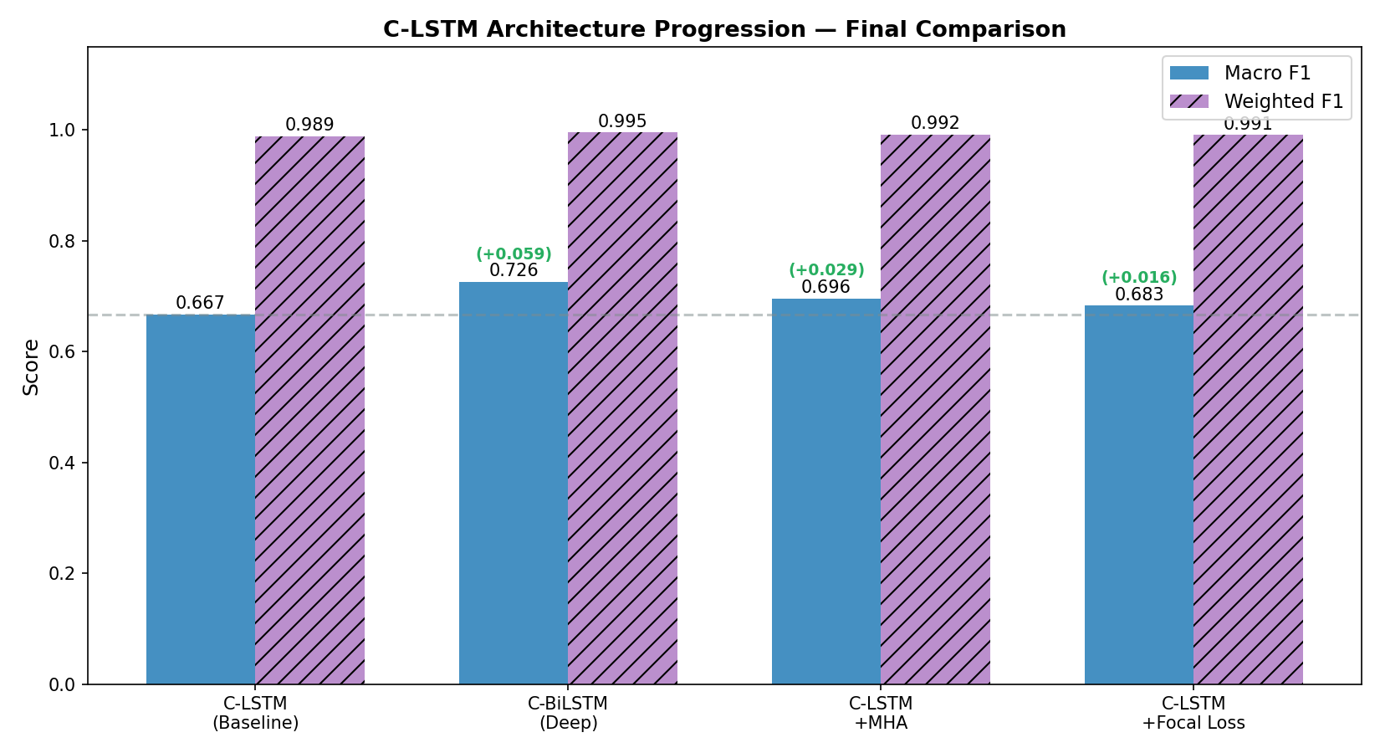
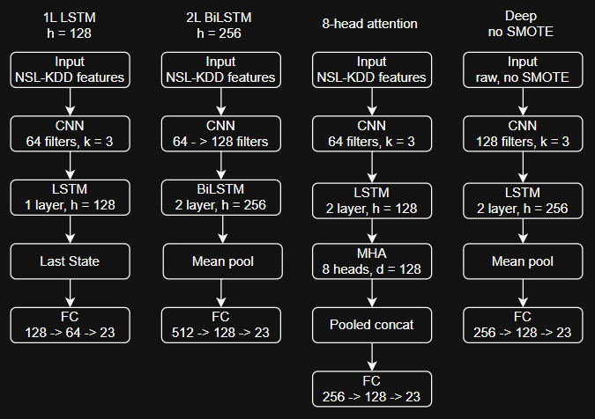
AI Student Symposium 2026
CSC 491/ CSC 525/ ECE 525
NNDL - 20
Deep Learing based Multi-class Network Intrusion Detection
Asavari Hangal, Nidhi Grover, Arnav Yennam
Problem Statement
Evaluation Plan and Results
Designing and developing a machine learning-based Network Intrusion Detection System capable of:
●Classifying 20+ distinct network anomalies in real-world traffic
●Effectively handling highly imbalanced datasets
●Capturing the sequential patterns inherent in network traffic
Split: 90/10 train/val · KDDTest+ as held-out test · SMOTE on train only (no leakage)
No Accuracy: 13,469 normal vs. 1 spy sample — majority-class bias makes it meaningless
Macro F1 (Primary): Equal weight across all 23 classes — penalises ignoring rare attacks
Weighted F1 (Secondary): Context only — dominated by normal, masks minority failure
Per-Class: Precision → minimise false alarms · Recall → catch rare stealthy attacks
Visuals: Confusion matrices (row-normalised) · Loss curves · 3-model comparison chart
Data
Dataset Used
● NSL-KDD dataset from Kaggle, benchmark for network intrusion detection research
Input Features
● 41 tabular features per connection
Connection details (e.g., source/destination IP, port)
Payload content attributes
Temporal traffic patterns
Approach and Network Architecture
4 models with shared CNN → LSTM → FC layer backbone (Chosen based on baseline evaluations over LR and RF).
CNN for local feature extraction, LSTM for capturing sequential dependencies and FC layer to map to 23 attack classes.
Each iteration introduced specific changes from the C-LSTM baseline. Starting from bidirectionality and mean pooling to self attention and finally focal loss to target class imbalance better.
Main References
[1] Kaggle NSL-KDD dataset for Network Security, Information Security and Cyber Security https://www.kaggle.com/datasets/hassan06/nslkdd/data
[2] KDD Cup 1999 Dataset, https://archive.ics.uci.edu/ml/datasets/kdd+cup+1999+data

