Slide 1

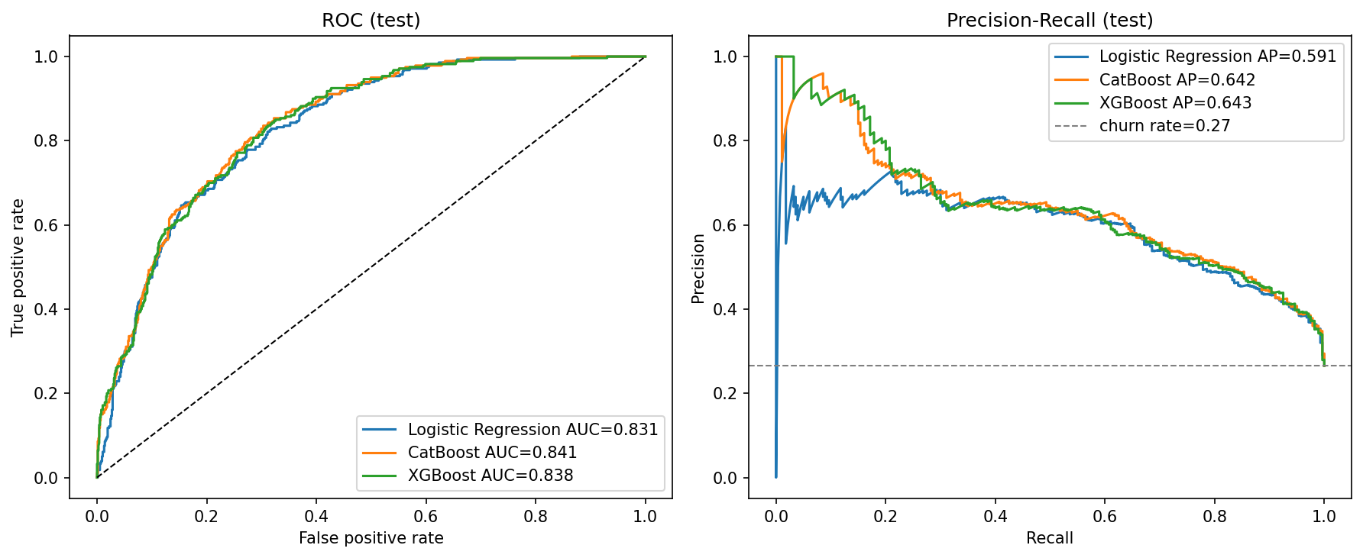
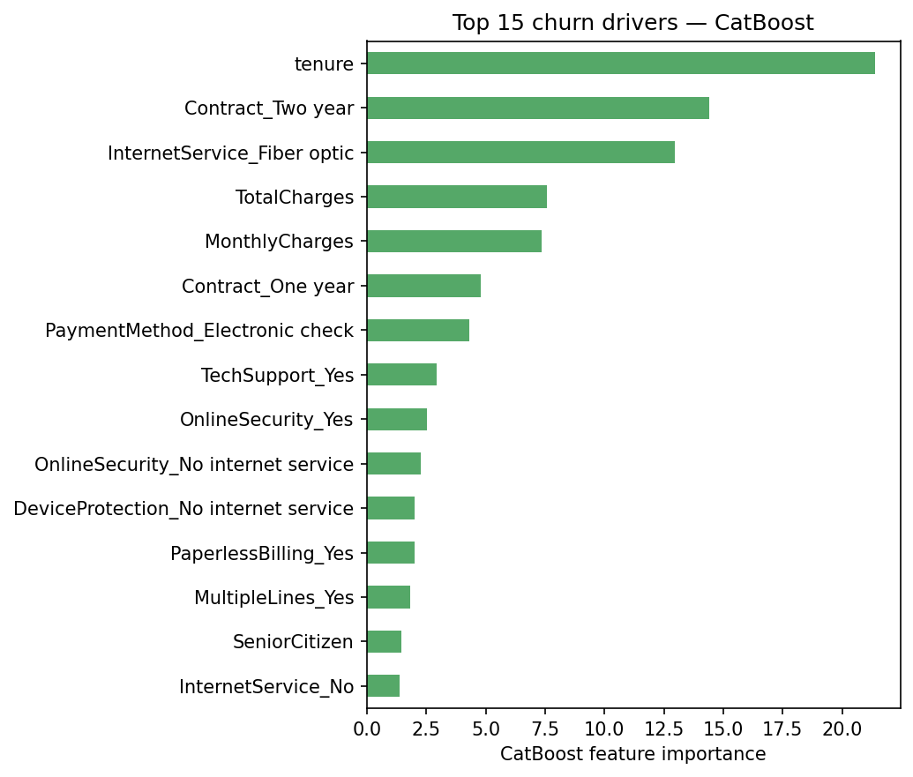
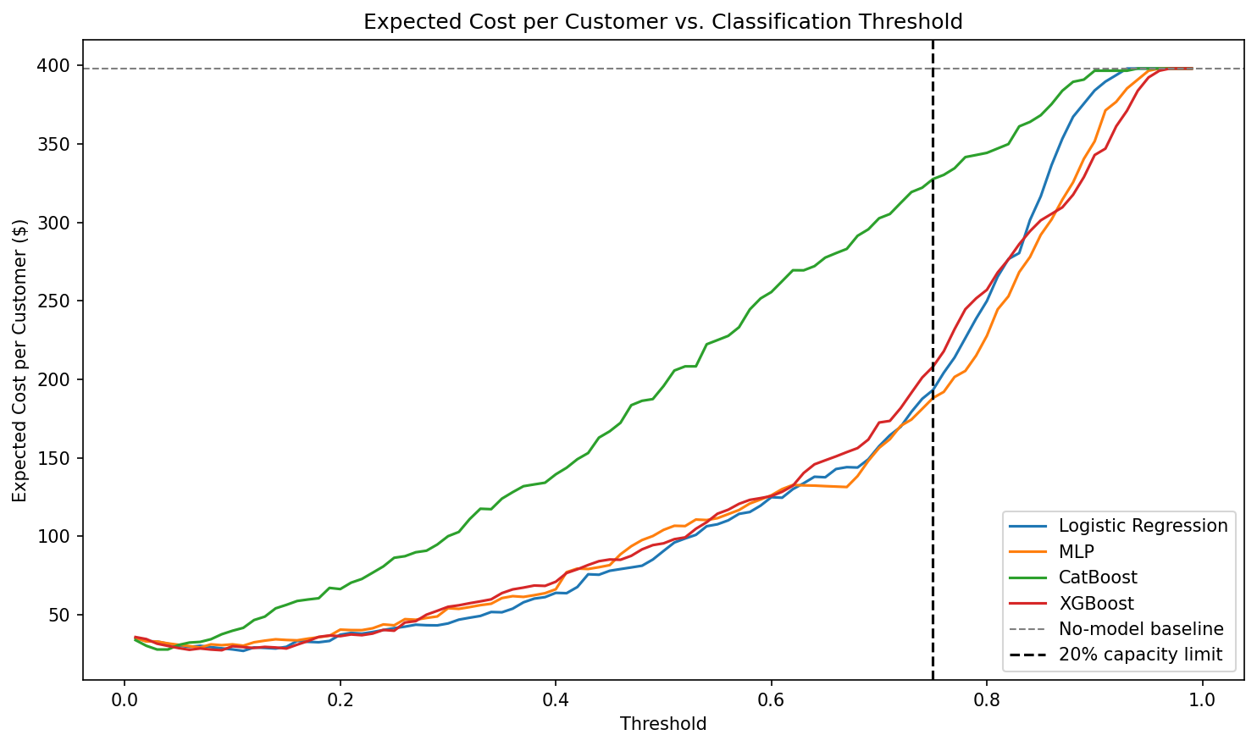

AI Student Symposium 2026
ECE 525
Poster 60
Cost-Aware Customer Churn Prediction for Telecom Industry
Problem Statement
Sree Vathsa Kashyap Mydugolam (smydugo) | Srinidhi Shivashankar (sshivas) | Deekshith Anantha (dananth)
Department of Electrical and Computer Engineering, NC State University
Customer churn is one of the most expensive problems in telecom: acquiring a new customer costs 5-7x more than retaining one.
Two challenges make it hard:
- Imbalanced labels - only 26% of customers churn, so accuracy is misleading.
- Asymmetric cost - missing a churner ($1500 lost lifetime value) is ~30x worse than a false alarm ($50 retention call).
Goal: predict churn probabilities AND tie them to dollar value via cost-aware threshold tuning.
Threshold tuning beats architecture: ~$370K net value per 1,000 customers
Why cost-aware evaluation?
Default 0.5 threshold ignores both class imbalance and the asymmetric cost of being wrong.
We compute Net Value = TP*$1500 - FP*$50 across all thresholds and pick the optimum on validation only.
Result: every model recovers ~$370K of business value when tuned; the choice of architecture changes this by <1%.
Data
IBM Telco Customer Churn dataset (Kaggle): 7,032 customers x 19 features.
Demographics, contract, services, monthly/total charges. Target: Churn (Yes/No).
Class balance: 5,163 stayed (73.4%) / 1,869 churned (26.6%).
Top drivers: Month-to-month contracts churn at 43% (vs 3% for 2-year); fiber-optic 42% (vs DSL 19%); short tenure dominates churners.
Counterfactual: action from probability
For the highest-risk customer (predicted churn = 0.93), perturbing InternetService from
Fiber Optic -> No internet drops the predicted churn probability to 0.82 - a directly actionable retention lever.
Approach
Stratified 70/15/15 train/val/test split; StandardScaler fit on train only (no leakage).
Compare 4 models: Logistic Regression, custom MLP, CatBoost, XGBoost.
Validation-tuned decision threshold (max F1) applied once to test.
Cost-aware analysis: sweep thresholds under $1500 (FN) / $50 (FP) cost.
Evaluation Plan and Results
Network Architecture
Model | F1 | ROC-AUC | PR-AUC | Brier | Recall | Precision
CatBoost | 0.624 | 0.841 | 0.642 | 0.139 | 0.768 | 0.526
Logistic Regression | 0.610 | 0.831 | 0.591 | 0.176 | 0.746 | 0.516
XGBoost | 0.608 | 0.838 | 0.643 | 0.169 | 0.725 | 0.523
MLP (custom NN) | 0.603 | 0.826 | 0.592 | 0.177 | 0.789 | 0.488
Custom MLP (per course requirement):
Input (45 one-hot features) -> Linear 128 -> ReLU -> Dropout(0.2)
-> Linear 64 -> ReLU -> Dropout(0.2) -> Linear 1
Loss: BCEWithLogitsLoss with pos_weight = neg/pos to balance churn class.
Optimizer: Adam (lr 1e-3, weight decay 1e-4); early stopping (patience 30) on val loss.
Boosted models tuned via grid search on validation PR-AUC.
Test-set metrics with validation-tuned threshold (max F1). CatBoost wins on F1 + calibration; XGBoost ties on PR-AUC.
Findings:
1. CatBoost is the strongest classifier (F1 0.624, ROC-AUC 0.841, best calibration).
2. Custom MLP does not beat logistic regression - nonlinearity adds little on small one-hot tabular data.
3. Cost-aware threshold tuning recovers ~$370K / 1000 customers across all 4 models.
4. CatBoost importance + counterfactual identify directly actionable churn drivers.
Next steps: stacking ensemble; cost-sensitive loss in MLP training; live A/B test of threshold; monthly recalibration.
Net business value vs decision threshold - all 4 models converge to ~$370K / 1000 customers
Main References
[1] Verbeke, W. et al. (2012). New insights into churn prediction in the telecommunications sector. Eur. J. Op. Res., 218(1), 211-229.
[2] Prokhorenkova, L. et al. (2018). CatBoost: unbiased boosting with categorical features. NeurIPS.
[3] Chen, T. & Guestrin, C. (2016). XGBoost: a scalable tree boosting system. KDD.
Dataset: IBM Telco Customer Churn (Kaggle blastchar/telco-customer-churn). Acknowledgements: Dr. Edgar Lobaton (instructor).

