Slide 1

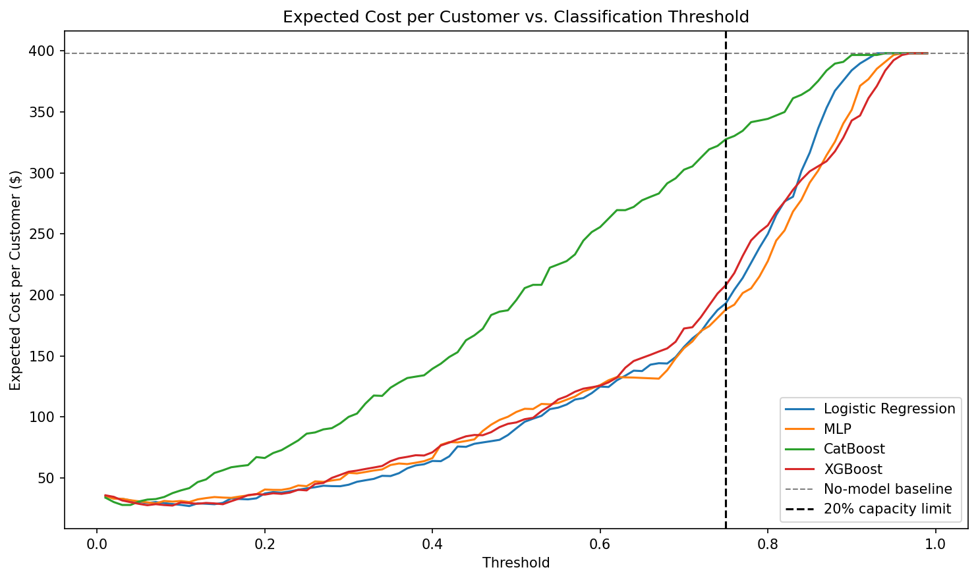
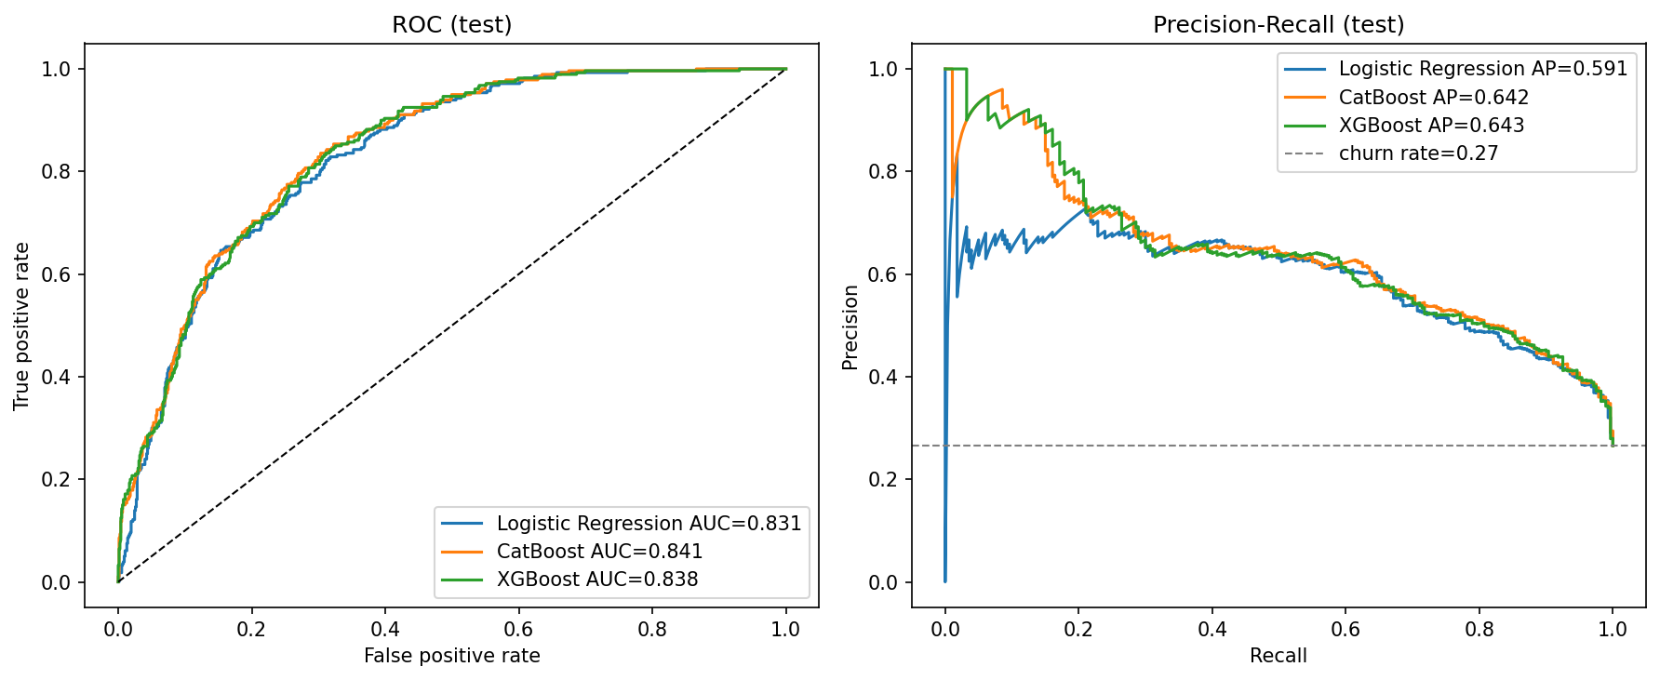
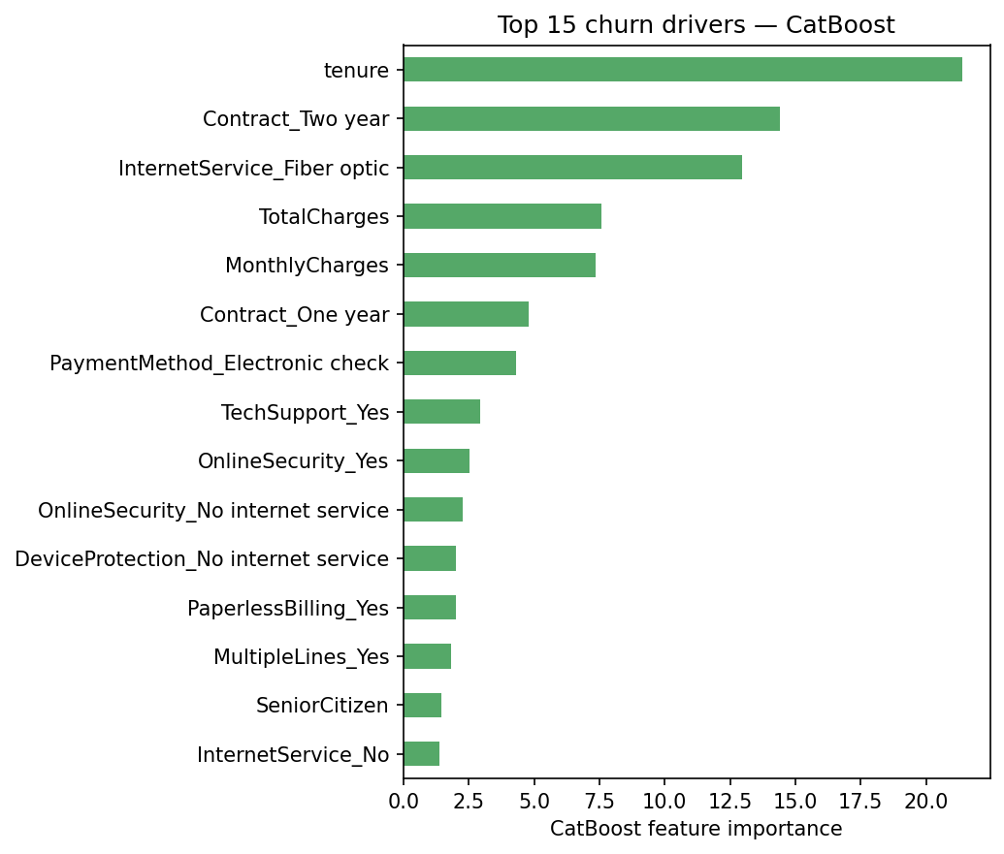
AI Student Symposium 2026
ECE 525
Poster 60
Cost-Aware Customer Churn Prediction for Telecom Industry
Problem Statement
Sree Vathsa Kashyap Mydugolam (smydugo) | Srinidhi Shivashankar (sshivas) | Deekshith Anantha (dananth)
Department of Electrical and Computer Engineering, NC State University
Customer churn is one of the most expensive problems in telecom: acquiring a new customer costs 5-7 times more than retaining one.
Two challenges make it hard:
- Imbalanced labels - only 26% of customers actually churn, so accuracy is misleading.
- Asymmetric cost - missing a churner ($1500 lost LTV) is ~30x worse than a false alarm ($50 retention call).
Goal: predict churn probability AND tie it to dollar value via cost-aware threshold tuning - not just maximize a metric.
Threshold tuning beats architecture: ~$370K net value per 1,000 customers
Why cost-aware evaluation?
Default 0.5 threshold ignores both class imbalance and the asymmetric cost of being wrong.
We compute Net Value = TP * $1500 - FP * $50 across all thresholds and pick the optimum on validation only.
Result: every model recovers ~$370K of business value when tuned; choice of architecture changes this by < 1%.
Data
IBM Telco Customer Churn (Kaggle): 7,032 customers x 19 features.
Demographics, contract, services, monthly + total charges. Target: Churn (Yes / No).
Class balance: 5,163 stayed (73.4%) vs 1,869 churned (26.6%) - 1:2.76 minority ratio.
Strongest signals: Month-to-month contract -> 43% churn (vs 3% for 2-year); Fiber-optic -> 42% (vs 19% DSL); Electronic-check payment -> 45%; short tenure dominates churners.
Counterfactual: from probability to action
Highest-risk customer (predicted churn = 0.93). Perturbing InternetService from
Fiber-optic -> No internet drops the predicted churn probability to 0.82.
-> The model points retention teams to a specific lever per customer, not just a binary alert.
Approach
Stratified 70 / 15 / 15 train-validation-test split. StandardScaler fit on training fold ONLY (no leakage).
Compare four models: Logistic Regression, custom MLP, CatBoost, XGBoost (matched preprocessing for fair comparison).
Tune decision threshold on validation (max F1) - apply once to test.
Cost-aware analysis: sweep threshold under FN=$1500 / FP=$50 cost, with and without 20% capacity constraint.
Evaluation Plan and Results
Network Architecture
Model | F1 | ROC-AUC | PR-AUC | Brier | Recall | Precision
CatBoost | 0.624 | 0.841 | 0.642 | 0.139 | 0.768 | 0.526
Logistic Regression | 0.610 | 0.831 | 0.591 | 0.176 | 0.746 | 0.516
XGBoost | 0.608 | 0.838 | 0.643 | 0.169 | 0.725 | 0.523
MLP (custom NN) | 0.603 | 0.826 | 0.592 | 0.177 | 0.789 | 0.488
Custom MLP - course requirement (no pretrained / foundation models):
Input (45 one-hot features) -> Linear(128) -> ReLU -> Dropout(0.2)
-> Linear( 64) -> ReLU -> Dropout(0.2) -> Linear(1)
Loss: BCEWithLogitsLoss with pos_weight = neg / pos to balance churn class.
Optimizer: Adam (lr 1e-3, weight_decay 1e-4); early stopping (patience 30) on validation BCE.
Boosted trees: grid search over depth / lr / l2 / iterations; selection criterion = validation PR-AUC.
Test metrics with validation-tuned threshold. CatBoost wins on F1 + Brier; XGBoost ties PR-AUC.
Model | Optimal threshold | Net value / 1,000 customers
Logistic Regression | 0.11 | $371,043
XGBoost | 0.09 | $370,616
CatBoost | 0.03 | $370,142
MLP (custom NN) | 0.07 | $368,910
Cost-aware optima ($1500 FN / $50 FP). Architecture gap < 1% - threshold dominates.
Findings:
1. CatBoost is the strongest classifier (F1 0.624, ROC-AUC 0.841, lowest Brier 0.139).
2. Custom MLP does NOT beat logistic regression - nonlinear capacity adds little on small one-hot tabular data.
3. Cost-aware threshold tuning recovers ~$370K / 1,000 customers across all 4 models; architecture gap < 1%.
4. CatBoost importance + counterfactual map model output to specific retention actions (contract upgrade, internet downgrade).
Next steps: stacking ensemble; cost-sensitive loss inside MLP training; live A/B test of threshold; monthly recalibration.
Net business value vs threshold - all four models converge to ~$370K / 1,000 customers
Main References
[1] Verbeke, W. et al. (2012). New insights into churn prediction in telecommunications. Eur. J. Operational Research, 218(1), 211-229.
[2] Prokhorenkova, L. et al. (2018). CatBoost: unbiased boosting with categorical features. NeurIPS.
[3] Chen, T. & Guestrin, C. (2016). XGBoost: a scalable tree-boosting system. KDD.
Dataset: IBM Telco Customer Churn (Kaggle: blastchar/telco-customer-churn). Acknowledgements: Dr. Edgar Lobaton (instructor, ECE 525).

