Slide 1

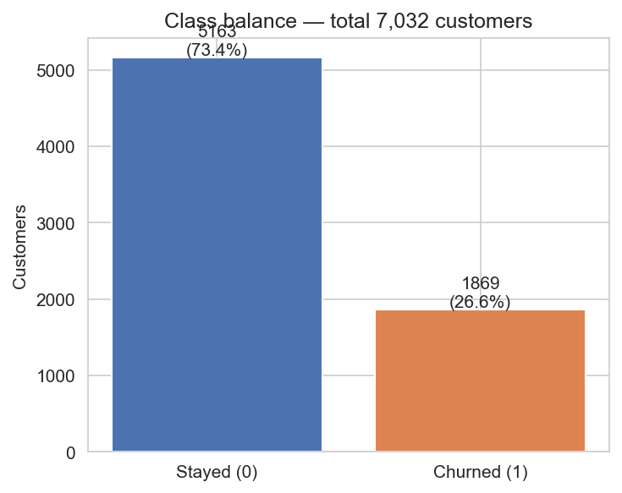
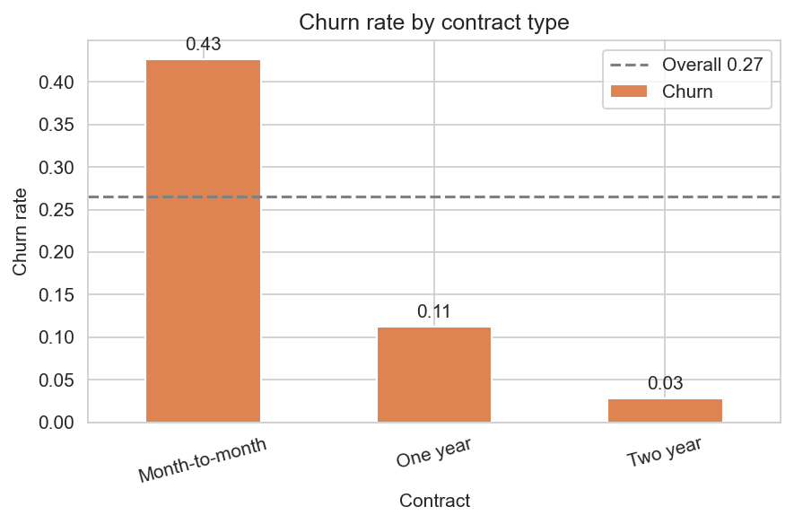
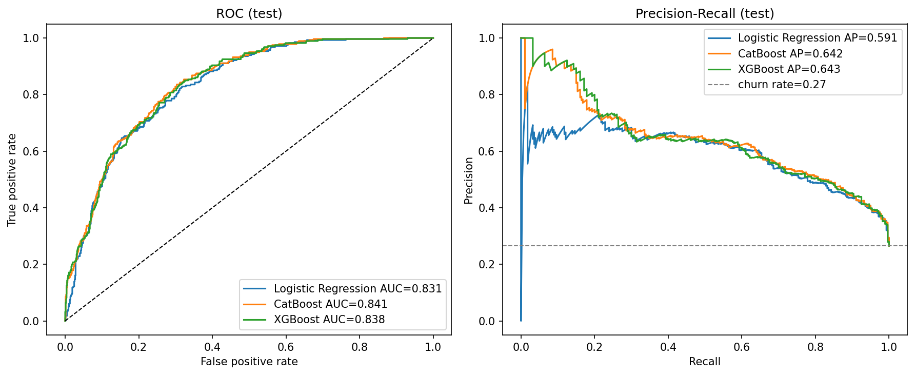
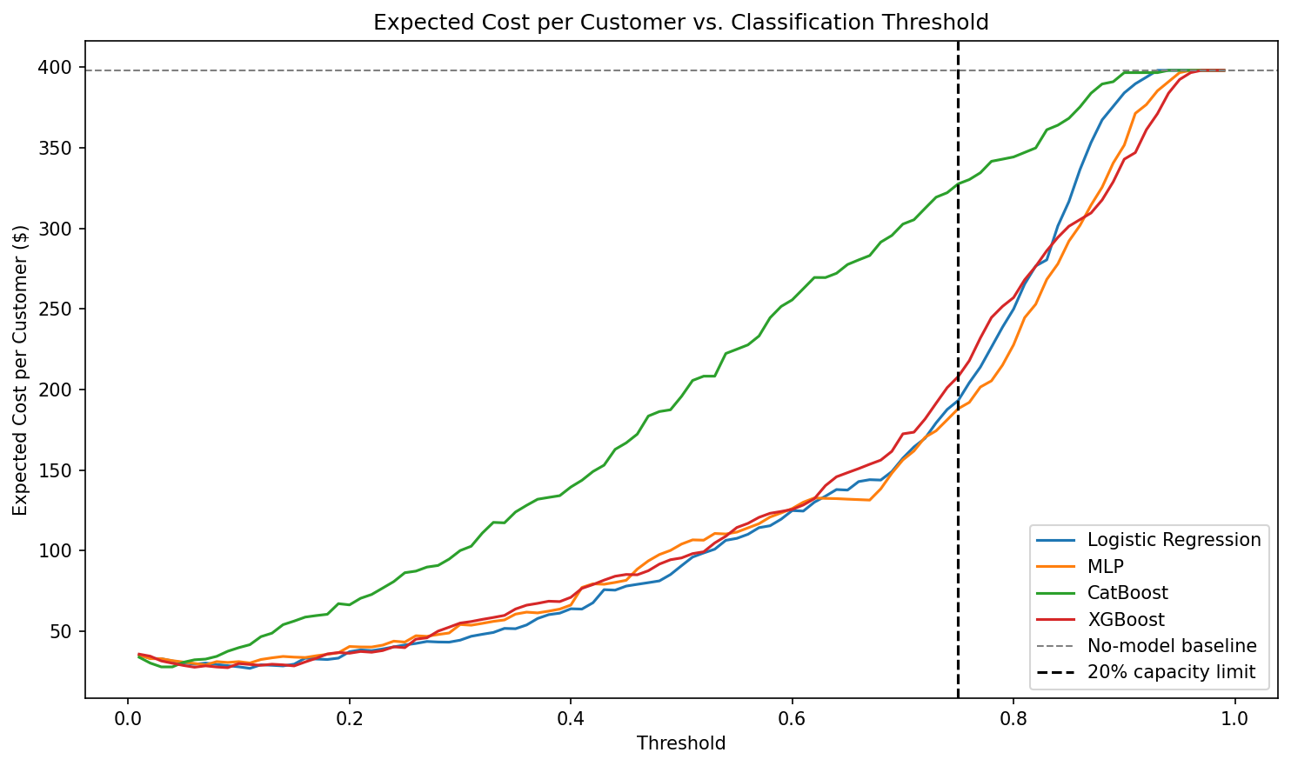
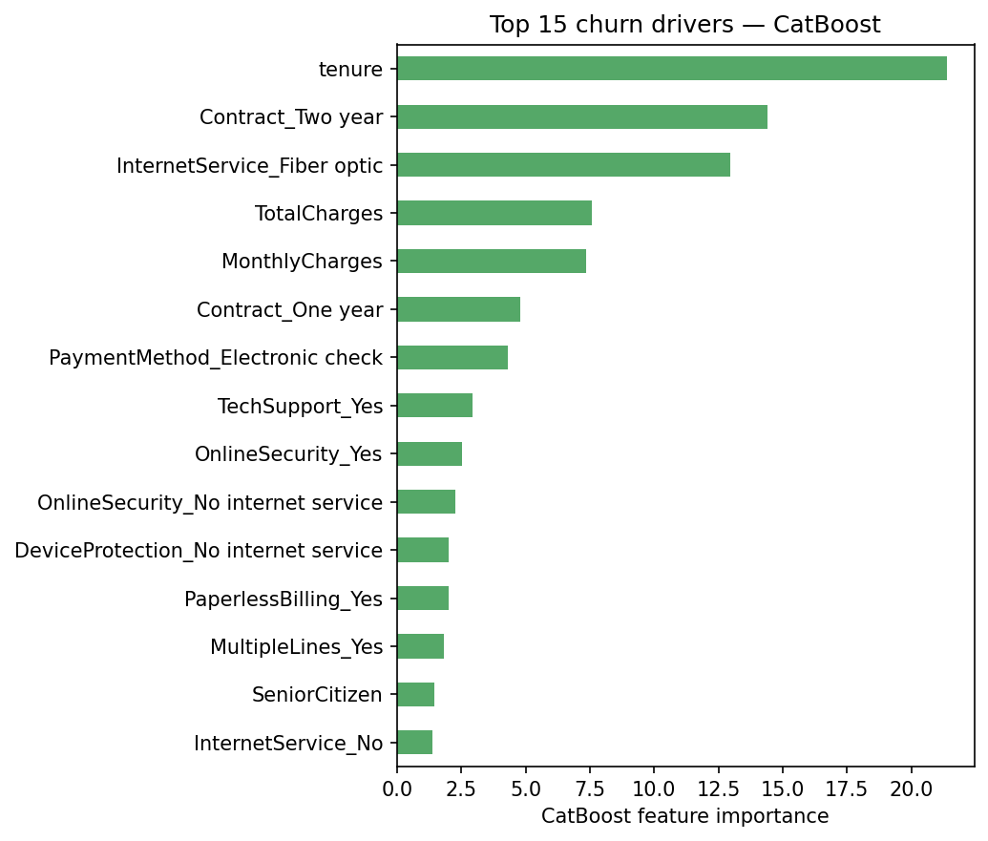
AI Student Symposium 2026
Course ID : ECE525
Poster 60
Cost-Aware Customer Churn Prediction for Telecom Industry
Sree Vathsa Kashyap Mydugolam (smydugo) | Srinidhi Shivashankar (sshivas) | Deekshith Anantha (dananth)
Department of Electrical and Computer Engineering, NC State University
A. Motivation & Problem
B. Data & EDA
C. Methodology
Customer churn -- when a paying subscriber leaves a service -- is the most expensive problem in telecom.
Acquiring a new customer costs 5x-7x more than retaining one, so identifying customers about to leave is directly tied to revenue.
IBM Telco Customer Churn (Kaggle)
7,032 customers x 19 features after cleaning.
Demographics, contract, services, charges. Target: Churn (Yes/No).
Raw CSV
Clean (drop customerID, fix TotalCharges) One-hot encode
Class balance
5,163 stayed (73.4%)
1,869 churned (26.6%)
Minority ratio 1 : 2.76
Stratified split 70 / 15 / 15 Fit StandardScaler on TRAIN only
The challenge
Logistic Reg.
MLP (custom NN)
CatBoost
XGBoost
Imbalanced. only 26% of customers churn; accuracy is misleading.
Top churn drivers
Tune threshold on VALIDATION (max F1)
Asymmetric cost. missing a churner ($1,500 LTV) is ~30x worse than a false alarm ($50).
Report TEST metrics + cost-aware $ analysis
Threshold blindness. default 0.5 cutoffs ignore both, so a 'good' model is a poor business tool.
Models
- Logistic Regression: class_weight='balanced', interpretable baseline.
- Custom MLP: 128 -> 64 -> 1, ReLU + Dropout 0.2;
BCEWithLogitsLoss with pos_weight = neg/pos;
Adam (lr 1e-3, wd 1e-4); early stopping on val loss.
- CatBoost / XGBoost: gradient-boosted trees,
grid search on validation PR-AUC.
Evaluation: F1, ROC-AUC, PR-AUC, Brier, $ value (FN $1500 / FP $50).
Our contribution
Compare four churn classifiers -- Logistic Regression, custom MLP, CatBoost, XGBoost -- under a cost-aware evaluation that ties model probabilities to dollars.
We show that the right operating threshold matters more than the choice of architecture.
- Contract: month-to-month 43% vs two-year 3%
- Tenure: churners cluster in first 12 months
- Internet: fiber 42% vs DSL 19%
- Payment: electronic check 45% vs auto-pay <20%
D. Results -- Model Comparison
E. Results -- Cost-Aware Analysis
Model | F1 | ROC-AUC | PR-AUC | Brier | Recall | Precision
CatBoost | 0.624 | 0.841 | 0.642 | 0.139 | 0.768 | 0.526
Logistic Regression | 0.610 | 0.831 | 0.591 | 0.176 | 0.746 | 0.516
XGBoost | 0.608 | 0.838 | 0.643 | 0.169 | 0.725 | 0.523
MLP (custom NN) | 0.603 | 0.826 | 0.592 | 0.177 | 0.789 | 0.488
~$370K net value per 1,000 customers
when the decision threshold is set right
Model | Optimal threshold | Net value / 1,000 customers
Logistic Regression | 0.11 | $371,043
XGBoost | 0.09 | $370,616
CatBoost | 0.03 | $370,142
MLP (custom NN) | 0.07 | $368,910
CatBoost wins on F1 + calibration. XGBoost ties on PR-AUC.
MLP does NOT beat logistic regression -- a known result for small one-hot tabular data, and itself a finding.
Under a 20% retention-team capacity constraint, CatBoost delivers $175,687 / 1,000 at threshold 0.54.
Counterfactual
Highest-risk customer:
predicted churn = 0.93
Switch InternetService:
Fiber optic -> No internet
-> predicted churn = 0.82
Model -> action.
F. What Drives Churn
G. Conclusions & Next Steps
ROC and Precision-Recall curves -- ranking quality on test set.
Feature | Importance
tenure | 21.4
Contract = Two year | 14.4
InternetService = Fiber optic | 13.0
TotalCharges | 7.6
MonthlyCharges | 7.4
Contract = One year | 4.8
PaymentMethod = Electronic check | 4.3
Findings
1. CatBoost is the strongest classifier (F1 0.624, ROC-AUC 0.841, lowest Brier 0.139).
2. Custom MLP did NOT beat logistic regression -- nonlinearity adds little on small one-hot tabular data.
3. Cost-aware threshold tuning is the dominant lever -- all 4 models recover ~$370K per 1,000 customers; choice of architecture changes this by < 1%.
4. Counterfactual analysis turns probabilities into specific retention actions (e.g., contract upgrade, internet downgrade).
These match the EDA findings and align with industry intuition: short tenure, no long-term contract, fiber, and electronic-check payments are the strongest churn signals.
Next steps
Stacking ensemble - Cost-sensitive loss directly in MLP training
Monthly recalibration - Live A/B test of the threshold in a retention pipeline
References & Acknowledgements
[1] Verbeke, W. et al. (2012). New insights into churn prediction in the telecommunication sector. Eur. J. Op. Res., 218(1), 211-229.
[2] Prokhorenkova, L. et al. (2018). CatBoost: unbiased boosting with categorical features. NeurIPS.
[3] Chen, T. & Guestrin, C. (2016). XGBoost: a scalable tree-boosting system. KDD.
Dataset: IBM Telco Customer Churn (Kaggle: blastchar/telco-customer-churn). Acknowledgements: Dr. Edgar Lobaton (instructor, ECE 525, NC State University).

