Slide 1

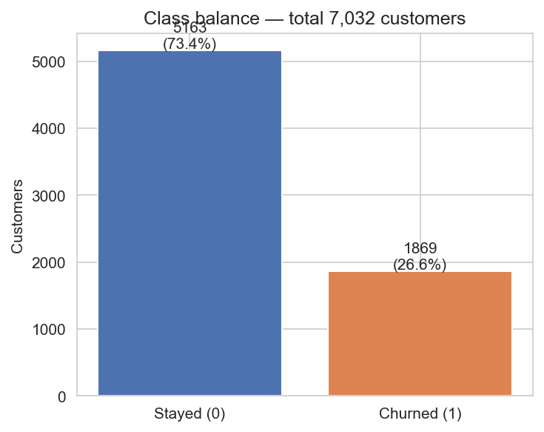
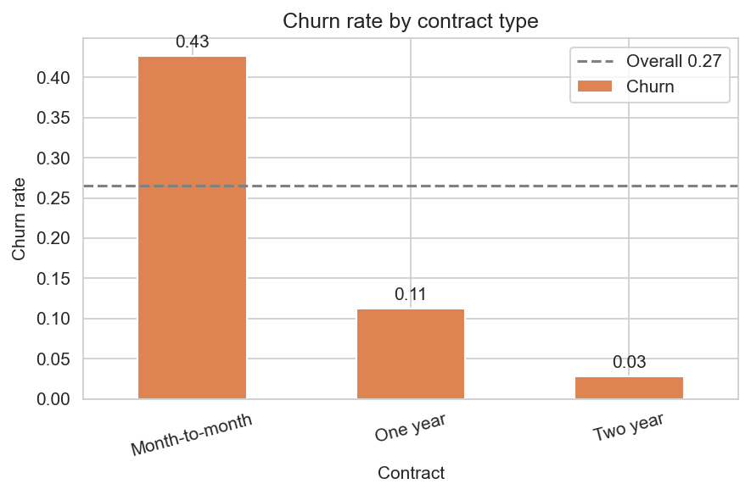
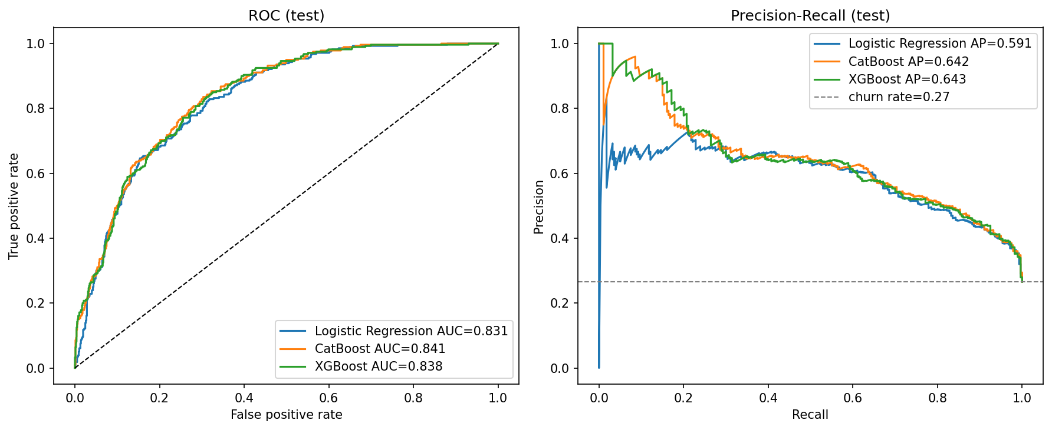
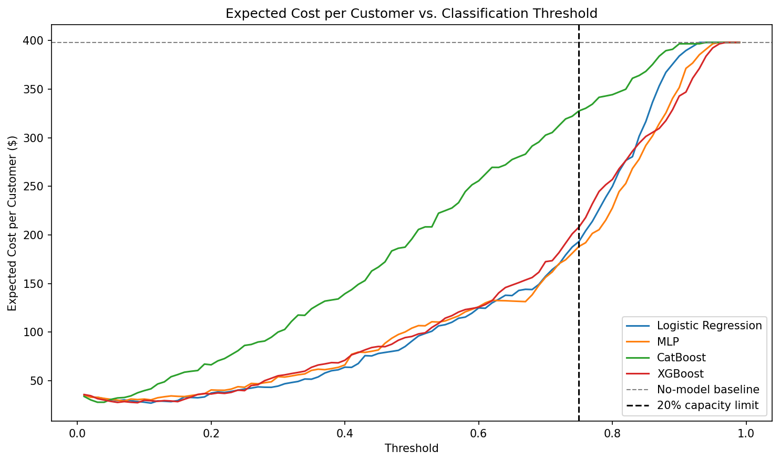
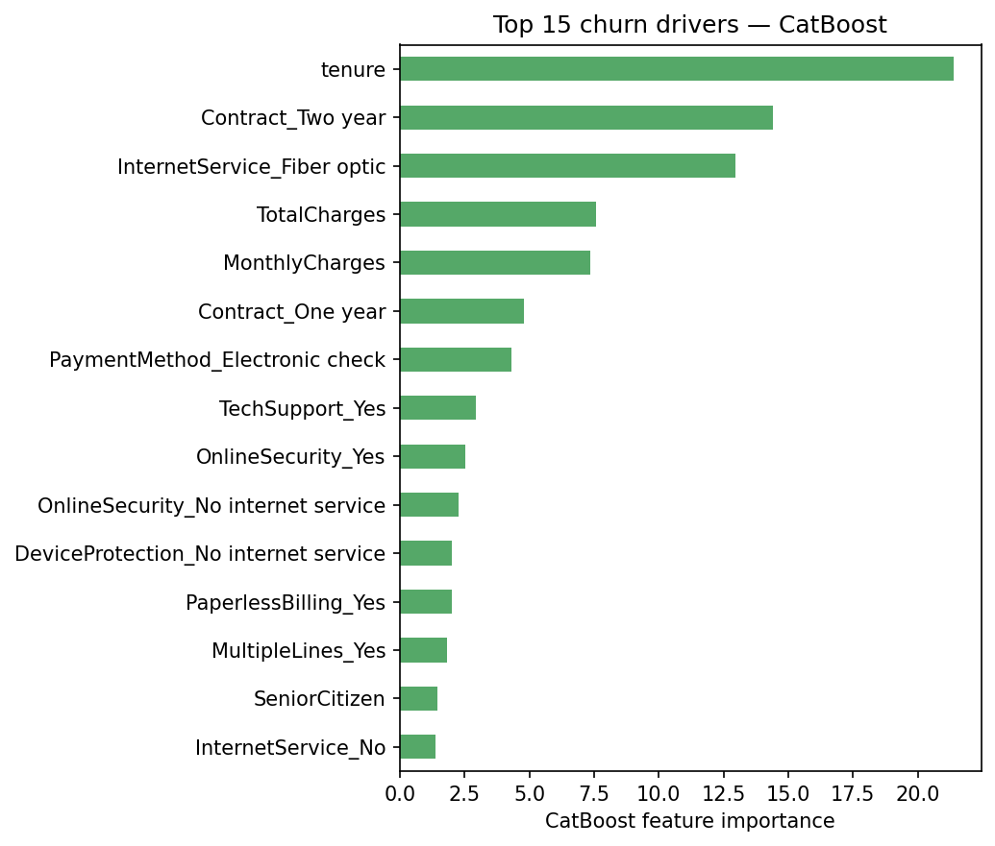
AI Student Symposium 2026
Course ID : ECE525
NNDL.39
Cost-Aware Customer Churn Prediction for Telecom Industry
Sree Vathsa Kashyap Mydugolam (smydugo) | Srinidhi Shivashankar (sshivas) | Deekshith Anantha (dananth)
Department of Electrical and Computer Engineering, NC State University
A. Motivation & Problem
B. Data & EDA
C. Methodology
Customer churn -- a paying subscriber leaving a service -- is one of the most costly problems in telecom.
Acquiring a new customer costs 5x-7x more than retaining one, so the ability to identify customers about to leave is directly tied to revenue.
IBM Telco Customer Churn (Kaggle)
7,032 customers x 19 features after cleaning.
Demographics, contract, services, monthly + total charges.
Target: Churn (Yes / No).
We compare four models under one disciplined pipeline so differences come from architecture, not preprocessing.
All models share the same stratified split, the same train-only scaling, and the same validation-tuned threshold.
Why standard ML misses the mark
Class balance
5,163 stayed (73%)
1,869 churned (27%)
Minority ratio 1 : 2.76
Raw CSV (7,032 customers x 21 cols)
Imbalanced labels
Only 26.6% of customers churn. A 'predict no churn' model gets 73% accuracy and zero business value -- accuracy is the wrong metric.
Clean: drop customerID, fix TotalCharges One-hot encode
Asymmetric cost
Missing a churner costs ~$1,500 in lost lifetime value; a false alarm costs ~$50 in retention outreach. False negatives are 30x more expensive than false positives.
Stratified split 70 / 15 / 15 Fit StandardScaler on TRAIN only (no leakage)
Top churn drivers
Logistic Regression
Custom MLP
CatBoost
XGBoost
Threshold blindness
Default 0.5 cutoffs ignore both imbalance and cost, so a 'good' model can still be a poor business tool. The decision threshold needs to be tuned -- not assumed.
Tune threshold on VALIDATION (max F1)
Our contribution
Test metrics + Cost-aware $ analysis
We build and compare four churn classifiers -- Logistic Regression, a custom MLP, CatBoost, and XGBoost -- under a cost-aware evaluation that ties model probabilities to dollars.
Across all four architectures, choosing the right operating threshold matters more than the choice of model -- and unlocks roughly $370K of net business value per 1,000 customers.
The four models
Logistic Regression -- linear, interpretable baseline (class_weight = balanced).
Custom MLP (course requirement) -- 128 -> 64 -> 1, ReLU + Dropout 0.2; weighted BCE; Adam + early stopping.
CatBoost / XGBoost -- gradient-boosted trees, grid search on validation PR-AUC.
Evaluation: F1, ROC-AUC, PR-AUC, Brier score, and $ value (FN $1,500 / FP $50).
Contract: month-to-month 43% vs two-year 3%
Tenure: churners cluster in the first 12 months
Internet: fiber 42% vs DSL 19%
Payment: electronic check 45% vs auto-pay <20%
D. Results -- Model Comparison
E. Results -- Cost-Aware Analysis
All four models were trained on identical features and splits, then scored on the held-out test set with a validation-tuned threshold (max F1).
The story is more interesting than 'pick the best F1' -- the gap between models is small, and the custom MLP does not beat logistic regression on this small one-hot dataset.
We translate model probabilities into business value by sweeping the decision threshold under realistic costs: $1,500 for a missed churner (FN), $50 for a false alarm (FP).
Net Value = TP * $1,500 - FP * $50. The optimum is chosen on validation only, then evaluated on test.
Model | F1 | ROC-AUC | PR-AUC | Brier | Recall | Precision
CatBoost | 0.624 | 0.841 | 0.642 | 0.139 | 0.768 | 0.526
Logistic Regression | 0.610 | 0.831 | 0.591 | 0.176 | 0.746 | 0.516
XGBoost | 0.608 | 0.838 | 0.643 | 0.169 | 0.725 | 0.523
MLP (custom NN) | 0.603 | 0.826 | 0.592 | 0.177 | 0.789 | 0.488
~ $370K
net business value per 1,000 customers when the threshold is tuned
Model | Optimal threshold | Net value / 1,000 customers
Logistic Regression | 0.11 | $371,043
XGBoost | 0.09 | $370,616
CatBoost | 0.03 | $370,142
MLP (custom NN) | 0.07 | $368,910
CatBoost wins on F1 and calibration; XGBoost ties on PR-AUC. MLP does not beat logistic regression -- a known result for small one-hot tabular data, and itself a finding.
Realistic constraint: if retention can contact only the top 20% riskiest customers,
CatBoost still delivers $175,687 / 1,000 at threshold 0.54 -- the best constrained option.
Counterfactual
From probability to action
Highest-risk customer:
predicted churn = 0.93
Switch InternetService:
Fiber optic -> No internet
predicted churn = 0.82
(-11 pp -- a specific lever)
ROC and Precision-Recall curves on test set -- ranking quality independent of any single threshold.
F. What Drives Churn
G. Conclusions & Next Steps
Top driver | Importance
tenure | 21.4
Contract = Two year | 14.4
InternetService = Fiber optic | 13.0
TotalCharges | 7.6
MonthlyCharges | 7.4
Contract = One year | 4.8
PaymentMethod = Electronic check | 4.3
Findings
1. CatBoost is the strongest classifier (F1 0.624, ROC-AUC 0.841, lowest Brier 0.139).
2. Custom MLP does not beat logistic regression -- nonlinearity adds little on small one-hot tabular data.
3. Cost-aware threshold tuning is the dominant lever -- all four models recover ~$370K per 1,000 customers; architecture changes the result by < 1%.
4. Counterfactuals turn probabilities into specific retention actions (e.g., contract upgrade, internet downgrade).
These match the EDA findings and align with industry intuition: short tenure, no long-term contract, fiber, and electronic-check are the strongest churn signals.
Next steps
Stacking ensemble - cost-sensitive loss inside MLP training
Monthly recalibration - live A / B test of the threshold in the retention pipeline
References & Acknowledgements
[1] Verbeke, W. et al. (2012). New insights into churn prediction in telecommunications. Eur. J. Op. Res., 218(1), 211-229.
[2] Prokhorenkova, L. et al. (2018). CatBoost: unbiased boosting with categorical features. NeurIPS.
[3] Chen, T. & Guestrin, C. (2016). XGBoost: a scalable tree-boosting system. KDD.
Dataset: IBM Telco Customer Churn (Kaggle: blastchar/telco-customer-churn). Acknowledgements: Dr. Edgar Lobaton (instructor, ECE 525, NC State University).

