Slide 1

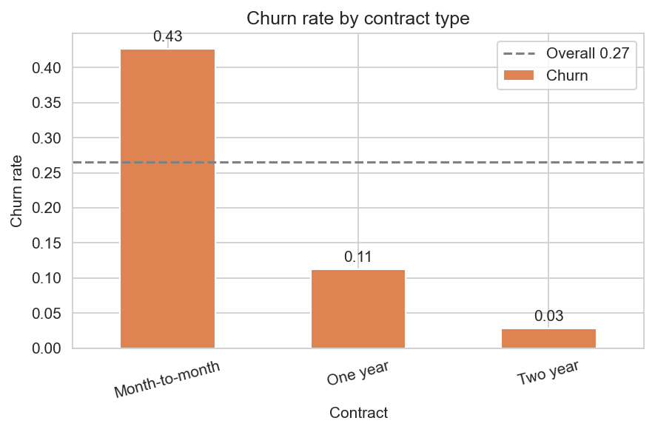
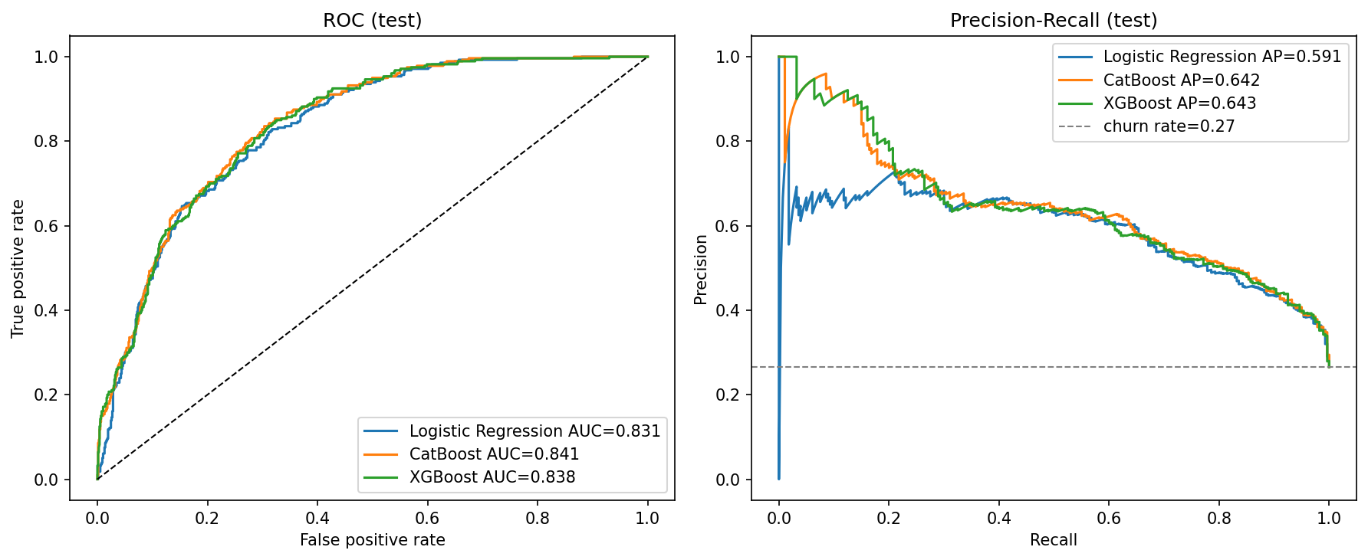
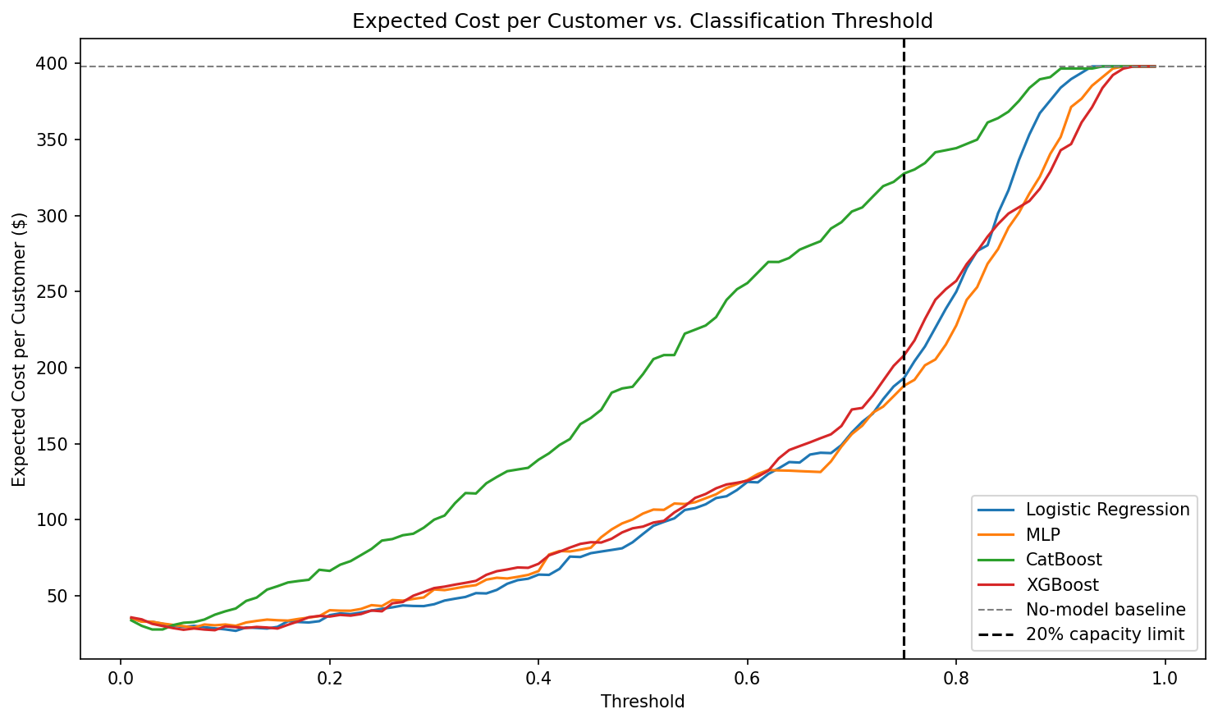
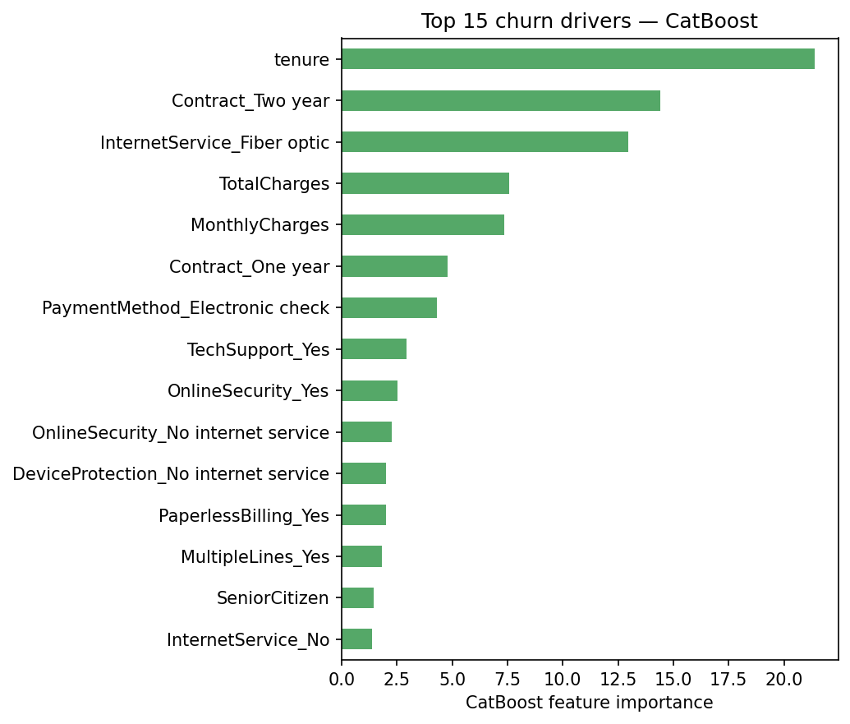
AI Student Symposium 2026
Course ID : ECE525
NNDL.39
Cost-Aware Customer Churn Prediction for Telecom Industry
Sree Vathsa Kashyap Mydugolam (smydugo) | Srinidhi Shivashankar (sshivas) | Deekshith Anantha (dananth)
Department of Electrical and Computer Engineering, NC State University
A. Motivation
B. Data & EDA
C. Methodology
Customer churn -- a paying subscriber leaving a service -- is one of the most costly problems in telecom.
Acquiring a new customer costs 5x-7x more than retaining one.
Dataset: IBM Telco Customer Churn (Kaggle)
One disciplined pipeline -- differences come from architecture, not preprocessing.
7,032 customers x 19 features after cleaning.
Demographics, contract, services, monthly + total charges. Target: Churn (Yes / No).
Class balance: 5,163 stayed (73%) vs 1,869 churned (27%). Minority ratio 1 : 2.76.
Raw CSV (7,032 customers)
Why standard ML misses the mark
Clean + one-hot encode (drop ID, fix TotalCharges)
Imbalanced labels
Only 26.6% of customers churn -- accuracy is the wrong metric.
Top churn drivers (EDA)
Stratified split 70 / 15 / 15 Fit StandardScaler on TRAIN only
Asymmetric cost
Missing a churner costs ~$1,500; a false alarm ~$50.
False negatives are 30x worse.
Logistic Reg.
Custom MLP
Cat Boost
XG Boost
Tune threshold on VAL (max F1)
Threshold blindness
Default 0.5 cutoff ignores both -- the threshold must be tuned, not assumed.
Test metrics + Cost analysis
The four models
Our contribution
Contract: month-to-month 43% vs two-year 3%
Tenure: churners cluster in the first 12 months
Internet: fiber 42% vs DSL 19%
Payment: electronic check 45% vs auto-pay <20%
LR -- linear baseline (class_weight=balanced).
MLP -- 128 -> 64 -> 1, ReLU + Dropout 0.2;
weighted BCE; Adam; early stopping.
CatBoost / XGBoost -- gradient-boosted trees,
grid search on validation PR-AUC.
Metrics: F1, ROC-AUC, PR-AUC, Brier, $ value.
Compare four classifiers -- LR, MLP, CatBoost, XGBoost -- under cost-aware evaluation that ties model probabilities to dollars.
D. Results -- Model Comparison
E. Cost-Aware Analysis
All four models trained on identical features and splits, scored on test with a validation-tuned threshold (max F1).
Translate probabilities to dollars: sweep threshold under realistic costs.
FN $1,500 FP $50. Net Value = TP * $1,500 - FP * $50. Optimum chosen on validation.
Model | F1 | ROC-AUC | PR-AUC | Brier | Recall | Precision
CatBoost | 0.624 | 0.841 | 0.642 | 0.139 | 0.768 | 0.526
Logistic Regression | 0.610 | 0.831 | 0.591 | 0.176 | 0.746 | 0.516
XGBoost | 0.608 | 0.838 | 0.643 | 0.169 | 0.725 | 0.523
MLP (custom NN) | 0.603 | 0.826 | 0.592 | 0.177 | 0.789 | 0.488
~ $370K
net business value per 1,000 customers when threshold is tuned
CatBoost wins on F1 + calibration; XGBoost ties on PR-AUC. MLP does NOT beat LR -- a meaningful finding.
Model | Optimal threshold | Net value / 1,000 customers
Logistic Regression | 0.11 | $371,043
XGBoost | 0.09 | $370,616
CatBoost | 0.03 | $370,142
MLP (custom NN) | 0.07 | $368,910
Top-20% capacity constraint: CatBoost still delivers $175,687 / 1,000 at threshold 0.54.
Counterfactual
From probability to action
Highest-risk customer:
predicted churn = 0.93
Switch InternetService:
Fiber optic -> No internet
predicted churn = 0.82
(-11 pp -- a specific lever)
ROC and Precision-Recall curves on test set.
F. What Drives Churn
G. Conclusions & Next Steps
Top driver | Importance
tenure | 21.4
Contract = Two year | 14.4
InternetService = Fiber optic | 13.0
TotalCharges | 7.6
MonthlyCharges | 7.4
Contract = One year | 4.8
PaymentMethod = Electronic check | 4.3
Findings
1. CatBoost is the strongest classifier (F1 0.624, ROC-AUC 0.841, lowest Brier 0.139).
2. Custom MLP does not beat logistic regression -- nonlinearity adds little on small one-hot data.
3. Cost-aware threshold tuning is the dominant lever -- all four models recover ~$370K per 1,000 customers; architecture changes the result by < 1%.
4. Counterfactuals turn probabilities into specific retention actions.
Matches EDA: short tenure, no long contract, fiber, electronic check are the strongest churn signals.
References & Acknowledgements
Next steps
[1] Verbeke, W. et al. (2012). New insights into churn prediction in telecommunications. Eur. J. Op. Res., 218(1), 211-229.
[2] Prokhorenkova, L. et al. (2018). CatBoost: unbiased boosting with categorical features. NeurIPS.
[3] Chen, T. & Guestrin, C. (2016). XGBoost: a scalable tree-boosting system. KDD.
Dataset: IBM Telco Customer Churn (Kaggle: blastchar/telco-customer-churn). Acknowledgements: Dr. Edgar Lobaton (instructor, ECE 525, NC State University).
Stacking ensemble - cost-sensitive loss inside MLP - monthly recalibration - live A/B test of the threshold

