Slide 1

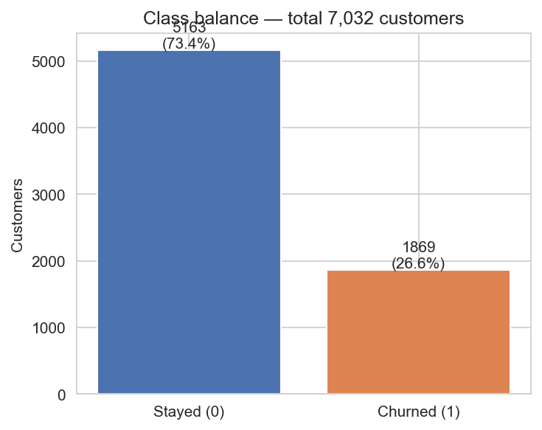
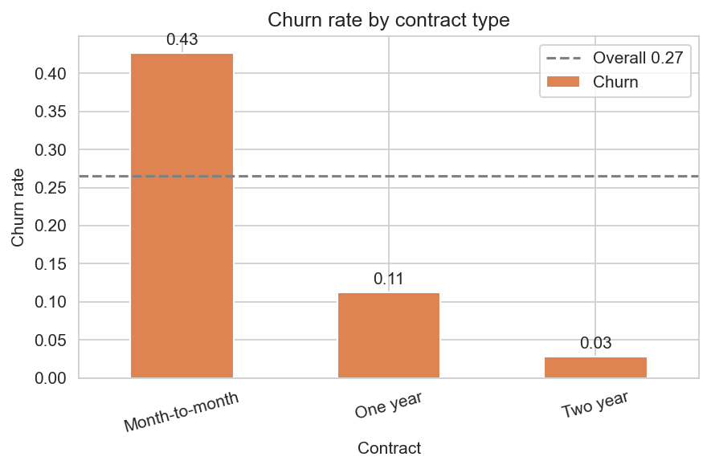
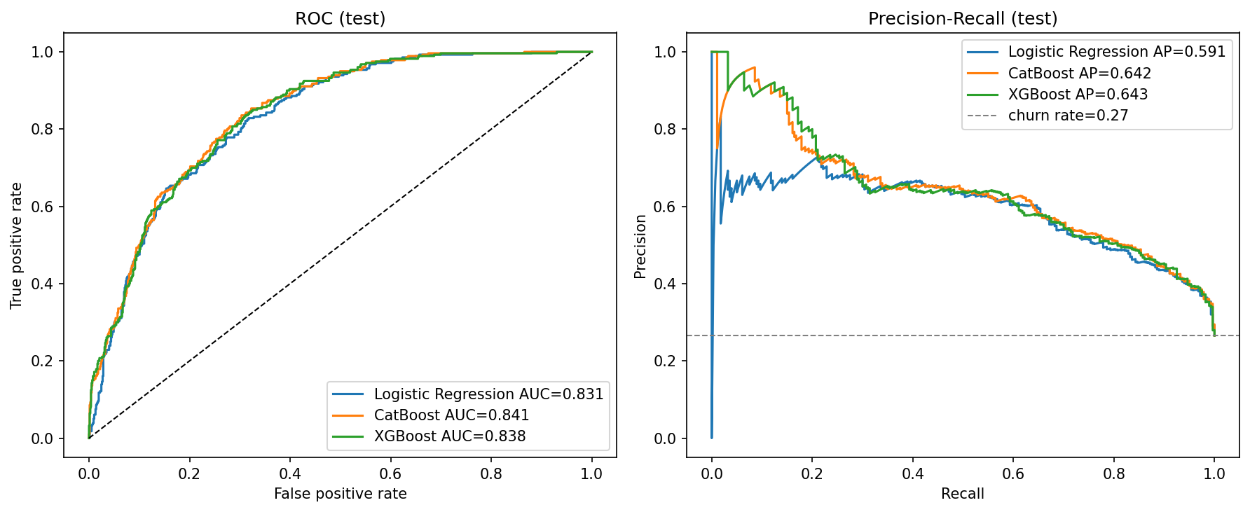
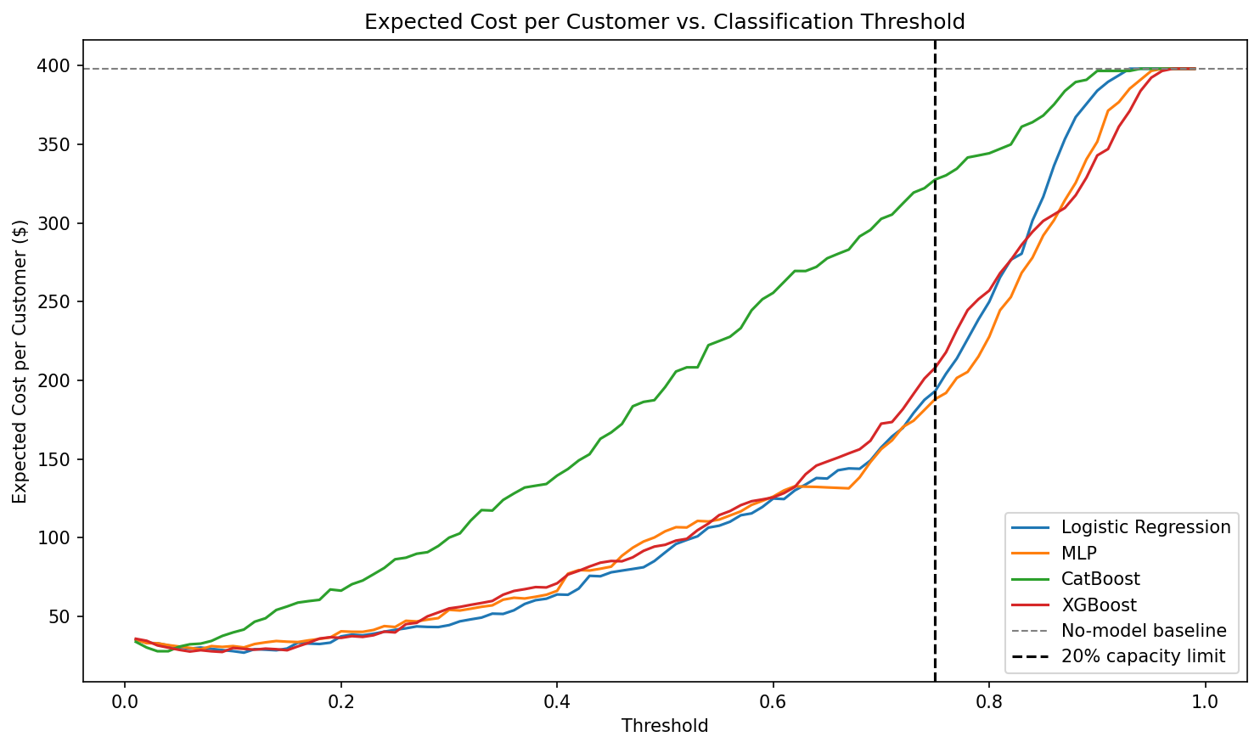
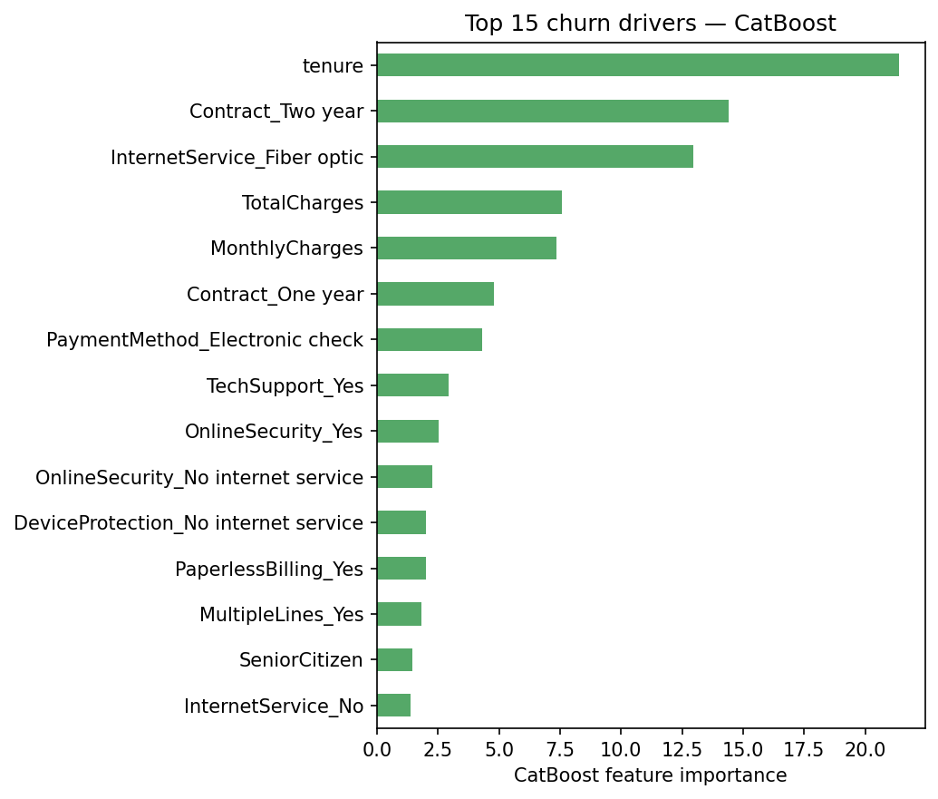
AI Student Symposium 2026
Course ID : ECE525
NNDL.39
Cost-Aware Customer Churn Prediction for Telecom Industry
Sree Vathsa Kashyap Mydugolam (smydugo) | Srinidhi Shivashankar (sshivas) | Deekshith Anantha (dananth)
Department of Electrical and Computer Engineering, NC State University
A. Motivation
B. Data & EDA
C. Methodology
Customer churn -- when a paying subscriber leaves a service -- is one of the most expensive problems in telecom.
Acquiring a new customer costs 5x-7x more than retaining one, so the ability to identify customers about to leave is directly tied to revenue.
Dataset: IBM Telco Customer Churn (Kaggle)
One disciplined pipeline -- so differences come from architecture, not preprocessing.
7,032 customers x 19 features after cleaning (11 dropped for invalid TotalCharges).
Demographics, tenure, contract type, services (phone/internet/security/streaming), monthly + total charges. Target: Churn (Yes/No).
Raw CSV (7,032 customers)
For a mid-size carrier with 1 million subscribers and 25% annual churn, even a 3% reduction translates to ~7,500 retained customers per year -- worth millions in lifetime value.
Clean + one-hot encode
Stratified split 70 / 15 / 15 Fit StandardScaler on TRAIN only
Why standard ML misses the mark
Logistic Reg.
Custom MLP
Cat Boost
XG Boost
Imbalanced labels
Only 26.6% of customers churn. A trivial 'predict no-churn' model gets 73% accuracy and zero business value, so accuracy is the wrong metric.
Tune threshold on VAL (max F1)
Test metrics + Cost analysis
Asymmetric cost
Missing a churner ($1,500 lost lifetime value) is ~30x worse than a false alarm ($50 retention call). Optimization must reflect this.
Why each step
What the data tells us
Stratified split: preserves the 26.6% churn rate in every fold so val/test stay representative.
Train-only scaling: prevents test-set statistics from leaking into training -- a real source of inflated benchmarks.
Threshold tuning: default 0.5 is arbitrary on imbalanced data; pick on val, evaluate on test once.
Brier + PR-AUC: measure calibration and minority-class ranking, which accuracy hides.
Threshold blindness
Default 0.5 cutoffs ignore both imbalance and cost. A 'good' model with the wrong threshold can still be a poor business tool.
Imbalanced class: 5,163 stayed (73.4%) vs 1,869 churned (26.6%) -- ratio 1 : 2.76.
Contract is the dominant driver: month-to-month customers churn at 43% vs 3% on a 2-year contract -- a 14x gap.
Tenure: churners cluster heavily in the first 12 months; long-tenure customers rarely leave.
Service: fiber 42% vs DSL 19%; electronic-check payers 45% vs auto-pay <20%.
D. Results -- Model Comparison
E. Cost-Aware Analysis
All four models trained on identical features and splits, scored on the held-out test set with a validation-tuned threshold (max F1).
Brier captures calibration: do predicted probabilities match observed churn rates? Lower is better.
Translate probabilities into business value: sweep threshold under realistic costs.
FN $1,500 FP $50. Net Value = TP * $1,500 - FP * $50. Optimum chosen on validation only.
Model | F1 | ROC-AUC | PR-AUC | Brier | Recall | Precision
CatBoost | 0.624 | 0.841 | 0.642 | 0.139 | 0.768 | 0.526
Logistic Regression | 0.610 | 0.831 | 0.591 | 0.176 | 0.746 | 0.516
XGBoost | 0.608 | 0.838 | 0.643 | 0.169 | 0.725 | 0.523
MLP (custom NN) | 0.603 | 0.826 | 0.592 | 0.177 | 0.789 | 0.488
~ $370K
net business value per 1,000 customers when threshold is tuned
Model | Optimal threshold | Net value / 1,000 customers
Logistic Regression | 0.11 | $371,043
XGBoost | 0.09 | $370,616
CatBoost | 0.03 | $370,142
MLP (custom NN) | 0.07 | $368,910
CatBoost wins on F1, ROC-AUC, and Brier -- it ranks well AND its probabilities are calibrated.
MLP does not beat logistic regression -- on small one-hot tabular data, a linear decision boundary is already most of the signal. Nonlinearity adds little.
Top-20% capacity constraint: CatBoost still delivers $175,687 / 1,000 at threshold 0.54.
COUNTERFACTUAL
ACTION
RESULT
ROC and Precision-Recall curves on test set.
Highest-risk customer: predicted churn = 0.93
Switch InternetService: Fiber optic -> No internet
predicted churn = 0.82 (-11 pp)
F. What Drives Churn
G. Conclusions & Next Steps
Top driver | Importance
tenure | 21.4
Contract = Two year | 14.4
InternetService = Fiber optic | 13.0
TotalCharges | 7.6
MonthlyCharges | 7.4
Contract = One year | 4.8
PaymentMethod = Electronic check | 4.3
Findings
Deployment readiness
1. CatBoost is the strongest classifier (F1 0.624, ROC-AUC 0.841, lowest Brier 0.139).
2. Custom MLP does not beat logistic regression -- nonlinearity adds little on small one-hot data.
3. Cost-aware threshold tuning is the dominant lever -- all four models recover ~$370K per 1,000 customers; architecture changes the result by < 1%.
4. Counterfactuals turn probabilities into specific retention actions.
Save: CatBoost model + fitted scaler + threshold (0.31).
Score new customers monthly; recalibrate quarterly as pricing and offers change.
Limitations
These align with industry intuition: short tenure (no commitment yet),
no long-term contract (low switching cost), fiber (price-sensitive segment),
electronic check (no auto-pay lock-in) -- all known retention friction points.
Actionable lever: contract upsell campaigns target the top 3 drivers directly.
Static snapshot dataset -- no temporal drift modeling.
Cost ratios ($1500 / $50) are illustrative; real numbers vary by segment.
Next steps
Stacking ensemble; cost-sensitive loss in MLP;
live A/B test of the chosen threshold.
References & Acknowledgements
[1] Verbeke, W. et al. (2012). New insights into churn prediction in telecommunications. Eur. J. Op. Res., 218(1), 211-229.
[2] Prokhorenkova, L. et al. (2018). CatBoost: unbiased boosting with categorical features. NeurIPS.
[3] Chen, T. & Guestrin, C. (2016). XGBoost: a scalable tree-boosting system. KDD.
Dataset: IBM Telco Customer Churn (Kaggle: blastchar/telco-customer-churn). Acknowledgements: Dr. Edgar Lobaton (instructor, ECE 525, NC State University).

