Slide 1

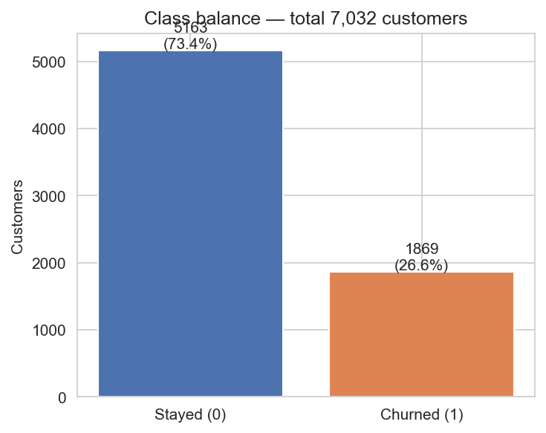
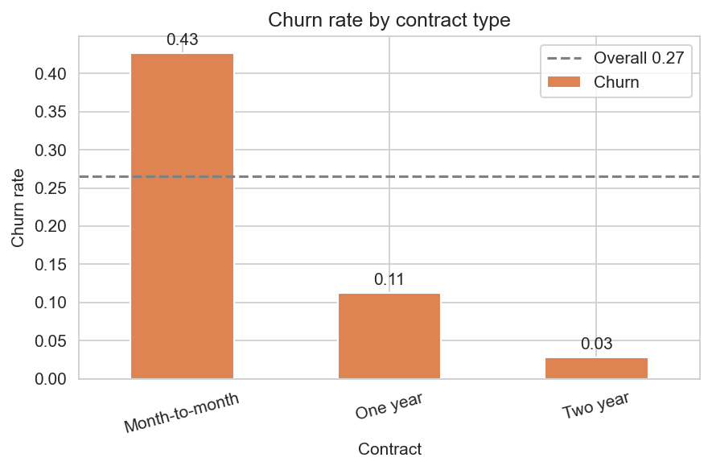
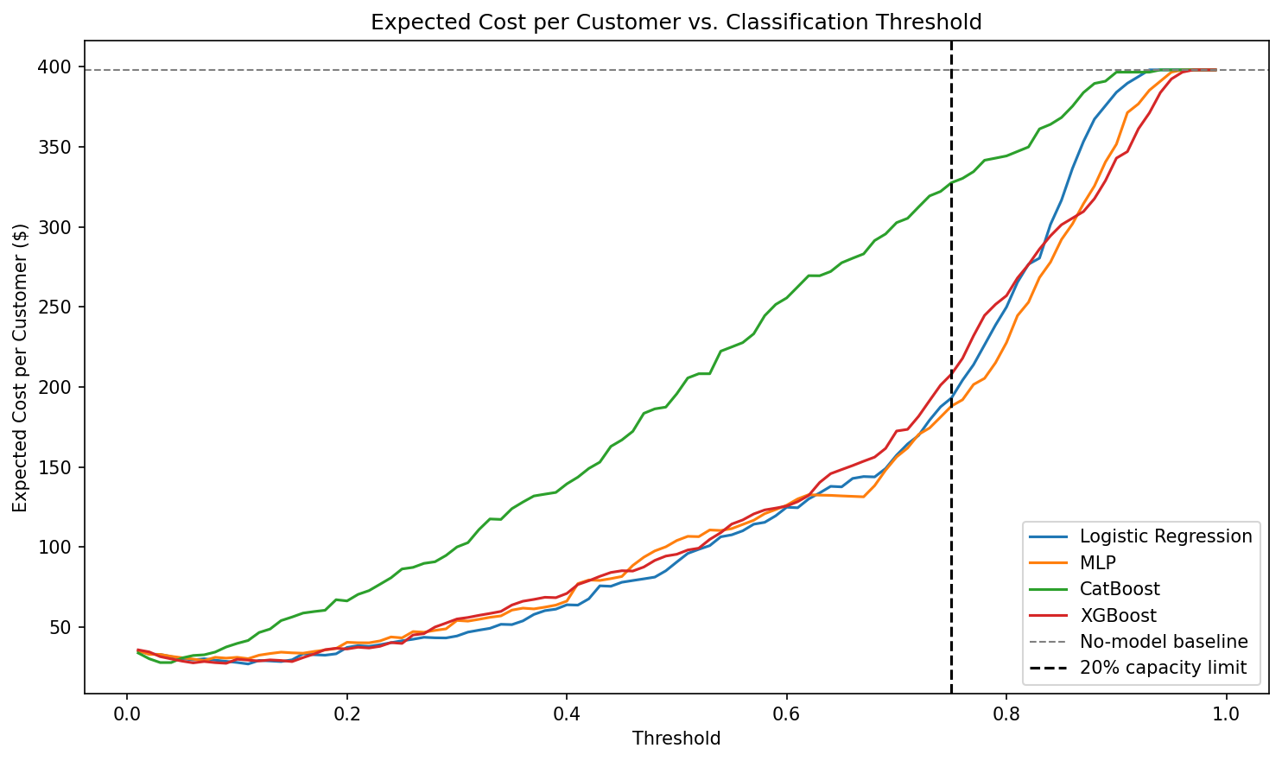
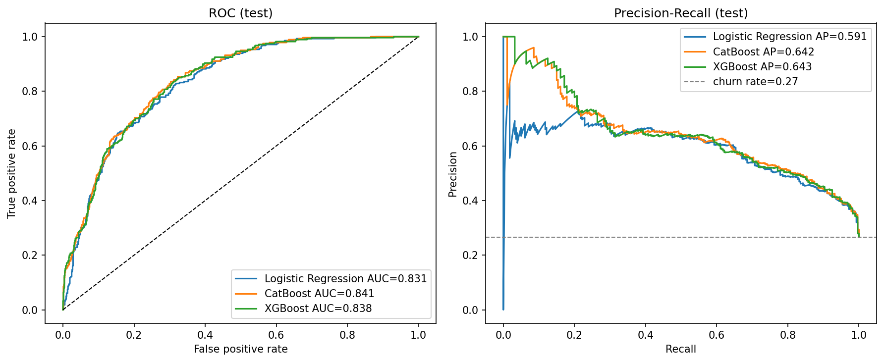
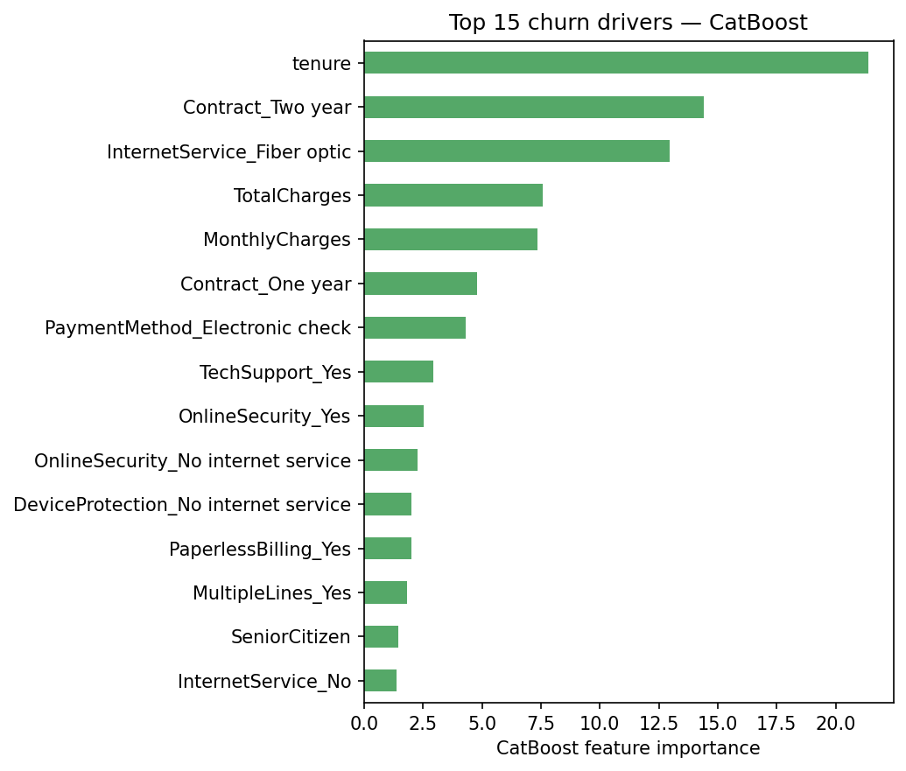
AI Student Symposium 2026
Course ID : ECE525
NNDL.39
Cost-Aware Customer Churn Prediction for Telecom Industry
Sree Vathsa Kashyap Mydugolam (smydugo) | Srinidhi Shivashankar (sshivas) | Deekshith Anantha (dananth)
Department of Electrical and Computer Engineering, NC State University
A. Motivation
B. Data & EDA
C. Methodology
Customer churn -- when a paying subscriber leaves a service -- is one of the most expensive problems in telecom.
Acquiring a new customer costs 5x-7x more than retaining one, so identifying customers about to leave is directly tied to revenue.
Churn is rarely a surprise overnight: usage slips, support tickets spike, bills become unpredictable -- weak signals appear weeks or months before cancel.
Carriers already hold the data to spot those patterns; the gap is reliable risk scores and thresholds aligned with who you can afford to save.
Dataset: IBM Telco Customer Churn (Kaggle)
One disciplined pipeline -- so differences come from architecture, not preprocessing.
7,032 customers x 19 features after cleaning (11 dropped for invalid TotalCharges).
Demographics, tenure, contract, services (phone/internet/security/streaming), monthly + total charges. Target: Churn (Yes/No).
Raw CSV (7,032 customers)
Clean + one-hot encode
For a 1M-subscriber carrier with 25% churn, a 3% reduction = ~7,500 retained customers/year, worth millions in lifetime value.
Stratified split 70 / 15 / 15 Fit StandardScaler on TRAIN only
Why standard ML misses the mark
Logistic Reg.
Custom MLP
Cat Boost
XG Boost
Imbalanced labels
Only 26.6% of customers churn. A trivial 'predict no-churn' model gets 73% accuracy and zero business value. Accuracy is the wrong metric.
Tune threshold on VAL (max F1)
Test metrics + Cost analysis
Why each step
Asymmetric cost
Missing a churner ($1,500 lost LTV) is ~30x worse than a false alarm ($50 retention call). Optimization must reflect this.
What the data tells us
Stratified split: preserves the 26.6% churn rate in every fold.
Train-only scaling: prevents test-set leakage into training.
Threshold tuning: default 0.5 is arbitrary on imbalanced data.
Brier + PR-AUC: measure calibration and minority-class ranking.
Threshold blindness
Default 0.5 cutoffs ignore both imbalance and cost. A 'good' model with the wrong threshold is still a poor business tool.
Imbalanced class: 5,163 stayed (73.4%) vs 1,869 churned (26.6%) -- ratio 1 : 2.76.
Contract dominates: month-to-month 43% vs 2-year 3% -- a 14x gap.
Tenure: churners cluster heavily in the first 12 months.
Service: fiber 42% vs DSL 19%; electronic-check 45% vs auto-pay <20%.
D. Results -- Model Comparison
E. Cost-Aware Analysis
All four models trained on identical features and splits, scored on test with a validation-tuned threshold (max F1).
Brier captures calibration: do predicted probabilities match observed churn rates? Lower is better.
Sweep threshold under realistic costs: FN $1,500 FP $50. Net Value = TP*$1500 - FP*$50. Optimum chosen on validation.
Model | Threshold | Net value / 1,000
Logistic Regression | 0.11 | $371,043
XGBoost | 0.09 | $370,616
CatBoost | 0.03 | $370,142
MLP (custom NN) | 0.07 | $368,910
~ $370K
net business value per 1,000 customers when threshold is tuned
Model | F1 | ROC-AUC | PR-AUC | Brier | Recall | Precision
CatBoost | 0.624 | 0.841 | 0.642 | 0.139 | 0.768 | 0.526
Logistic Regression | 0.610 | 0.831 | 0.591 | 0.176 | 0.746 | 0.516
XGBoost | 0.608 | 0.838 | 0.643 | 0.169 | 0.725 | 0.523
MLP (custom NN) | 0.603 | 0.826 | 0.592 | 0.177 | 0.789 | 0.488
Top-20% capacity constraint: CatBoost still delivers $175,687 / 1,000 at threshold 0.54.
CatBoost wins on F1, ROC-AUC, and Brier -- it ranks well AND its probabilities are calibrated.
MLP does not beat logistic regression -- on small one-hot tabular data, a linear boundary is most of the signal.
COUNTERFACTUAL
ACTION
RESULT
ROC and Precision-Recall curves on test set.
Customer: predicted churn = 0.93
Switch InternetService: Fiber -> No internet
predicted churn = 0.82 (-11 pp)
F. What Drives Churn
G. Conclusions & Next Steps
Top driver | Importance
tenure | 21.4
Contract = Two year | 14.4
InternetService = Fiber optic | 13.0
TotalCharges | 7.6
MonthlyCharges | 7.4
Contract = One year | 4.8
PaymentMethod = Electronic check | 4.3
Findings
Limitations
1. CatBoost is the strongest classifier (F1 0.624, ROC-AUC 0.841, lowest Brier 0.139).
2. Custom MLP does not beat logistic regression -- nonlinearity adds little on small one-hot data.
3. Cost-aware threshold tuning is the dominant lever -- all four models recover ~$370K per 1,000 customers; architecture changes the result by < 1%.
4. Counterfactuals turn probabilities into specific retention actions.
Static snapshot; no temporal drift.
Cost ratios illustrative -- vary by segment.
Next steps
Deployment readiness
Stacking ensemble.
Cost-sensitive loss in MLP.
Live A/B test of threshold.
Aligns with industry intuition: short tenure, no long contract,
fiber, electronic check -- known retention friction points.
Lever: contract upsell campaigns target the top 3 drivers.
Save: model + scaler + threshold (0.31).
Score monthly; recalibrate quarterly.
References & Acknowledgements
[1] Verbeke, W. et al. (2012). New insights into churn prediction in telecommunications. Eur. J. Op. Res., 218(1), 211-229.
[2] Prokhorenkova, L. et al. (2018). CatBoost: unbiased boosting with categorical features. NeurIPS.
[3] Chen, T. & Guestrin, C. (2016). XGBoost: a scalable tree-boosting system. KDD.
Dataset: IBM Telco Customer Churn (Kaggle: blastchar/telco-customer-churn). Acknowledgements: Dr. Edgar Lobaton (instructor, ECE 525, NC State University).

