Slide 1
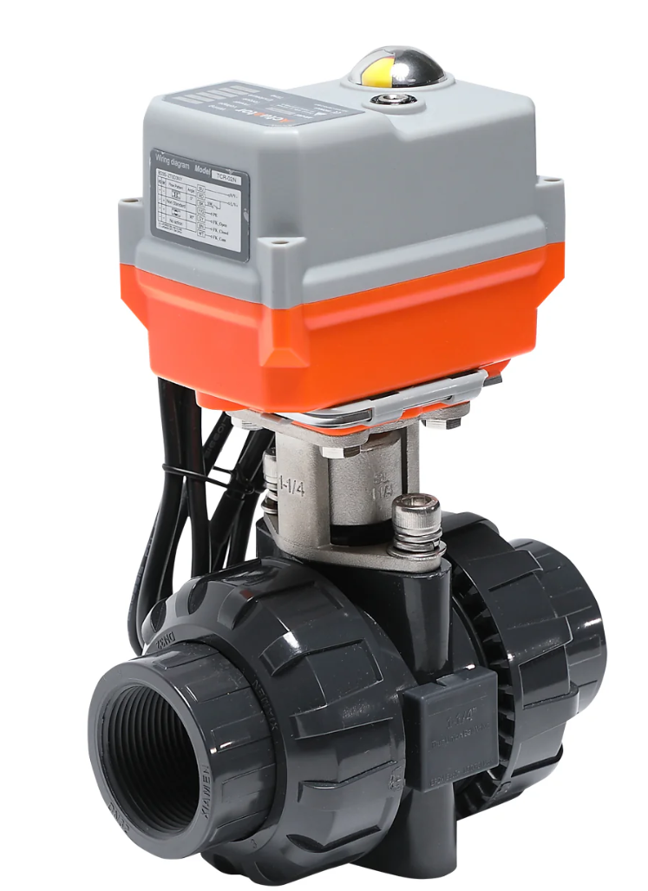
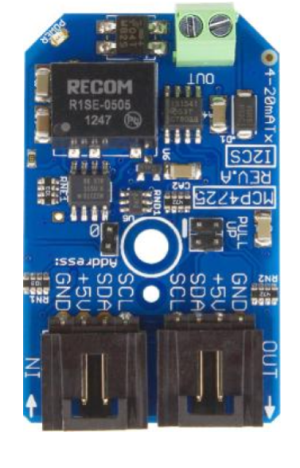
Subtask 4.3.0: Valve Control Wiring Diagram
NC
Power Supply
24 V
12 V
NCD 4-20 mA I2C transmitter
4-20 mA servo angle measurement (not currently used)
I2C from Arduino
I2C to other boards (future)

