Slide 1
Software Architecture and Workflow Tutorial
3/30/2020
Mitchell Cobb

Slide 2
Presentation Outline
Part 1:
Fundamental Tools in Simulink
Part 2:
Specifics of Our Implementation
Part 3:
Version Management and Software Workflow
Part 4:
Video Tutorial of the Model

Slide 3
Part 1: Simulink Fundamentals
This part of the presentation is intended cover the following subjects
Subsystems
Masked Subsystems
Variant Subsystems
Busses
How to Log Signals
Simulink Models Vs Simulink Libraries
Simulink Project
Object Oriented Programming

Slide 4
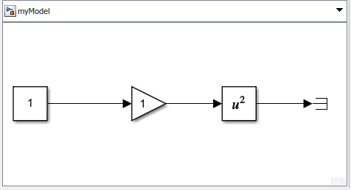
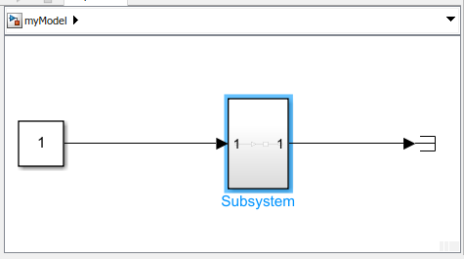
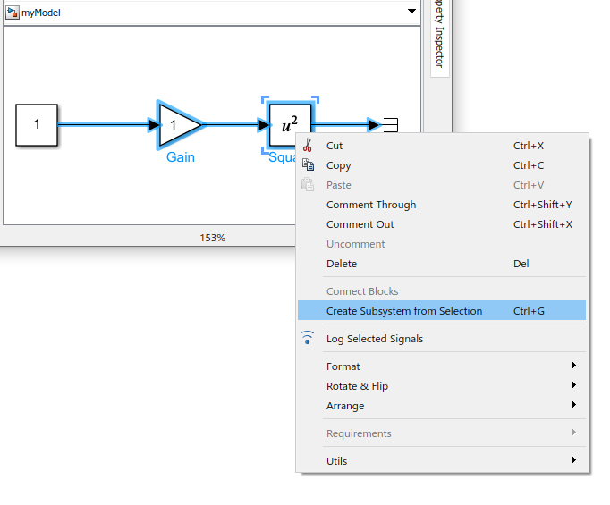
Subsystems
Subsystems are basically just a way to organize your Simulink code
Before
After

Slide 5
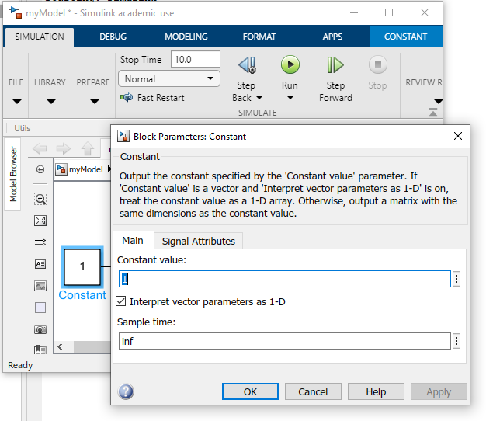
Masked Subsystems
There are two basic ways to get data “into” a subsystem so that it can be used by the blocks in that subsystem.
Input ports: These are the lines connected on the left side of a subsystem.
Mask parameters: When you double click on a block and window pops up where you can enter numbers, those are mask parameters.
Mask Parameters

Slide 6
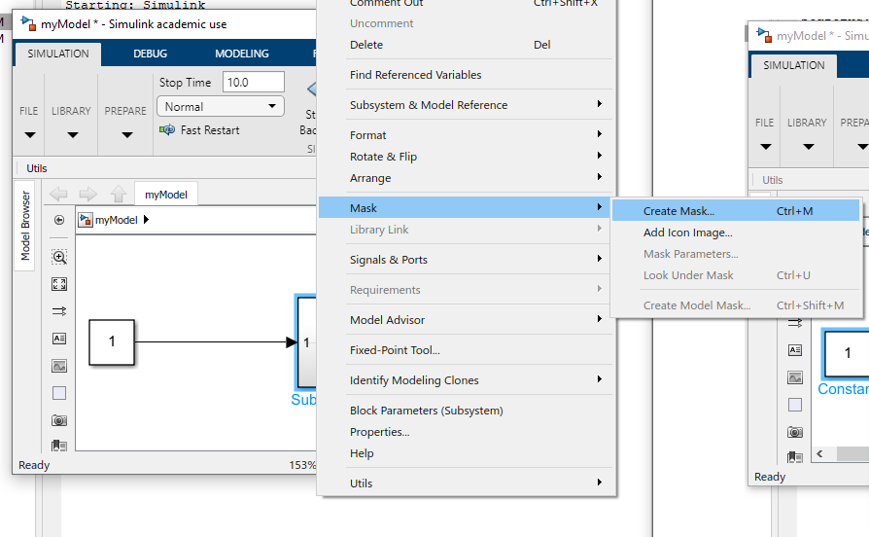
Masked Subsystems
To create a masked subsystem, you must add a mask to an existing subsystem

Slide 7
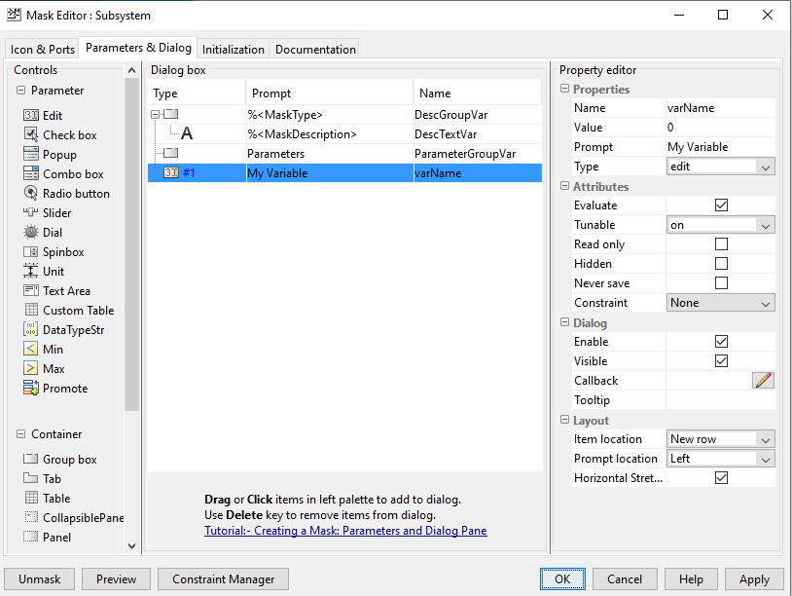
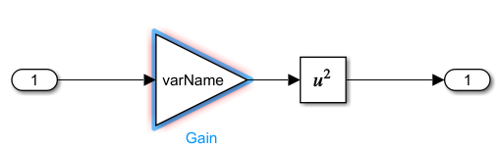
Masked Subsystems
You can then add parameters so that they appear on the front (right click, mask > edit mask, go to “parameters & dialog tab at the top)
This is the variable name for all the blocks inside this subsystem now.

Slide 8
Variant Subsystems
Suppose you and I both write a controller for the same system and we want to see who’s is better. We want to write a matlab script that runs your controller, saves the result, then runs my controller and saves the result, then compares the two.
Option 1: Create two Simulink models. One with your controller hooked up, one with mine hooked up, run them both.
Problem: What happens if I have 10 controllers, and I want to run each of those on 10 different version of the plant? Am I going to create and run 100 Simulink models?
No. Solution: Variant Subsystems

Slide 9
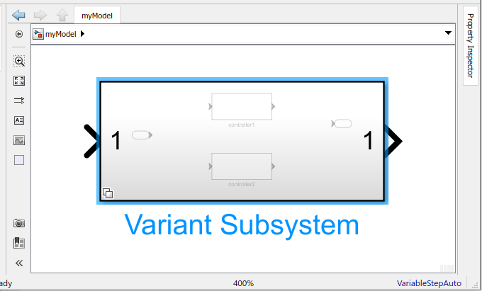
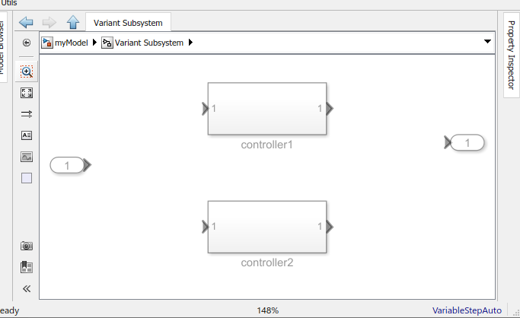
Variant Subsystems
Variant subsystems are subsystem blocks that contain different versions (variants) of the same thing (for example a controller).

Slide 10
Variant Subsytems
The user can change which variant is “active” (used during the simulation) by changing things in the Matlab workspace.
There’s a whole bunch of messy details on how this is set up, but most of it should be done automatically for you in our model so I won’t dive into it.
Basically, what you need to know is that we’ve implemented a lot things as variant subsystems, for instance, the flow environment and the flight controller, this allows the user to flip back and forth quickly between different flow profiles and different flight controllers.

Slide 11
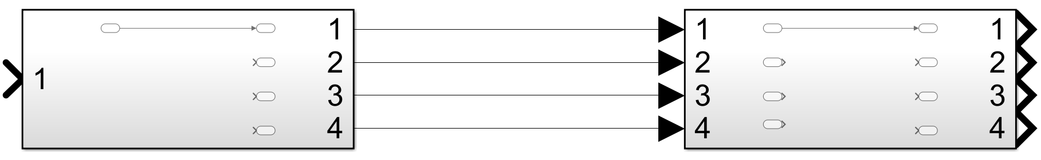
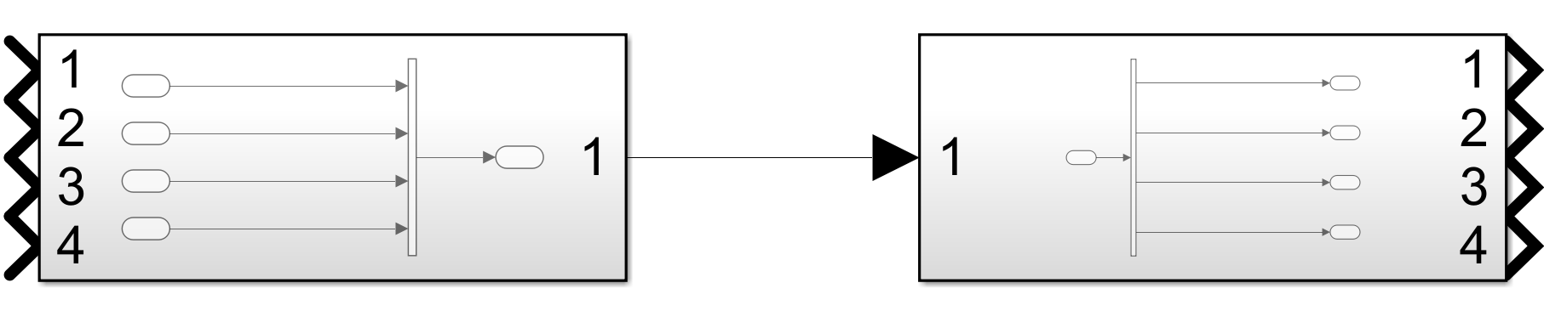
Busses
Problem: How do you pass a ton of signals between subsystems?
One solution
What if you have a lot of signals? Mux them?
What happens if someone puts a new signal in between signal 2 and signal 3? Everything downstream breaks
How do I know which number signal I need to pull out when I want to do some math? Go to where it was muxed and count. What if there are 75 signals?
How do you mux together a scalar signal and a matrix signal? (answer, you can’t)
Solution: Busses!

Slide 12
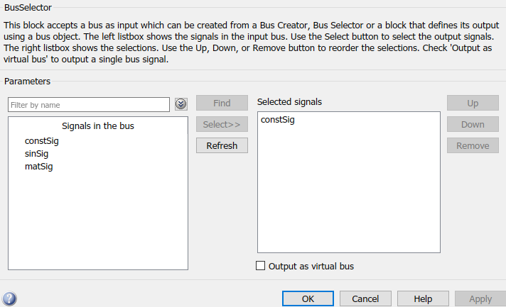
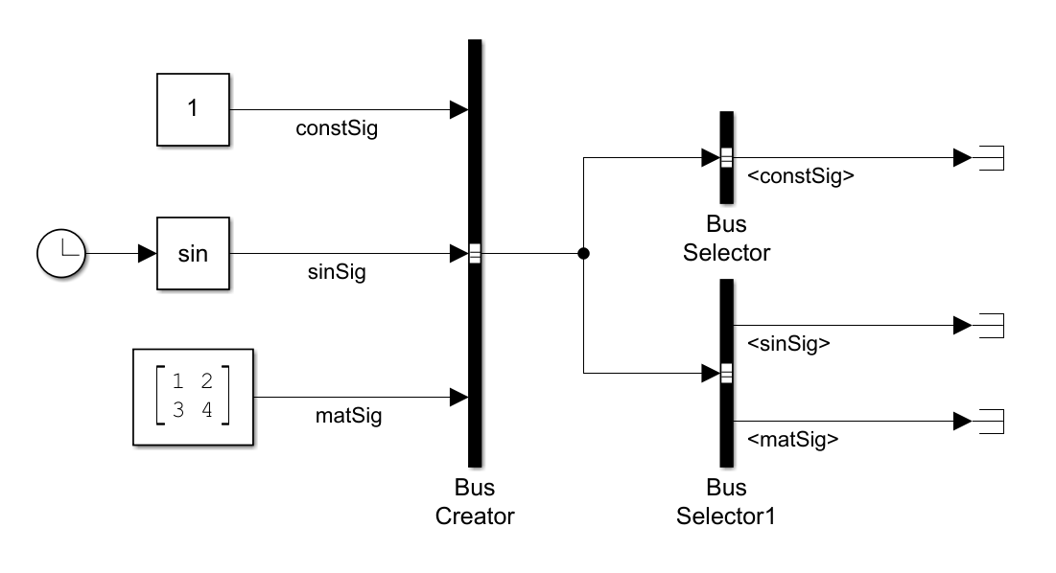
Busses
Bus sector blocks let you pull any number of signals out of the “bundle” of signals by selecting their name(s) from a list.
Bus Creator
Signal Names
Bus Selectors

Slide 13
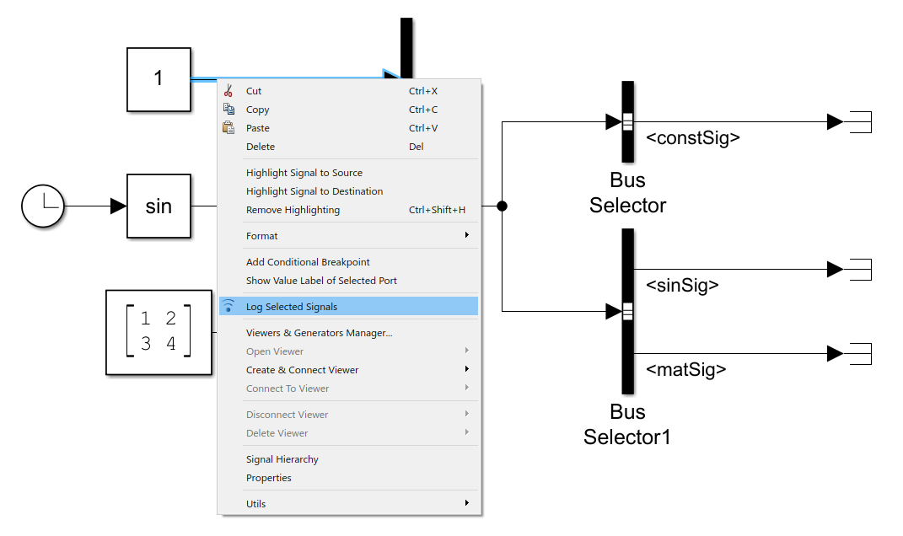
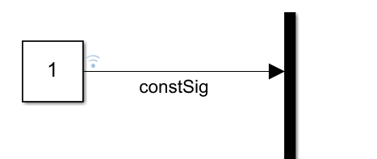
How to Log Signals
How do we look at the results when the simulation is done?
We have to save the value of a signal during the simulation:

Slide 14
How to Log Signals
Once the simulation ends, now what?
When Simulink finishes, it dumps something into the workspace called “out” or “logsout”
Logsout is a pain to deal with, so we wrote something to convert it into a nice convenient format to work with.
This “function” (not really a function but you can treat it like that) is called “signal container” and it can be run like this
tsc = signalcontainer(logsout);

Slide 15
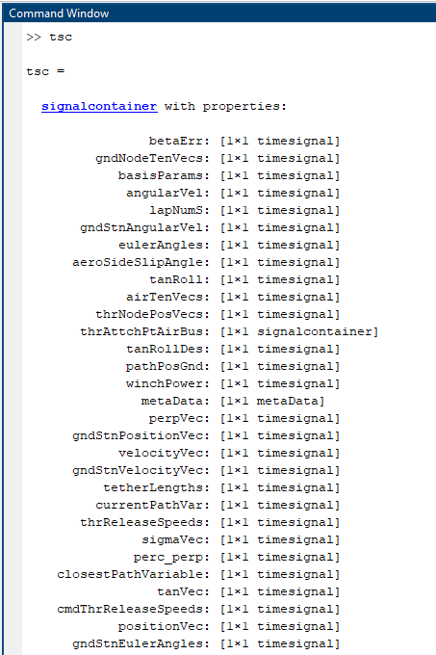

How to Log Signals
Once you’ve run this
tsc = signalcontainer(logsout);
Now you can see a list of all the signals you’ve logged by typing
tsc
Note, you can call the variable that you output to whatever you want, we jus use tsc usually by convention

Slide 16


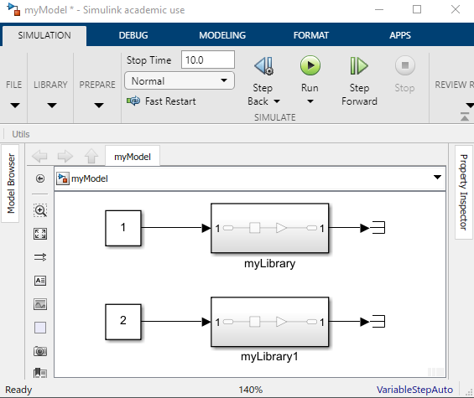
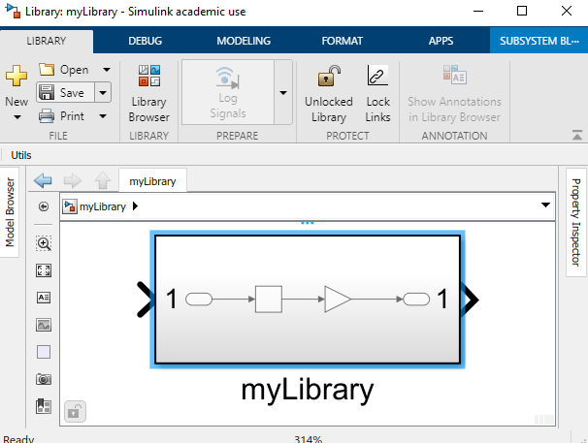


Simulink Models Vs Simulink Libraries
The script calls the function multiple times, but that function is always the same.
The function is stored in a separate file.
Editing that file means that your changes apply everywhere that function is used
Matlab Script $≈$ Simulink Model
Matlab Function $≈$ Simulink Library
To put a library block into a model, just drag and drop it from the library file into the model file.

Slide 17
Things to Note
Any changes in the library impacts every place you used that block in the model.
You can only run Simulink models (no play button on libraries)
Both have .slx file extensions, for extra confusion
The connection between the library and where it’s used in the model is called the link.
It is possible to break this link, so the block in the model is no longer tied to the library file.
It is also possible to reconnect this link
When reconnecting (known as resolving) the link, if the block in the model and the block in the library don’t match, you have to choose which one to keep. You can “push” your changes from the model to the library, or you can “restore”

Slide 18
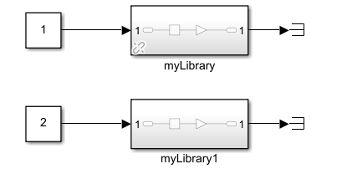
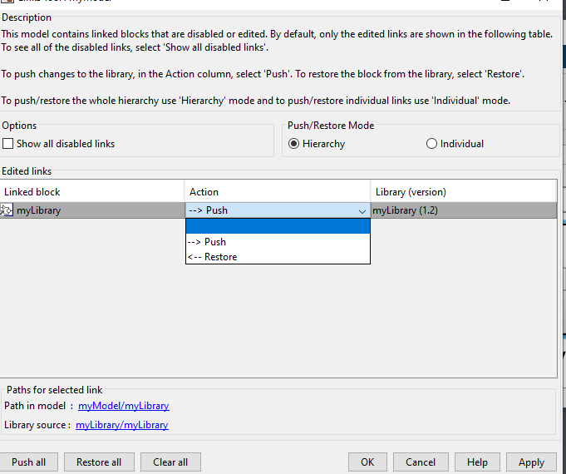
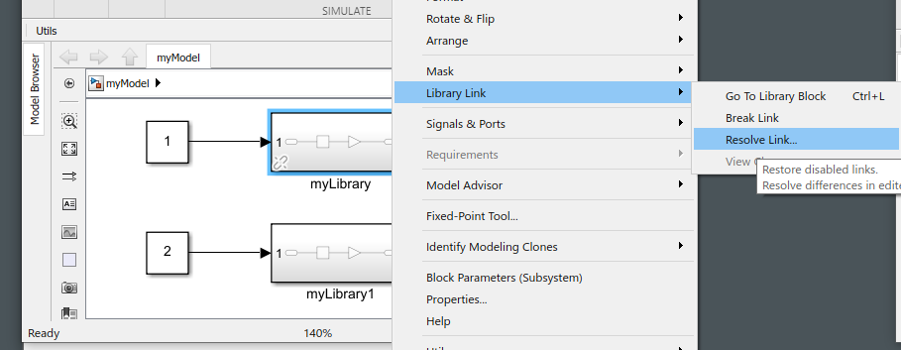
Things to Note
The connection between the library and where it’s used in the model is called the link.
It is possible to break this link, so the block in the model is no longer tied to the library file.
It is also possible to reconnect this link
When reconnecting (known as resolving) the link, if the block in the model and the block in the library don’t match, you have to choose which one to keep. You can “push” your changes from the model to the library, thus overwriting what is stored in the library, or you can “restore” (take the version in the library file)
Broken Link

Slide 19
Pros and Cons of Simlink Libraries
Pros
Makes code reuseable
Makes is to that people can work on different parts of a model at the same time, just edit the libraries, not the model that contains those libraries.
Cons
Big models mean that now you’ll have a ton of libraries to keep track of.
Solution: Organize everything into a Simulink project

Slide 20
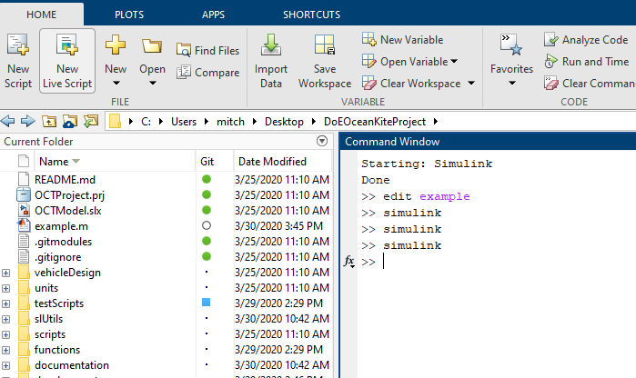
Simulink Project: .prj File

Slide 21
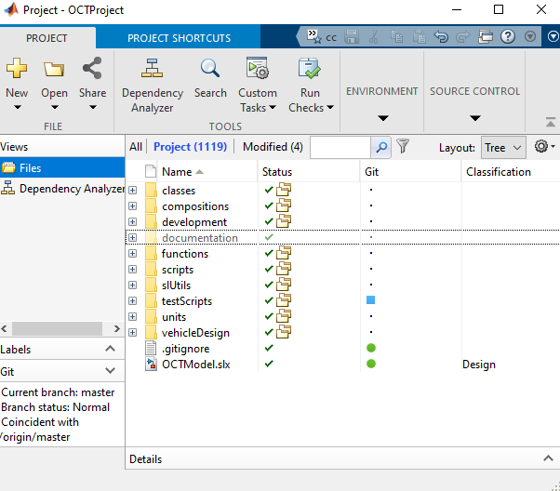
Project Path
The Simulink project keeps track of the project path for you. This is the list of directories that Matlab and Simulink will automatically search through when you try to use a Matlab function or a Simulink Library
If you try to use a block or function that is not on the project path, you will get an error saying that Matlab or Simulink cannot find that block or function.
If you create new directories, those will not be on the project path until you add them to the project path (right click the directory and select project path -> add to project path)
Not on the project path, as indicated by the faded color.
On the project path

Slide 22
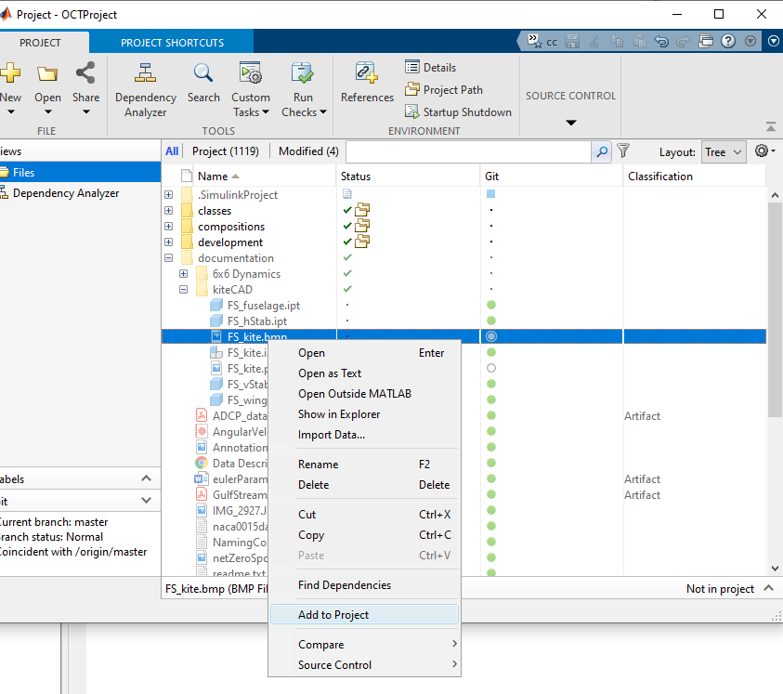
Project Files
The Simulink project also keeps track of individual files.
Just like directories must be added to the project path, files must be added to the project after they are created (right click the file, then select add to project)
Note that the Simulink project only displays files that are on the project by default, you have to make it show you all the files by clicking here

Slide 23
Notes on Project Files
Before doing anything else with this model you must open the project file. It should be open the entire time you’re working with the model.
Opening the project automatically runs a “callback” script (OCTModel_init.m) which sets up some stuff automatically for you, mostly plot formatting things.
Pros:
Tracks file dependencies. If model (or script) X uses library (or function) Y and you rename file Y to Z, then model X doesn’t lose track of Y, it “knows” to now look at Z. You can also make it show you things like which files depend on file X, so you know what you’ll break if you change things.
Integrates source control (do all you GitHub stuff with easy button clicks right from the project window)
Cons:
Can be a little tedious to maintain
Gotta have it open all the time

Slide 24
Object Oriented Programming
Programming as it’s usually taught for Matlab ins school: write a set of instructions that the computer executes in order, which basically amount to stuff you could do on a calculator (given enough time).
Object Oriented Programming
OOP centers on this thing called a class definition. This is a bit of code that defines, in a rigorous way, two things:
All the characteristics of the objects (known as properties)
All the things the object can do (known as methods)

Slide 25
OOP: Analogy w/ English Class
English Class
Noun: person, place or thing
Adjective: describes a noun
Verb: something a noun can do or can be done to the noun
Object Oriented Programming
Object
Properties: describe the object
Methods: something the object can do or something that can be done to the object

Slide 26
OOP: Example
Object Oriented Programming
Object
Properties: describe the object
Methods: something the object can do or something that can be done to the object
Example
Car
Properties
Color
Mass
Condition
…
Methods
Drive
Open Sunroof
Crash
…

Slide 27
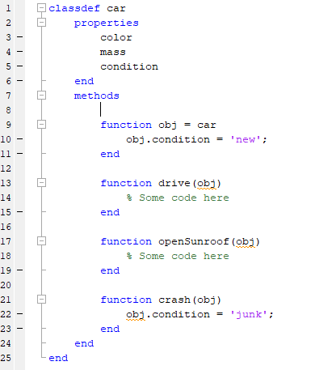
OOP Example:
Class name
Properties
Car
Methods
Properties
Color
Mass
Condition
…
Methods
Drive
Open Sunroof
Crash
…

Slide 28
OOP: Instantiation and Instances
Our car class is totally generic. We haven’t defined anything about any one specific car. Suppose I want to use this generic class to describe my car. To do that, I have to do something called instantiation. Instantiation means to create an instance of the class. Instantiation works like this:
myCar = car;
I now have a car-type object floating around in my workspace that I can manipulate by setting properties and calling methods, for example
myCar.color = ‘green’;
myCar.drive;
I can also create an instance of the car class to describe your car and make it “do things” with it’s methods.
yourCar = car;
yourCar.color = ‘blue’;
yourCar.crash;
The key idea here is that myCar and yourCar are both instances of the general class car, but they describe different cars, and they’re doing different things at any one moment.

Slide 29
OOP: Key Idea: Constructor
When you create a new instance of a class, Matlab automatically runs a special method, called the constructor.
This can do whatever you want it to do (including nothing).
This can be useful for doing things like setting default values of properties.
Constructor

Slide 30
Part 2: Specifics of Our Implementation
This part of the presentation is intended to cover the specifics of how se used the tools from part 1 (and others) to implement a model of a MHK system. Topics include
Units vs Compositions
Important Classdefs to Know and Love
Build Scripts and Their .mat Files
Commonly Used Functions
Test Scripts
Summary of File Name Appendices

Slide 31
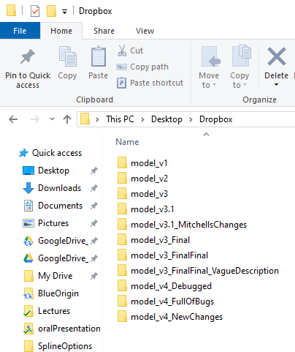
Part 3: Version Management & Software Workflow
Problem: There are (about) 5 of us working on this. We need to all be able to edit the same files, simultaneously, on different computers.
This is not going to work

Slide 32
Git and GitHub
Git: Git is software that keeps track of the changes that you make to a file (or files). It maintains a big long list of every change that you’ve ever made to each file.
GitHub: GitHub is a website that you can use to share your big lists of changes with other people.
Git & GitHub allow you to do 2 key things:
Go back to old versions of your code without having to save those on your computer.
Share things across many users/computers.

Slide 33
Git and GitHub: Mental Map & Key Terms
Red arrows represent moving around your list of changes. Green words are the term used for that specific movement.
GitHub
(The Cloud)
Push
Push
My Computer
Your Computer
Fetch
Fetch
Local Repository
Local Repository
Pull = Fetch then Checkout
Checkout
Commit
Checkout
Commit
Sandbox
Sandbox

Slide 34
Git: Important!
Potential Problem:
James makes some changes to file X and pushes them to the repository (GitHub)
The next day, I make some other changes to file X and try to push them repository
Our changes are different, therefore the resulting file is different. Which one is the “correct” one? Which one should we keep?
This is called a file conflict or just a conflict.
Now, you can manually go through each proposed file and pick out which changes to keep. This is called resolving conflicts and it’s tedious and it’s a pain so we want to avoid it.
The better solution:
Pull before you start working every time. This ensures that your changes will be done after the other persons changes. You can even pull while you’re in the middle of your work.
Don’t work on the same files as someone else. This is a bit harder to do because it requires that we all know where each other are working, but it’s doable with good communication.

Slide 35
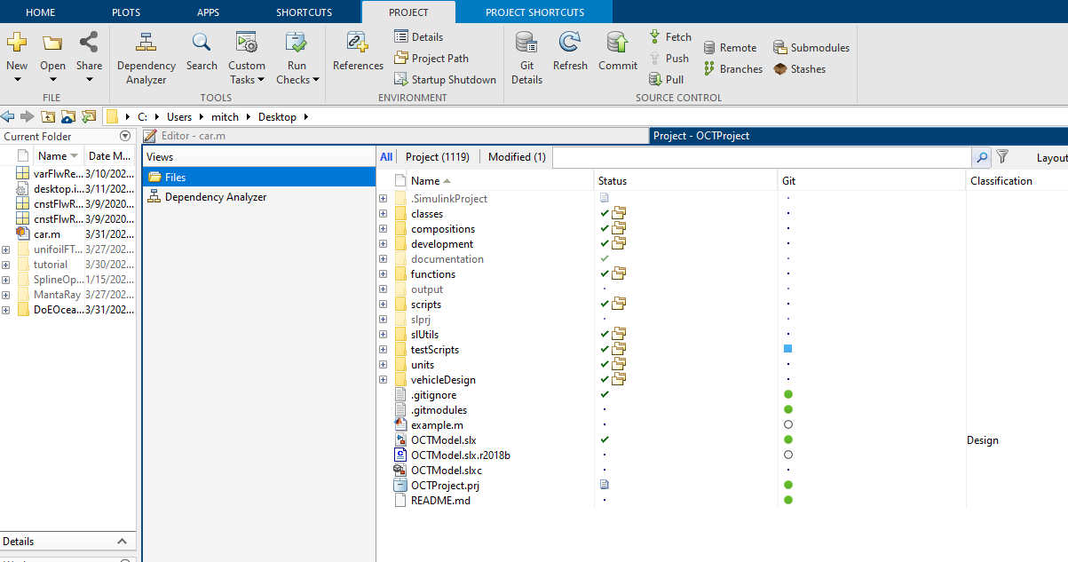
Simulink Project and Git
All version control actions can be done with the click of a single button in Simulink project.
This column tells me the status of each file.
Green Circle: the version in my sandbox matches what’s in my local repository.
Blue Square: the version in my sandbox does not match what’s on my local repository
Empty Circle: This file is not being tracked by Git (there fore it’s not on GitHub, or anyone else's computer)
Plus Sign: I’ve started tracking this file with Git on my computer, but I haven’t committed it to my local repository or pushed it to GitHub for anyone else to get yet.

Slide 36
Software Workflow
Notes:
I don’t remember clearly, but I think that doing step 6 might automatically do step 7 too, or vice versa.
You can do step 7 multiple times before doing step 8.
Every time you do step 7 it will prompt you for comments. You should write descriptive, precise comments that describe in plain English what you did.
You can jump back and forth between steps 4-7 multiple times, eg create a file, add it to the project & Git, commit that to the repo, then go back and make some new files and repeat.
Open Matlab
Open the Simulink Project
Pull
Make any changes I want to existing files, and create new files if necessary.
Add new files to the Simulink project
Add new files to Git so that they’re tracked with version control
Commit my changes to local repository
Push changes to GitHub

Slide 37
Part 3: Video Tutorial

