Slide 1
Rapp Linearized Equations

Slide 2
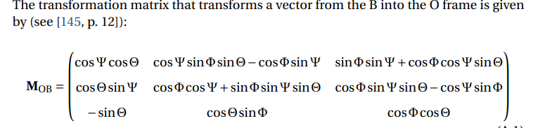
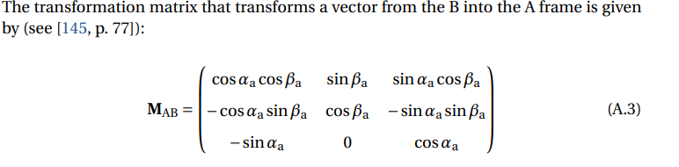
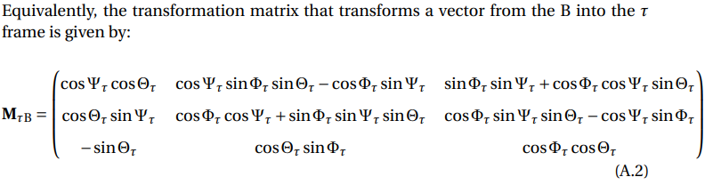
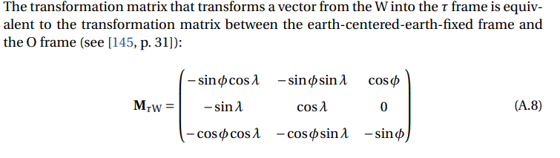
Rotations
Ground to Body
Body to Aerodynamic
Body to tangent
Wind to tangent

Slide 3

Other definitions
${\left[\begin{aligned}p \\ q \\ r\end{aligned}\right]}_{a}$= ${\left\{ω^{BO}\right\}}_{A}$
$\left[\begin{aligned}λ \\ ϕ \\ h_{t}\end{aligned}\right]$= longitude, latitude, and radial position

Slide 4
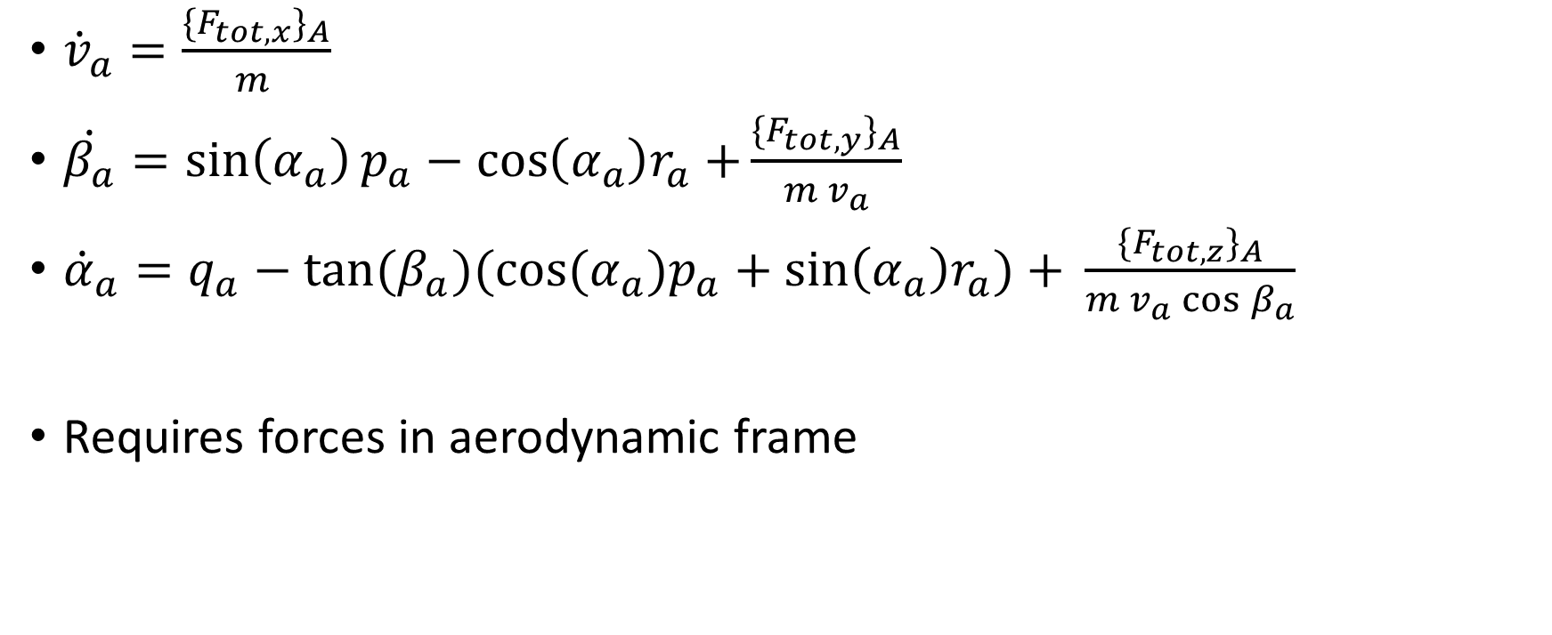
State equations (1-3)
${\dot{v}}_{a}=\frac{{{\{F}_{tot,x}\}}_{A}}{m_{ }}$
$\dot{β_{a}}=\sin\left(α_{a}\right)p_{a}−\cos\left(α_{a}\right)r_{a}+\frac{{{\{F}_{tot,y}\}}_{A}}{m_{ }v_{a}}$
${\dot{α}}_{a}=q_{a}−\tan{{(β}_{a})(\cos{{(α}_{a})p_{a}+\sin\left(α_{a}\right)r_{a})+ }}\frac{{{\{F}_{tot,z}\}}_{A}}{m_{ }v_{a}\cos{β_{a}}}$
Requires forces in aerodynamic frame

Slide 5

State equations (4-6)
$\left(\begin{aligned}{\dot{φ}}_{t} \\ {\dot{θ}}_{t} \\ {\dot{ψ}}_{t}\end{aligned}\right)=\left(\begin{matrix}1 & \sin{ψ_{t}}tan⁡θ_{t} & \cos{φ_{t}\tan{θ_{t}}} \\ 0 & \cos{φ_{t}} & −\sin{φ_{t}} \\ 0 & \frac{\sin{φ_{t}}}{\cos{θ_{t}}} & \frac{\cos{φ_{t}}}{\cos{θ_{t}}}\end{matrix}\right){(\left\{ω^{BO}\right\}}_{B}−{\left[c\right]}^{Bt}\left(\begin{aligned}\dot{λ}\cos{ϕ} \\ −\dot{ϕ} \\ −\dot{λ}\sin{ϕ}\end{aligned}\right))$

Slide 6

State equation 7-9
${\left(\begin{aligned}\dot{p} \\ \dot{q} \\ \dot{r}\end{aligned}\right)}_{B}=−J^{−1}({\left(\begin{aligned}p \\ q \\ r\end{aligned}\right)}_{B}×J{\left(\begin{aligned}p \\ q \\ r\end{aligned}\right)}_{B}−M_{tot,B})$
Requires total moments in body frame

Slide 7

State equation 10-12
$\dot{λ}=\frac{v_{k,y,t}}{\cos{ϕ}h_{t}}$
$\dot{ϕ}=\frac{v_{k,x,t}}{h_{t}}$
${\dot{h}}_{t}={−v}_{k,x,t}$
$v_{k,t}={\left[c\right]}^{tB}{\left[c\right]}^{BA}\left(\begin{aligned}v_{a} \\ 0 \\ 0\end{aligned}\right)+{\left[c\right]}^{tW}V_{w,W}$

Slide 8

${\dot{v}}_{a}=\frac{{{\{F}_{tot,x}\}}_{A}}{m_{ }}$
$\dot{β_{a}}=\sin\left(α_{a}\right)p_{a}−\cos\left(α_{a}\right)r_{a}+\frac{{{\{F}_{tot,y}\}}_{A}}{m_{ }v_{a}}$
${\dot{α}}_{a}=q_{a}−\tan{{(β}_{a})(\cos{{(α}_{a})p_{a}+\sin\left(α_{a}\right)r_{a})+ }}\frac{{{\{F}_{tot,z}\}}_{A}}{m_{ }v_{a}\cos{β_{a}}}$
$\left(\begin{aligned}{\dot{φ}}_{t} \\ {\dot{θ}}_{t} \\ {\dot{ψ}}_{t}\end{aligned}\right)=\left(\begin{matrix}1 & \sin{ψ_{t}}tan⁡θ_{t} & \cos{φ_{t}\tan{θ_{t}}} \\ 0 & \cos{φ_{t}} & −\sin{φ_{t}} \\ 0 & \frac{\sin{φ_{t}}}{\cos{θ_{t}}} & \frac{\cos{φ_{t}}}{\cos{θ_{t}}}\end{matrix}\right){(\left\{ω^{BO}\right\}}_{B}−{\left[c\right]}^{Bt}\left(\begin{aligned}\dot{λ}\cos{ϕ} \\ −\dot{ϕ} \\ −\dot{λ}\sin{ϕ}\end{aligned}\right))$
${\left(\begin{aligned}\dot{p} \\ \dot{q} \\ \dot{r}\end{aligned}\right)}_{B}=−J^{−1}({\left(\begin{aligned}p \\ q \\ r\end{aligned}\right)}_{B}×J{\left(\begin{aligned}p \\ q \\ r\end{aligned}\right)}_{B}−M_{tot,B})$
$\dot{λ}=\frac{v_{k,y,t}}{\cos{ϕ}h_{t}}$
$\dot{ϕ}=\frac{v_{k,x,t}}{h_{t}}$
${\dot{h}}_{t}={−v}_{k,x,t}$

Slide 9
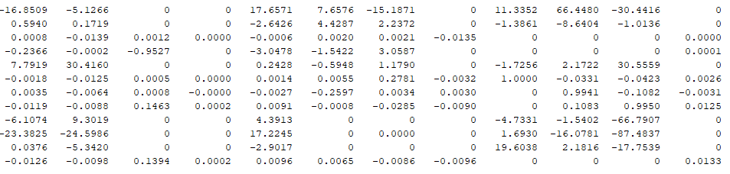
State Order
Va=integrator
Beta=integrator2
El=integrator10
Ht=integrator11
Alpha=integrator1
Phi=integrator3
Theta=integrator4
Psi=integrator5
P=intrgrator6
Q=integrator7
R=integrator8
Az=integrator9

Slide 10
State Order
Va
Beta
El
Ht
Alpha
Phi
Theta
Psi
P
Q
R
Az

