Slide 1
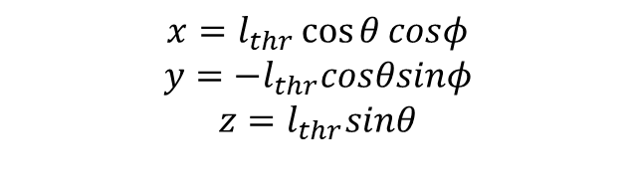


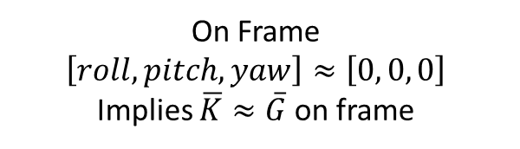
$${+θ}_{meas}$$
On Frame
$$\left[roll,pitch,yaw\right]≈\left[0, 0, 0\right]$$
Implies $\overline{K}≈\overline{G}$ on frame
x+
y+
z+
$$x=l_{thr}\cos{θ}cosφ$$
$$y=−l_{thr}cosθsinφ$$
$$z=l_{thr}sinθ$$
y+
$${+φ}_{meas}$$
x+
z+

Slide 2


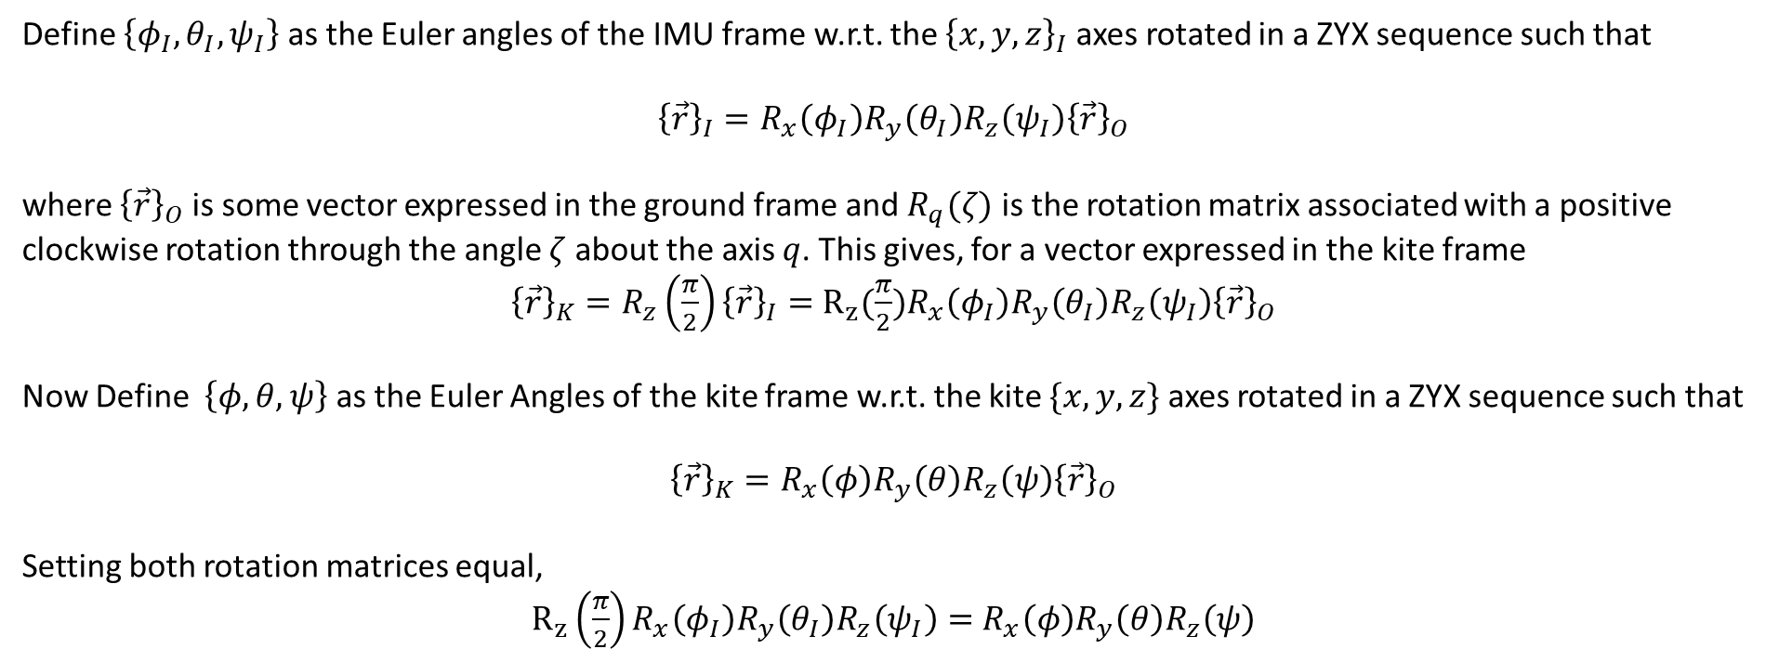
x+
y+
y+
x+
z+
z+
Kite Frame $\overline{K}$
IMU Frame $\overline{I}$
Define $\left\{φ_{I},θ_{I},ψ_{I}\right\}$ as the Euler angles of the IMU frame w.r.t. the ${\left\{x,y,z\right\}}_{I}$ axes rotated in a ZYX sequence such that
${\left\{\vec{r}\right\}}_{I}=R_{x}\left(φ_{I}\right)R_{y}\left(θ_{I}\right)R_{z}\left(ψ_{I}\right){\left\{\vec{r}\right\}}_{O}$
where ${\left\{\vec{r}\right\}}_{O}$ is some vector expressed in the ground frame and $R_{q}(ζ)$ is the rotation matrix associated with a positive clockwise rotation through the angle $ζ$ about the axis $q$. This gives, for a vector expressed in the kite frame
${\left\{\vec{r}\right\}}_{K}=R_{z}\left(\frac{π}{2}\right){\left\{\vec{r}\right\}}_{I}=$ $R_{z}(\frac{π}{2})R_{x}\left(φ_{I}\right)R_{y}\left(θ_{I}\right)R_{z}\left(ψ_{I}\right){\left\{\vec{r}\right\}}_{O}$
Now Define $\left\{φ,θ,ψ\right\}$ as the Euler Angles of the kite frame w.r.t. the kite $\{x,y,z\}$ axes rotated in a ZYX sequence such that
${\left\{\vec{r}\right\}}_{K}=R_{x}\left(φ\right)R_{y}\left(θ\right)R_{z}\left(ψ\right){\left\{\vec{r}\right\}}_{O}$
Setting both rotation matrices equal,
$R_{z}\left(\frac{π}{2}\right)R_{x}\left(φ_{I}\right)R_{y}\left(θ_{I}\right)R_{z}\left(ψ_{I}\right)=$ $R_{x}\left(φ\right)R_{y}\left(θ\right)R_{z}\left(ψ\right)$

Slide 3
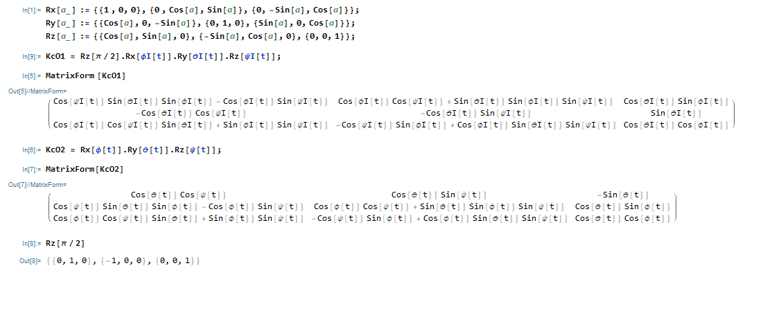
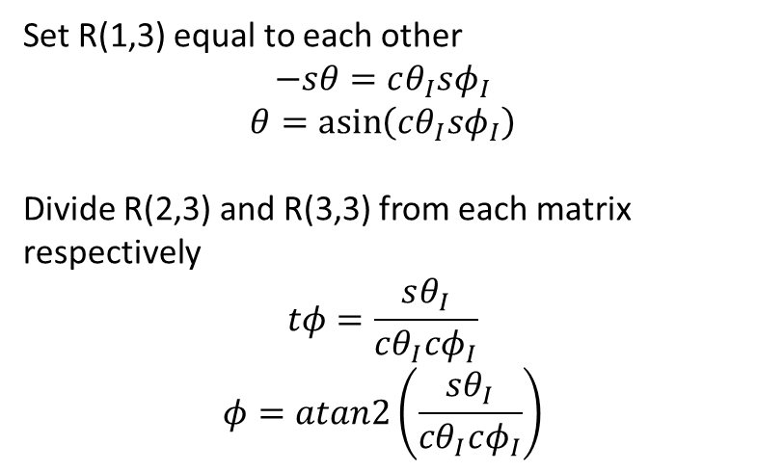

Set R(1,3) equal to each other
$$−sθ=cθ_{I}sφ_{I}$$
$$θ=\operatorname{asin}\left(cθ_{I}sφ_{I}\right)$$
Divide R(2,3) and R(3,3) from each matrix respectively
$$tφ=\frac{sθ_{I}}{cθ_{I}cφ_{I}}$$
$$φ=atan2\left(\frac{sθ_{I}}{cθ_{I}cφ_{I}}\right)$$
We now know 5 of 6 values. Pick any matrix value that contains $ψ$ and you can solve for it directly. R(1,1) for reference here
$$cθcψ=cψ_{I}sθ_{I}sφ_{I}−cφ_{I}sψ_{I}$$
$$ψ=\operatorname{acos}\left(\frac{cψ_{I}sθ_{I}sφ_{I}−cφ_{I}sψ_{I}}{cθ}\right)$$

